Slide 1
Nishkam High School Year 9 Options Curriculum Pathways Years 10-11 2019 - 2021
nishkamhighschoolbirmingham
Mr Deeks, 14 March 2019

Slide 2
Key Stage 4
The key stage 4 curriculum that students will start in year 10 gives them the opportunity to make choices about which courses they wish to take for the next two years.
The choices are there to help meet their individual needs, their aspirations and to give them the opportunity to choose subjects that interest them.
The choices that students make will help to lay the foundations for their future opportunities within further education, and the world of work.
Nishkam aims to offer a flexible and varied curriculum to prepare students for life, their future study and career.

Slide 3
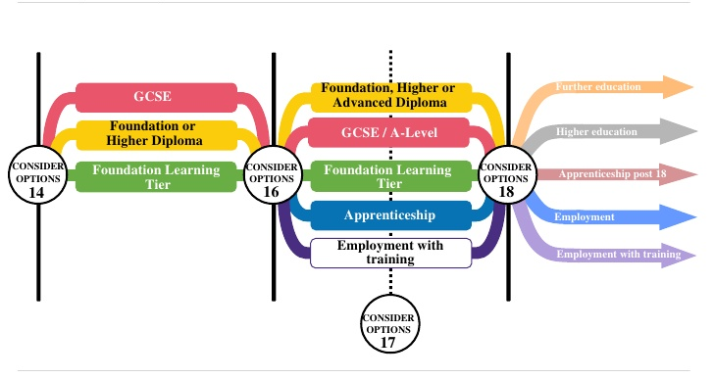

Slide 4
Reasons for Selecting Optional Subjects
Interesting
Career Plans
Enjoyable
Success

Slide 5
The Wrong Reasons for Selecting Optional Subjects
X Friends
X Teacher
X Pressure
X Easy

Slide 6
Which are you?

Slide 7
English Baccalaureate (Ebacc) Subjects
What it isn’t…
It isn’t a qualification like maths or history
So what is it?
Collection of subjects
Maths, English, Sciences, MFL, Geography, History, Computer Science
Why might it be useful for me?
National agenda - 75% of students by 2022 are studying 5 Ebacc subjects
Greater choice at University
Open more degree doors than other subjects

Slide 8
Core Subjects
English Language
English Literature
Mathematics
Combined Science or Separate Sciences
Core PE
RS

Slide 9
Science
You take: Separate Sciences– Physics, Chemistry and Biology
OR Combined Science

Slide 10
Languages
As outlined in the options booklet, students will continue with their current language option if they are on the Blue or Green path.

Slide 11
Year 10 Pathways
 | Core 1 | Core 2 | Core 3 | Core 4 | Core 5 | Core 6 | Core 7 | Option 1 | Option 2
Subjects | English | Maths | RS | PE (none examined) | French or Punjabi | History or Geography | Triple Science | Triple Science | Business Art Music Comp Sci H&S Media PE Psychology
Periods per week | 5 | 4 | 2 | 1 | 3 | 3 | 6 | 3 | 3
 | Core 1 | Core 2 | Core 3 | Core 4 | Core 5 | Core 6 | Core 7 | Option 1 | Option 2
Subjects | English | Maths | RS | PE (none exam) | French or Punjabi | History or Geography | Trilogy Science | Business Art Music Comp Sci H&S Media PE Psychology | Business Art Music Comp Sci H&S Media PE Psychology
Periods per week | 5 | 4 | 2 | 1 | 3 | 3 | 6 | 3 | 3
 | Core 1 | Core 2 | Core 3 | Core 4 | Core 5 | Core 6 | Core 7 | Option 2 | Option 3
Subjects | English | Maths | RS | PE (no exam) | Trilogy Science | Literacy & Numeracy support (no exam) | GCSE Citizenship | Business Art Music Comp Sci H&S Media PE Psychology | Business Art Music Comp Sci H&S Media PE Psychology
Periods per week | 5 | 4 | 2 | 1 | 6 | 3 | 3 | 3 | 3

Slide 12
Options form and deadline date
Friday 22nd March 2019
Any questions?

