Slide 1
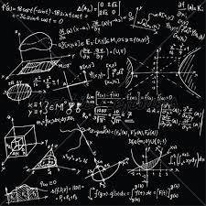
nishkamhighschool
Welcome to
A level mathematics
at
nishkamhighschool

Slide 2
nishkamhighschool
Welcome from the Head of Faculty
Hello,
Here at Nishkam High School, Mathematics is becoming an increasingly popular choice of subject at A-Level. With our expert team of Mathematics teachers, students are able to explore fundamental concepts, deepen their understanding and effectively communicate their methods of problem solving. I am privileged to work alongside such an experienced team of teachers and Pearson examiners who have helped students excel into studying Maths or maths-related courses at degree level.
Studying Maths at A-Level can help open many doors for future careers as well as compliment other subjects being studied. Our main goal in Maths is to ensure students develop a greater passion for the subject and can admire the beauty of its application in the world around us
Mr G Nandra

Slide 3
nishkamhighschool
Meet the teachers
Mr G Nandra
Head of Faculty
Mr G Chand
KS 5 Subject Lead
Mr A Cotgreave
Lead Practitioner for Maths

Slide 4
nishkamhighschool
What will you study?
We will follow the Pearson EdExcel AS and A level maths course
It comprises of 2 elements:
PURE MATHEMATICS | APPLIED MATHEMATICS
Algebra | MECHANICS
Geometry | The study of laws of motion
Trigonometry | How forces affect how things move
Calculus | STATISTICS
These are the areas of maths you will be familiar with from GCSE | You will be familiar with some of these ideas from GCSE
They are the building blocks of maths | These ideas are used in many areas of study
More than Academic Excellence | More than a School | More than 'self'

Slide 5
nishkamhighschool
What does the assessment look like?
AS Maths
Paper 1 : 2 hours – Pure Maths
Paper 2: 1 hr 15 mins – Applied Maths
A Level Maths
Paper 1: 2 hrs – Pure Maths
Paper 2: 2 hrs – Pure Maths
Paper 3: 2 hrs – Applied Maths
More than Academic Excellence | More than a School | More than 'self'

Slide 6
nishkamhighschool
Further Maths is a separate qualification which continues the study of many areas of maths.
At Nishkam we study:
Core Pure Maths – more of the algebra, geometry, trigonometry and calculus. This is compulsory.
We then study 2 optional units:
Further Mechanics – more study of laws of motion
Decision Maths – looking algorithms to solve real life problems
More than Academic Excellence | More than a School | More than 'self'

Slide 7
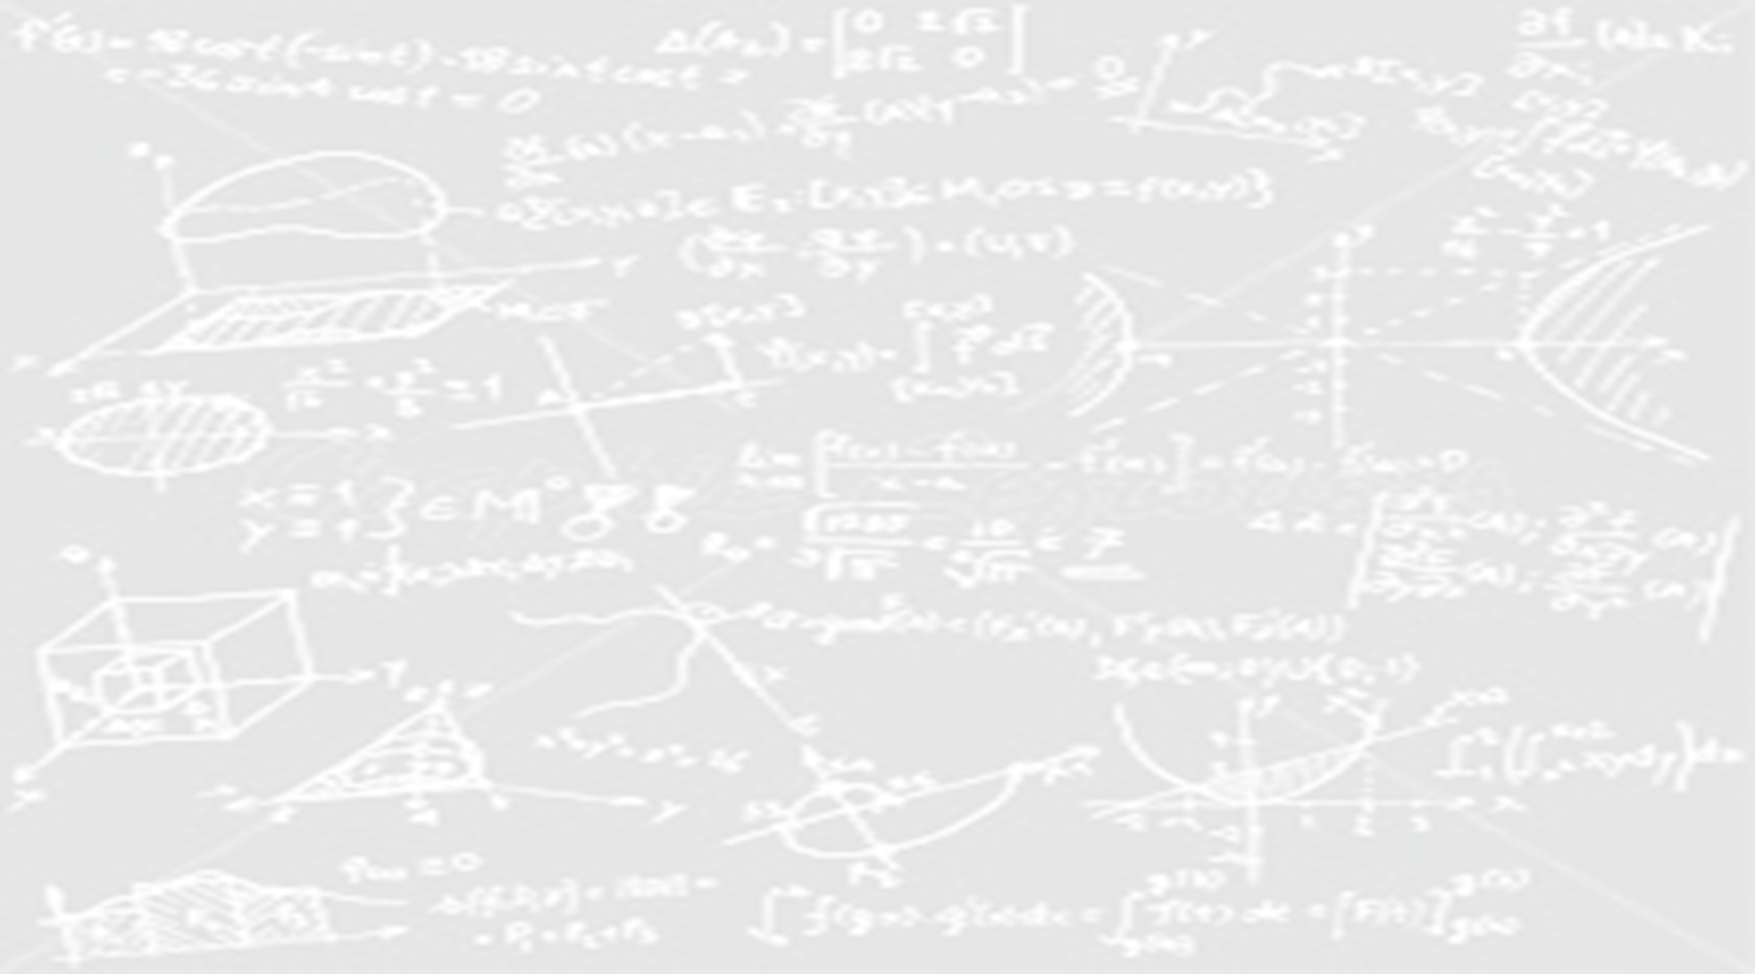
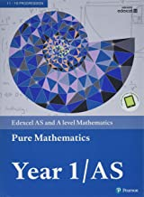
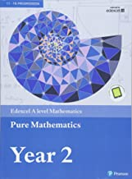
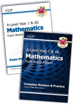
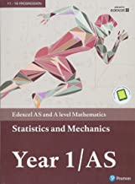
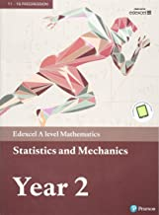
nishkamhighschool
Resources
Purpose written text books are available for the course and will be provided for all students
We will also make available revision guides at discounted rates
More than Academic Excellence | More than a School | More than 'self'

Slide 8
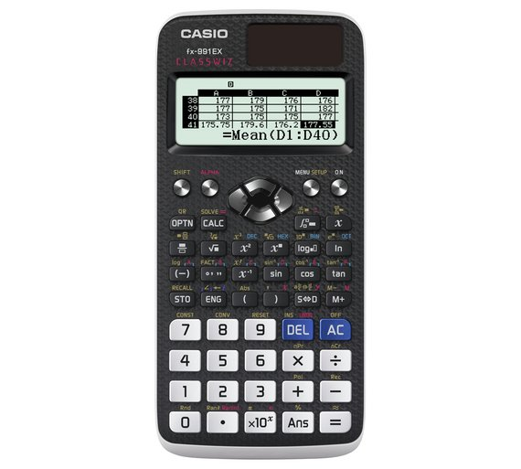
nishkamhighschool
Calculators
Calculators are an essential part of the course. We will source the latest recommended calculator at the best price possible
The Casio FX 991EX or the Casio FX-9860GII
are currently recommended- but we will review this each year.
More than Academic Excellence | More than a School | More than 'self'

Slide 9
nishkamhighschool
What skills do I need to succeed?
It is a fact that the better your GCSE grade in mathematics the more confident you will be on this course.
Data suggests the following target grades based on GCSE performance.
GCSE grade in maths | Target AS/A level grade
9 | A*/A
8 | A/B/C
7 | C/D
More than Academic Excellence | More than a School | More than 'self'

Slide 10
nishkamhighschool
What skills do I need to succeed?
You will need to be able to work independently, as well as part of a team. You will need to be dedicated and willing to ask questions.
More than Academic Excellence | More than a School | More than 'self'

Slide 11
nishkamhighschool
What skills do I need to succeed?
A level mathematics is a highly prized qualification but you need to be prepared for there to be a big ‘gear change’ from what is expected of you for GCSE.
You will learn a lot of new mathematics and how to apply this in the real world.
More than Academic Excellence | More than a School | More than 'self'

Slide 12
nishkamhighschool
What will we expect from you?
1. Continue your studies outside of lesson time. YOU MUST PUT IN AT LEAST AN EXTRA 45-60 MINUTES PER 60 MINUTE LESSON OF STUDY. THIS EXCLUDES TIME SPEND ON COMPLETING HOMEWORK.
You must do this to strengthen and maintain your understanding.
2. Complete assigned homework. It is essential to independently assess your own work and understanding.
If you are struggling or cannot answer certain questions you must seek help
3. Have 96+% attendance. If you are absent you must speak to your teacher and ensure you catch up on your work.
More than Academic Excellence | More than a School | More than 'self'

Slide 13
nishkamhighschool
Why should I study mathematics?
An A level qualification in mathematics opens the door to the study of many different subjects at university and then to many, varied careers afterwards.
More than Academic Excellence | More than a School | More than 'self'

Slide 14
nishkamhighschool

Slide 15
nishkamhighschool
Are there opportunities for extra curricular activities?
We offer interested students the opportunity to take part in the UKMT Senior Maths Challenge as well as encouraging students to take part in workshops and lectures offered by local universities
More than Academic Excellence | More than a School | More than 'self'

Slide 16
nishkamhighschool
What do our students think?
More than Academic Excellence | More than a School | More than 'self'

Slide 17
nishkamhighschool
One student sums it all up nicely!
More than Academic Excellence | More than a School | More than 'self'

