Slide 1
Prayers
Year 1

Slide 2
End of day prayers

Slide 3
ddw dwqw eyku hY sB kau dyvnhwr ]
dhadhaa dhaataa ek hai sabh kau dhevanahaar ||
The One Lord is the Great Giver; He is the Giver to all.
dyNdy qoit n AwveI Agnq Bry BMfwr ]
dhe(n)dhe toT na aaviee aganat bhare bha(n)ddaar ||
There is no limit to His Giving. His countless warehouses are filled to overflowing.
ijs dw idqw Kwvxw iqsu khIAY swbwis ]
jis dhaa dhitaa khaavanaa tis kaheeaai saabaas ||
Let us all celebrate Him, from whom we receive our nourishment.
nwnk hukmu n cleI nwil Ksm clY Ardwis ]22]
naanak hukam na chaliee naal khasam chalai aradhaas ||22||
O Nanak, no one can issue commands to the Lord Master; let us offer prayers instead. ||22|
ieko dwqw mMgIAY sBu ikCu plY pwie ]
eiko dhaataa ma(n)geeaai sabh kichh palai pai ||
Ask from the One Lord, the Great Giver, and you will be blessed with everything.
min qin swis igrwis pRBu ieko ieku iDAwie ]
man tan saas giraas prabh iko ik dhiaai ||
In your mind and body, with each breath and morsel of food, meditate on the One and only Lord God
nwnku nwm cVHdI klw, qyry Bwxy srb¤q dw Blw[
Nanak naam, chardikala, tere bhane sarbat da bhulla
Nanak says, always have ever-ascending optimism and bless all of creation.

Slide 4
The Lord Bless You and Keep You
The Lord bless you and keep you; the Lord make his face to shine upon you and be gracious to you; the Lord lift up his countenance upon you and give you peace.
Amen
Numbers 6:24-26

Slide 5
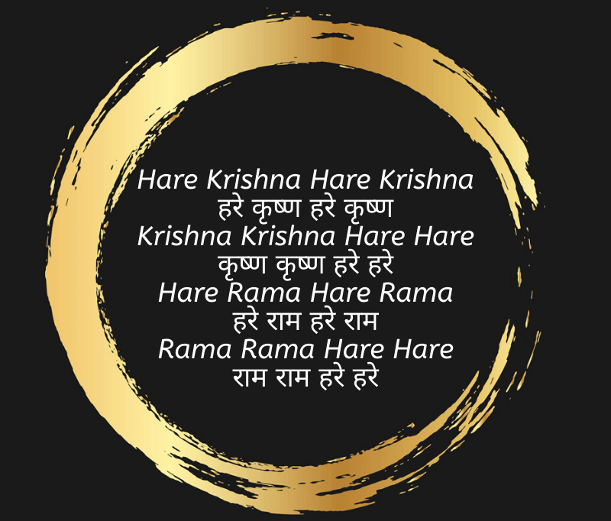
Hindu Prayer

Slide 6
Muslim Prayer Surah Fatiha – The Opening
Bismallah
Bismillah hir rahman nir raheem In the name of Allah, The Most Gracious and The Most Merciful
الْحَمْدُ لِلَّهِ رَبِّ الْعَالَمِينَ
Alhamdulillahi Rabbil ‘aalameen [All] praise is [due] to Allah, Lord of the worlds
الرَّحْمَٰنِ الرَّحِيمِ
Ar-Rahmaanir-Raheem The Entirely Merciful, the Especially Merciful,
مَالِكِ يَوْمِ الدِّينِ
Maliki Yawmi-Deen Sovereign of the Day of Recompense.
إِيَّاكَ نَعْبُدُ وَإِيَّاكَ نَسْتَعِينُ
iyyaka na’budu wa iyyaka nastaee
It is You we worship and You we ask for help.
اهْدِنَا الصِّرَاطَ الْمُسْتَقِيمَ
Ihdinas Siraatal Mustaqee
Guide us to the straight path –
صِرَاطَ الَّذِينَ أَنْعَمْتَ عَلَيْهِمْ غَيْرِ الْمَغْضُوبِ عَلَيْهِمْ وَلَا الضَّالِّينَ
Siraatal lazeena an’amta ‘alaihim ghayril maghdoobi ‘alaihim wa lad daaalleen The path of those upon whom You have bestowed favour, not of those who have evoked [Your] anger or of those who are astray.

Slide 7
Prayers learnt in previous years

Slide 8
Sikh Prayer - Mool Manter
<> siq nwmu krqw purKu inrBau inrvYru Akwl mUriq AjUnI sYBM gur pRswid ]
Ik Oankaar sat naam karta purakh nirabhau niravair akaal moorat ajoonee saibha(n) gur prasaadh ||
One Universal Creator God. The Name Is Truth. Creative Being Personified. No Fear. No Hatred. Image Of The Undying, Beyond Birth, Self-Existent. By Guru's Grace
] jpu ]
|| jap ||
Name of the Composition, "Jup". Chant And Meditate:
Awid scu jugwid scu ]
aadh sach jugaadh sach ||
True In The Primal Beginning. True Throughout The Ages.
hY BI scu nwnk hosI BI scu ]1]
hai bhee sach naanak hosee bhee sach ||1||
True Here And Now. O Nanak, Forever And Ever True. ||1||

Slide 9
Christian Prayer
The Grace
May the grace of the Lord Jesus Christ, and the love of God, and the fellowship of the Holy Spirit be with you all.
Amen.

