Slide 1
Prayers
Year 2

Slide 2
End of day prayers

Slide 3
slok mÚ 3 ]
salok mahalaa teejaa ||
Shalok, Third Mehla:
jgqu jlµdw riK lY AwpxI ikrpw Dwir ]
jagat jala(n)dhaa rakh lai aapanee kirapaa dhaar ||
The world is going up in flames - shower it with Your Mercy, and save it!
ijqu duAwrY aubrY iqqY lYhu aubwir ]
jit dhuaarai ubarai titai laih ubaar ||
Save it, and deliver it, by whatever method it takes.
siqguir suKu vyKwilAw scw sbdu bIcwir ]
satigur sukh vekhaaliaa sachaa sabadh beechaar ||
The True Guru has shown the way to peace, contemplating the True Word of the Shabad.
nwnk Avru n suJeI hir ibnu bKsxhwru ]1]
naanak avar na sujhiee har bin bakhasanahaar ||1||
Nanak knows no other than the Lord, the Forgiving Lord. ||1|

Slide 4
The Lord’s Prayer
Our Father, who art in heaven, hallowed be thy name, thy kingdom come, thy will be done, on earth as it is in heaven. Give us this day our daily bread and forgive us our trespasses, as we forgive those who trespass against us, and lead us not into temptation, but deliver us from evil, for thine is the kingdom and the power and the glory, forever and ever.
Amen.
Matthew 6: 9-13

Slide 5
ॐ जय जगदीश हरे,
Om Jai Jagadiish Hare
Om, Victory to You, the Lord of the Universe, स्वामी जय जगदीश हरे |
Swaami Jai Jagadiish Hare | Swami, Victory to You, the Lord of the Universe
भक्त जनों के संकट,
Bhakta Jano Ke Sankatt
The difficulties of Your devotees
दास जनों के संकट,
Daas Janon Ke Sankatt, The difficulties of Your servants
क्षण में दूर करे |
Kssann Me Duur Kare
You remove in an instant.
ॐ जय जगदीश हरे ||
Om Jai Jagadiish Hare || Om, Victory to You, the Lord of the Universe.
जो ध्यावे फल पावे,
Jo Dhyaave Phal Paave, Whoever meditates on You will get Your grace
दुःखबिन से मन का,
Duhkh-Bin Se Man Kaa, Whoever meditates with a mind free of sorrows
स्वामी दुःखबिन से मन का |
Swaami Duhkh-Bin Se Man Kaa | Swami, with a mind free of sorrows. सुख सम्पति घर आवे,
Sukh Sampati Ghar Aave, Joy and Prosperity will come to them
सुख सम्पति घर आवे,
Sukh Sampati Ghar Aave, Joy and Prosperity will come to them
कष्ट मिटे तन का |
Kasstta Mitte Tan Kaa |
And distress of body (and mind) will be relieved
ॐ जय जगदीश हरे || Om Jai Jagadiisha Hare || Om, Victory to You, the Lord of the Universe.

Slide 6
ayatulkursi.mp3
Ayutal Qursi – The Throne
Allahu laaa ilaaha illaa huwal haiyul qai-yoom; laa taakhuzuhoo sinatunw wa laa nawm; lahoo maa fissamaawaati wa maa fil ard; man zallazee yashfa'u indahooo illaa be iznih; ya'lamu maa baina aideehim wa maa khalfahum; wa laa yuheetoona beshai 'immin 'ilmihee illa be maa shaaaa; wasi'a kursiyyuhus samaa waati wal arda wa la ya'ooduho hifzuhumaa; wa huwal aliyyul 'azeem
Meaning: Allah! There is no god but He - the Living, the Self-subsisting, Eternal. No slumber can seize Him nor Sleep. His are all things in the heavens and on earth. Who is there can intercede in His presence except as he permitteth? He knoweth what (appeareth to His creatures As) Before or After or Behind them. Nor shall they compass aught of His knowledge except as He willeth. His throne doth extend over the heavens and on earth, and He feeleth no fatigue in guarding and preserving them, For He is the Most High, the Supreme (in glory).

Slide 7
Prayers learnt in previous years

Slide 8
Sikh Prayer - Mool Manter
<> siq nwmu krqw purKu inrBau inrvYru Akwl mUriq AjUnI sYBM gur pRswid ]
Ik Oankaar sat naam karta purakh nirabhau niravair akaal moorat ajoonee saibha(n) gur prasaadh ||
One Universal Creator God. The Name Is Truth. Creative Being Personified. No Fear. No Hatred. Image Of The Undying, Beyond Birth, Self-Existent. By Guru's Grace
] jpu ]
|| jap ||
Name of the Composition, "Jup". Chant And Meditate:
Awid scu jugwid scu ]
aadh sach jugaadh sach ||
True In The Primal Beginning. True Throughout The Ages.
hY BI scu nwnk hosI BI scu ]1]
hai bhee sach naanak hosee bhee sach ||1||
True Here And Now. O Nanak, Forever And Ever True. ||1||

Slide 9
ddw dwqw eyku hY sB kau dyvnhwr ]
dhadhaa dhaataa ek hai sabh kau dhevanahaar ||
The One Lord is the Great Giver; He is the Giver to all.
dyNdy qoit n AwveI Agnq Bry BMfwr ]
dhe(n)dhe toT na aaviee aganat bhare bha(n)ddaar ||
There is no limit to His Giving. His countless warehouses are filled to overflowing.
ijs dw idqw Kwvxw iqsu khIAY swbwis ]
jis dhaa dhitaa khaavanaa tis kaheeaai saabaas ||
Let us all celebrate Him, from whom we receive our nourishment.
nwnk hukmu n cleI nwil Ksm clY Ardwis ]22]
naanak hukam na chaliee naal khasam chalai aradhaas ||22||
O Nanak, no one can issue commands to the Lord Master; let us offer prayers instead. ||22|
ieko dwqw mMgIAY sBu ikCu plY pwie ]
eiko dhaataa ma(n)geeaai sabh kichh palai pai ||
Ask from the One Lord, the Great Giver, and you will be blessed with everything.
min qin swis igrwis pRBu ieko ieku iDAwie ]
man tan saas giraas prabh iko ik dhiaai ||
In your mind and body, with each breath and morsel of food, meditate on the One and only Lord God
nwnku nwm cVHdI klw, qyry Bwxy srb¤q dw Blw[
Nanak naam, chardikala, tere bhane sarbat da bhulla
Nanak says, always have ever-ascending optimism and bless all of creation.

Slide 10
Christian Prayer
The Grace
May the grace of the Lord Jesus Christ, and the love of God, and the fellowship of the Holy Spirit be with you all.
Amen.

Slide 11
The Lord Bless You and Keep You
The Lord bless you and keep you; the Lord make his face to shine upon you and be gracious to you; the Lord lift up his countenance upon you and give you peace.
Amen
Numbers 6:24-26

Slide 12
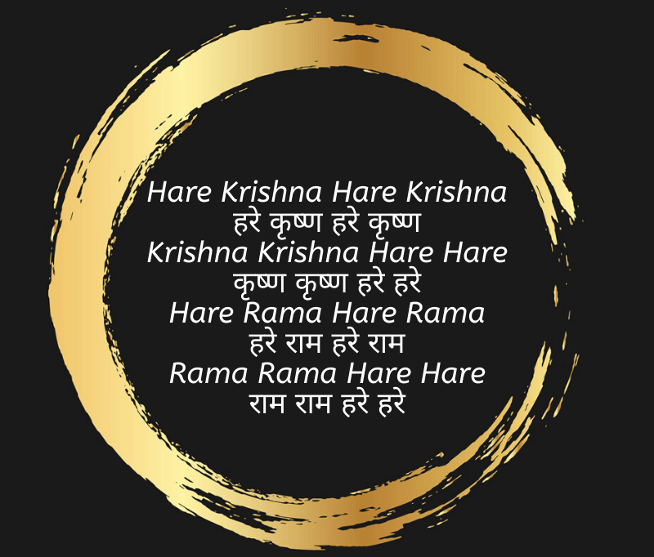
Hindu Prayer

Slide 13
Muslim Prayer Surah Fatiha – The Opening
Bismallah
Bismillah hir rahman nir raheem In the name of Allah, The Most Gracious and The Most Merciful
الْحَمْدُ لِلَّهِ رَبِّ الْعَالَمِينَ
Alhamdulillahi Rabbil ‘aalameen [All] praise is [due] to Allah, Lord of the worlds
الرَّحْمَٰنِ الرَّحِيمِ
Ar-Rahmaanir-Raheem The Entirely Merciful, the Especially Merciful,
مَالِكِ يَوْمِ الدِّينِ
Maliki Yawmi-Deen Sovereign of the Day of Recompense.
إِيَّاكَ نَعْبُدُ وَإِيَّاكَ نَسْتَعِينُ
iyyaka na’budu wa iyyaka nastaee
It is You we worship and You we ask for help.
اهْدِنَا الصِّرَاطَ الْمُسْتَقِيمَ
Ihdinas Siraatal Mustaqee
Guide us to the straight path –
صِرَاطَ الَّذِينَ أَنْعَمْتَ عَلَيْهِمْ غَيْرِ الْمَغْضُوبِ عَلَيْهِمْ وَلَا الضَّالِّينَ
Siraatal lazeena an’amta ‘alaihim ghayril maghdoobi ‘alaihim wa lad daaalleen The path of those upon whom You have bestowed favour, not of those who have evoked [Your] anger or of those who are astray.

