Slide 1
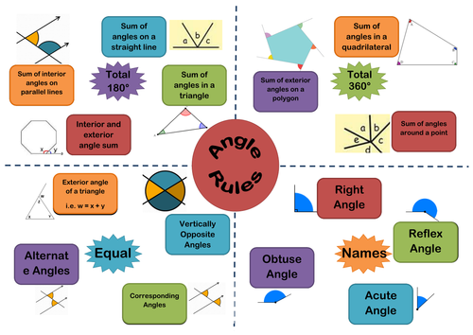

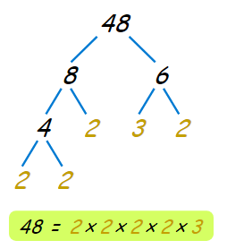
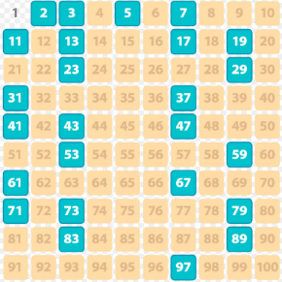
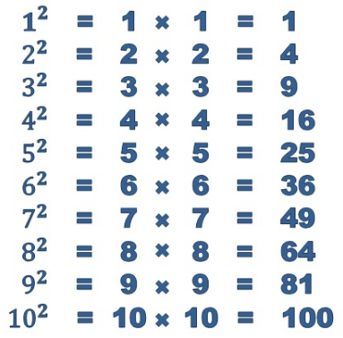
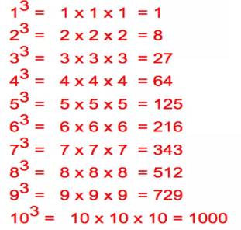

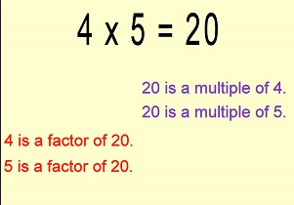
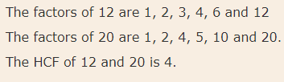

Algebra 71: Sequences
Sequence | A list of numbers that follow a rule
Nth Term | Formula used to calculate the terms of a sequence
Linear Sequence | For example, 4x + 5
Quadratic Sequence | For example, 2x² + 3
Ascending | When a series of numbers increases e.g. 2, 4, 6, 8, 10
Descending | When a series of numbers decreases e.g., 7, 5, 3, 1, -1
Substitute | When you replace a letter with a number
Year 7 Autumn 1
Geometry 71: Angles
You will also get a weekly task on MyMaths to complete on these topics
Number 71: Calculations
A factor tree looks like this…
Factors and multiples are…
The prime numbers are…
The square numbers are…
The cube numbers are…
HCF and LCM examples…
Notes:
Year 7 Spring 1

Slide 2
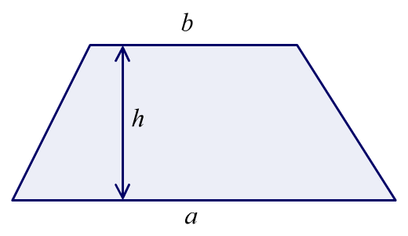
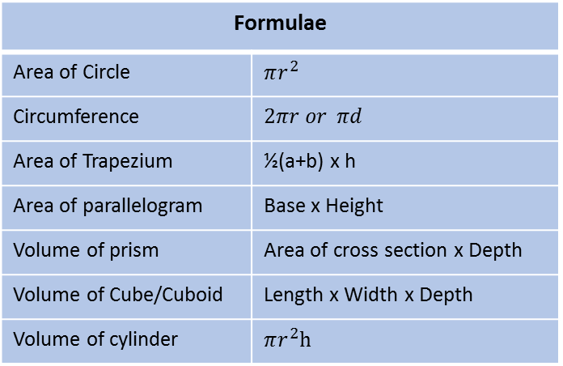
Geometry 81: Area, Perimeter, Volume
Area | Total space inside 2D shape
Perimeter | Total distance around a 2D shape
Volume | The total space inside a 3D shape
Surface Area | Total area of all the faces on a 3D shape
2D Shape | Two dimensional shape, that is flat
3D Shape | Three dimensional shape
Prism | A shape that can be cut anywhere to have the same cross section
Sector (eg quadrant) | A fraction of a circle (e.g. a quadrant is a quarter of a circle)
Circumference | The length around a circle
Year 8 Autumn 1
Formulae
Area of Circle | $$πr^{2}$$
Circumference | $$2πr or πd$$
Area of Trapezium | ½(a+b) x h
Area of parallelogram | Base x Height
Volume of prism | Area of cross section x Depth
Volume of Cube/Cuboid | Length x Width x Depth
Volume of cylinder | $$πr^{2}h$$
Number 81: Factors, Multiples, Directed Numbers
Ascending | From largest to smallest
Descending | From smallest to largest
Factor | Numbers which go into another number with no remainder
Multiple | Numbers which are in the multiplication table of a particular number
Prime Number | Numbers which have only two factors – 1 and themselves
Highest Common Factor (HCF) | The greatest number which goes into the given numbers
Lowest Common Multiple (LCM) | The smallest number which is a multiple of the given numbers
Algebra 81: Factors, Multiples, Directed Numbers
Solve | Work out the value of the unknown
Expression | Contains numbers, variables and operators
Equation | Contains numbers, variables, operators and an equals sign
Formula | A relationship exists between the variables in an equation
Simplify | Collect like terms
Expand | Multiply out the brackets
Factorise | Take out a common factor from all the terms
You will also get a weekly task on MyMaths to complete on these topics
Notes:
Year 7 Spring 1

Slide 3
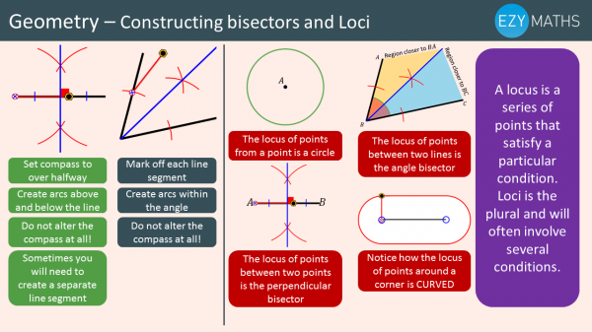
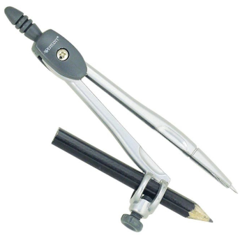
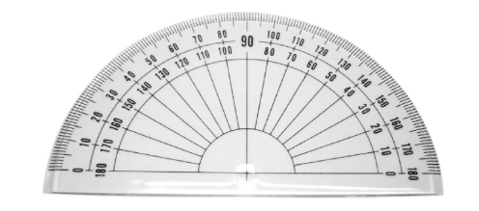
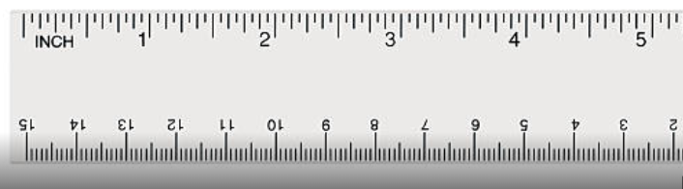
Year 9 Autumn 1
Geometry 91: Construction and Loci
Loci | A set of points or lines that are a set distance away from an object or point.
Bisect | Dividing a line or angle into two equal parts.
Perpendicular | At a 90◦ angle to a point or line.
Intersect | Two lines which cross each other.
Key Equipment
Number 91: Calculation, Standard Form, Rounding
Standard Form | A number in the form n x 10 ͣ , where n < 10.
Ordinary Form | A number in the regular format.
Decimal Places (d.p) | the position of a digit to the right of a decimal point.
Significant Figures (s.f) | each of the digits of a number that are used to express it to the required degree of accuracy, starting from the first non-zero digit.
Estimate | Round each part of equation to one significant figure.
Upper Bound | The highest value a rounded number could be.
Lower Bound | The lowest value a rounded number could be.
Compass
Protractor
Ruler
You will also get a weekly task on MyMaths to complete on these topics
Notes:
Year 7 Spring 1

Slide 4
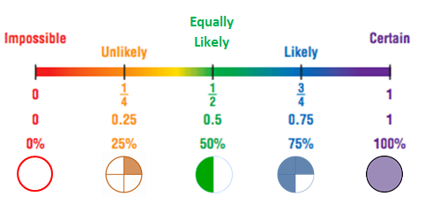
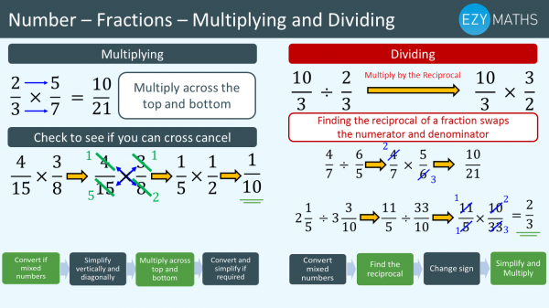
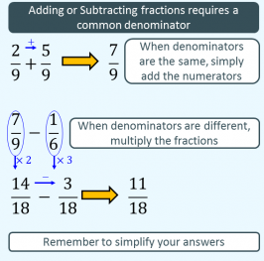
Statistics 71: Probability
Probability Scale
Probability | The chance of something happening
Relative frequency | How often something happens divided by all the outcomes
Mutually exclusive | Only one event can take place at a time
Sample Space Diagram | Shows all possible outcomes when two or more events are happening
P(A) | Probability of event A happening
P’(A) | Probability of event A not happening
Year 7 Autumn 2
Number 72: Fractions and negative numbers
Denominator | Bottom number of fraction. Number of parts the whole number is divided into
Numerator | Top number of the fraction. Number of parts that you have
Mixed Number | Has a whole number and a fraction
Improper fraction | Numerator is bigger than the denominator
Negative number | Number below 0
Algebra 72: Equations
Simplify | An expression that can be shortened by collecting like terms
Substitute | Replacing a letter with a number
Solve | Find the value of an unknown letter
Expand | Multiply out brackets with letters
Factorise | Put expressions into brackets
Expression | A combination of numbers and letters called terms
Equation | Has an equals sign and both sides are the same
Formula | A relationship or rule expressed with symbols and numbers
You will also get a weekly task on MyMaths to complete on these topics
Notes:
Year 7 Spring 1

Slide 5
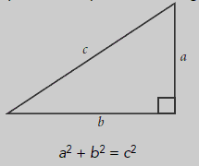
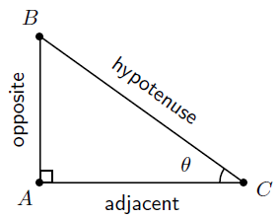
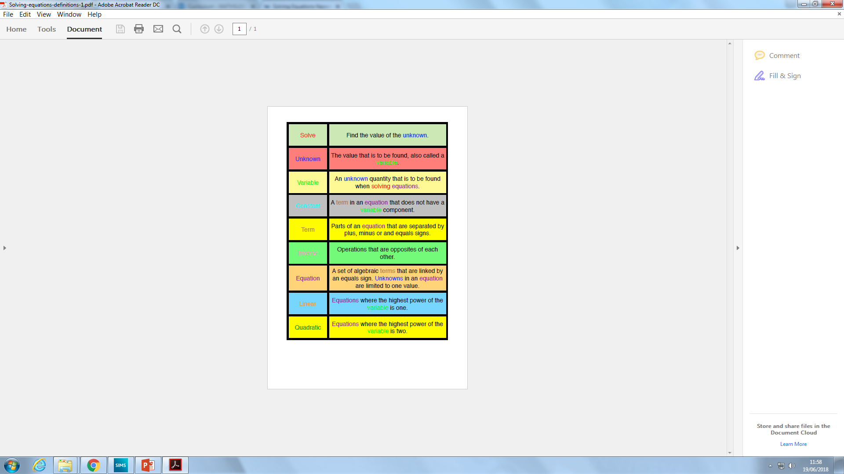
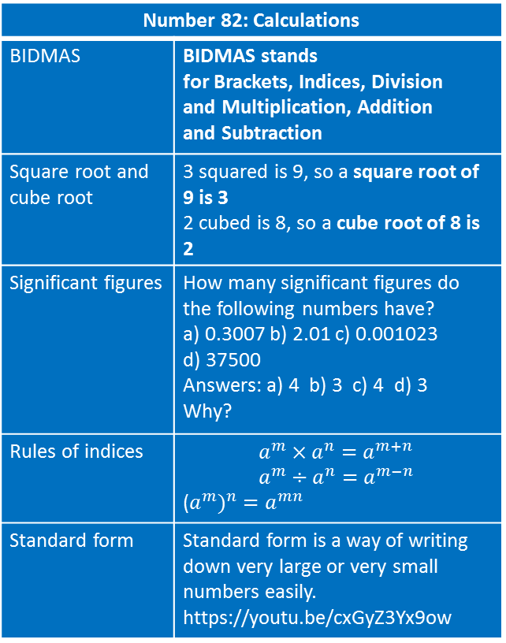
Geometry 82: Right angled triangles
Pythagoras Theorem | In any right angled triangle, the square of the hypotenuse is equal to the sum of the squares of the other two sides
Hypotenuse | the longest side of a right-angled triangle, opposite the right angle
Opposite | is opposite to the angle in question
Adjacent | is the side next to the angle in question
Sine | sine = ^{opposite} / _{hypotenuse}
Cosine | cosine = ^{adjacent} / _{hypotenuse}
Tangent | tan = ^{opposite} / _{adjacent}
Year 8 Autumn 2
Number 82: Calculations
BIDMAS | BIDMAS stands for Brackets, Indices, Division and Multiplication, Addition and Subtraction
Square root and cube root | 3 squared is 9, so a square root of 9 is 3 2 cubed is 8, so a cube root of 8 is 2
Significant figures | How many significant figures do the following numbers have? a) 0.3007 b) 2.01 c) 0.001023 d) 37500 Answers: a) 4 b) 3 c) 4 d) 3 Why?
Rules of indices | $$a^{m}×a^{n}=a^{m+n} \\ a^{m}÷a^{n}=a^{m−n}$$ ($a^{m})^{n}$ $=a^{mn}$
Standard form | Standard form is a way of writing down very large or very small numbers easily. https://youtu.be/cxGyZ3Yx9ow
Algebra 82: Equations
You will also get a weekly task on MyMaths to complete on these topics
Notes:
Year 7 Spring 1

Slide 6
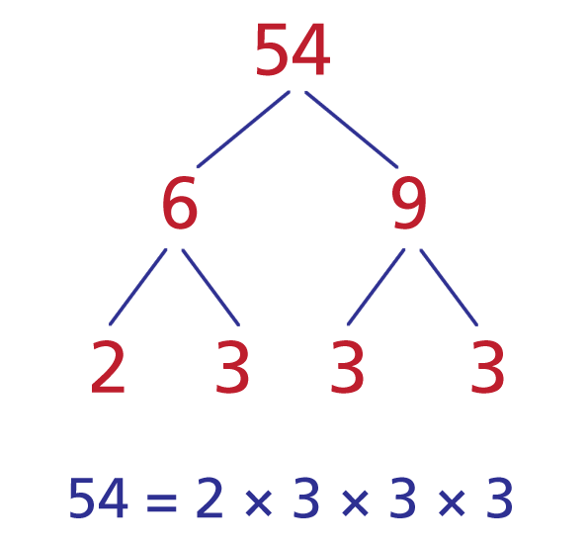
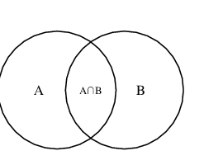
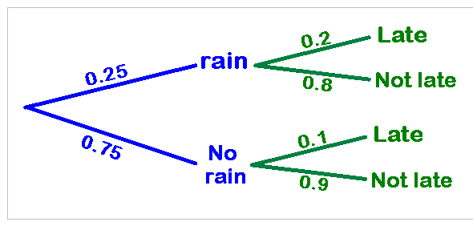
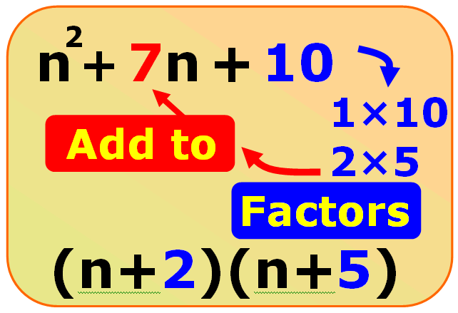
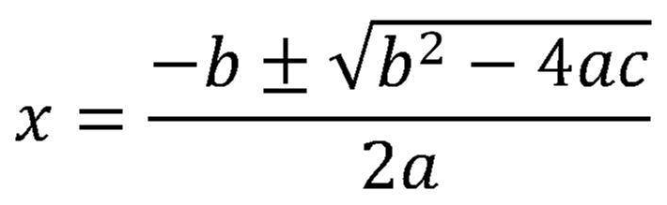
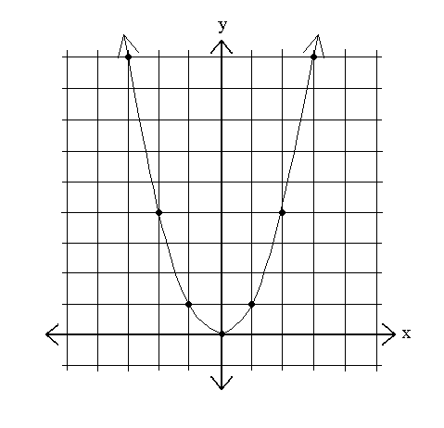
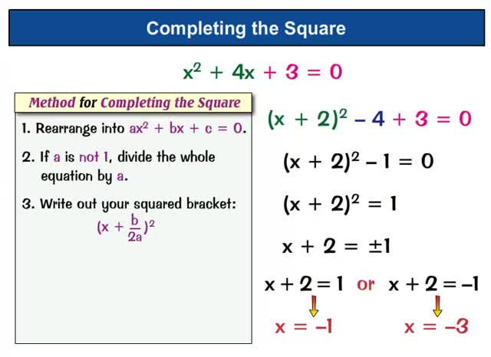
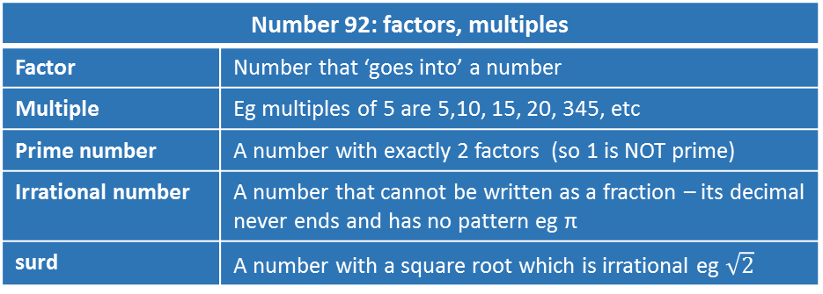
Year 9 Autumn 2
Number 92: factors, multiples
Factor | Number that ‘goes into’ a number
Multiple | Eg multiples of 5 are 5,10, 15, 20, 345, etc
Prime number | A number with exactly 2 factors (so 1 is NOT prime)
Irrational number | A number that cannot be written as a fraction – its decimal never ends and has no pattern eg π
surd | A number with a square root which is irrational eg $\sqrt{2}$
Statistics 91: Probability
Mutually exclusive | Events that can’t both happen at the same time
Relative frequency | The number of times an event happens in a experiment as a fraction of how many times the experiment has been done
Sample Space | A list of all the outcomes of an experiment
Sample space diagram | Usually a table showing all the outcomes
exhaustive | A set of events that cover all possibilities
The factor tree always has the same numbers at the end – however you start it.
This is a very important result.
Algebra 91: Quadratic equations
Linear equation | Eg. 2x+3 = 4 no x² or other powers
Quadratic Equation | ax² + bx + c = 0
Factorising quadratics | We use 2 brackets.
Quadratic formula
Completing the square
parabola | The shape of a quadratic graph
Venn Diagram
Tree diagram
You will also get a weekly task on MyMaths to complete on these topics
Notes:
Year 7 Spring 1

Slide 7
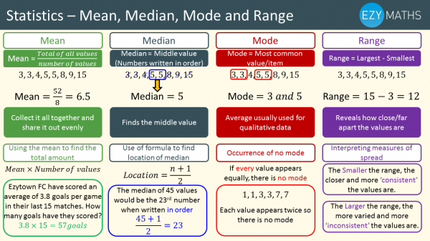
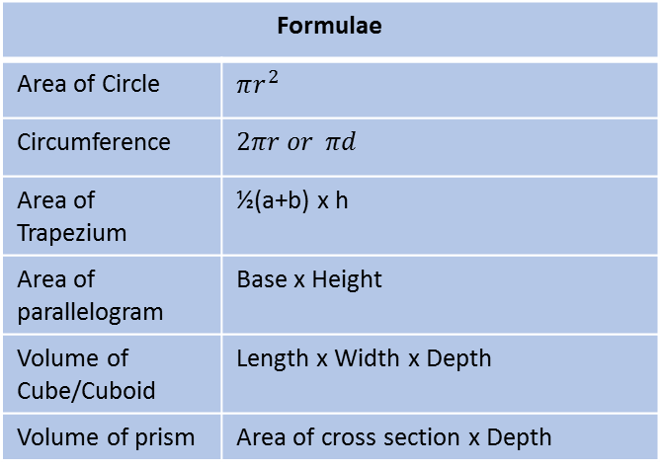
Geometry 72: Area, Perimeter, Volume
Area | Total space inside 2D shape
Perimeter | Total distance around a 2D shape
3D shape | Three dimensional shape,
2D shape | Two dimensional shape, that is flat
Net | A 3D shape flattened
Volume | The total space inside a 3D shape
Surface Area | Total area of all the faces on a 3D shape
Prism | A shape that can be cut anywhere to have the same cross section
Year 7 Spring 1
Formulae
Area of Circle | $$πr^{2}$$
Circumference | $$2πr or πd$$
Area of Trapezium | ½(a+b) x h
Area of parallelogram | Base x Height
Volume of Cube/Cuboid | Length x Width x Depth
Volume of prism | Area of cross section x Depth
You will also get a weekly task on MyMaths to complete on these topics
Statistics 72: Averages
Mean | Adding all the numbers together and dividing by the total amount of numbers
Mode | The number that occurs the most
Median | The number in the middle when all the numbers are ordered smallest to largest
Range | The difference between the largest and smallest number
Grouped Data | Data that has been bundled together in categories
Notes:
Year 7 Spring 1

Slide 8
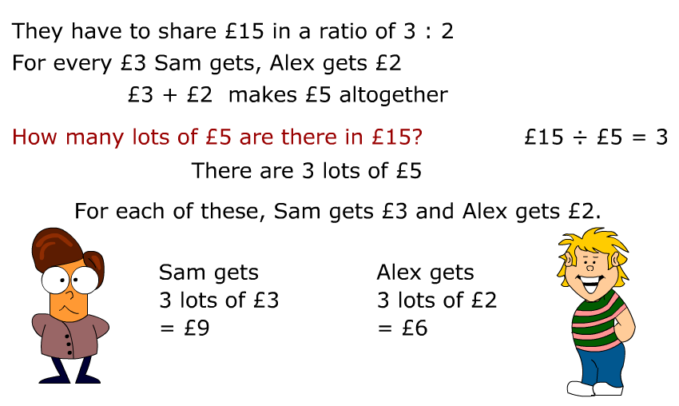
Year 8 Spring 1
Statistics 82: Representing Data
Bar Chart | A graph that compares the frequencies of data
Comparative Bar Chart | A bar chart that compares within a group
Pie Chart | A graph in which a circle is divided into sectors that each represent a proportion
Stem and Leaf | A diagram where the numbers are split up into stem and leaves
Scatter Graph | Graph of paired data in which the data values are plotted like co ordinates
Correlation | The trend of the data
Line of best fit | Line to help make predictions from scatter graphs
Conversion graph | A graph to help make conversions between units
Number 83: Ratio and Proportion
Statistics 82: Representing Data
Features of a good graph | Title Labelled Axis Accurate Scale Key (Where needed) Drawn using ruler and pencil
You will also get a weekly task on MyMaths to complete on these topics
Notes:
Year 7 Spring 1

Slide 9
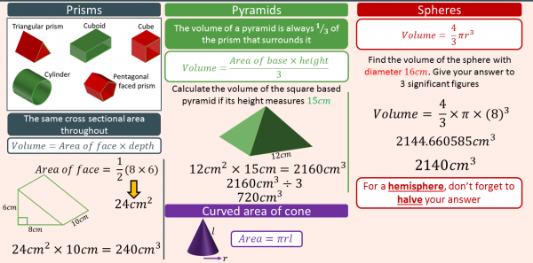
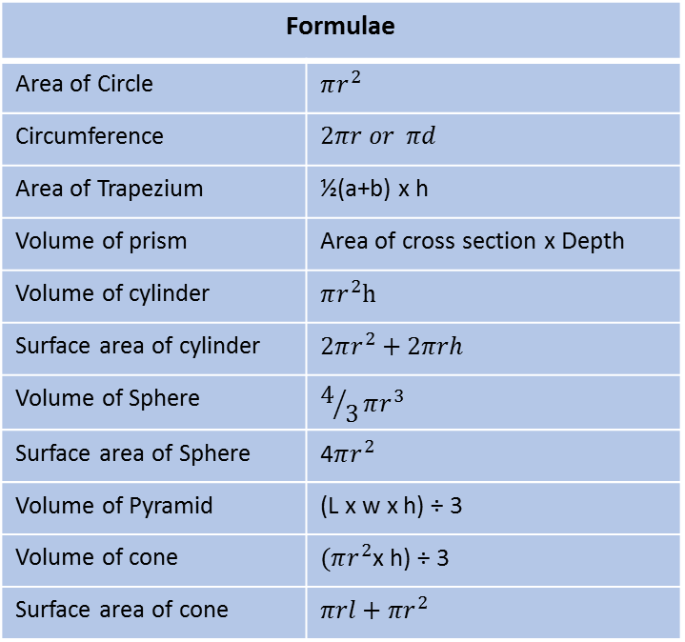
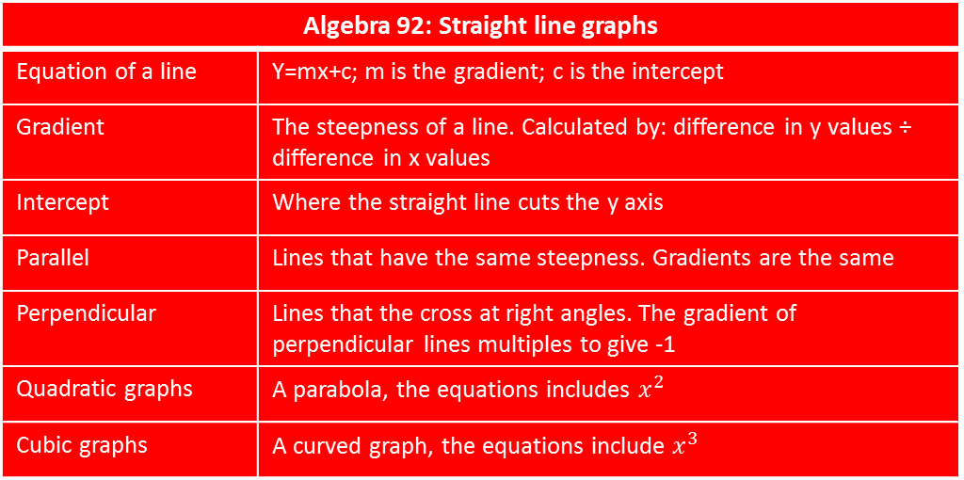
Geometry 92: Area, Perimeter, Volume
Area | Total space inside 2D shape
Perimeter | Total distance around a 2D shape
Volume | The total space inside a 3D shape
Surface Area | Total area of all the faces on a 3D shape
Frustum | Portion of a cone or pyramid
Year 9 Spring 1
Algebra 92: Straight line graphs
Equation of a line | Y=mx+c; m is the gradient; c is the intercept
Gradient | The steepness of a line. Calculated by: difference in y values ÷ difference in x values
Intercept | Where the straight line cuts the y axis
Parallel | Lines that have the same steepness. Gradients are the same
Perpendicular | Lines that the cross at right angles. The gradient of perpendicular lines multiples to give -1
Quadratic graphs | A parabola, the equations includes $x^{2}$
Cubic graphs | A curved graph, the equations include $x^{3}$
Formulae
Area of Circle | $$πr^{2}$$
Circumference | $$2πr or πd$$
Area of Trapezium | ½(a+b) x h
Volume of prism | Area of cross section x Depth
Volume of cylinder | $$πr^{2}h$$
Surface area of cylinder | $$2πr^{2}+2πrh$$
Volume of Sphere | $$4/3πr^{3}$$
Surface area of Sphere | 4$πr^{2}$
Volume of Pyramid | (L x w x h) ÷ 3
Volume of cone | $(πr^{2}$x h) ÷ 3
Surface area of cone | $$πrl+πr^{2}$$
You will also get a weekly task on MyMaths to complete on these topics
Notes:
Year 7 Spring 1

Slide 10
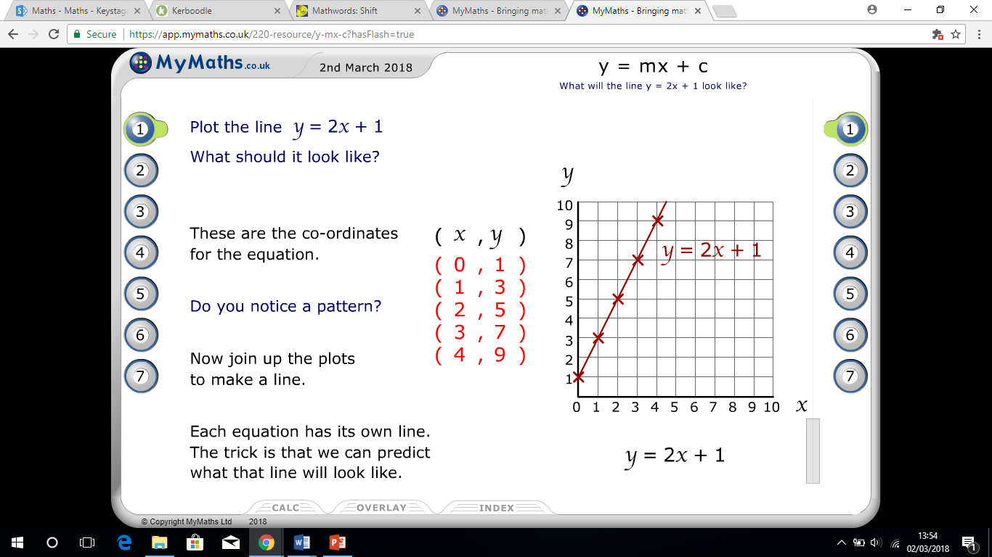
Year 7 Spring 2
Algebra 74: Equations of straight line graphs
Co ordinates | Location of a point on a co ordinate grid
Equation of line | Y=mx+c
Gradient | The steepness of a line
Intercept | Where the line cross the y axis
Substitution | Replacing a letter with a number
Real life graph | A graph that tells a real life story
Geometry 73: Transformations
Transformation | Changing a shape from the object to image
Reflection | Transforming a shape across a mirror line
Rotation | An object is turned around a fixed centre point
Clockwise | Turning towards the direction of a clock
Anti Clockwise | Turning in the opposite direction a clock
Enlargement | When a shape is made bigger or smaller
Centre of enlargement | The place where the enlargement takes place
Scale Factor | The amount a shape is enlarged
Translation | Transformation where a shape changes location
Vector | The direction in which a shape is translated
You will also get a weekly task on MyMaths to complete on these topics
Notes:
Year 7 Spring 1

Slide 11
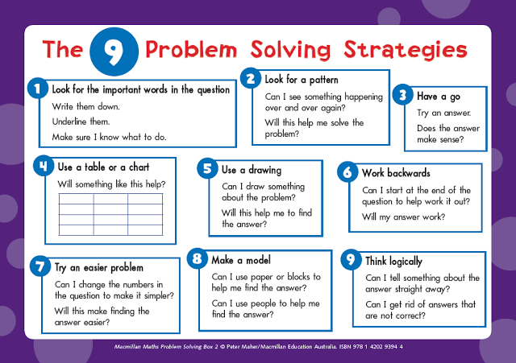
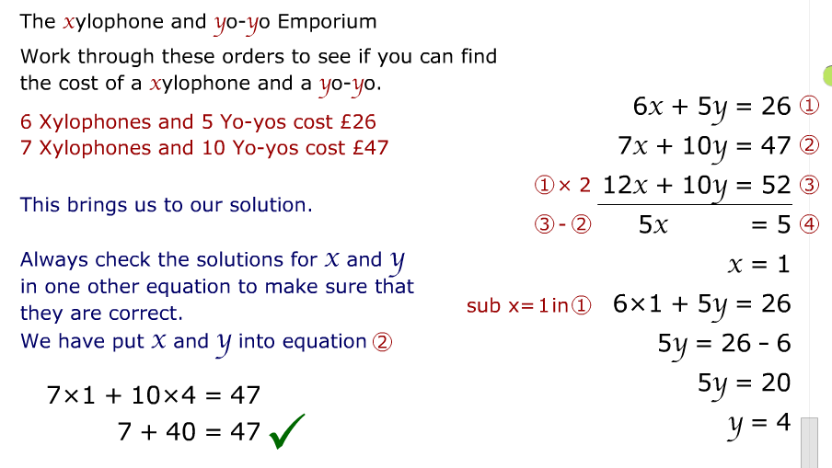
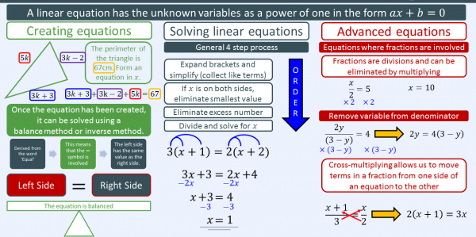
Year 8 Spring 2
Problem Solving
Algebra 83: Simultaneous equations
You will also get a weekly task on MyMaths to complete on these topics
Notes:
Year 7 Spring 1

Slide 12
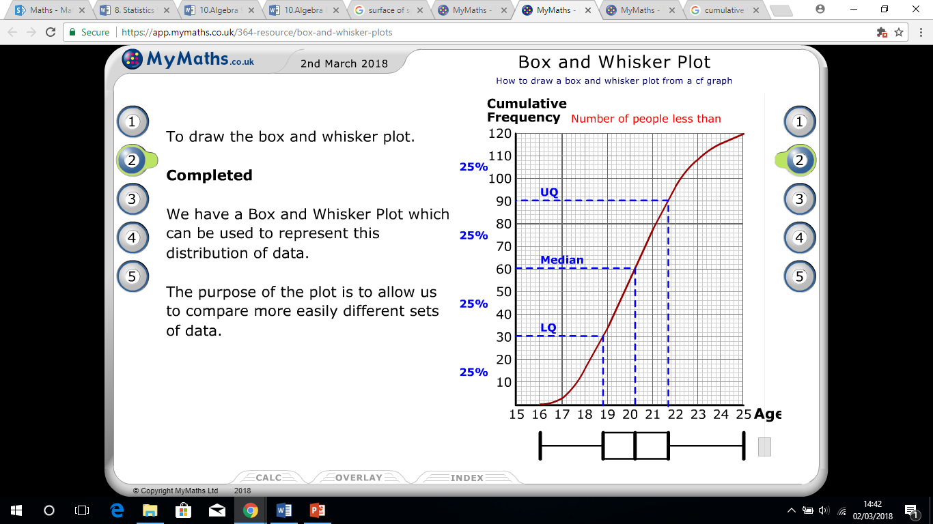
Year 9 Spring 2
Statistics 92: Averages
Mean | Adding all the numbers together and dividing by the total amount of numbers
Mode | The number that occurs the most
Median | The number in the middle when all the numbers are ordered smallest to largest
Range | The difference between the largest and smallest number
Grouped Data | Data that has been bundled together in categories
Cumulative frequency | The sum of previous frequencies up to the current point, to plot a ‘S’ shape graph
Upper Quartile | The middle number between the median and the largest number
Lower Quartile | The middle number between the median and the smaller number
Interquartile range | The difference between the upper quartile and lower quartile
Box plots | A chart to show the spread of data
You will also get a weekly task on MyMaths to complete on these topics
Notes:
Year 7 Spring 1

Slide 13
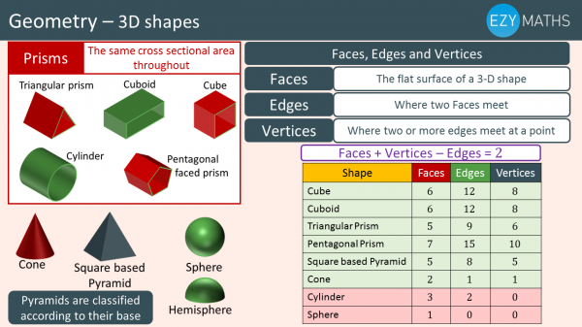
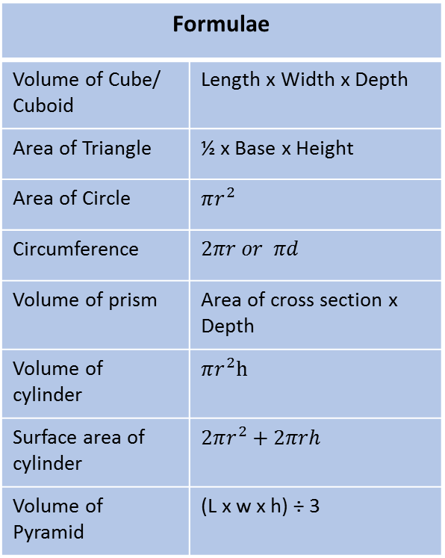
Year 7 Summer 1
Numbers 74: Ratios
Ratio | A ratio shows the relative sizes of two or more values.
Proportion | Proportion says that two ratios (or fractions) are equal.
Unitary Method | A method where we find the value of one unit before multiplying it to find the total units needed.
Geometry 74: 3D Shapes
Net | A 3D shape flattened
Volume | The total space inside a 3D shape
Surface Area | Total area of all the faces on a 3D shape
Elevation | The side view of any 3D shape
Prism | A shape that can be cut anywhere to have the same cross section
Vertex | Where three or more edges of a 3D shape meet
Edge | Where two faces of a 3D shape meet
Formulae
Volume of Cube/ Cuboid | Length x Width x Depth
Area of Triangle | ½ x Base x Height
Area of Circle | $$πr^{2}$$
Circumference | $$2πr or πd$$
Volume of prism | Area of cross section x Depth
Volume of cylinder | $$πr^{2}h$$
Surface area of cylinder | $$2πr^{2}+2πrh$$
Volume of Pyramid | (L x w x h) ÷ 3
You will also get a weekly task on MyMaths to complete on these topics
Notes:
Year 7 Spring 1

Slide 14
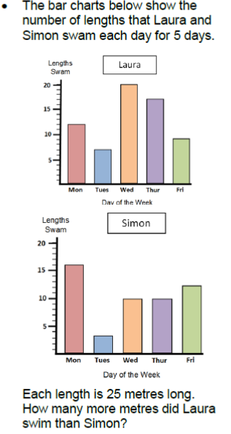
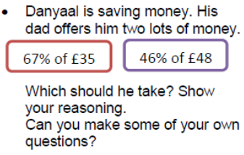
Year 7 Summer 1
Number 73: Percentages
Percentage Decrease | Find percentage and minus from 100%
Percentage Increase | Find percentage and add onto 100%
Percentage Change | Find the percentage increase or decrease from one value to another.
Statistics 73: Representing Data
Pictograph | A pictograph uses pictures or symbols to show the value of the data.
Bar Chart | A graph that compares the frequencies of data
Tally Chart | A way of keeping count by drawing marks.
Stem and Leaf | A diagram where the numbers are split up into stem and leaves
Pie Chart | A graph in which a circle is divided into sectors that each represent a proportion
Scatter Graph | Graph of paired data in which the data values are plotted like co ordinates
Correlation | The trend of the data
Conversion | Changing one unit of measurement into another proportionate unit
Hypothesis | A prediction
You will also get a weekly task on MyMaths to complete on these topics
Notes:
Year 7 Spring 1

Slide 15
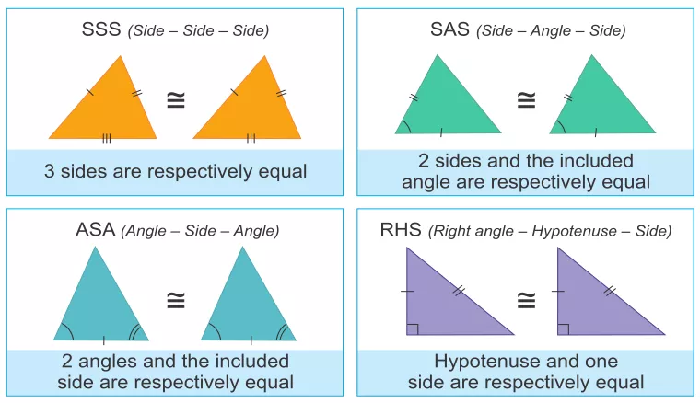
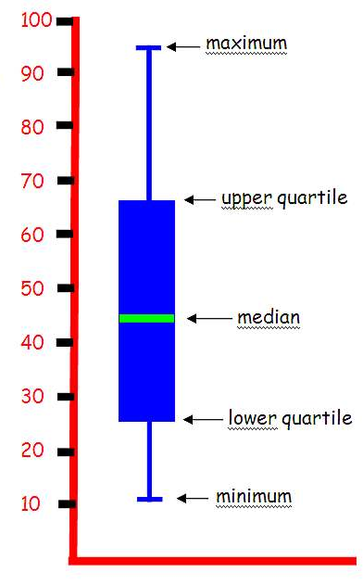
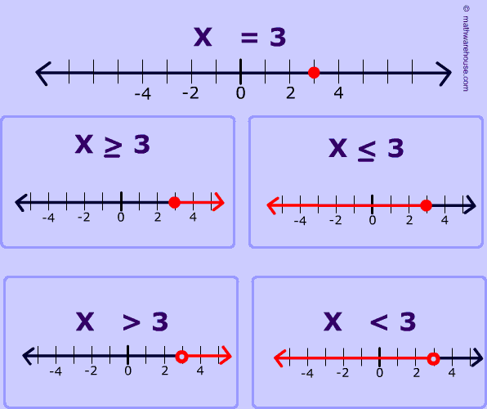
Year 8 Summer 1
Geometry 83: Angles |  | Congruent triangle rules:
Parallel lines | Never meet, they are always the same distance apart
Corresponding angles | Make a letter F they are equal
Alternate angles | Make a letter Z they are equal
Opposite angles | Make a letter X they are equal
Co-interior angles | Make a letter C and add up to 180
Interior angles | Sum of interior angles = (n-2) x 180
Exterior angles | Sum of 360
You will also get a weekly task on MyMaths to complete on these topics
Statistics 83: Averages
Mean | Add all the numbers together and divide by how many numbers there are
Median | Place numbers in order and find middle value
Mode | Most occurring number
Range | Largest number minus smallest number
Grouped Data | Data organised into groups
Midpoint | Middle value of grouped data
Lower Quartile | 25% of data
Upper Quartile | 75% of data
Interquartile range (IQR) | Upper Quartile – Lower Quartile. Middle 50% of data
Algebra 84: Inequalities
< | Less than
> | Greater than
≤ | Less than or equal too
≥ | Greater than or equal too
Notes:
Year 7 Spring 1

Slide 16
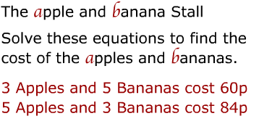
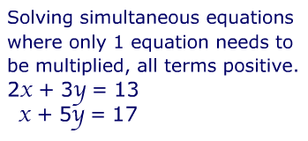
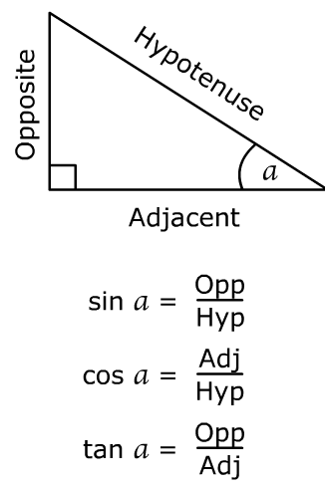
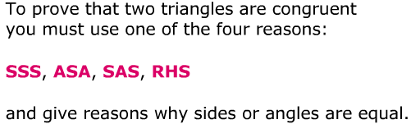
Algebra 93: Simultaneous Equations
Solve | Find the value of the unknowns given in the question
Form | Create an equation based on the information in the question
Substitute | Replacing a letter with a number
Linear | Equation in the form y=mx+c
Quadratic | Equation in the form ax²+bx+c
Graphically | Use the graph to find solutions
Year 9 Summer 1
You will also get a weekly task on MyMaths to complete on these topics
Number 93: Sequences
Nth term | Finding the value of any term in a sequence – a general rule
Linear Sequence | There is a common first difference between the terms in a sequence
Quadratic Sequence | There is a common second difference between the terms in a sequence
Geometric Sequence | There is a common ratio between the terms in a sequence
Generate | Use the nth term rule to find terms of a sequence
Arithmetic Progression | A sequence of numbers where the difference between consecutive terms has a constant difference
Fibonacci Sequence | A special sequence of numbers where the next term is found by adding the two previous terms together e.g.: 1, 1, 2, 3, 5, 8, 13 …
Triangle Numbers | A number that can make a triangular dot pattern e.g.: 1, 3, 6, 10, 15 …
Geometry 93: Triangles
Quadrilaterals | Four-sided shape
Parallel | Lines which never meet as they are always the same distance apart
Hypotenuse | The longest side on a right angled triangle (opposite the right angle)
Opposite | A shorter side on a right angled triangle (opposite the angle given)
Adjacent | A shorter side on a right angled triangle (next to the angle given)
Pythagoras | a²+b²=c² used to find missing lengths on a right angled triangle
Trigonometry | SOHCAHTOA used to find missing lengths and angles in right angled triangles
Similarity | Shapes are similar if they have the same angles but are different sizes
Congruence | Exactly equal in size and shape

Slide 17




Year 7 Summer 2
Geometry 75: Angles
Angles on a straight line | Add up to 180º
Angles round a point | Add up to 360º
Angles in a triangle | Add up to 180º
Parallel lines | Never meet, they are always the same distance apart
Corresponding angles | Make a letter F they are equal
Alternate angles | Make a letter Z they are equal
Opposite angles | Make a letter X they are equal
Co-interior angles | Make a letter C and add up to 180º
You will also get a weekly task on MyMaths to complete on these topics
Statistics 74: Probability
Probability Scale | We use the words on the scale to describe how likely something is to happen
0 | Means something is impossible
1 | Means something is certain to happen
0.5 or ½ or 50% | Is called an even chance
Mutually exclusive events | Can’t both happen
Relative frequency | How many times something happened how many times you did the experiment
Sample space | A list of all the possible outcomes
Sample Space diagram | A way of listing all the possible outcomes
Algebra 75: Graphs
Gradient | How steep a line is
Calculate the gradient | Rise or change in y Run change in x
y- intercept | Where the line crosses the y axis
y=mx +c | m= gradient c= y-intercept
Quadratic graph | A graph with an equation that has x² in it
parabola | The shape of a quadratic graph
Notes:
Year 7 Spring 1

Slide 18

Algebra 85: Sequences and Graphs
Sequence | A list of numbers that follow a rule
Nth Term | Formula used to calculate the terms of a sequence
Linear Sequence | For example, 4x + 5
Quadratic Sequence | For example, 2x² + 3
Fibonacci Sequence | A series of numbers where a number is found by adding up the two numbers before it
y = mx + c | Equation given to any linear graph
Gradient | The steepness of a line
Perpendicular lines | At a right angle, 90˚, to another line
Parallel lines | Lines that are the same distance apart from each other forever
Year 8 Summer 2
Geometry 84: Transformations
You will also get a weekly task on MyMaths to complete on these topics
Number 84: Fractions, Decimals and Percentages
Numerator | Top of a fractions
Denominator | Bottom of a fraction
Equivalent Fractions | Fractions that are the same value
To add or subtract fractions | Make sure the denominators are the same Add or subtract the numerators together
To multiply fractions | Multiply the numerators together Multiply the denominators together
To divide fractions | Keep the first fraction the same Flip the second fraction Change the sign to multiply
Notes:
Year 7 Spring 1

Slide 19






Number 94: Ratio and proportionality
Ratio | A ratio shows the relative sizes of two or more values.
Direct Proportion | As one variable increases, so does the other
Inverse Proportion | As one variable increases, the other decreases
y is directly proportional to x | y ∞ x y =kx
y is directly proportional to x² | y ∞ x² y =kx²
y is indirectly proportional to x | y ∞ $1/x$ y =$k/x$
y is indirectly proportional to the square of x | y ∞ $1/{\sqrt{x}}$ y =$k/{\sqrt{x}}$
Year 9 Summer 2
Statistics 93:Representing Data
Pie Chart | A graph in which a circle is divided into sectors that each represent a proportion
Histogram | Area of bar represents frequency
Frequency Density | Frequency ÷ class width
Scatter graph | Graph of paired data in which the data values are plotted like co ordinates
Moving Average | Mean calculated ot plot on time series graph to show a trend
Time Series | Plots observations taken over regular intervals
Hypothesis | Prediction of what you expect to happen
Algebra 94: Inequalities
< | Less than
> | Greater than
≤ | Less than or equal too
≥ | Greater than or equal too
Plotting Regions | Plot Equation of line given Dotted line if < or > and Solid line if ≤ or ≥ Pick a point and check if it satisfies inequality Shade the correct region
You will also get a weekly task on MyMaths to complete on these topics
Notes:
Year 7 Spring 1

