Slide 1
KS3 Knowledge Organisers
Nishkam High School
Music Department
2018-19

Slide 2
Term 1

Slide 3

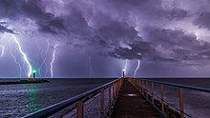






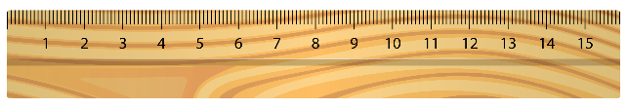
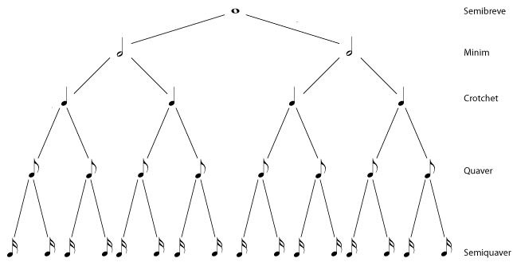



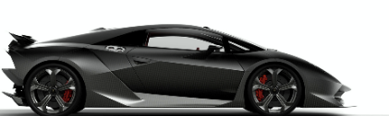
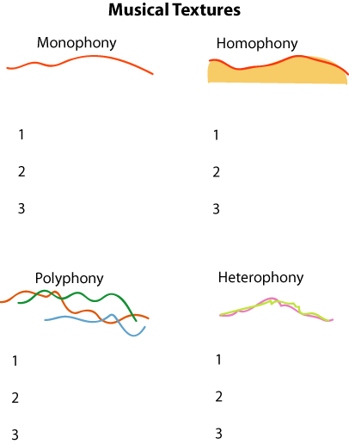
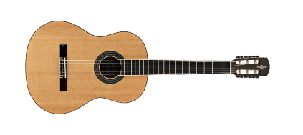
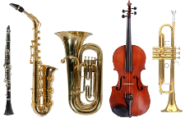
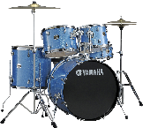
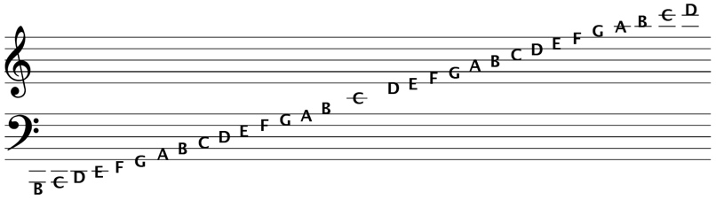

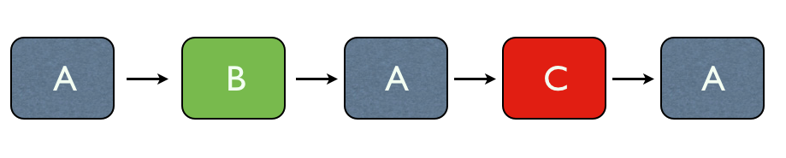
Musical Openings Knowledge Organiser – Year 7 Music
Program Music | A piece of music which either tells a story or describes something.
Pitch | Pitches is how high or low a piece of music, or a particular note, is.
Rhythm/ Duration | Duration/rhythm means how long or short a note is.
Dynamics | Dynamics are how loud or quiet the music is played.
Tempo | Tempo is how fast or slow a piece of music is played.
Texture | Texture describes how melodies, rhythms and harmonies are layered in a piece of music.
Timbre/ Sonority | Timbre (or sonority) describes the particular sound quality of an instrument or voice.
Structure | Structure (or form) is the overall plan of a piece of music.
It’s Theory Time!
Note Values This is a Rhythm Tree – it is designed to help you identify what the symbols for different note values are, and how they relate to one another. Here are the note values! Semibreve = 4 beats Minim = 2 beats Crotchet = 1 beat Quaver = ½ beat Semiquaver = ¼ beat Notes on the Stave Here are the notes of the treble (top line) and bass (bottom line) clefs. When the notes fall outside the five lines of music paper, we add extra lines called ledger lines. Here are some phrases to help you remember where the notes go! Treble Clef Lines: Every Green Bus Drives Fast Treble Clef Spaces: F A C E (in the space!) Bass Clef Lines: Green Buses Drive Fast Always Bass Clef Spaces: All Cows Eat Grass

Slide 4

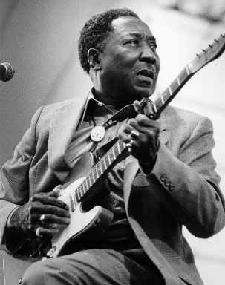

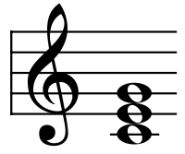
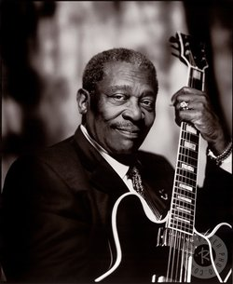
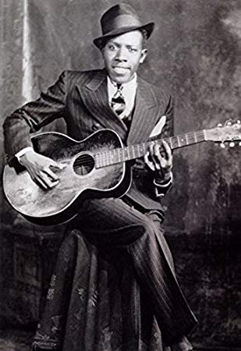
The Blues Knowledge Organiser – Year 8 Music – Term 1a & 1b
Blues | The Blues is a genre of music originated by African Americans in the Deep South of the United States around the end of the 19th century. The genre has its roots in African musical traditions, and African-American work songs.
Oppression | The exercise of authority or power in a cruel and unjust manner. People who are oppressed have their rights taken away, and are often forced to do things against their will.
Bassline | The musical part which sits at the bottom of the texture. In the Blues, it follows a conventional pattern: 1, 3, 5, 6, b7, 6, 5, 3
Chord | Two or more notes played simultaneously on a piano or guitar. There are three chords needed for the standard 12-bar blues:
12 Bar Blues | A form commonly used in Blues music which is made up of 12 bar cycles. The chords appear in the following order: C C C C F F C C G F C C C = CEG, F = FAC, G = GBD
Quick Change Blues | Similar to the 12 bar blues, this form changes the final chord in the 12 bar sequence to G, making the piece feel as if it should continue.
Key Artists – Go the extra mile!
Muddy Waters (1913-1983) | Muddy Waters was an American blues musician who is often cited as the “father of modern Chicago blues”. We will listen to his song ‘Hoochie Coochie Man’ in lessons – get a head start by listening here: https://www.youtube.com/watch?v=U5QKpsVzndc
B.B. King (1925-2015) | B.B. King was an American blues singer, electic guitarist, songwriter, and record producer. During his career, he earned the nickname ‘The King of the Blues’. Listen to a song of his here: https://www.youtube.com/watch?v=oica5jG7FpU
Robert Johnson (1911-1938) | Robert Johnson was an American blues singer-songwriter and musician. Even though his life was tragically short, he is one of the most prolific blues artists ever to have lived.

Slide 5
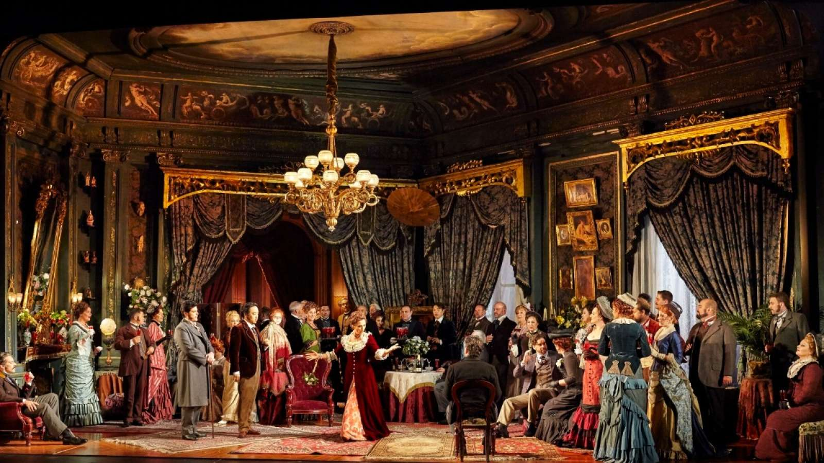
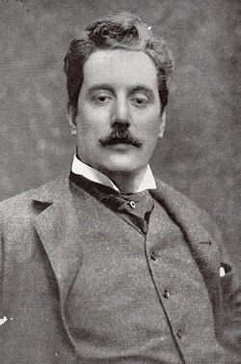
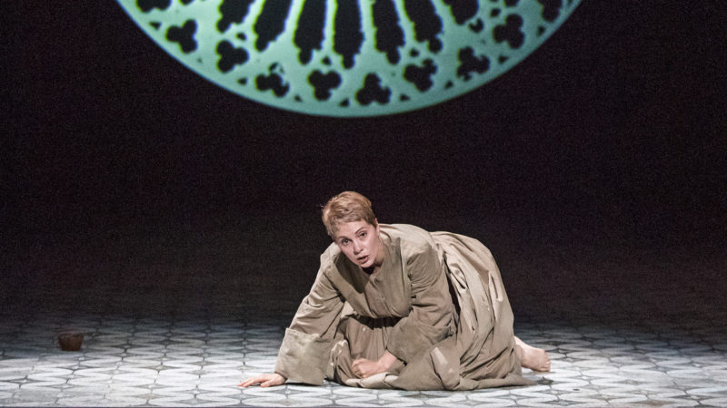
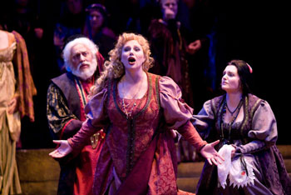
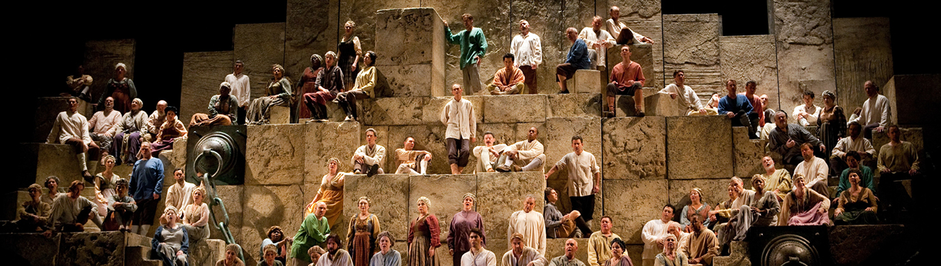
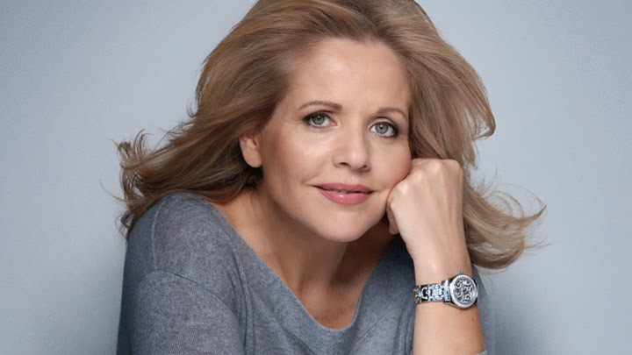
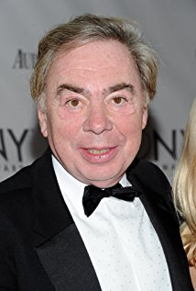
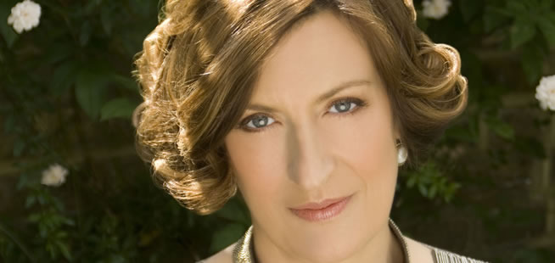
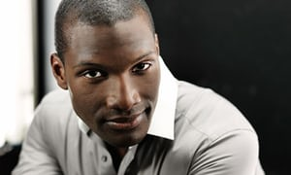
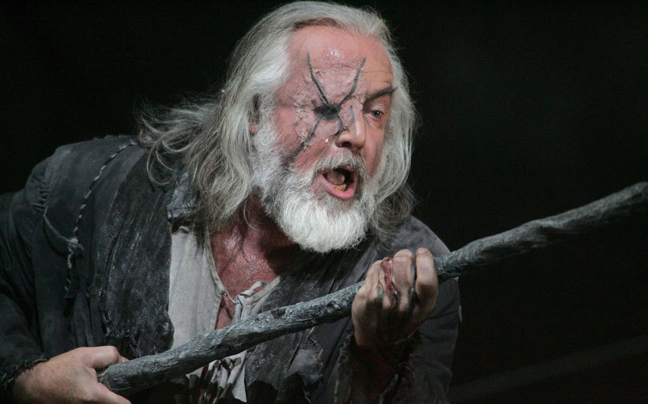
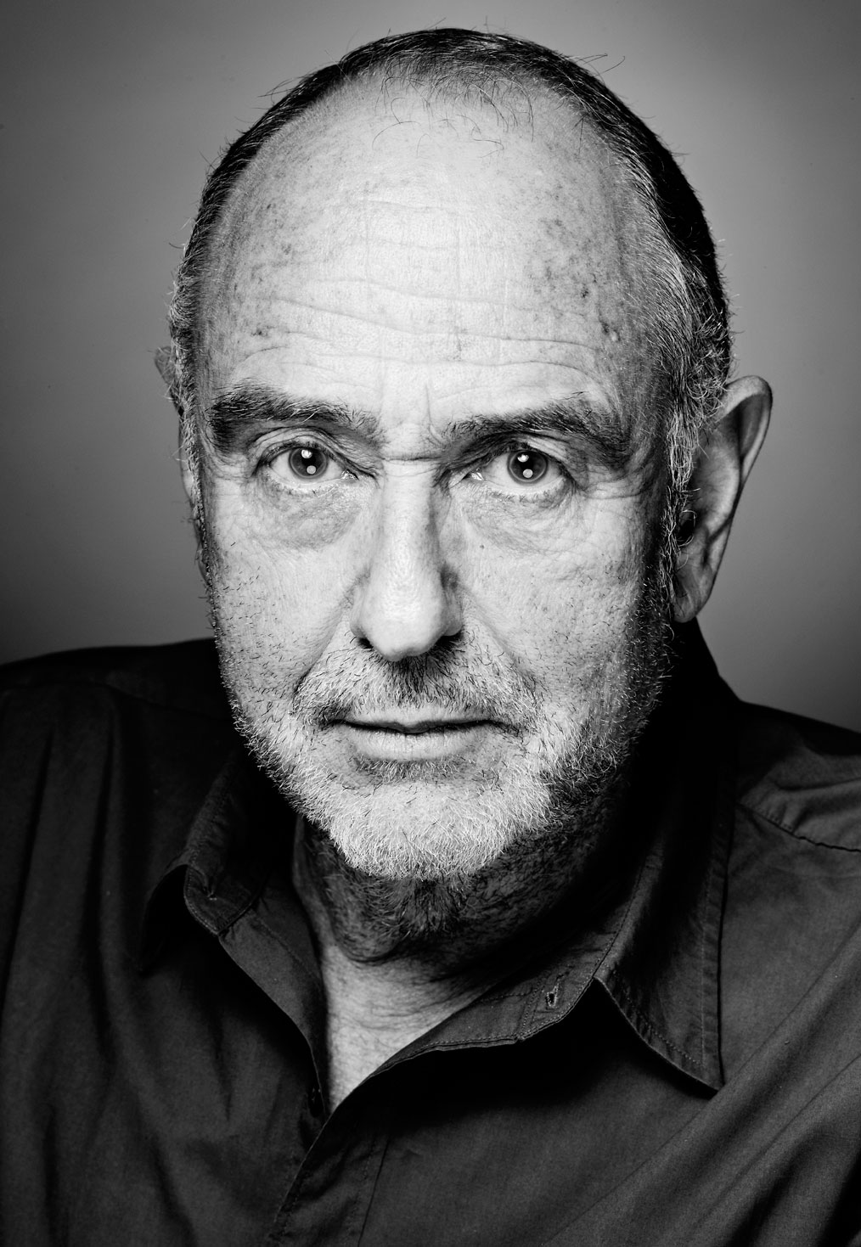


Opera & Musical Theatre Knowledge Organiser – Year 9 Music – Term 1a
Opera | An art form which originated in Italy in the late 16th century, combining music and acting. The first opera was called Dafne, written by Jacopo Peri in 1597.
Aria | A piece of music featured in an opera in which one character singing about their thoughts and feelings at that point in the story.
Recitative | A piece of music featured in an opera which consists of two or more characters in conversation with each other. This helps to move the plot forward.
Chorus | A piece of music featured in an opera where a group of people sing, either to advance the plot, or to comment on the action on stage.
Soprano | A high female voice, found in both opera and musical theatre. Usually plays a love interest or a younger character. Pictured: Renée Fleming (soprano)
Alto | A low female voice, found in both opera and musical theatre. Usually plays an older character. Pictured: Sarah Connolly (alto)
Tenor | A high male voice, found in both opera and musical theatre. Usually plays a young, heroic character; often the protagonist. Pictured: Noah Steward (tenor)
Bass | A low male voice, found in both opera and musical theatre. usually plays an older character, or an evil character. Pictured: John Tomlinson (bass)
Musical Theatre | An art form which combines singing, dancing and acting which originated in the early 20th century.
Verse | The part of a song from a musical which tells the story and advances the plot.
Key Composers – Go the extra mile!
Giacomo Puccini (1858-1924) | Giacomo Puccini was an Italian composer in the Romantic period. He wrote operas including Turandot, La Bohème and Suor Angelica. Have a listen to his famous aria, ’Nessun Dorma’ from Turandot. What voice type is singing this? https://www.youtube.com/watch?v=rTFUM4Uh_6Y
Andrew Lloyd-Webber (b.1948) | Andrew Lloyd-Webber is a composer most famous for his musicals The Phantom of the Opera, CATS, Evita!, and Jesus Christ Superstar. Have a listen to the title number from Phantom of the Opera – what instruments can you hear? https://www.youtube.com/watch?v=-JaeBxYCI9k
Claude-Michel Schönberg (b.1944) | Claude-Michel Schönberg is a French composer who often collaborates with lyricist Alain Boublil –together they wrote the hit musical Les Misérables. What story does this song, On My Own tell? https://www.youtube.com/watch?v=VjfmP7h3gBw

Slide 6
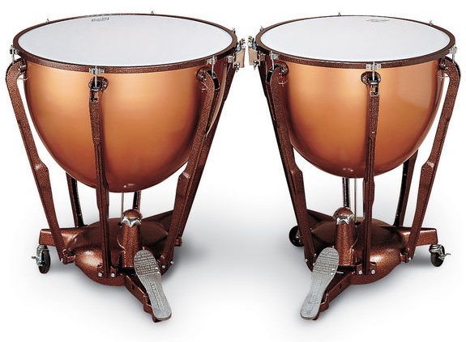
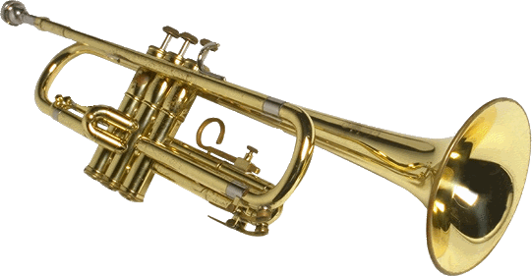
Music for Celebration Knowledge Organiser – Year 9 Music – Term 1b
Fanfare | A musical flourish which announces the arrival of an important person, or the opening of an important event or occasion.
Dotted Rhythm | A rhythmic pattern which uses a long note followed by a shorter note. The ‘dotted’ part comes from the fact that the first note is usually extended by a dot, and the second note shortened by the value that dot has.
Harmonic Series | A musical idea or theme which is recurring throughout a concerto. Literally translates to ‘returning’.
Repeated Pattern | A musical pattern which is repeated, often to create a strong, commanding atmosphere in the music.
Key Fanfares – Go the extra mile!
The Universal Pictures Theme – Jerry Goldsmith | You will almost certainly recognise this quintessential fanfare from the beginning of some of your favourite films! Have a listen, and see what instruments you can identiify! https://www.youtube.com/watch?v=zQdK6HLN2qI
’Sunrise’ from Also Sprach Zarathustra – Richard Strauss | This piece of music was written by German composer Richard Strauss in 1896, but became particularly famous after its use in the 1968 film 2001: A Space Oddysey. How does the composer build up excitement and atmosphere in the music? https://www.youtube.com/watch?v=Szdziw4tI9o
Fanfare for St Edmundsbury – Benjamin Britten | This piece of music was written for a ‘Pageant for Magna Carta’ in Edmundsbury Cathedral in 1959 by British composer, Benjamin Britten. How many key features of a fanfare can you spot in here? https://www.youtube.com/watch?v=Vc4dx0wKKiQ
Instrumental Spotlight – what are the key instruments?
Brass Brass instruments, including the trumpet, trombone and cornet, are used in fanfares because they are loud instruments. Fanfares originated in the military, and there are still particular fanfares which give particular orders to service personnel. Why do you think a quieter instrument wouldn’t have been successful in the military? | Percussion Percussion instruments including the snare drum, glockenspiel and timpani are used in fanfares because they are loud and distinctive. Have a look at the picture of the timpani below – what kind of sound do you think it might make?

Slide 7
Term 2

Slide 8
Musical Openings Knowledge Organiser – Year 7 Music
Program Music | A piece of music which either tells a story or describes something.
Pitch | Pitches is how high or low a piece of music, or a particular note, is.
Rhythm/ Duration | Duration/rhythm means how long or short a note is.
Dynamics | Dynamics are how loud or quiet the music is played.
Tempo | Tempo is how fast or slow a piece of music is played.
Texture | Texture describes how melodies, rhythms and harmonies are layered in a piece of music.
Timbre/ Sonority | Timbre (or sonority) describes the particular sound quality of an instrument or voice.
Structure | Structure (or form) is the overall plan of a piece of music.
It’s Theory Time!
Note Values This is a Rhythm Tree – it is designed to help you identify what the symbols for different note values are, and how they relate to one another. Here are the note values! Semibreve = 4 beats Minim = 2 beats Crotchet = 1 beat Quaver = ½ beat Semiquaver = ¼ beat Notes on the Stave Here are the notes of the treble (top line) and bass (bottom line) clefs. When the notes fall outside the five lines of music paper, we add extra lines called ledger lines. Here are some phrases to help you remember where the notes go! Treble Clef Lines: Every Green Bus Drives Fast Treble Clef Spaces: F A C E (in the space!) Bass Clef Lines: Green Buses Drive Fast Always Bass Clef Spaces: All Cows Eat Grass

Slide 9

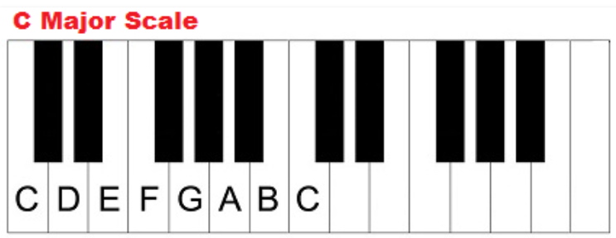
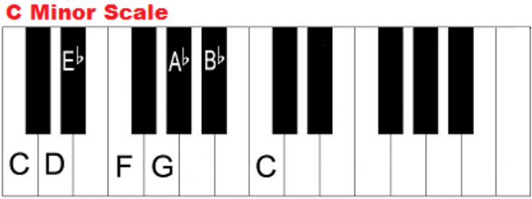


Music for Film Knowledge Organiser – Year 8 Music – Term 2a
Major Key | A musical key which sounds happy; suitable to use for comedy and kids’ films.
Minor Key | A musical key which sounds sad; suitable to use for horror and thriller films.
Leitmotif | A recurrent theme in a piece of film music which represents a character, feeling, thought or object. Think of Darth Vader or Jaws!
Diegetic | When the music/sound in a section of a film can be heard by both the audience and the characters in the film. For example: When a character is listening to a song on the radio, or when a character is at a gig.
Non-diegetic | When the music/sound in a section of film can only be heard by the audience and not the characters in the film. For example: Music which is added to create atmosphere, or the narrator is commenting on the action.
Musical Elements Checklist
Pitch | Is the piece of music in a major key or minor key? Does it suit the genre of film?
Rhythm/ Duration | Does the piece use long or short notes? Are there repeated rhythmic patterns?
Dynamics | Is the piece of music loud or quiet? Does it change throughout the piece or stay the same? What effect does this have on the audience?
Tempo | Is the piece of music fast or slow? Why has the composer chosen this tempo for this film?
Texture | Are there lots of layers to the music? Would you describe it as thick or thin? Can you used a more advanced term to describe the texture?
Timbre/ Sonority | What are the instruments you can hear in the music? Why do you think the composer has chosen those instruments?
Structure | How is the piece of music structured? Does it match well with the story of the film, or what you can see happening on screen?

Slide 10
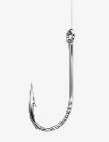

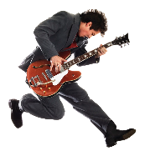
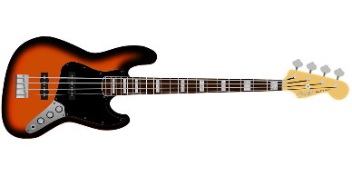



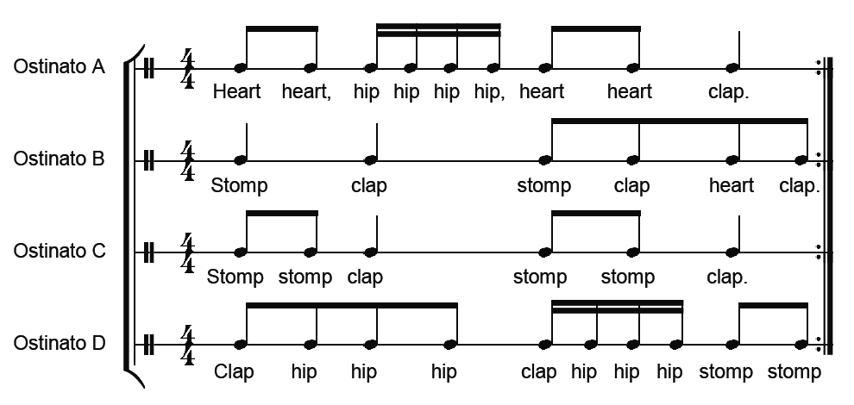
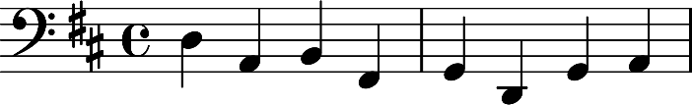
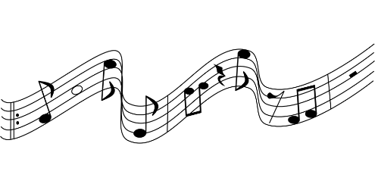
Hooks & Riffs Knowledge Organiser – Year 8 Music – Term 2b
Hook | A ‘musical hook’ is usually the ‘catchy bit’ of the song that you will remember. It is often short and used and repeated in different places throughout the piece.
Melodic Hook | A hook based on the instruments and the singers.
Rhythmic Hook | A hook based on the patterns in the drums and bass parts.
Verbal/Lyrical Hook | A hook based on the rhyming and/or repeated words of the chorus.
Riff | A repeated musical pattern often used in the introduction and instrumental breaks in a song or piece of music. Riffs can be rhythmic, melodic or lyrical, short and repeated.
Ostinato | A repeated musical pattern. The same meaning as the word riff, but used when describing repeated musical patterns in Classical and some World music.
Bassline | The lowest pitched part of the music often played on bass instruments such as the bass guitar or double bass. Riffs are often used in basslines.
Melody | The main “tune” of a song or piece of music, played higher in pitch that the bassline and it may also contain riffs or hooks. In Classical Music, the melody line is often performed with an ostinato pattern below.
Go the extra mile - spot the riff!
Can you spot the hooks, riffs or ostinatos in the following pieces of music? Search them on YouTube/Spotify and find out!
Queen | We Will Rock You
One Direction | What Makes You Beautiful
The White Stripes | Seven Nation Army
Guns ‘n Roses | Sweet Child o’ mine
Purcell | Dido’s Lament
Stevie Wonder | Superstition
Anon. | Sumer is Icumen in
Pachelbel | Canon in D
Skills Check
Can you perform the following ostinatos accurately? Clap them to a friend or your music teacher to check!

Slide 11

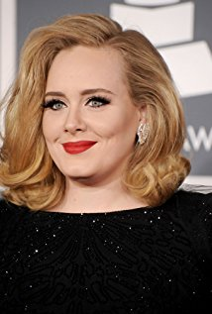


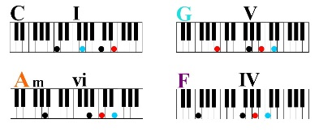

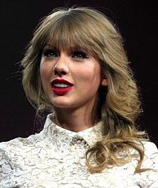
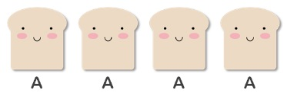
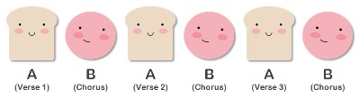
Songwriting Knowledge Organiser – Year 9 Music – Term 2a
Verse | The part of the song that sets up the chorus and tells the story.
Chorus | The part of the song that is usually the most memorable, and includes the title. This is typically the part of the song that people remember and sing along with!
Bassline | The lowest pitched part of the music often played on bass instruments such as the bass guitar or double bass. Creative and distinctive basslines make your song stand out!
Melody | The main “tune” of a song or piece of music, played higher in pitch that the bassline.
Chord Sequence | The pattern of chords used to create the harmony of the song for the melody
Lyricist | The person responsible for writing the lyrics during the songwriting process.
Strophic | A structure of a popular song which is simply Verse, Verse, Verse etc. It can also be referred to as A-A-A-A etc.
Verse-Chorus Form | A structure of a popular song which makes use of verses and choruses – there’s usually an intro, bridge and outro somewhere in there too!
Key Artists – Go the extra mile!
Adele (b.1988) | Adele is often cited as the one of the most successful female singers in history, selling over 40 million albums and 50 million singles in just five years. Here one of her most famous songs, Someone Like You, here. Can you work out the structure? https://www.youtube.com/watch?v=hLQl3WQQoQ0
Ed Sheeran (b.1991) | Ed Sheeran is a singer-songwriter, famous for his honest and emotional songwriting. His two albums ‘+’ and ‘÷’ are two of the best selling UK albums of all time. Listen to one of his most emotive songs, Supermarket Flowers, here: https://www.youtube.com/watch?v=bIB8EWqCPrQ
Taylor Swift (b.1989) | Taylor Swift is an American singer-songwriter who has her roots in Country music, and has moved more into mainstream pop music in recent years. Have a listen to her song Love Story released in 2008. Can you name the instruments used? https://www.youtube.com/watch?v=8xg3vE8Ie_E

Slide 12
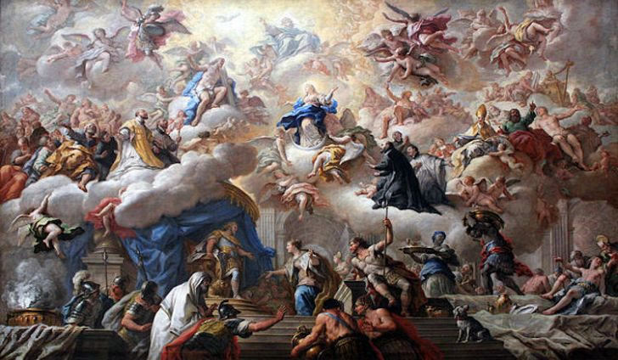
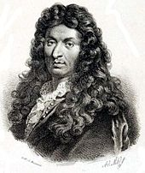
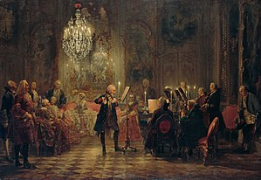

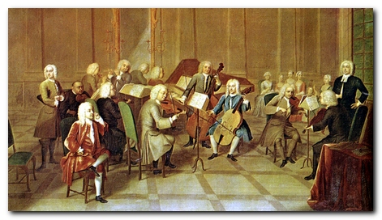
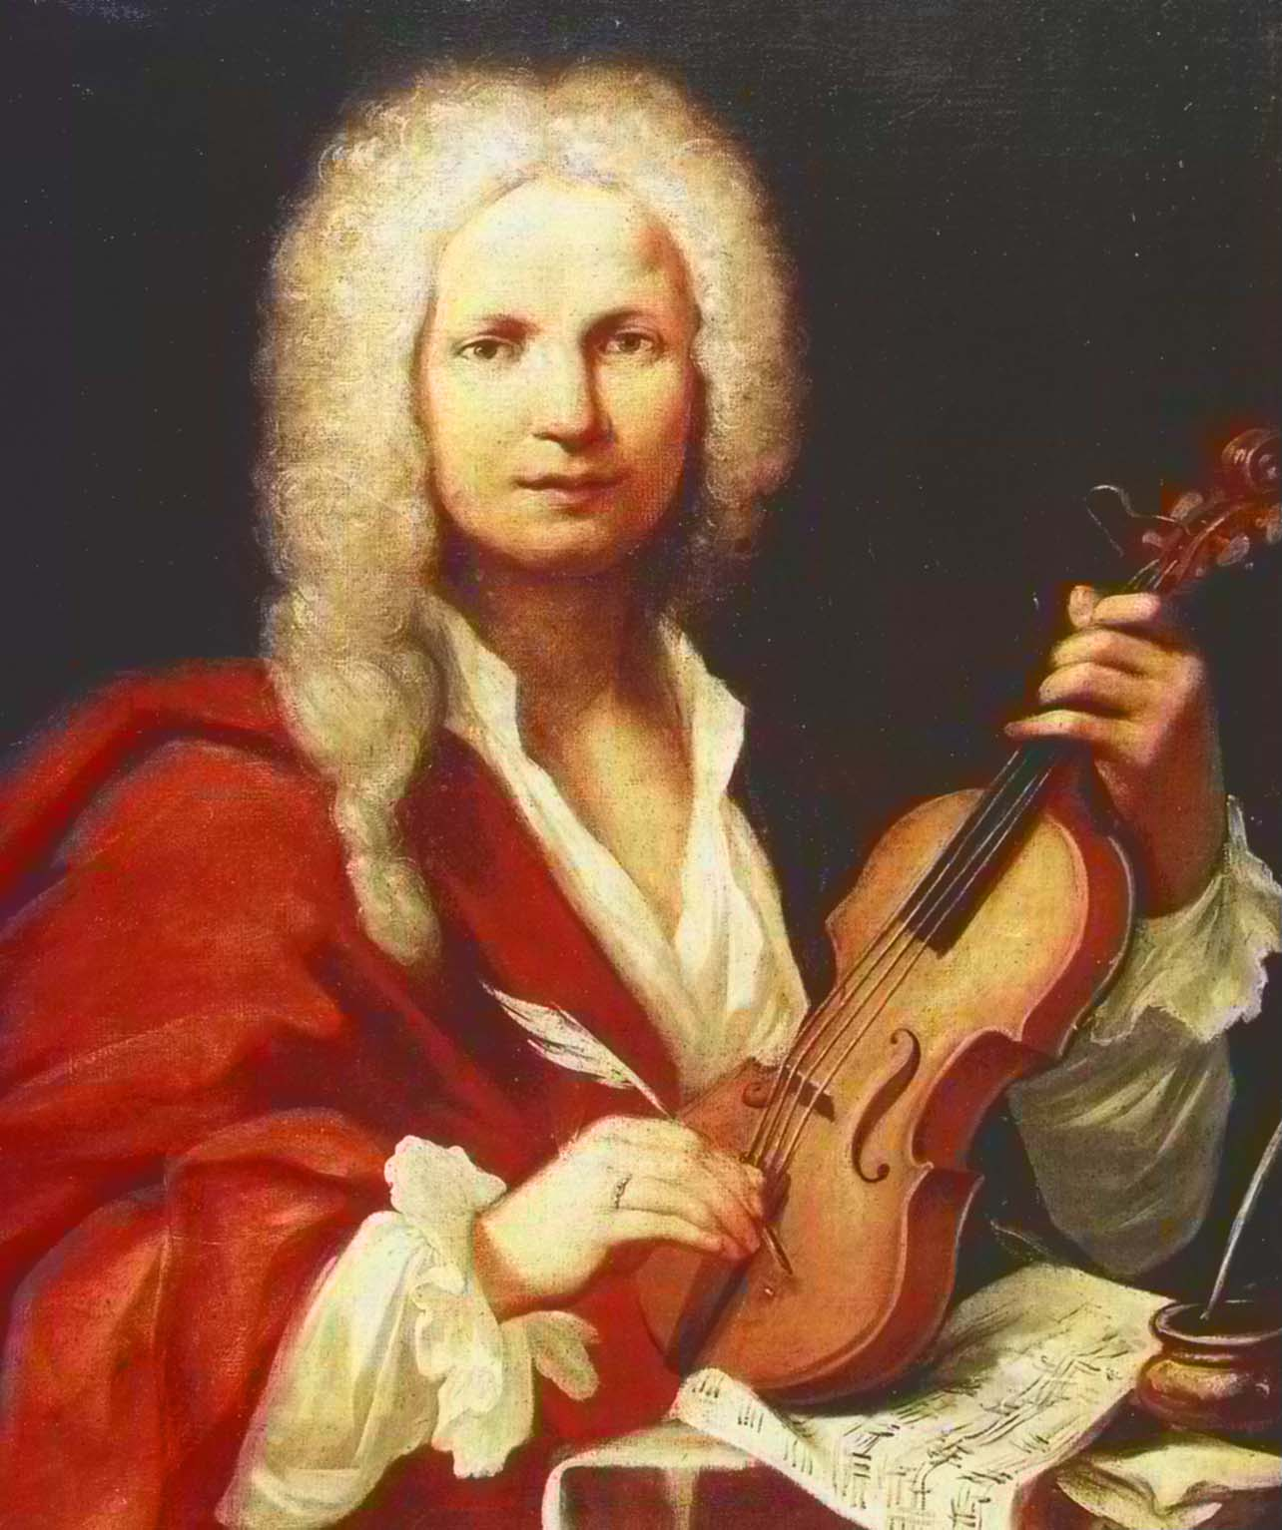
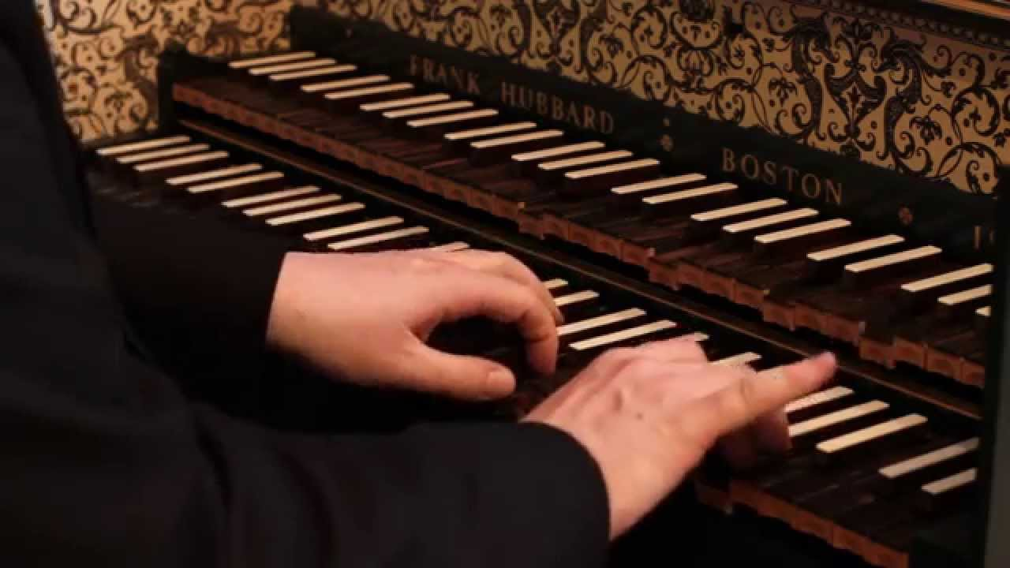
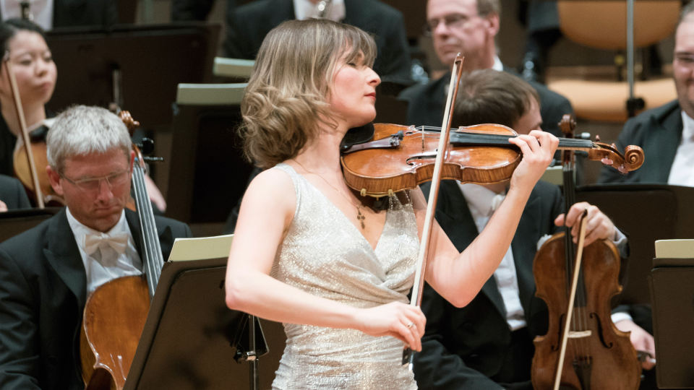
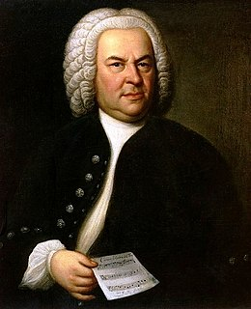
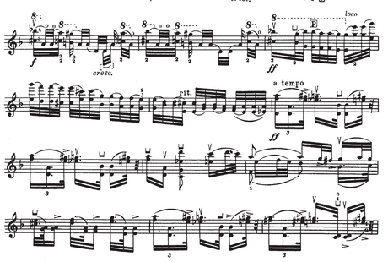
Baroque Concerto Knowledge Organiser – Year 9 Music – Term 2b & 3a
Baroque | An artistic movement including music and architecture which spans from 1600 – 1750. Key composers include Vivaldi, Handel and Bach.
Concerto | A piece of music written for a solo instrumentalist and orchestra.
Ritornello | A musical idea or theme which is recurring throughout a concerto. Translates literally as ‘returning’.
Ripieno | The name given to the whole ensemble – the full orchestra and the soloist.
Concertino | The name given to a small group of instrumentalists who perform with the ripieno, some of whom also accompany the soloist.
Soloist | The performer who plays the most complex and demanding musical part, accompanied by the concertino.
Harmonisation | The compositional process of adding chords to a melody.
Virtuosic | A term used to describe a musical composition which is complex, demanding and requires great technical skill. A performer who plays virtuosic music is known as a virtuoso.
Key Composers – Go the extra mile!
Jean-Baptiste Lully (1632-1687) | Jean-Baptiste Lully was a composer, dancer and one of the very first ’conductors’ in musical history – he notoriously died after an unfortunate incident in which he stabbed his foot with his conducting staff! He wrote a considerable number of Baroque Concerti.
Antonio Vivaldi (1678-1741) | Antonio Vivaldi was an Italian composer in the Baroque Period, most famous for his composition, The Seasons. This is a piece in four movements (sections), named after each season. See if you can identify how Vivaldi has used music to portray the features of each season!
Johann Sebastian Bach (1685-1750) | Johann Sebastian Bach was a German composer of the Baroque Period who wrote hundreds of pieces of music during his lifetime. Amongst these, he wrote a set of Brandenburg Concertos, written for the military commander of Brandenburg in 1721. Do you like them? Why?

Slide 13
Term 3

Slide 14
Musical Openings Knowledge Organiser – Year 7 Music
Program Music | A piece of music which either tells a story or describes something.
Pitch | Pitches is how high or low a piece of music, or a particular note, is.
Rhythm/ Duration | Duration/rhythm means how long or short a note is.
Dynamics | Dynamics are how loud or quiet the music is played.
Tempo | Tempo is how fast or slow a piece of music is played.
Texture | Texture describes how melodies, rhythms and harmonies are layered in a piece of music.
Timbre/ Sonority | Timbre (or sonority) describes the particular sound quality of an instrument or voice.
Structure | Structure (or form) is the overall plan of a piece of music.
It’s Theory Time!
Note Values This is a Rhythm Tree – it is designed to help you identify what the symbols for different note values are, and how they relate to one another. Here are the note values! Semibreve = 4 beats Minim = 2 beats Crotchet = 1 beat Quaver = ½ beat Semiquaver = ¼ beat Notes on the Stave Here are the notes of the treble (top line) and bass (bottom line) clefs. When the notes fall outside the five lines of music paper, we add extra lines called ledger lines. Here are some phrases to help you remember where the notes go! Treble Clef Lines: Every Green Bus Drives Fast Treble Clef Spaces: F A C E (in the space!) Bass Clef Lines: Green Buses Drive Fast Always Bass Clef Spaces: All Cows Eat Grass

Slide 15


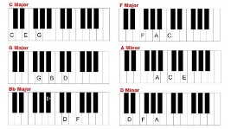






Variations Knowledge Organiser – Year 8 Music – Term 3a
Theme | The main musical or melodic idea in a piece of music.
Variation | When one or more of the musical elements are manipulated to produce a different version of the theme.
Harmonisation | The compositional process of adding chords to a melody.
Tonality | The character of a piece of music as determined by the key in which it is played or the relations between the notes of a scale or key (usually major or minor).
Retrograde | When the theme is played backwards (from end to beginning, instead of beginning to end).
Sequence | Where all or part of the theme is played a step higher or lower than the original. This example is one step higher each time.
Inversion | When descending intervals in a melody are turned into ascending intervals, and vice versa.
Augmentation | When the note values in a theme are made longer – often they are doubled. For example, crotchets becomes minims, minims become semibreves etc.
Diminution | When the note values in a theme are made shorter – often they are halved. For example, crotchets become quavers, quavers become semiquavers etc.
Musical Elements – revision time!
Test yourself on these simple definitions of the musical elements – can you remember all of them?
Pitch | How high or low a note or piece of music is.
Rhythm/Duration | How long or short the notes are in a piece of music.
Dynamics | How loud or quiet a piece of music is.
Tempo | The speed of a piece of music.
Texture | How many different parts or layers there are in a piece of music.
Timbre | The sounds or instruments used in a piece of music.
Structure | How many different sections there are in a piece of music?

Slide 16









Recycled Rhythms Knowledge Organiser – Year 8 Music – Term 3b
Pulse | The constant beat heard through a piece of music.Listening to the pulse will help you to identify the tempo of a particular piece of music.
Call & Response | A musical texture in which one part makes a ‘rhythmic’ or ‘melodic’ call, and the remainder of the ensemble respond. This is either with the same idea, or an answering phrase.
Coda | The final section of a piece of music, usually as an addition to the basic structure.
Form & Structure | A musical element which refers to the different Sections in a piece of music, and what order those sections appear in.
Cyclic Rhythm | A specific rhythmic pattern which is repeated over and over again.
Timbre/ Sonority | Timbre (or sonority) describes the particular sound quality of an instrument or voice.
STOMP – who are they and what to they do?
STOMP are a percussion group, originating in Brighton in 1991. The performers use a variety of everyday objects as percussion instruments in their shows. Listen to these clips and answer the questions relating to each one.
Newspapers (https://www.youtube.com/watch?v=7NhFmARAgu0) | What is the first instrument you hear playing a rhythm? Skip to 5:00 – what time signature does this piece of music have?
Stomp Out Loud (https://www.youtube.com/watch?v=Zu15Ou-jKM0) | Name four different objects you can see or hear being used as instruments in this clip. Imagine being a performer in this piece. What would be the greatest challenge?

Slide 17
Baroque Concerto Knowledge Organiser – Year 9 Music – Term 2b & 3a
Baroque | An artistic movement including music and architecture which spans from 1600 – 1750. Key composers include Vivaldi, Handel and Bach.
Concerto | A piece of music written for a solo instrumentalist and orchestra.
Ritornello | A musical idea or theme which is recurring throughout a concerto. Translates literally as ‘returning’.
Ripieno | The name given to the whole ensemble – the full orchestra and the soloist.
Concertino | The name given to a small group of instrumentalists who perform with the ripieno, some of whom also accompany the soloist.
Soloist | The performer who plays the most complex and demanding musical part, accompanied by the concertino.
Harmonisation | The compositional process of adding chords to a melody.
Virtuosic | A term used to describe a musical composition which is complex, demanding and requires great technical skill. A performer who plays virtuosic music is known as a virtuoso.
Key Composers – Go the extra mile!
Jean-Baptiste Lully (1632-1687) | Jean-Baptiste Lully was a composer, dancer and one of the very first ’conductors’ in musical history – he notoriously died after an unfortunate incident in which he stabbed his foot with his conducting staff! He wrote a considerable number of Baroque Concerti.
Antonio Vivaldi (1678-1741) | Antonio Vivaldi was an Italian composer in the Baroque Period, most famous for his composition, The Seasons. This is a piece in four movements (sections), named after each season. See if you can identify how Vivaldi has used music to portray the features of each season!
Johann Sebastian Bach (1685-1750) | Johann Sebastian Bach was a German composer of the Baroque Period who wrote hundreds of pieces of music during his lifetime. Amongst these, he wrote a set of Brandenburg Concertos, written for the military commander of Brandenburg in 1721. Do you like them? Why?

Slide 18
Nishkam Records Knowledge Organiser – Year 9 Music – Term 3b
Record Label | A company which signs artists – meaning they agree to promote, engage and publicise their music. By way of payment, they take a large percentage of any income from the artist, and generally own the copyrights on any music produced by the artist.
Portfolio | A collection of work designed to showcase a musician in their best light. Usually they contain their logo/promotional materials, a selection of photos, a copy of a song and a music video.
Pitch | This is an artist’s opportunity to present their music to a record label – at the end of this unit, you will pitch to a panel of VIPs to be signed to the fictional record label Nishkam Records.
Logo | A distinct design which identifies a company, brand or person as unique or individual.
Biography | A piece of writing which details information about each member of your group, and perhaps details about how/where you met, interests outside of music, and musicians who inspire or influence you.
End of Year Exam Revision – what do I need to know?
Performing and Composing (60%) | You will receive a choice of composition briefs to work on in a small group – it will be centred around the topics studied this year. Using your exercise book, revise the key features and components of each genre we have looked at. You will be assessed on how effective your piece of music is according to the style you compose in, how well you perform as a group, and how effectively you work. In the examination, your teacher will only be able to provide limited support and will not be able to give you ideas or key features of the style which you are composing in.
Listening and Appraising (40%) | You will sit a short listening exam in a GCSE style – there will be questions around the topics we have studied linked to the musical elements. Opera and Musical Theatre Celebratory Music Songwriting Baroque Concerto

