Slide 1
Autumn 1

Slide 2

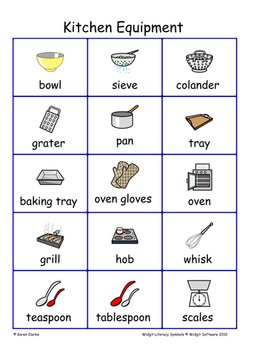
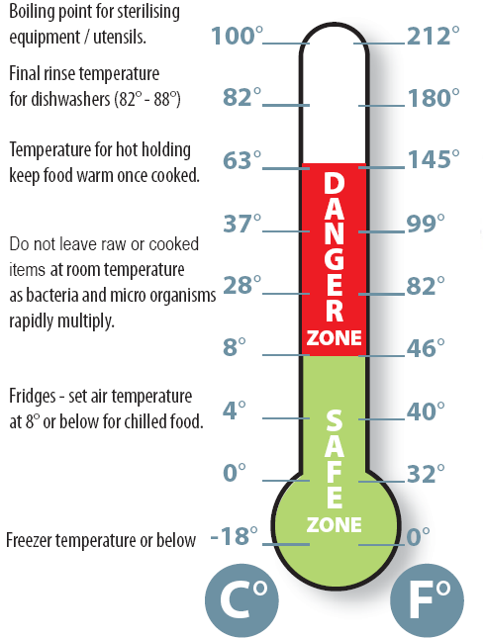
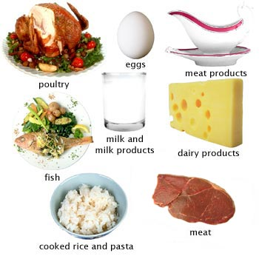
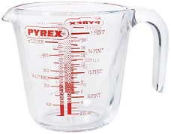
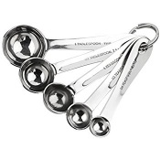
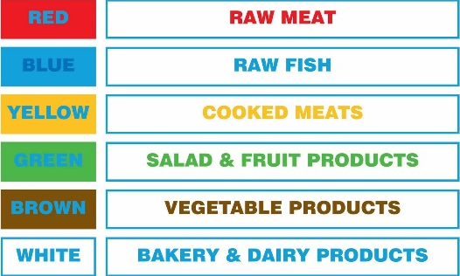
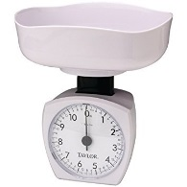
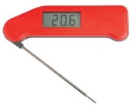
Yr. 7 Food Safety and use of equipment
Personal hygiene
Wash hands
Hair tied up
Apron on
Nails short and clean
No jewellery
Blue plaster on cuts
Tie long hair up
Storing food safely
Keep fridges and cupboards clean
Fridge temp between 1°C and 4°C and freezer temp below 18°C
Cover food
Always follow instructions and eat within the use-by-date
Keep raw meat at the bottom of the fridge to stop it dripping onto other food
No raw food next to cooked
No out of date food
No open cans
No over loading of food in containers
Safety in the food room
Handles of saucepans turned in
Mop up spills
Walk
Oven gloves on
Wipe surfaces
Wash fruit and vegetables
Store food safely
Wash equipment with hot soapy water
Bags and blazers outside, on the right
High risk foods
Weighing and measuring
Measuring jug Measuring spoons
Scales Temperature probe
Key words
Cross contamination
Temperature
Hygiene
Safety
Hazards
Bacteria
D&T: food technology

Slide 3
Yr. 8 Food Safety and use of equipment
Personal hygiene
Wash hands
Hair tied up
Apron on
Nails short and clean
No jewellery
Blue plaster on cuts
Tie long hair up
Storing food safely
Keep fridges and cupboards clean
Fridge temp between 1°C and 4°C and freezer temp below 18°C
Cover food
Always follow instructions and eat within the use-by-date
Keep raw meat at the bottom of the fridge to stop it dripping onto other food
No raw food next to cooked
No out of date food
No open cans
No over loading of food in containers
Safety in the food room
Handles of saucepans turned in
Mop up spills
Walk
Oven gloves on
Wipe surfaces
Wash fruit and vegetables
Store food safely
Wash equipment with hot soapy water
Bags and blazers outside, on the right
High risk foods
Weighing and measuring
Measuring jug Measuring spoons
Scales Temperature probe
Key words
Cross contamination
Temperature
Hygiene
Safety
Hazards
Bacteria
D&T: food technology

Slide 4
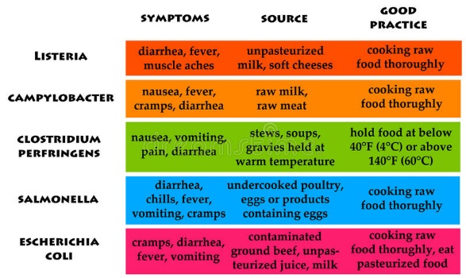
Yr. 9 Food Safety
Personal hygiene
Wash hands
Hair tied up
Apron on
Nails short and clean
No jewellery
Blue plaster on cuts
Tie long hair up
Storing food safely
Keep fridges and cupboards clean
Fridge temp between 1°C and 4°C and freezer temp below 18°C
Cover food
Always follow instructions and eat within the use-by-date
Keep raw meat at the bottom of the fridge to stop it dripping onto other food
No raw food next to cooked
No out of date food
No open cans
No over loading of food in containers
Signs of food spoilage
Bubble or foam
Slime
Fuzzy growth
Circular pattern of growth
Off odour
Discolouration
Mushy texture
Cloudy appearance
Soft spots or broken skin (on f&V)
High risk foods
Key words
Cross contamination
Temperature
Hygiene
Safety
Hazards
Bacteria
D&T: food technology

Slide 5
Autumn 2

Slide 6
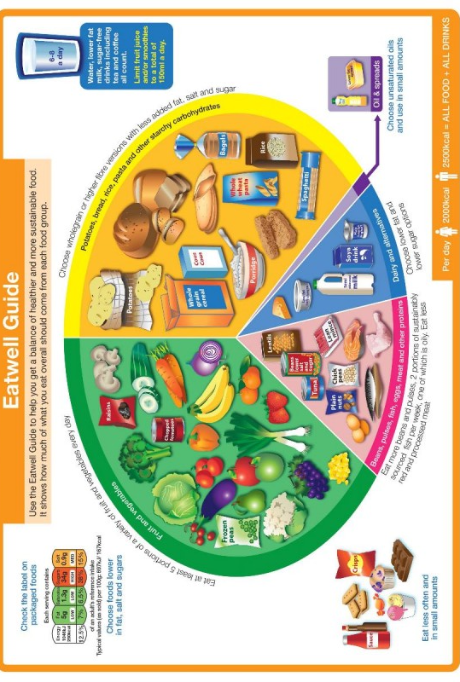
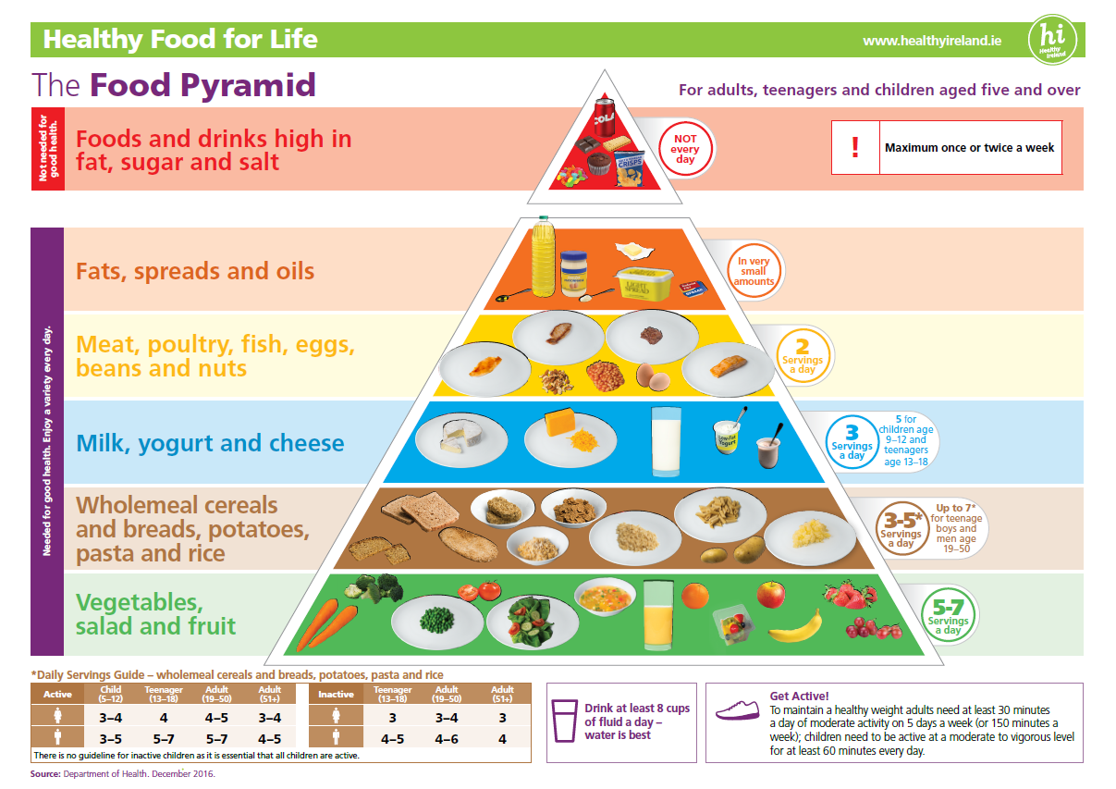
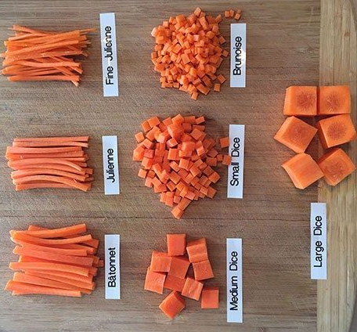
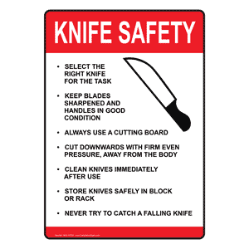
Yr. 7 Nutrition and Knife skills
Key words
Nutrients
Healthy
Balanced
Nutrition
Variety
Julienne
Batonnet
Brunoise
Claw grip
Bridge hold
Knife skills
D&T: food technology

Slide 7
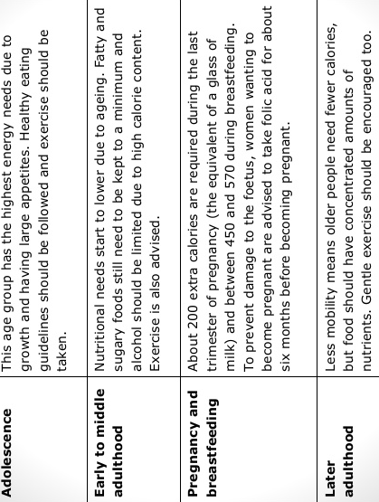
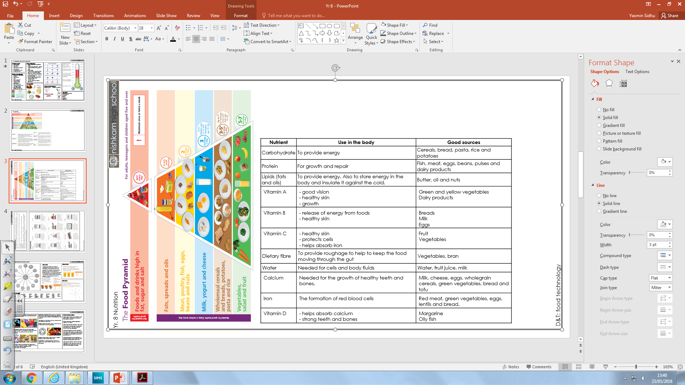
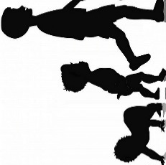
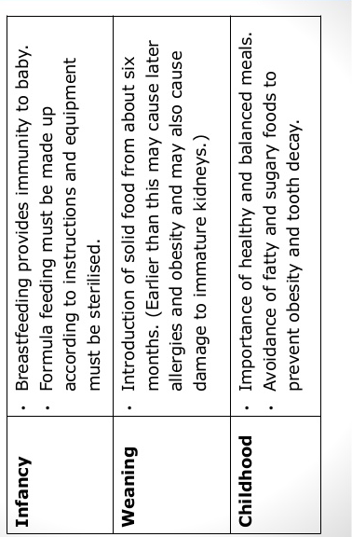

Yr. 8 Nutrition
Diet through life stages
D&T: food technology

Slide 8
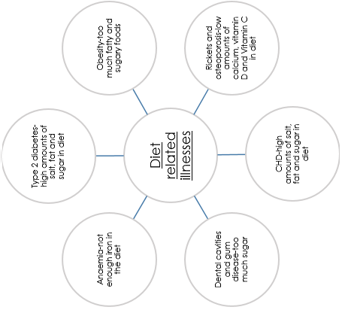
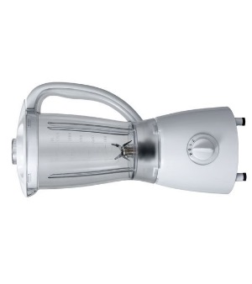
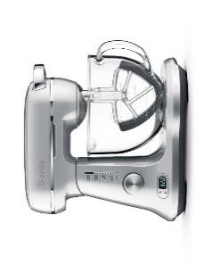
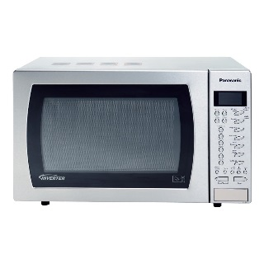
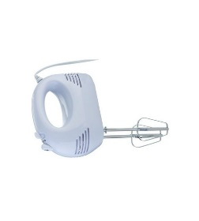
Yr. 9 Nutrition
Blender-blend ingredients and make sauces and juices
Electric mixer-making doughs and mixing ingredients
Labour saving devices
D&T: food technology
Microwave- heat up , defrost and cook food
Electric whisk-whisking foods

Slide 9
Spring1

Slide 10
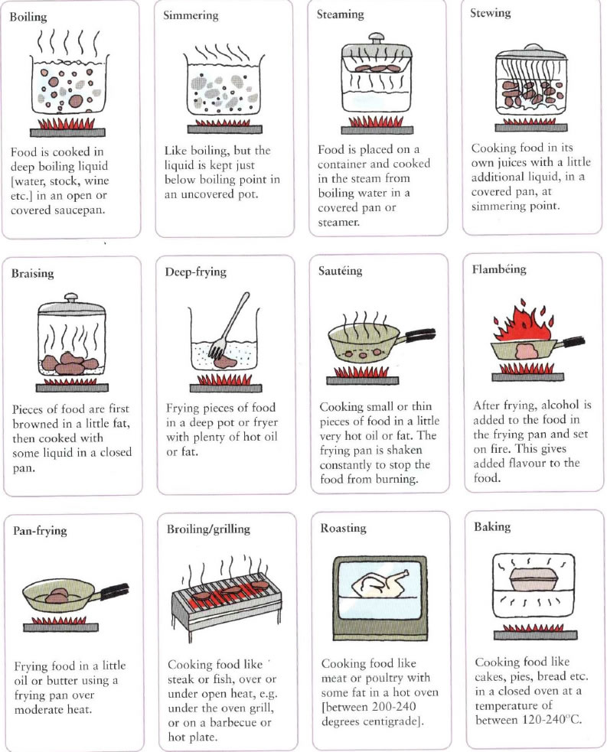
Why is food Cooked?
Yr. 7 Food Science
Why is food Cooked?
To change or improve the taste e.g. flour being used to make cake.
To change or enhance the appearance e.g. preserving strawberries to make jam
To change the texture e.g. Oats are dry, when cooked they soften and soak up moisture
To make food safer to eat e.g. eating raw eggs can cause Salmonella poisoning
To make foods more digestible e.g. hard staples such as rice, cooking these foods makes it easier for the body to use it and get all the nutrients from it
To increase the shelf life e.g. making jam
Cooking methods
D&T: food technology

Slide 11
Why is food Cooked?
Yr. 8 Food Science
Why is food Cooked?
To change or improve the taste e.g. flour being used to make cake.
To change or enhance the appearance e.g. preserving strawberries to make jam
To change the texture e.g. Oats are dry, when cooked they soften and soak up moisture
To make food safer to eat e.g. eating raw eggs can cause Salmonella poisoning
To make foods more digestible e.g. hard staples such as rice, cooking these foods makes it easier for the body to use it and get all the nutrients from it
To increase the shelf life e.g. making jam
Cooking methods
D&T: food technology

Slide 12
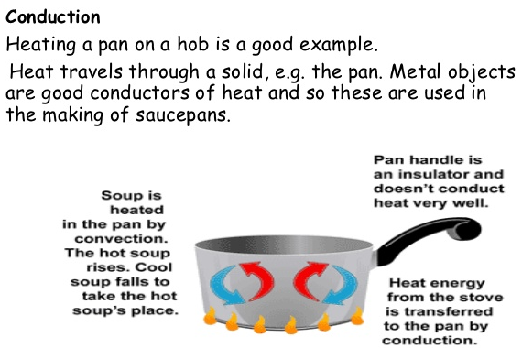
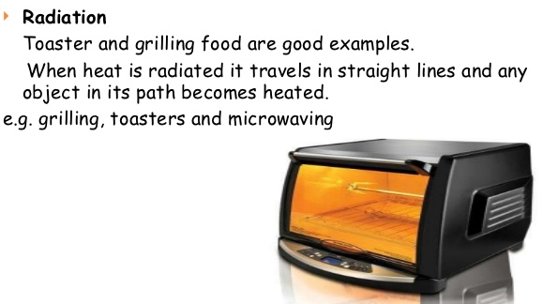
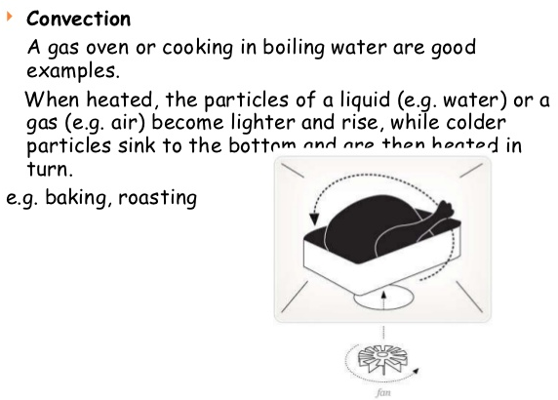
Yr. 9 Food Science
Yr. 9 Food Science
Cooking methods
Why is food Cooked?
To change or improve the taste e.g. flour being used to make cake.
To change or enhance the appearance e.g. preserving strawberries to make jam
To change the texture e.g. Oats are dry, when cooked they soften and soak up moisture
To make food safer to eat e.g. eating raw eggs can cause Salmonella poisoning
To make foods more digestible e.g. hard staples such as rice, cooking these foods makes it easier for the body to use it and get all the nutrients from it
To increase the shelf life e.g. making jam
Key words
Conduction
Convection
Radiation
Heat transfer
Insulation
D&T: food technology

Slide 13
Spring 2

Slide 14
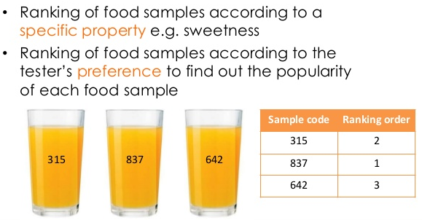
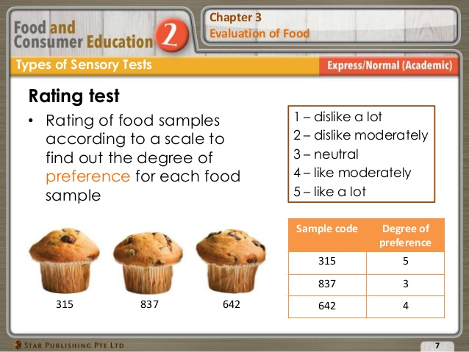
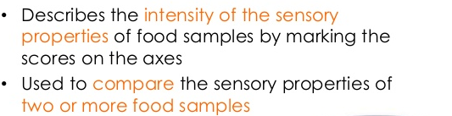
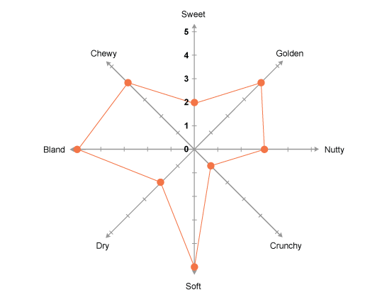
Yr. 7 Food Choice and sensory analysis
Factors which influence food choice
Physical activity level
Celebration / occasion
Cost of food
Preferences
Enjoyment
Food availability
Healthy eating
Income
Lifestyle
Seasonality
Time available
Skills
Time available to prepare
Rating tests
Products are tested for a specific characteristic to find out if there is a noticeable difference between two products. For example, manufacturers can test a new low fat version of a product to see if it is similar to the original. In one type of test the testers are given two identical products and one different product. They are asked to pick the different product.
Ranking tests
Star profile
Sensory key words
Sweet zesty sour bland spicy sharp tainted bitter tangy
Salty acidic mild rich burnt pale dull saucy dry
Crunchy crispy unripe savoury peppery pale golden lumpy grainy
Dark light hot cold creamy stale strong weak
D&T: food technology

Slide 15
Yr. 8 Food Choice and sensory analysis
Religious dietary requirements
Rating tests
Products are tested for a specific characteristic to find out if there is a noticeable difference between two products. For example, manufacturers can test a new low fat version of a product to see if it is similar to the original. In one type of test the testers are given two identical products and one different product. They are asked to pick the different product.
Ranking tests
Religion | Dietary requirement
Muslim | Halal, No pork, Alcohol prohibited Coffee/tea/stimulants avoided
Sikh | Vegetarian-no egg
Hindu | Vegetarian preferable or no beef
Christian | Catholic-No meat on Friday, fish only
Buddhist | Vegetarian diet is preferable
Judaism | No Pork and shellfish Meat and dairy at same meal prohibited
Star profile
Sensory key words
Sweet zesty sour bland spicy sharp tainted bitter tangy
Salty acidic mild rich burnt pale dull saucy dry
Crunchy crispy unripe savoury peppery pale golden lumpy grainy
Dark light hot cold creamy stale strong weak
D&T: food technology

Slide 16
Yr. 9 Food Choice and sensory analysis
Food labelling-what must be shown
the name of the food
the name and address of the manufacturer, packer or seller
instructions for use or cooking, if necessary
any necessary warnings
a ‘best before’ or ‘use by’ date (or instructions on where to find it)
net quantity information
a list of ingredients (if there is more than 1)
the country of origin, if required
the lot number or use-by date
any special storage conditions
Rating tests
Products are tested for a specific characteristic to find out if there is a noticeable difference between two products. For example, manufacturers can test a new low fat version of a product to see if it is similar to the original. In one type of test the testers are given two identical products and one different product. They are asked to pick the different product.
Ranking tests
Star profile
Sensory key words
Sweet zesty sour bland spicy sharp tainted bitter tangy
Salty acidic mild rich burnt pale dull saucy dry
Crunchy crispy unripe savoury peppery pale golden lumpy grainy
Dark light hot cold creamy stale strong weak
D&T: food technology

Slide 17
Summer 1

Slide 18

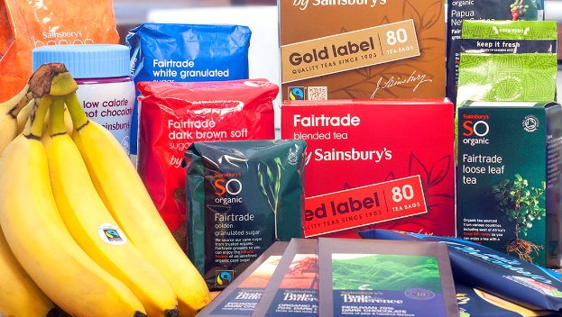
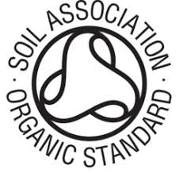
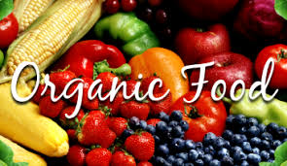
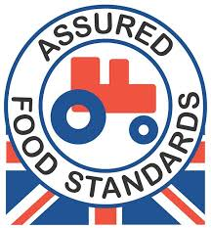
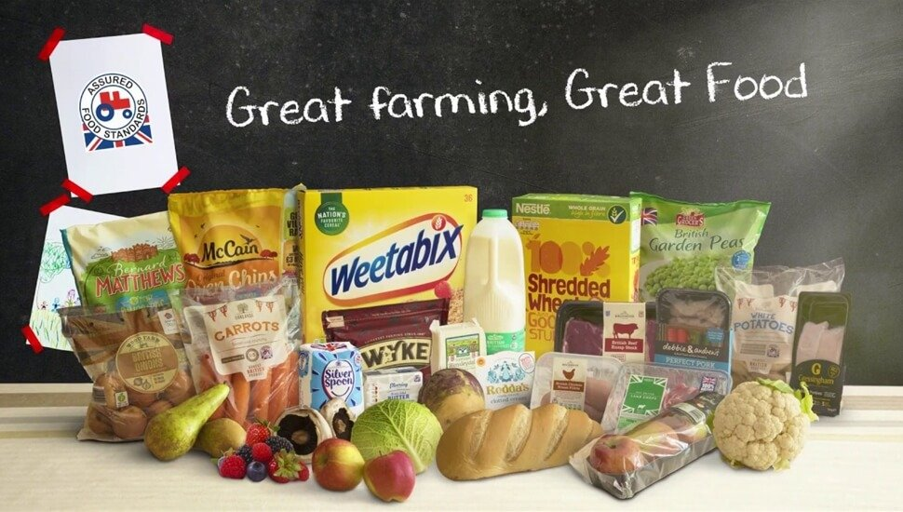
Yr. 8 Food Provenance
Fair trade food production aims to provide fair prices and better working conditions for farmers and farm workers.
Farm assured means that the farms and food companies meet high standards of food safety and hygiene, animal welfare and environmental protection.
Food miles means the distance that food travels from where it is grown to where it is bought. This is an environmental concern because of the CO₂ emissions from transport.
Genetically modified food is grown with genetic manipulation technology. Some people consider this a risk to the environment and choose GM-free products.
Free range is a method of farming where animals are allowed to roam freely.
Organic foods have been grown without the use of chemical fertilisers or pesticides.
Seasonal foods means foods that are in season. Choosing these reduces food miles
Sustainability is food production that aims to preserve the world's natural resources for future generations
Benefits of eating locally
Locally grown food is full of flavour-When grown locally, the crops are picked at their peak of ripeness
Eating local food is eating seasonally-Food is full of flavour
Local food has more nutrients- Local food has a shorter time between harvest and your table, and it is less likely that the nutrient value has decreased
Local food supports the local economy-The money that is spent with local farmers and growers all stays close to home and is reinvested with businesses and services in your community
Local food benefits the environment- By purchasing locally grown foods you help maintain farmland and less air miles
Local growers can tell you how the food was grown-When you know where your food comes from and who grew it, you know a lot more about that food
D&T: food technology

Slide 19
Yr. 9 Food Provenance
Fair trade food production aims to provide fair prices and better working conditions for farmers and farm workers.
Farm assured means that the farms and food companies meet high standards of food safety and hygiene, animal welfare and environmental protection.
Food miles means the distance that food travels from where it is grown to where it is bought. This is an environmental concern because of the CO₂ emissions from transport.
Genetically modified food is grown with genetic manipulation technology. Some people consider this a risk to the environment and choose GM-free products.
Free range is a method of farming where animals are allowed to roam freely.
Organic foods have been grown without the use of chemical fertilisers or pesticides.
Seasonal foods means foods that are in season. Choosing these reduces food miles
Sustainability is food production that aims to preserve the world's natural resources for future generations
Benefits of eating locally
Locally grown food is full of flavour-When grown locally, the crops are picked at their peak of ripeness
Eating local food is eating seasonally-Food is full of flavour
Local food has more nutrients- Local food has a shorter time between harvest and your table, and it is less likely that the nutrient value has decreased
Local food supports the local economy-The money that is spent with local farmers and growers all stays close to home and is reinvested with businesses and services in your community
Local food benefits the environment- By purchasing locally grown foods you help maintain farmland and less air miles
Local growers can tell you how the food was grown-When you know where your food comes from and who grew it, you know a lot more about that food
D&T: food technology

Slide 20
Yr. 7 Food Provenance
Fair trade food production aims to provide fair prices and better working conditions for farmers and farm workers.
Farm assured means that the farms and food companies meet high standards of food safety and hygiene, animal welfare and environmental protection.
Food miles means the distance that food travels from where it is grown to where it is bought. This is an environmental concern because of the CO₂ emissions from transport.
Genetically modified food is grown with genetic manipulation technology. Some people consider this a risk to the environment and choose GM-free products.
Free range is a method of farming where animals are allowed to roam freely.
Organic foods have been grown without the use of chemical fertilisers or pesticides.
Seasonal foods means foods that are in season. Choosing these reduces food miles
Sustainability is food production that aims to preserve the world's natural resources for future generations
Benefits of eating locally
Locally grown food is full of flavour-When grown locally, the crops are picked at their peak of ripeness
Eating local food is eating seasonally-Food is full of flavour
Local food has more nutrients- Local food has a shorter time between harvest and your table, and it is less likely that the nutrient value has decreased
Local food supports the local economy-The money that is spent with local farmers and growers all stays close to home and is reinvested with businesses and services in your community
Local food benefits the environment- By purchasing locally grown foods you help maintain farmland and less air miles
Local growers can tell you how the food was grown-When you know where your food comes from and who grew it, you know a lot more about that food
D&T: food technology

