Slide 1
Autumn 1
Year 7
Year 8
Year 9

Slide 2
Punjabi Year 7 Autumn Term 1
1. Punjabi Alphabet
2. Punjabi Alphabet’s sounds
ੳ | ਅ | ੲ | ਸ | ਹ
Urha | Aerha | Eerhi | Sassa | Haha
U/O | A | I | S | H
ਕ K | ਖ KH | ਗ G | ਘ GH | ਙ NG
Kakka | Khakha | Gagga | Ghagha | Nganga
K | KH | G | GH | NG
ਚ CH | ਛ CHH | ਜ J | ਝ JH | ਞ NJ
Chacha | Chhechha | Jajja | Jhajha | Jnayan
CH | CHH | J | JH | NJ
ਟ T | ਠ TH | ਡ D | ਢ DHH | ਣ N
Tainka | Thatha | Dadda | Dhada | Nannha
T | TH | D | DHH | N
ਤ T | ਥ TH | ਦ D | ਧ DH | ਨ N
Tatta | Thatha | Dadda | Dhada | Nanna
T | TH | D | DH | N
ਪ P | ਫ PH/F | ਬ B | ਭ BH | ਮ M
Pappa | Phaphha | Babba | Bhabha | Mamma
P | PH/F | B | BH | M
ਯ Y | ਰ R | ਲ L | ਵ V/W | ੜ RH
Yayya | Rarra | Lalla | Vavva | Rharha
Y | R | L | V/W | RH

Slide 3
1. Key words
nwm | Naam | Name
ivckwrlw | Vichkarla | Middle
KwndwnI | Khaandani | Family name
isMG | Singh | Singh
kOr | Kaur | Kaur
mwqw | Mata | Mom
ipqw | Pita | Dad
BYx | Bhen | Sister
Brw | Bhra | Brother
dwdw | Dada | Dad’s dad
dwdI | Dadi | Dad’s mon
nwnw | Nana | Mom’s dad
nwnI | Nani | Mom’s mom
cwcw | Chacha | Dad’s younger brother
cwcI | Chachi | Dad’s younger brother’s wife
qwieAw | Taaya | Dad’s elder brother
qweI | taayi | Dad’s elder brother’s wife
Punjabi Year 8 Autumn 1
Myself/ Family
2. Adjectives
SuglI | shugli | Funny
iemwndwr | imaandaar | Honest
imhnqI | Mehnti | Hardworking
sKq | sakht | Strict
shuxw | Sahuna | Beautiful
pqlw | petla | slim
cMgw | changaa | nice
3.Useful negatives
myry kol nhIN hY | Mere kol nahi hai | I don’t have any
mYN psMd nhIN krdw/krdI | Mai psand nahi kerda/kerdi | I don’t like
mYN nhIN cwhuMdw | Mai nahi chahunda | I don’t want
4. Connectives
Aqy And ate
ikauNik Because keeyukey
pr But per
jykr if jeyker

Slide 4
Punjabi Year 9 Autumn Term 1
Topic: Technology
1. Key vocabulary
2. Using Connectives
Aqy And | audwhrx dy qOr qy For Example
pr But | nqIjy vjoN As a result
ikauNik Because | iPr Then
ies leI That’s why | vI Also
5. Opinions
Like | psMd
really like | bhuq psMd
don’t like | nhIN psMd
Opinions
bhuq vDIAw hY | It’s really good
bhuq vDIAw hY | It’s too good
iblkul psMd nhIN krdw | I hate it
Technology | qknIk
Social media | soSl mIfIAw
Use | vrqxw
Advantages | Pwiedy
Disadvantages | nukswn
Easy and better life | sOKI Aqy vDIAw izMdgI
Saves time | smyN dI bcq
Conversation | g`lbwq kr skdy ho
Easy life | izMdgI sOKI ho jWdI
Isolation | v`K hoxw
Unemployment | byruzgwrI
Loneliness | ie``klwpx
6. Useful negtives
myry kol nhIN hY | I don’t have any
mYN nhIN psMd krdw/krdI | I don’t like
3. Using Connectives
Aqy And | audwhrx dy qOr qy For Example
pr But | nqIjy vjoN As a result
ikauNik Because | iPr Then
ies leI That’s why | vI Also
7.Key questions
ku`J hor? | Anything else?
ikMny dw? | How much is it?
kI qusIN ies nUM psMd krdy ho? | Do you like this?
ikhVw rMg? | Which colour?
4.Key conjunctions
First of all | sB qoN pihlW
Then | iPr
After | bwAd iv``c

Slide 5
Autumn 2
Year 7
Year 8
Year 9

Slide 6
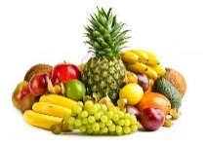
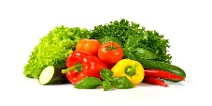
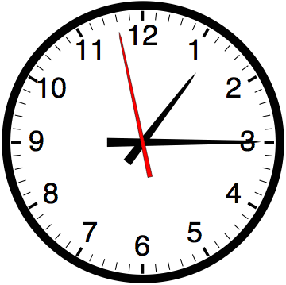
1. Fruits Pl Phal
syb seb Apple Anwr anaar Pomegranate
kylw kela Banana hdvwxw hadvana Watermelon
AMb anb Mango KurmwnI khurmani Apricot
AMgUr angoor Grapes KzUr khajoor Dates
nwSpwqI nashpati Pear AwlU buKwrw aaloo bukhara Plum
Punjabi Year 7 Autumn Term 2
4. Days of the week Monday | Somvaar | somvwr
Tuesday | Mangalvaar | mMglvwr
Wednesday | Budhvaar | bu`Dvwr
Thursday | Veervaar | vIrvwr
Friday | Shukarvaar | Su`krvwr
Saturday | Sanichrvaar | sin``crvwr
Sunday | aitvaar | AYqvwr
2. sbzIAW sabzeeaan vegetables
AwlU aaloo Potatoes gMFw gandhaa Onion
l``sx lasan Garlic ADrk adhrak Ginger
tmwtr tamater Tomatoes mtr matar Peas
gwjr gaajar Carrot iBMfI bhindi Okra
Slgm shalgum Turnip imrc mirch Chilli
Pu``l goBI phullgobhee Cauliflower
iSmlw imrc Shimla mirch peppers
5. Colours
Red | Laal | lwl
Blue | Neela | nIlw
Green | Hara | hrw
Yellow | peela | pIlw
Purple | jaamni | jwmxI
black | kala | kwlw
White | Chita | ic`tw
3. Time
Quarter past sava svw
Quarter to pouney pOxy
Half past saadey swF

Slide 7
1. Key words: Free time
Punjabi Year 8 Autumn 2
Free time activities/daily routine
Playing football | Football khedna | Pu``tbwl Kyfxw
Gardening | Baagvani kerna | bwgvwnI krnw
Playing Piano | Piano vajauna | ipAwno vjwauxw
Skipping | Rasi tapna | r``sI tpxw
Writing | Likhna | ilKxw
Dancing | Nachna | n``cxw
Listening to radio | Radio sunna | ryfIE suxnw
Watching TV | TV dekhna | tI vI dyKxw
Doing exercise | Kesrat kerna | ksrq krnw
Playing cards | Taash kedna | qwS Kyfxw
Reading newspaper | Akhbaar perna | AKbwr pVHxw
Reading a book | Kitaab perna | ikqwb pVHxw
Swimming | Terna | qrnw
Using computer | Computer tey kanm kerna | kMipaUtr qy kMm krnw
Relax | Aaram kerna | Arwm krnw
2. Daily ruoutine key words
sONxw Souna sleeping
jwgxw Jaagna wake up
k`pVy pwauxw Keprey pauna to put on clothes
dMd swP krnw Dand saaf kerna brush your teeth
nhwauxw Nahuna have a shower
skUl jwxw School jaana going to school
3. Verbs: To do
I do mai…..kerda/kerdee mYN krdw You do tusi…..kerdey qusIN krdy He does uh……..kerda auh krdw She does uh…….kerdee auh krdI We do asi…….kerdey AsIN krdy You do tusi…..kerdey qusIN krdy They do uh……..kerdey auh krdy
Playing games | Game khedna | gym Kyfxw
Going Shopping/cinema | Shopping/cinema jaana | SOipMg jwxw
Listening to music | Gaaney sunna | gwxy suxnw

Slide 8
Punjabi Year 9 Autumn term 2 Topic: Healthy Living 1. Fruits Pl Phal
Anwr Pomegranate | syb Apple
Kylw Banana | AMb Mango
hdvwxw Watermelon | AMgUr Grapes
KurmwnI Apricot | KzUr Dates
AwlU buKwrw Plum | nwSpwqI nashpati
3. Opinions
I like to eat | mYN …… Kwxw psMd
I don’t like to eat | mYN …… Kwxw nhIN psMd
I hate to eat | mYN …… Kwxw iblkul nhIN psMd
I think | myry iKAwl nwl
My favourite | myrw mnpsMd
6. KEY WORDS
Healthy ishqmMd
Unhealthy ishqmMd nhIN
Exercise ksrq
Swimming qrnw/qYrnw
Salt lUx
Fresh qwzw/qwzIAW
Boiled aublIAW
2. sbzIAW vegetables
AwlU Potatoes | ADrk Ginger
l``sx Garlic | imrc Chilli
tmwtr Tomatoes | Pu``l goBI Cauliflower
Gwjr Carrot | iSmlw imrc peppers
iBMfI Okra | gMFw Onion
Slgm Turnip | mtr Peas
4. Healthy life
ksrq krnw doing exercise
Pl Kwxw eating fruit
pwxI pIxw drinking water
qwzw Kwxw eating fresh food
qurnw walking
KuS rihxw be happy
5. Unhealthy life
tI vI dyKxw watching tv
gymW Kyfxw playing games
jMk Kwxw eating junk food
su``qy rihxw being sleeping
susq rihxw being lazy

Slide 9
Spring 1
Year 7
Year 8
Year 9

Slide 10


1. Vocabulary
1. School subjects (school dey vishey)
AMgryzI Angreji English
pMjwbI Punjabi
PrYNc French
ihswb Hisaab Maths
BUgol Bhugol Geography
ieiqhws Itihaas History
srIirk is``iKAw Sarirak sikhiaa PE
Dwrimk is``iKAw Dharmik sikhiaa RF
klw Kala Ary
sMgIq Sangeet Music
ivigAwn Vigiaan Science
Punjabi Year 7
Spring Term 1
Topic: School
3. Opinions
myrw mnpsMd ivSw………hY ? mera manpsand visha……hai
myrw iKAwl Anuswr ieh……mere khiyaal anusaar ihe
vDIAw vadiyaa
AOKw aoukha
bhuq vDIAw bahut vadiyaa
sOKw soukha
ikauNik kiyukey
idlcsp dilchasp
boirMg boaring
Aqy ate
pr per
My favourite subject is.....?
I think it’s.....
good
difficult
great
easy
difficult
interesting
boring
and
but
2. School uniform (school dee verdee)
trwaUzr trousers
kmIz kameez shirt
tweI tie
blyzr blazer
skrt skirt
kotI koti cardigan
tI Srt t-shirt
svYtr jumper
frYs dress
ju`qI jutti shoes
trynr trainers
jurwbW jurabaan shocks

Slide 11
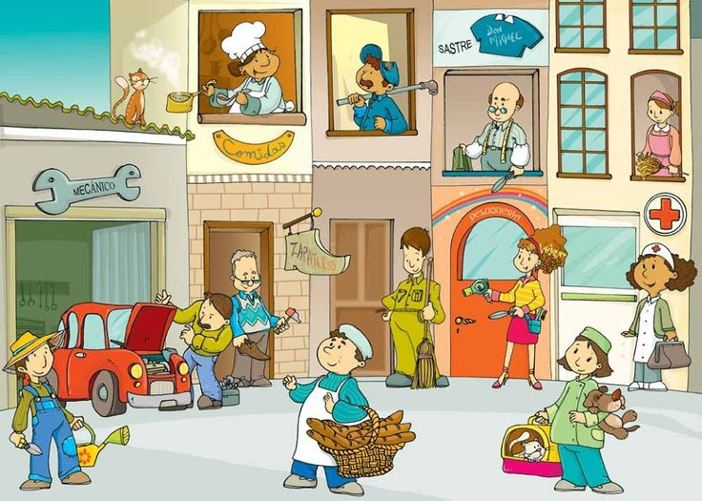
Punjabi Year 8 Spring Term 1 Topic JOBS
1: vocabulary
2. I will become………….
Masculine
Mai …………Banagaa.
mYN …………bxWgw [
Feminine
Mai ………..banagee
mYN………… bxWgI [
5. Useful verbs: To be
I am mai.. haan mYN… hW
He is uh.. hai auh… hY
She is uh.. hai auh… hY
We are asi.. hun AsIN… hn
You are tusi..ho qusIN… ho
They are uh.. hun auh… hn
Useful verbs: To want
I want mai chundaa/chundee mYN cwhuMdw/cwhuMdI
You want tusi..chundey qusIN………cwhuMdy
He want uh ….. Chundaa auh……cwhuMdw
She want uh ….. Chundee auh……cwhuMdI
They want uh ….. Chundey auh……cwhuMdy
We want asi……. Chundey AsIN……cwhuMdy
Doctor | Dactar | fwktr
Lawler | Vakeel | vkIl
Builder | Mistree | imsqrI
Barber | Naee | nweI
Gardener | Malee | mwlI
Postman | Dakeeya | fwkIAw
Cashier | Khjanchee | KzwncI
Magician | Jadoogar | jwdUgr
Opticition | Aenak Saaj | AYnk swz
Player | Khidaree | iKfwrI
Actor | Kalakaar | klwkwr
Social worker | Samaj Sevek | smwj syvk
3. Using Connectives
Aqy ate And | audwhrx dy qOr qy Udahran dey tor tey For Example
pr per But | nqIjy vjoN nateejey vajo As a result
ikauNik kiyukey Because | iPr phir Then
ies leI iss layee That’s why | vI vee Also
Dentist | Danda daa dacter | dMdW dw fwktr
Farmer | Kisaan | ikswn
Nurse | Nurse | nrs
Waiter | Behraa | bihrw
Carpenter | Terkhan | qrKwx
Driver | Sanchalk | sMcwlk
Writer | Lekhak | lyKk
Reporter | Peterkar | p``qrkwr
Singer | Gayek | gwiek
Office worker | Defter vich kanm kerna | dPqr iv``c kMm krnw
Teacher | Adhiapak | AiDAwpk
Chef | Khana pkaun wala | Kwxw pkwaux vwlw
4. Opinions
Like | Pasand | psMd
A lot of Money | Paisey bahut hun | pYsy bhuq hn
Parents wants it | Mata pita chundey | mwqw ipqw cwhuMdy
Hobby | Shounk | SOk

Slide 12
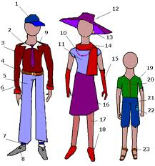
Punjabi Year 9 Spring 1 Topic
Shopping/money/fashion
Key Vocabulary
1trwaUzr trousers
2 kotI cardigan
3 kmIz shirt
4 kot coat
5 tweI tie
6 tI Srt t-shirt
7 frYs dress
8 ju``qI shoes
9 jurwbW socks
10 trynr trainers
11 jMpr jumper
12 Sots shorts
13 kotI cardigan
14 jYikt jacket
15 bYlt belt
16 skwrP scarf
17 topI hat
18 bUt boot
19 dsqwny gloves
20 skrt skirt
8. Quiz
4. Verbs
mYN igAw/geI I went
mYN jwxw hY (to) go
KrIdxw (to) buy
dyKxw/imlxw (to) visit
pwauxw (to) wear
5. Adjectives
mihMgw Expensive
ssqw Cheap
nvW New
purwxw Old
vDIAw nice
shuxw beautiful
6.Useful negatives
myry kol nhIN hY I don’t have any
mYN psMd nhIN krdw/krdI I don’t like
mYN nhIN cwhuMdw I don’t want
7. Key questions
ikMny dw? How much is it?
qusIN iesnMU psMd krdy ho? Do you like this?
ikhVw rMg? What colour?
kuJ hor Anything else?
2. Opinions
(masculine/feminine)
psMd krdw I like (m)
psMd krdI I like (f)
nhIN psMd krdw I don’t like (m)
nhIN psMd krdI I don’t like (f)
bhuq psMd krdw I really like (m)
bhuq psMd krdI I really like (f)
3. Money
ie`k one
hzwr thousand
poNf pound
rupieAw rupee
sO hundred

Slide 13
Spring 2
Year 7
Year 8
Year 9

Slide 14

1. Key words
Playing football | Football khedna | Pu``tbwl Kyfxw
Gardening | Baagvani kerna | bwgvwnI krnw
Playing Piano | Piano vajauna | ipAwno vjwauxw
Skipping | Rasi tapna | r``sI tpxw
Writing | Likhna | ilKxw
Dancing | Nachna | n``cxw
Listening to radio | Radio sunna | ryfIE suxnw
Watching TV | TV dekhna | tI vI dyKxw
Doing exercise | Kesrat kerna | ksrq krnw
Playing cards | Taash kedna | qwS Kyfxw
Reading newspaper | Akhbaar perna | AKbwr pVHxw
Reading a book | Kitaab perna | ikqwb pVHxw
Swimming | Terna | qrnw
Using computer | Computer tey kanm kerna | kMipaUtr qy kMm krnw
Relax | Aaram kerna | Arwm krnw
Punjabi Year 7 Spring 2
Free time activities
2. Using Connectives
Aqy ate And | audwhrx dy qOr qy Udahran dey tor tey For Example
pr per But | nqIjy vjoN nateejey vajo As a result
ikauNik kiyukey Because | iPr phir Then
ies leI iss layee That’s why | vI vee Also
3. Verbs: To do
I do mai…..kerda/kerdee mYN krdw You do tusi…..kerdey qusIN krdy He does uh……..kerda auh krdw She does uh…….kerdee auh krdI We do asi…….kerdey AsIN krdy You do tusi…..kerdey qusIN krdy They do uh……..kerdey auh krdy
Playing games | Game khedna | gym Kyfxw
Going Shopping/cinema | Shopping/cinema jaana | SOipMg jwxw
Listening to music | Gaaney sunna | gwxy suxnw

Slide 15

Punjabi Year 8 Spring 2 Topic: Food
2. sbzIAW sabzeeaan vegetables
AwlU aaloo Potatoes gMFw gandhaa Onion
l``sx lasan Garlic ADrk adhrak Ginger
tmwtr tamater Tomatoes mtr matar Peas
gwjr gaajar Carrot iBMfI bhindi Okra
Slgm shalgum Turnip imrc mirch Chilli
Pu``l goBI phullgobhee Cauliflower iSmlw imrc Shimla mirch peppers
6. KEY WORDS
Healthy sehatmand
ishqmMd
Unhealthy sehatmand nahi
ishqmMd nhIN
Exercise kesrat
ksrq
Water paani
pwxI
Fruit phal
Pl
Vegetable sabzi
sbzI
Walk turna/turan
qurnw
Swimming tairna
qrnw/qYrnw
Fresh taaza
qwzw/qwzIAW
Boiled ubliyaan
aublIAW
Salt loon
lUx
1. Fruits Pl Phal
syb seb Apple Anwr anaar Pomegranate
kylw kela Banana hdvwxw hadvana Watermelon
AMb anb Mango KurmwnI khurmani Apricot
AMgUr angoor Grapes KzUr khajoor Dates
nwSpwqI nashpati Pear AwlU buKwrw aaloo bukhara Plum
4. Healthy life
ksrq krnw kesrat kerna doing exercise
Pl Kwxw phal khana eating fruit
pwxI pIxw paani peena drinking water
qwzw Kwxw taaza khana eating fresh food
qurnw turna walking
KuS rihxw khush rehna be happy
3. Opinions
I like to eat mYN …… Kwxw psMd mai ……..khana psand
I really like to eat mYN …… Kwxw bhuq psMd mai …….khana bhuat psand
I don’t like to eat mYN …… Kwxw nhIN psMd mai ……..khana nahi psand
I hate to eat mYN …… Kwxw iblkul nhIN psMd mai ……..khana bilkul nahi psand
I think myry iKAwl nwl mere khiaal naal
My favourite myrw mnpsMd mera manpsand
eg: mYN syb Kwxw psMd krdw (masculine) krdI (feminine) hW [
Mai seb khana psand kerda/kerdi haan. I like to eat apple.
5. Unhealthy life
tI vI dyKxw tv dekhna watching tv
gymW Kyfxw geman kehdna playing games
jMk Kwxw junk khana eating junk food
su``qy rihxw suthey rehna being sleeping
susq rihxw susat rehna being lazy

Slide 16
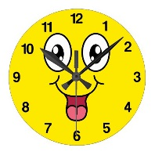

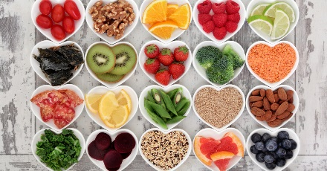

1.Time and Frequency Phrases
grmIAW iv`c in summer
AwmqOr qy normally
kdI kdI sometimes
hmySw always
rwq nUM at nignt
Punjabi Year 9 Spring 2
Holidays
Cu``tIAW
9.Question words
ikMny? ikMnw? ikvyN? kdoN? ik`Qy? ikhVw? kOx? ikauN?
5. Adjectives
mihMgw Expensive
ssqw Cheap
gMdw Dirty
swP Clean
suAwd Delicious
boirMg Boring
purwxw Old
mzw Fun
vDIAw nice
6. Vocabulary
idlcsp Interesting smuMdrI jhwz Ship
hvweI A`fw Airport ikSqI Boat
Kws Special
itkt Ticket
icVIAw Gr Zoo
qMbU tent
7. Verbs
mYN igAw/geI I went
mYN jwxw hY (to) go
KrIdxw (to) buy
dyKxw/imlxw (to) visit
Poto iKcxw (to) take photo
qrnw (to) swim
qurnw walk
10. Giving Opinions
myry iKAwl iv`c In my opinion
psMd Like
mYnUM psMd nhIN I don’t like
mYN cwhuMdw/cwhuMdI I prefer
2. Weather
Du``p Sunny
grm Hot
mOsm cMgw The weather's nice
mOsm cMgw nhIN The weather's bad
mINh Raining
qyz hvw Windy
brP Snow/ice
8. The Present Tense
The present tense(s) of the regular and irregular verbs listed in the contexts
hY, hW, hn
The Past Tense
The past tense(s) of the regular and irregular verbs listed in the contexts
sI, sn
The Future Tense
The future tense(s) of the regular and irregular verbs listed in the contexts
gw, gy, gI
11 Nouns
smuMdr The beach
phwV The mountain
lok The people
Kwxw The food
Sihr City
ipMf Village
pMjwb Punjab
AMimRqsr Amirtsar
3. Days of the week
somvwr Monday
mMglvwr Tuesday
bu`Dvwr Wednesday
vIrvwr Thursday
Su`krvwr Friday
Sin`crvwr Saturday
AYqvwr Sunday
4. Connectives
Aqy And
ikauNik Because
pr But
jykr if

Slide 17
Summer 1
Year 7
Year 8
Year 9

Slide 18
1 key vocabulary
Gr | Ghar | House
guslKwnw | Gusalkhana | Bathroon
sOx vwlw kmrw | Soun wala karma | Bedroom
rsoeI | Rsoiee | Kitchen
Kwx vwlw kmrw | Khan wala karma | Dining room
bYTx vwlw kmrw | Baithan wala karma | Living room
hwl | Haal | Hall
pOVIAW | Poriyaan | Stairs
bgIcw | Bgeecha | Garden
gYirj | Garage | Garage
dPqr | Dafter | Office/study
mMizlW | manjilaan | Floors
Punjabi Year 7 Summer 1
Topic: My Home
3. Useful Connectives
qW | taan | Then
ikauNik | keeyokee | Because
ies leI | Iss layee | That’s why
Aqy | Ate | And
pr | per | but
nqIjy vjoN | Nateejey vajo | As a result
audwhrx dy qOr qy | Udhran dey tor tey | For example
2. Useful adjectives
v`fw | Vada | Big
swP | Saaf | Clean
vDIAw | Vadhyaa | Nice
nvW | Navan | New
bhuq v`fw | Bahut vada | Very big
Cotw | Chota | Small
gMdw | Gandaa | Dirty
drimAwnw | Dermiana | Medium
purwxw | Purana | Old
bhuq Cotw | Bahut chota | Very small
mihMgw | Mehnga | Expensive
ssqw | Sasta | Cheap
shuxw | Souna | Beautiful
bdsUrq | badsurat | Ugly
4. Useful negatives
mYN nhIN psMd krdw | Mai nahi psand kerda | I Don’t like
nhIN shuxw | Nahi souna | Not nice
myry kol nhIN hY | Mere kol nahi hai | I don’t have
mYN nhIN cwhuMdw/cwhuMdI | Mai nahi chaunda/chundee | I don’t want
ie`klw Gr | Ikalaa ghar | Detached
juVvW Gr | Jurvaan ghar | Semi detached
PlYt | flat | flat
bMglw | banglaa | Bungalow
drvwzw | dervaza | door

Slide 19
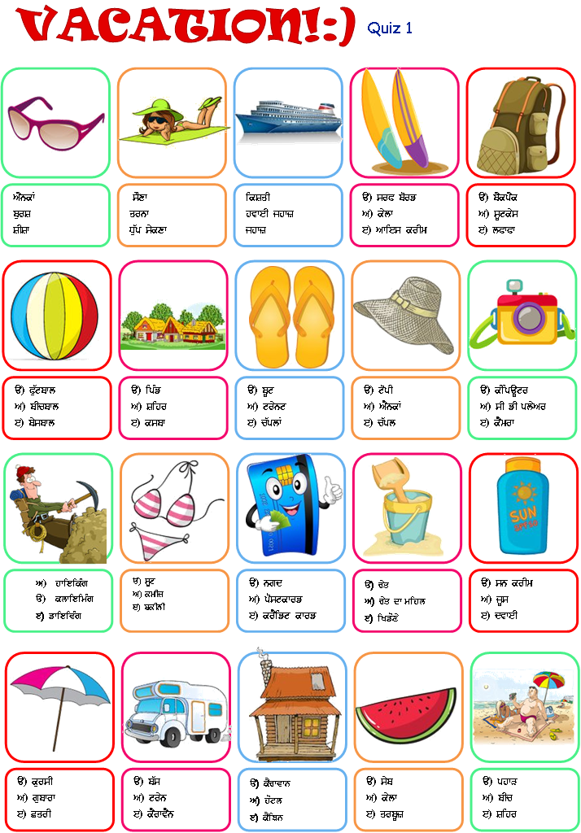
Punjabi Year 8 Summer 1
Holidays
Cu``tIAW
Holiday quiz 2
Three things you bought!
Three people you spent time with!
Three places you visited!
Three foods you ate and liked
Three foods you ate and disliked
Three things you said!
Three things you enjoyed!
3. Time and Frequency Phrases
grmIAW iv`c in summer
AwmqOr qy normally
kdI kdI sometimes
hmySw always
rwq nUM at night
4. Weather
Du``p Sunny
grm Hot
mOsm cMgw The weather's nice
mOsm cMgw nhIN The weather's bad
mINh Raining
qyz hvw Windy
brP Snow/ice
Three things you regret having done!
Three favourite activities.
Three episodes you will remember from the holiday.
Three ways to get to your destination.
Three reasons to go where you did!
5. Days of the week
somvwr Monday
mMglvwr Tuesday
bu`Dvwr Wednesday
vIrvwr Thursday
Su`krvwr Friday
sin`crvwr Saturday
AYqvwr Sunday

Slide 20





Punjabi Year 9 Summer 1
Topic: Weather
4 Opposite Weather
srd/srdI
swP
quPwn
TMf
KuSk
1. Key words
COLD | TMf
DRIZZLE | bUMdw-bWdI
DRY | KuSk
FOG | DuMd
FROST | korw
HAIL | gVy
CLOUD | b``dl
RAIN | mINh
STROM | quPwn
SNOW/ICE | brP
SUNNY | D``up
LIGHTING | ibjlI cmkxw
WIND | hvw
2 Opinions/masculine/feminine
I like mYN …… psMd krdw/krdI
I really like mYN …… bhuq psMd krdw/krdI
I don’t like mYN …… nhIN psMd krdw/krdI
I hate mYN …… iblkul nhIN psMd krdw/krdI
My favourite myrw mnpsMd
3 Months name
January jnvrI July julweI
February PrvrI August Agsq
March mwrc September sqMbr
April ApRYl October AkqUbr
May meI November nvMbr
June jUn December dsMbr
5 Time and Frequency Phrases
grmIAW iv`c in summer
AwmqOr qy normally
kdI kdI sometimes
hmySw always
rwq nUM at night
A`j today
k`lH tomorrow
k`lH yesterday
WINTER | srdI
AUTUMN | p`qJV
SPRING | bhwr
SUMMER | grmI

Slide 21
Summer 2
Year 7
Year 8
Year 9

Slide 22
1.Key vocabulary
ielwkw | ilaakaa | Area
shUlqW | sahultaan | Facilities
dukwnW | dukaana | Shops
bYNk | bank | Bank
sVk | srak | Road
guAWFI | guaandee | Neighbour
pwTSwlw | paathshala | School
hspqwl | hasptal | Hospital
lwiebryrI | Library | Library
b`s A``fw | Bus adda | Bus station
fwktr dI drjrI | Dacter dee surgery | Doctor's surgery
Pu``lW dI dukwn | Phulaan dee dukan | Flowers shop
PlW dI dukwn | Phalaan dee dukan | Fruit shop
sbzIAW dI dukwn | Sabzeean dee dukan | Vegetable shop
du`D vwlw | Dudh wala | Milk man
fwkIAw | Daakiyaa | Postman
fwkKwnw | daakkhana | Post office
Punjabi Year 7 Summer 2
Topic: Local Area
4. Useful adjectives
v`fw | Vada | Big
swP | Saaf | Clean
vDIAw | Vadhyaa | Nice
nvW | Navan | New
bhuq v`fw | Bahut vada | Very big
Cotw | Chota | Small
2.Key prepositions
s`jy pwsy | Sjaye paasey | On the right
K``by pwsy | Khbey paasey | On the left
A``gy | Aagey | Next to
ivckwr | Vichkaar | In between
swhmxy | Sahmney | Opposite
swhmxy | sahmney | Front
SWqmeI | shantmayee | peaceful
rOlw | roula | noisy
BIV BVkw | Bheer bhraka | Crowdy
purwxw | purana | old
Ku``lHw | khulaa | open
BIVw | bheera | Tight
3. key opinions
bhuq vDIAw | Bahut vadeeya | Very nice
AkwaU/nIrs | Akaau/neeras | boring
ieiqhwsk | itihaasak | Historical
siBAwcwrk | sabhiaachark | Cultural
shuxw | sahuna | Beautiful
qMg | tang | Narrow

Slide 23
3. Tenses
The Present Tense
The present tense(s) of the regular and irregular verbs listed in the contexts
hY, hW, hn
The Past Tense
The past tense(s) of the regular and irregular verbs listed in the contexts
sI, sn
The Future Tense
The future tense(s) of the regular and irregular verbs listed in the contexts
gw, gy, gI
Punjabi Year 8 Summer 2
Holidays (Going to Punjab)
Cu``tIAW
5. Verbs
mYN igAw/geI | I went Mai gyaa/gayee see
mYN jwxw hY | (to) go Mai jana hai
KrIdxw | (to) buy khreedna
imlxw | (to) visit millna
Poto iKcxw | (to) take photo Photo khichna
qrnw | (to) swim terna
qurnw | Walk turna
1. Adjectives
mihMgw Expensive mehnaga
ssqw Cheap sasta
gMdw Dirty ganda
swP Clean saaf
suAwd Delicious swad
boirMg Boring boring
purwxw Old purana
mzw Fun maza
vDIAw nice vadhiaa
2. Vocabulary
idlcsp interesting dilchsap
hvweI jhwz aeroplane hawai jahaz
hvweI A`fw airport hawai adda
itkt ticket Ticket
gurduAwrw Gurudwara gurudwara
mnorMjn entertainment manoranjan
irSqydwr relatives rishteydaar
pirvwr family parivaar
4 Opinions/masculine/feminine
I like mYN …… psMd krdw/krdI
I really like mYN …… bhuq psMd krdw/krdI
I don’t like mYN …… nhIN psMd krdw/krdI
I hate mYN …… iblkul nhIN psMd krdw/krdI
My favourite myrw mnpsMd
6. Nouns
smuMdr The beach samundar
phwV The mountain phaar
lok The people lok
Kwxw The food khana
Sihr City shear
ipMf Village pind
pMjwb Punjab Punjab
AMimRqsr Amirtsar Amitsar

Slide 24
Punjabi Knowledge Organiser year 9 Summer 2
Topic: festivals/celebrations
4.Useful time phrases
1.Key challenging verbs in the past tense
AwmqOr qy | Usually
ipCly swl | Last year
mYN igAw sI | I went
mYN/AsIN kIqw | I / we did
mYN/AsIN dyiKAw | I / we saw
mYN/AsIN Kwdw | I/ we ate
mYN/AsIN suixAw | i/ we listened to
mYN/AsIN rhy | I /we stayed
AsIN psMd kIqw | We liked
mYN/AsIN bhuq psMd kIqw | I/ we loved
ipCly hPqy | Last week
bYNk holIfy | A bank holiday
jUn iv`c | In June
 | 3. Key vocabulary
kirsms=Christmas | ivswKI = Vaisakhi | ngr kIrqn=nagar kirtan
eIstr=Easter | Kwxw =meal/dish | mylw = Fair
lok = people | AwiqSbwzI/ptwky=fireworks | sMgq = people
qyrW ApRYl=April 13th | jSn=a party/a celebration | gurduAwrw = Gurdwara
pMJI dsMbr =25th December | holI =Holi | syvw = selfless service
Agly AYqvwr | Next Sunday
Agly mhIny | Next month
grmIAW iv``c | In summer
2. key opinions
5. Weather in the past
bhuq vDIAw hY/sI | It is /It was great
hwsy vwlw hY/sI | It is/It was funny
mnorMjk hY/sI | It is/It was amusing
idlcsp hY/sI | It is/It was interesting
bhuq vDIAw sI | It was nice
grmI sI | It was hot
TMf sI | It was cold
momb`qI = Candle | nvW swl =New Year | mdrz fy = Mothers Day
lMgr = Langer | holw mohlw =Holla mohalla | jnmidn =birthday
r`KVI = Rakhri | JUty = rides | qohPy = presents
lohVI = Lohri | pwrk = park | vrHygMF=anniversary
gurpurb = Gurpurab | jlybIAW = jalebiyaan | Pwdrz fy =Fathers Day
AkwaU hY/sI | It is/was boring
ieiqhwsk | Historical
siBAwcwrk | Cultural
Du``p sI | It was sunny
mINh sI | It was raining
brP pYNdI sI | It was snowing

