Slide 1
Autumn 1
Year 7
Year 8
Year 9

Slide 2
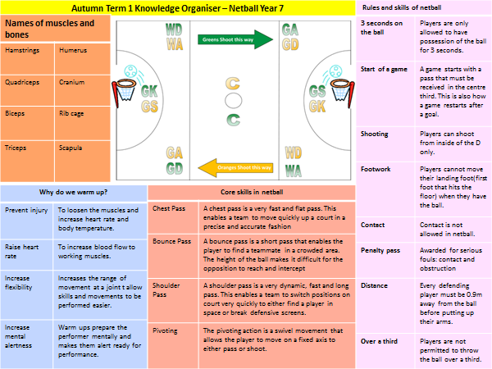

Slide 3
PE Autumn Term 1 Knowledge Organiser – Handball Year 8
Rules and skills of handball
3 seconds on the ball | Players are only allowed to have possession of the ball for 3 seconds.
Start of a game | A game starts with a pass backwards to e teammate. This is also how a game restarts after a goal.
Shooting | Players can shoot from outside of the D or by performing a jump shot.
Dribbling | Players can move with the ball by bouncing but only for 3 seconds.
Passing | Passing is done with one arm and can include a shoulder pass and bounce pass.
Contact | Contact is allowed in handball.
Goalkeeper | Goalkeeper can leave the D but not in possession of the ball.
Corners | Awarded if the ball comes off a defender and goes behind the goal.
Penalty throw | Awarded if a defender steps into the D.
Names of Bones |  | Names of Muscles
Humerus | The long bone in the arm. Used when throwing a ball. | Hamstrings | Located at the back of the upper leg. Used when kicking a ball.
Femur | A long bone in the top half of the leg. Used when running. | Quadriceps | Known as the thigh muscle. Located on the front of the upper leg. Used when kicking a ball.
Cranium | Another name for the skull. Used when heading a ball. | Biceps | Located at the top of the arm between the shoulder and elbow. Used when lifting weights.
Rib cage | Protects the vital organs of the body. Used during tacking in rugby. | Triceps | Located at the back of the arm. Used when throwing a ball.
Scapula | The shoulder bone. Used when swimming. | Gastrocnemius | Known as the calf muscle. Located in the lower leg.
 |  | Deltoid | When something is repeated for a certain effect e.g. to reinforce an idea.
Why do we warm up?
Prevent injury | To loosen the muscles and increase heart rate and body temperature.
Raise heart rate | To increase blood flow to working muscles.
Increase flexibility | Increases the range of movement at a joint t allow skills and movements to be performed easier.
Increase mental alertness | Warm ups prepare the performer mentally and makes them alert ready for performance.
Skill components of fitness
Balance | Ability to maintain a stationary position. Needed in gymnastics.
Power | Ability to perform strength exercises quickly. Used when weightlifting.
Coordination | Using to body parts at the same time. Used in badminton.
Agility | Ability to change direction quickly. Used in football and basketball.
Reaction time | Ability to respond to a stimulus quickly. Used at the start of the 100m.
Speed | Ability to get from one place to another quickly. Used in sprinting and football.

Slide 4
PE Autumn Term 1 Knowledge Organiser – Basketball Year 9
Rules of basketball
Travelling | Players are not allowed to carry or move with the ball in their hands. Side line ball awarded to the opposition is awarded.
Double Dribble | This is when a player dribbles the ball twice after the ball comes to rest or they put two hands on the ball. Side line ball to the opposition is awarded.
Physical Foul | No contact is permitted between players. Side line ball is awarded to the opposition. If a foul occurs in the key during a shot. A free throw is awarded.
Back court violation | This is when a player passes or dribbles the all back into their own half of the court.
Scoring | 2 points awarded for a basket within the key. 3 points are awarded for a basket from outside the key. 1 point is awarded for a free throw.
Triple threat | This a position when a player can either pass, dribble or shoot.
Skeletal System |  | Muscular System
Ulna | Located in the lower arm next to the radius. Used when hitting a ball in tennis. | Pectorals | Located on the top/front of the chest. Used in throwing such as javelin.
Radius | Located in the lower arm next to the ulna. Used when hitting a ball in cricket. | Latissimus dorsi | Allows the shoulder to move up and down. Used in swimming.
Vertebrae | Protects the spinal cord. Used when performing rolls in gymnastics. | Trapezius | Located at the top of the back keeping the shoulder in position. Used when taking a throw in in football.
Hip | Consists of the pelvis that is a flat bone. | Tendon | Attaches a muscle to a bone
Ankle | Bones that make up the ankle include the talus, tibia and fibula. Used when kicking a ball. | Ligament | Attaches a bone to a bone
 |  | Abdominals | Located in the middle of the body. Allows the body to bend. Used in gym.
Different body types in sport
Ectomorph | Characteristics include: long arms and legs, little body fat/muscle. Sports: marathon running, high jump.
Mesomorph | Characteristics include: lots of muscle, wide shoulders and narrow waist. Sports: Weightlifting, swimming, sprinting.
Endomorph | Characteristics: dumpy, lots of fat, little muscle, short arms/legs. Sports: Sumo wrestling.
Health components of fitness
Flexibility | The range of movement at a joint. Needed in gymnastics.
Muscular Strength | The maximum force that can be applied to an object. Used in weightlifting.
Cardiovascular Fitness | The ability of the heart to work for long periods without tiring. Needed in long distance running and cycling.
Muscular Endurance | The ability of the muscles to work for long periods without tiring. Needed in the legs when cycling.
Body Composition | The percentage of muscles, bone and fat on the body. Runners would need low body composition. Rugby players a higher body composition.

Slide 5
Autumn 2
Year 7
Year 8
Year 9

Slide 6
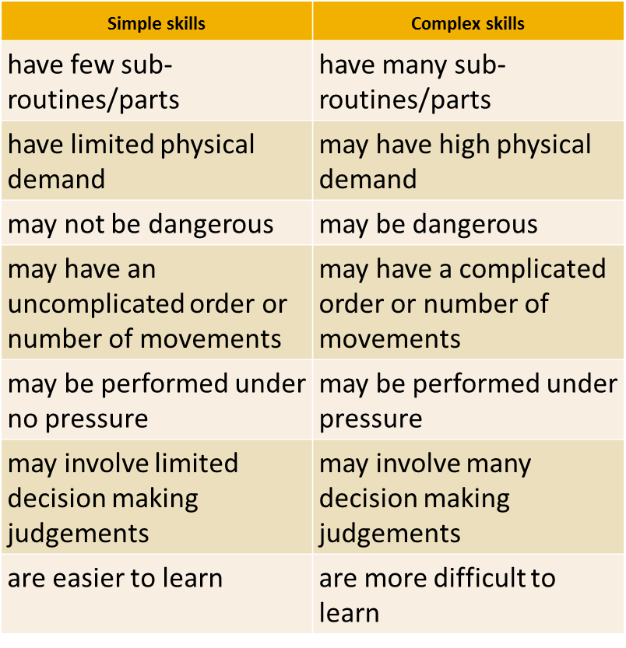
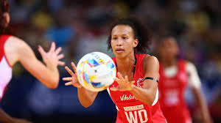
PE Autumn Term 1: Knowledge Organiser – Netball Year 8
Key Words
Chest pass
Bounce pass
Shoulder pass
Shooting
Footwork
Obstruction
Contact
Centre pass
Landing foot
Shooting circle
Goal third
Centre third
Dodge
On toes
Defending
Core Skill – Chest pass
Step 1 | Your hands should form a W behind the ball. Bring your thumbs together in the centre with your fingers comfortably spread out.
Step 2 | When making a pass, step forward with one foot. This will help you get energy from the floor as you push through with the ball.
Step 3 | Keep your elbows close to your body and push through with the ball. As you release the ball, straighten your arms and fingers. Keep your wrists pointed upwards to help fully extend your arms. Keep your eye on the receiver. If you're catching the ball, move towards not away from it.
Types of feedback in sport
Positive feedback | This is feedback about good aspects of a performance.
Negative Feedback | This is feedback about bad performances or movements.
Intrinsic Feedback | This is feedback received from within e.g. how the movement felt.
Extrinsic Feedback | This is feedback received from others e.g. coaches, parents, players.
Knowledge of results | This is feedback about the result of the game e.g. you won 3-1
Knowledge of performance | This is feedback about your performance or movement.
Components of fitness needed in Netball
Flexibility | The range of movements possible at a joint.
Agility | The ability to move and change direction quickly
Co-ordination | The ability to use different (two or more) parts of the body together, smoothly and efficiently.
Balance | is the maintenance of the centre of mass over the base of support.

Slide 7
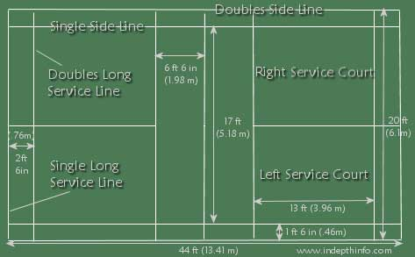
PE Autumn Term 2 Knowledge Organiser – Badminton Year 8
Rules of badminton
Scoring | Games are played first to 21 points. Players must win by 2 clear points if the score reaches 20-20. Players can score on their own and on their opponents serve.
Service | The serve in both doubles and singles games starts from the right hand side of the court. When the score is even e.g. 2-2 the serve is from the right. When the score is odd e.g. 3-2, the serve is from the left.
Court dimensions for singles and doubles
Skeletal system and movement at joints
Hinge Joints | Examples include the knee and elbow. Allow flexion and extension.
Ball and socket joints | Examples include the hip and the shoulder. They allow abduction, adduction and rotation.
Flexion | Decrease in the angle at a joint.
Extension | Increase in the angle at a joint.
Abduction | Movement of a body part away from the body.
Adduction | Movement of a body part towards the body.
Rotation | Movement of a body part around an axis.
Cardio-Respiratory System
Cardiac cycle | The process of the heart going through the stages of systole and diastole in the atria and ventricles.
Diastolic blood pressure | When the heart is relaxing
Embolism | The blockage of a blood vessel
Haemoglobin | The substance in red blood cells that transports oxygen and carbon dioxide.
Hypertension | High blood pressure in the arteries
Systolic blood pressure | When the heart is contracting
Training Methods
Fartlek | This involves speed play. Working at different speeds across different terrains and distances.
Interval | Periods of work followed by periods of rest.
Weight | This involves resistance training using weights aiming at improving strength and endurance of muscles.
Continuous | This involves aerobic activity for long periods of time without stopping e.g. cycling, running, swimming.
Circuit | This involves performing a series of activities in a circuit to develop either aerobic or anaerobic fitness.
Types of feedback in sport
Positive feedback | This is feedback about good aspects of a performance.
Negative Feedback | This is feedback about bad performances or movements.
Intrinsic Feedback | This is feedback received from within e.g. how the movement felt.
Extrinsic Feedback | This is feedback received from others e.g. coaches, parents, players.
Knowledge of results | This is feedback about the result of the game e.g. you won 3-1
Knowledge of performance | This is feedback about your performance or movement.

Slide 8
PE Autumn Term 2 Knowledge Organiser – Handball Year 9
Rules and skills of handball
3 seconds on the ball | Players are only allowed to have possession of the ball for 3 seconds.
Start of a game | A game starts with a pass backwards to e teammate. This is also how a game restarts after a goal.
Shooting | Players can shoot from outside of the D or by performing a jump shot.
Dribbling | Players can move with the ball by bouncing but only for 3 seconds.
Passing | Passing is done with one arm and can include a shoulder pass and bounce pass.
Contact | Contact is allowed in handball.
Goalkeeper | Goalkeeper can leave the D but not in possession of the ball.
Corners | Awarded if the ball comes off a defender and goes behind the goal.
Penalty throw | Awarded if a defender steps into the D.
Names of Bones |  | Names of Muscles
Humerus | The long bone in the arm. Used when throwing a ball. | Hamstrings | Located at the back of the upper leg. Used when kicking a ball.
Femur | A long bone in the top half of the leg. Used when running. | Quadriceps | Known as the thigh muscle. Located on the front of the upper leg. Used when kicking a ball.
Cranium | Another name for the skull. Used when heading a ball. | Biceps | Located at the top of the arm between the shoulder and elbow. Used when lifting weights.
Rib cage | Protects the vital organs of the body. Used during tacking in rugby. | Triceps | Located at the back of the arm. Used when throwing a ball.
Scapula | The shoulder bone. Used when swimming. | Gastrocnemius | Known as the calf muscle. Located in the lower leg.
 |  | Deltoid | When something is repeated for a certain effect e.g. to reinforce an idea.
Why do we cool down?
Prevent injury | To prevent blood pooling of blood in the muscles
Lower heart rate | To return heart rate back to its resting rate
Increase flexibility | Increases the range of movement at a joint t allow skills and movements to be performed easier.
Lower body temperature | To return the temperature of the body back to normal.
Health components of fitness
Flexibility | Range of movement possible at a joint.
Cardiovascular endurance | Ability of the heart and lungs to work without tiring.
Muscular endurance | Ability of muscles to work for long periods without tiring.
Strength | Ability to work against a resistance e.g. weightlifting
Power | Explosive power involves short, sharp burst of power. Strength x Speed
Health | A state of physical, mental and social well being.
Fitness | Ability to meet the demands of the environment.

Slide 9
Spring 1
Year 7
Year 8
Year 9

Slide 10
PE Spring Term 1 Knowledge Organiser – Basketball Year 7
Rules of basketball
Travelling | Players are not allowed to carry or move with the ball in their hands. Side line ball awarded to the opposition is awarded.
Double Dribble | This is when a player dribbles the ball twice after the ball comes to rest or they put two hands on the ball. Side line ball to the opposition is awarded.
Physical Foul | No contact is permitted between players. Side line ball is awarded to the opposition. If a foul occurs in the key during a shot. A free throw is awarded.
Back court violation | This is when a player passes or dribbles the all back into their own half of the court.
Scoring | 2 points awarded for a basket within the key. 3 points are awarded for a basket from outside the key. 1 point is awarded for a free throw.
Triple threat | This a position when a player can either pass, dribble or shoot.
Skeletal System |  | Muscular System
Ulna | Located in the lower arm next to the radius. Used when hitting a ball in tennis. | Pectorals | Located on the top/front of the chest. Used in throwing such as javelin.
Radius | Located in the lower arm next to the ulna. Used when hitting a ball in cricket. | Latissimus dorsi | Allows the shoulder to move up and down. Used in swimming.
Vertebrae | Protects the spinal cord. Used when performing rolls in gymnastics. | Trapezius | Located at the top of the back keeping the shoulder in position. Used when taking a throw in in football.
Hip | Consists of the pelvis that is a flat bone. | Tendon | Attaches a muscle to a bone
Ankle | Bones that make up the ankle include the talus, tibia and fibula. Used when kicking a ball. | Ligament | Attaches a bone to a bone
 |  | Abdominals | Located in the middle of the body. Allows the body to bend. Used in gym.
Different body types in sport
Ectomorph | Characteristics include: long arms and legs, little body fat/muscle. Sports: marathon running, high jump.
Mesomorph | Characteristics include: lots of muscle, wide shoulders and narrow waist. Sports: Weightlifting, swimming, sprinting.
Endomorph | Characteristics: dumpy, lots of fat, little muscle, short arms/legs. Sports: Sumo wrestling.
Health components of fitness
Flexibility | The range of movement at a joint. Needed in gymnastics.
Muscular Strength | The maximum force that can be applied to an object. Used in weightlifting.
Cardiovascular Fitness | The ability of the heart to work for long periods without tiring. Needed in long distance running and cycling.
Muscular Endurance | The ability of the muscles to work for long periods without tiring. Needed in the legs when cycling.
Body Composition | The percentage of muscles, bone and fat on the body. Runners would need low body composition. Rugby players a higher body composition.

Slide 11
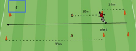
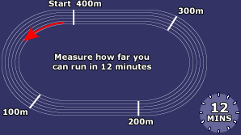
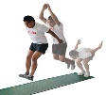

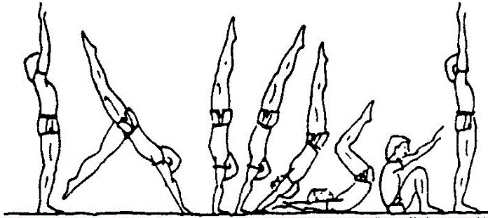
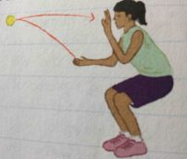
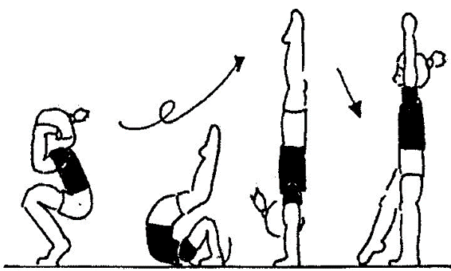
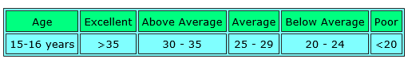
PE Spring Term 1 Knowledge Organiser - Gymnastics Year 8
Core Skills
 |  Start in a lunge position with your most dominant leg forward Place your hands on the floor in a 90 degree angle Kick your non-domiant leg up into the air bringing your straightened legs over your head into a straddle position Finish landing in a lunge position
Shoulder stand | Start lied horizontially on your back Lift your legs up straight and bend them towards your face Push your hips up towards the ceiling Bend your elbows and place your hands to support under your lower back Ensure your legs ar sraight and your toes are pointed
Cat leap | Start facing fowards Most dominant leg straight forward Step forwards and push of this leg Lift opposite leg with slight bend and toes pointed As this leg lowers to the floor and lift opposite leg Return to starting position
Arabesque | Place your dominant leg forward Lift you non-dominant backwards as high as you can Lower your chest forwards no more than 90 degrees Ensure you leg is straight with your arms out at the sides and tension is applied
Key Words
Tension
Extension
Control
Fluency
Aesthetic
Balance
Power
Choreography
Jumps
Leaps
Twists
Turns
Elegance
Components of Fitness tests (G)
Agility – Illinois Agility Test
Speed – 30m Sprint
Cardiovascular endurance – Multi Stage Fitness Test
Co-ordination – Wall Throw
Balance – Standing Stork Test
Reaction Time – Ruler Drop Test
Muscular Endurance – Sit up Test
Strength – 1 Repetition Max Test (1RM)
Flexibility – Sit and Reach Test
Power – Vertical Jump Test
Cartwheel
Advanced Skills
Handstand forward roll | Start upright in lunge position, most dominant leg forward Place hands on the floor and kick back leg towards ceiling Bring other up to ceiling and hold position with tension Slowly bend arms, tuck chin into chest, curve your back Roll forwards and return to standing position
Backwards roll to handstand | Start in a upright position with arms straight by your ears Bend your knees, curve your back and begin to roll backwards Place hand flat on the floor beside either on your ears Bring your legs over the top of your body Push your legs and hips towards the ceiling at the sae time as pushing off your hands, straightening your arms Hold position, bring one leg down to the floor and return to stand
Example of a fitness test (Wall Test)
This tests for - Coordination (Hand eye)
Used by: performers who need to use two or more body parts together smoothly and effectively, such as:
- Cricket fielders
- Handball players
Facilities/equipment
- Wall
- Tennis ball
- Stop watch

Slide 12
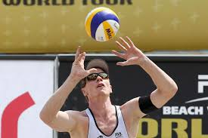
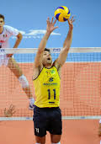
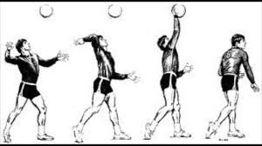
PE Autumn Term 1: Knowledge Organiser – Volleyball Year 9
The Serve
Stage one
Stand in position on the balls of your feet, with knees slightly flexed.
Face forwards with your chest facing towards the target.
Hold the ball in front of your body with left hand, right hand held back.
Body weight should be on the back foot.
Stage two
Throw the ball gently into the air, swing the straight arm forward to strike underneath the ball with the heel of the hand, with your fingers clenched.
Transfer bodyweight from back to front foot.
Stage three
Follow through with the fist pointing towards the intended target or the sky.
Key Words
Kill
Rotation
Set
Forearm pass
Play-over
Spiker
Attack
Dig
Lob
Block
Fault
Front Court
Setter
Topspin
Core Skill – Volley-pass
Preparation | The preparation phase is how your body moves into position to perform a skill. Judging the flight of the ball move into position just behind it with fingers spread, hands at forehead, knees bent and feet apart
Action | The action phase is the movement required to perform the main part of a skill. Straighten the legs to and extend the arms to meet the ball. Push the ball with fingertips
Recovery | The recovery phase is getting back into position/regaining your balance after performing a skill. Follow through with the arms forward and transfer weight forward, move into ready position for the next shot
Components of fitness needed in Volleyball
Flexibility | The range of movements possible at a joint.
Agility | The ability to move and change direction quickly
Co-ordination | The ability to use different (two or more) parts of the body together, smoothly and efficiently.
Balance | is the maintenance of the centre of mass over the base of support.
Types of feedback in sport
Positive feedback | This is feedback about good aspects of a performance.
Negative Feedback | This is feedback about bad performances or movements.
Knowledge of results | This is feedback about the result of the game e.g. you won 3-1
Knowledge of performance | This is feedback about your performance or movement.

Slide 13
Spring 2
Year 7
Year 8
Year 9

Slide 14
PE Spring Term 2 Knowledge Organiser – Handball Year 7
Rules and skills of handball
3 seconds on the ball | Players are only allowed to have possession of the ball for 3 seconds.
Start of a game | A game starts with a pass backwards to e teammate. This is also how a game restarts after a goal.
Shooting | Players can shoot from outside of the D or by performing a jump shot.
Dribbling | Players can move with the ball by bouncing but only for 3 seconds.
Passing | Passing is done with one arm and can include a shoulder pass and bounce pass.
Contact | Contact is allowed in handball.
Goalkeeper | Goalkeeper can leave the D but not in possession of the ball.
Corners | Awarded if the ball comes off a defender and goes behind the goal.
Penalty throw | Awarded if a defender steps into the D.
Names of Bones |  | Names of Muscles
Humerus | The long bone in the arm. Used when throwing a ball. | Hamstrings | Located at the back of the upper leg. Used when kicking a ball.
Femur | A long bone in the top half of the leg. Used when running. | Quadriceps | Known as the thigh muscle. Located on the front of the upper leg. Used when kicking a ball.
Cranium | Another name for the skull. Used when heading a ball. | Biceps | Located at the top of the arm between the shoulder and elbow. Used when lifting weights.
Rib cage | Protects the vital organs of the body. Used during tacking in rugby. | Triceps | Located at the back of the arm. Used when throwing a ball.
Scapula | The shoulder bone. Used when swimming. | Gastrocnemius | Known as the calf muscle. Located in the lower leg.
 |  | Deltoid | When something is repeated for a certain effect e.g. to reinforce an idea.
Why do we warm up?
Prevent injury | To loosen the muscles and increase heart rate and body temperature.
Raise heart rate | To increase blood flow to working muscles.
Increase flexibility | Increases the range of movement at a joint t allow skills and movements to be performed easier.
Increase mental alertness | Warm ups prepare the performer mentally and makes them alert ready for performance.
Skill components of fitness
Balance | Ability to maintain a stationary position. Needed in gymnastics.
Power | Ability to perform strength exercises quickly. Used when weightlifting.
Coordination | Using to body parts at the same time. Used in badminton.
Agility | Ability to change direction quickly. Used in football and basketball.
Reaction time | Ability to respond to a stimulus quickly. Used at the start of the 100m.
Speed | Ability to get from one place to another quickly. Used in sprinting and football.

Slide 15
PE Spring Term 2 Knowledge Organiser – Basketball Year 8
Rules of basketball
Travelling | Players are not allowed to carry or move with the ball in their hands. Side line ball awarded to the opposition is awarded.
Double Dribble | This is when a player dribbles the ball twice after the ball comes to rest or they put two hands on the ball. Side line ball to the opposition is awarded.
Physical Foul | No contact is permitted between players. Side line ball is awarded to the opposition. If a foul occurs in the key during a shot. A free throw is awarded.
Back court violation | This is when a player passes or dribbles the all back into their own half of the court.
Scoring | 2 points awarded for a basket within the key. 3 points are awarded for a basket from outside the key. 1 point is awarded for a free throw.
Triple threat | This a position when a player can either pass, dribble or shoot.
Skeletal System |  | Muscular System
Ulna | Located in the lower arm next to the radius. Used when hitting a ball in tennis. | Pectorals | Located on the top/front of the chest. Used in throwing such as javelin.
Radius | Located in the lower arm next to the ulna. Used when hitting a ball in cricket. | Latissimus dorsi | Allows the shoulder to move up and down. Used in swimming.
Vertebrae | Protects the spinal cord. Used when performing rolls in gymnastics. | Trapezius | Located at the top of the back keeping the shoulder in position. Used when taking a throw in in football.
Hip | Consists of the pelvis that is a flat bone. | Tendon | Attaches a muscle to a bone
Ankle | Bones that make up the ankle include the talus, tibia and fibula. Used when kicking a ball. | Ligament | Attaches a bone to a bone
 |  | Abdominals | Located in the middle of the body. Allows the body to bend. Used in gym.
Different body types in sport
Ectomorph | Characteristics include: long arms and legs, little body fat/muscle. Sports: marathon running, high jump.
Mesomorph | Characteristics include: lots of muscle, wide shoulders and narrow waist. Sports: Weightlifting, swimming, sprinting.
Endomorph | Characteristics: dumpy, lots of fat, little muscle, short arms/legs. Sports: Sumo wrestling.
Health components of fitness
Flexibility | The range of movement at a joint. Needed in gymnastics.
Muscular Strength | The maximum force that can be applied to an object. Used in weightlifting.
Cardiovascular Fitness | The ability of the heart to work for long periods without tiring. Needed in long distance running and cycling.
Muscular Endurance | The ability of the muscles to work for long periods without tiring. Needed in the legs when cycling.
Body Composition | The percentage of muscles, bone and fat on the body. Runners would need low body composition. Rugby players a higher body composition.

Slide 16
PE Spring Term 2 Knowledge Organiser – Badminton Year 9
Rules of badminton
Scoring | Games are played first to 21 points. Players must win by 2 clear points if the score reaches 20-20. Players can score on their own and on their opponents serve.
Service | The serve in both doubles and singles games starts from the right hand side of the court. When the score is even e.g. 2-2 the serve is from the right. When the score is odd e.g. 3-2, the serve is from the left.
Court dimensions for singles and doubles
Skeletal system and movement at joints
Hinge Joints | Examples include the knee and elbow. Allow flexion and extension.
Ball and socket joints | Examples include the hip and the shoulder. They allow abduction, adduction and rotation.
Flexion | Decrease in the angle at a joint.
Extension | Increase in the angle at a joint.
Abduction | Movement of a body part away from the body.
Adduction | Movement of a body part towards the body.
Rotation | Movement of a body part around an axis.
Cardio-Respiratory System
Cardiac cycle | The process of the heart going through the stages of systole and diastole in the atria and ventricles.
Diastolic blood pressure | When the heart is relaxing
Embolism | The blockage of a blood vessel
Haemoglobin | The substance in red blood cells that transports oxygen and carbon dioxide.
Hypertension | High blood pressure in the arteries
Systolic blood pressure | When the heart is contracting
Training Methods
Fartlek | This involves speed play. Working at different speeds across different terrains and distances.
Interval | Periods of work followed by periods of rest.
Weight | This involves resistance training using weights aiming at improving strength and endurance of muscles.
Continuous | This involves aerobic activity for long periods of time without stopping e.g. cycling, running, swimming.
Circuit | This involves performing a series of activities in a circuit to develop either aerobic or anaerobic fitness.
Types of feedback in sport
Positive feedback | This is feedback about good aspects of a performance.
Negative Feedback | This is feedback about bad performances or movements.
Intrinsic Feedback | This is feedback received from within e.g. how the movement felt.
Extrinsic Feedback | This is feedback received from others e.g. coaches, parents, players.
Knowledge of results | This is feedback about the result of the game e.g. you won 3-1
Knowledge of performance | This is feedback about your performance or movement.

Slide 17
Summer 1
Year 7
Year 8
Year 9

Slide 18
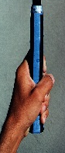

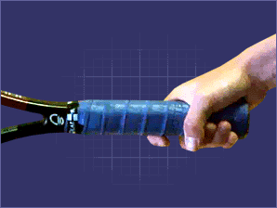
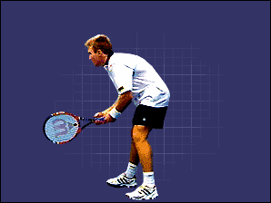
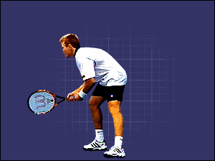
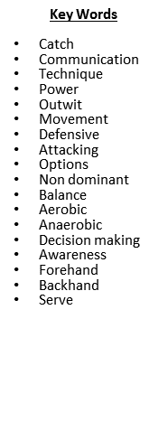
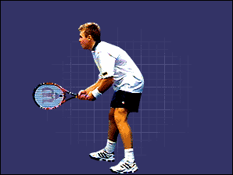
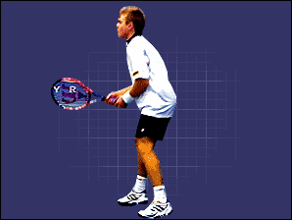
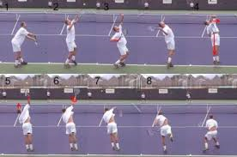
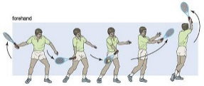
PE Summer Term 1 Knowledge Organiser – Tennis Year 7
Core Skills
Griping the racquet | Shake-hands grip Curl your fingers around the grip near the base so your thumb and forefinger form a 'V' along the top right edge of the handle.
Ready Position | Both hands need to start on the racquet, this allows quick grip changes and stronger, earlier body rotation for the shot. feet at least shoulder width apart Head forwards Bend your knees slightly As your opponent strikes the ball try to bounce onto your toes so that you are ready to return. After hitting the ball return to the ready position.
Forehand | Ready position None hitting hand holding the throat of the racquet Drop the racquet grip down and point the end of the handle towards the on coming ball. Swing through and open shoulders Pull the arm in and follow through across your body
What components of fitness can we associate with Tennis?
Agility | * You have to be able to change directions to hit the ball while maintaining a constant fast motion. * This helps you to reach certain shots.
Co-ordination | To move to the ball at the same time you swing the racquet. When serving you need to toss the ball whilst watching it and swinging your racquet.
Power | Serving Smashing Forehand shots
Speed | To get to the net for a drop shot. Reaching a long ball that has been shot to the corner of the court.
Balance | Your body weight has to be equally distributed on both legs whilst hitting the ball. When you lean backwards the ball tends to go up. When you lean forwards the ball tends to go towards the net.
Reaction Time | Reacting quickly with short strokes in order to win the rally.
Why do we warm up?
Prevent injury | To loosen the muscles and increase heart rate and body temperature.
Raise heart rate | To increase blood flow to working muscles.
Increase flexibility | Increases the range of movement at a joint t allow skills and movements to be performed easier.
Increase mental alertness | Warm ups prepare the performer mentally and makes them alert ready for performance.
Serving | - Feet are positioned so that the front foot is pointing towards the net and the back foot is parallel to the baseline. Body weight on the front foot and lean slightly forward. (start position) Shift on to the back foot and separate the arms. - Separate the ball from the hand and transfer the weight to the front foot. - Drive up with the legs and looping action from the racquet as you hit the ball. It should feel as if you are high fiving the ball. Land on your left foot and right shoulder pointing forward.

Slide 19
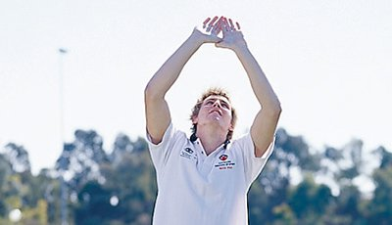
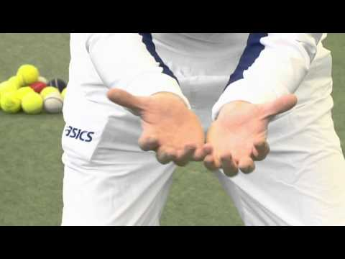
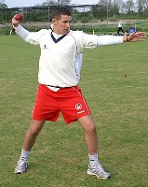
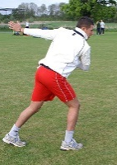
PE Summer Term 1: Knowledge Organiser – Cricket Year 8
Benefits of fitness testing
- Identify strengths and areas for improvement
- Identify training requirements
- To show a starting level of fitness
To motivate
To provide goals
During and after training programme
- To monitor improvement
- To compare results against the norms of the group/national average
To identify whether training has been successful
Limitations of fitness testing
- Tests do not have competitive conditions
- Some tests have questionable reliability
- Tests must be carried out using correct procedures to increase validity
Key Words
Technique
Reactions
Awareness
Decision
Fingers ready
Catching
Throwing
Overarm
Bowling
Batting
Fielding
Balance
Agility
Coordination
Flexibility
Core Skills – Catching and throwing
Catching (high) | Hands cupped Eyes on the ball Tracking the ball Feet shoulder width apart with knees slightly bent Soft hands as you bring your hands in towards your body
Catching (low) | Hands cupped Eyes on the ball Tracking the ball Feet shoulder width apart with knees slightly bent Soft hands as you bring your hands in towards your body
Throwing (overarm) | Stand side on Point at the target Flex the throwing arm Eye on the target Shift weight Extend your throwing arm towards the target
Components of Fitness tests
Agility – Illinois Agility Test
Speed – 30m Sprint
Cardiovascular endurance – Multi Stage Fitness Test
Co-ordination – Wall Throw
Balance – Standing Stork Test
Reaction Time – Ruler Drop Test
Muscular Endurance – Sit up Test
Strength – 1 Repetition Max Test (1RM)
Flexibility – Sit and Reach Test
Power – Vertical Jump Test
Components of fitness needed in cricket
Flexibility | The range of movements possible at a joint.
Agility | The ability to move and change direction quickly
Co-ordination | The ability to use different (two or more) parts of the body together, smoothly and efficiently.
Balance | is the maintenance of the centre of mass over the base of support.

Slide 20
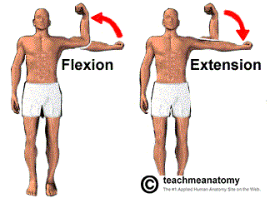
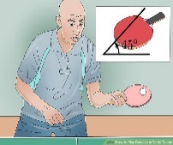
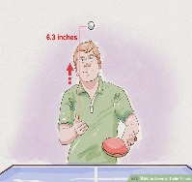
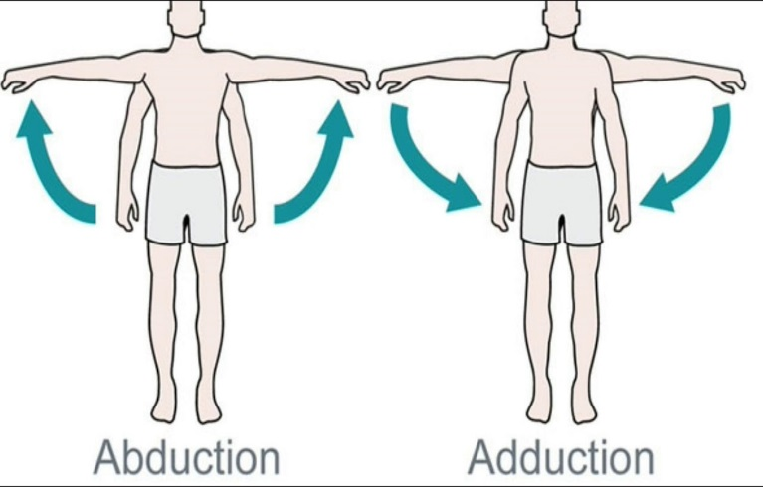
PE Summer Term 1: Knowledge Organiser – Table Tennis Year 9
Core Skills - Ready Position
Only one hand needs to be holding the bat using the shake-hands grip.
Your feet need to be at least shoulder width apart with your head forwards.
Bend your knees slightly, this lowers your centre of gravity.
As your opponent strikes the ball bounce onto your toes for extra spring in your legs.
After hitting the ball return to the centre of the table and the ready position as soon as possible.
Key Words
Catch
Communication
Technique
Power
Outwit
Movement
Defensive
Attacking
Options
Non dominant
Balance
Aerobic
Anaerobic
Decision making
Awareness
Forehand
Backhand
Serve
Core Skills – Grip the bat
Shake-hands grip as it should feel as if you are shaking hands with another person
Curl your fingers around the grip near the base so your thumb and forefinger form a 'V' along the top right edge of the handle.
As you stroke the racquet through on the forehand side, it should feel almost as if your hand is hitting the ball.
The ping-pong ball must bounce on your side of the table before you hit it.
Core Skills – Forehand and Serving
Forehand | Ready position Whole body turns sideways Power position (bat higher than grip) Keep the bat at a 45˚ angle. Swing through and open shoulders Pull the arm in and follow through across your body.
Serving | Feet are positioned 90˚ angle to the table with knees bent. Ball is held in none bat holding hand and is thrown roughly 6 inches into the air. Hit ball, downwards and forwards as it falls down towards the table. The ball must bounce on your side of the table once before going over the net for your serve only.
GCSE P.E Link – Joints and Movement
Flexion | Decrease in the size of the angle at a joint.
Extension | Increase in the size of an angle at a joint
Rotation | A circular movement around a joint e.g. bowling in cricket.
Adduction | Movement of a body part towards the body e.g. playing a forehand shot.
Abduction | Movement of a body part away from the body e.g. playing a backhand drive shot.

Slide 21
Summer 2
Year 7
Year 8
Year 9

Slide 22
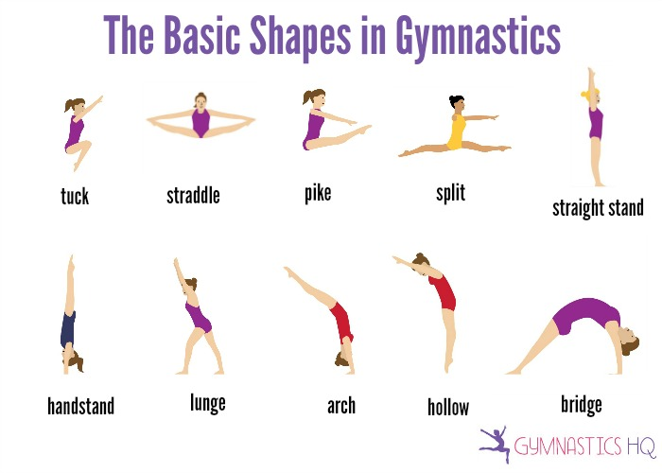


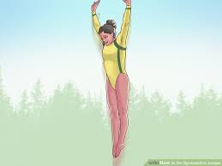
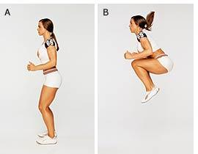

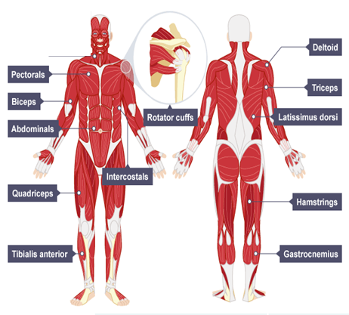
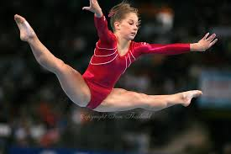
PE Summer Term 2 Knowledge Organiser - Gymnastics Year 7
Core Skills
Presentation | Applying tension and extension to present yourself at the start and end of a sequence or movement. Applying tension (straight legs, arms and pointed toes) consistently throughout sequences and movements to make it aesthetically pleasing.
Forwards roll to straddle | Start in a straight position, hands up straight by your ears. Place your hands flat on the floor, bring your body weight over the top of your hands, tuck your chin to your chest, bend your arms, roll forward with your legs straight, when reaching the forward position, straddle your legs, place your hands in between to support yourself up. Straighten upwards and present.
Jumps/Leaps | Pencil jump - Bend your knees slightly, as your bring your arms from backwards to forwards push off your legs to gain power. As you take off from the floor use tension to straighten your legs, arms and point your toes. When returning back to land, bend you knees slightly. Tuck jump - Bend your knees slightly, as your bring your arms from backwards to forwards push off your legs to gain power. As you take off from the floor tuck your knees into your chest and keep your toes pointed. When returning back to land, bend you knees slightly. Straddle jump - Bend your knees slightly, as your bring your arms from backwards to forwards push off your legs to gain power. As you take off from the floor use tension to straighten your legs and point your toes. Create a straddle shape in the air with your legs and stretch your arms forward. When returning back to land, bend you knees slightly
Advanced Skill
Starting from a bridge position, kick your most dominant leg into the air and extend it using tension. Push the other foot off the floor, bringing your legs over the top of your body returning to an upright lunge position.
Key Words
Tension | Extension | Control
Fluency | Aesthetic | Balance
Power | Co-ordination | Jumps
Leaps | Twists | Turns
Elegance | Roll | Apply
Straddle | Walkover | Tuck

Slide 23
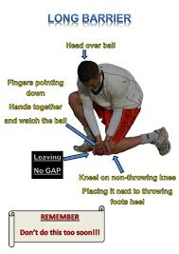
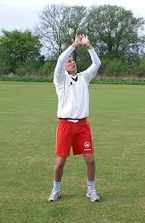
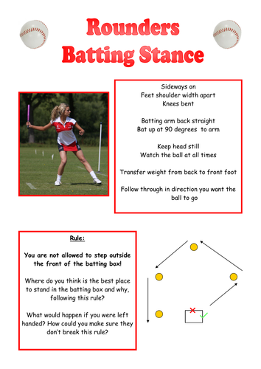
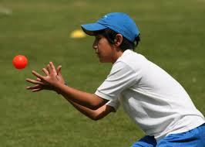
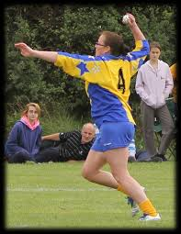
PE Summer Term 2: Knowledge Organiser – Rounders Year 9
GCSE P.E Link – Joints and Movement
Flexion | Decrease in the size of the angle at a joint.
Extension | Increase in the size of an angle at a joint
Rotation | A circular movement around a joint e.g. bowling in cricket.
Adduction | Movement of a body part towards the body e.g. playing a forehand shot.
Abduction | Movement of a body part away from the body e.g. playing a backhand drive shot.
Core Skills – Controlling the ball Approach the ball at speed and as you get into line with the ball, twist your upper body, leading with the shoulder furthest from the ball. Bend both knees, so that the knee of the leg nearest to the ball touches the ground, but it is also next to the back of the heel of the other leg. With fingers down and head forward, pick up the ball and then stand back up ready to deliver an overarm throw.
Core Skills – Catching and throwing
Catching (high) | Hands cupped Eyes on the ball Tracking the ball Feet shoulder width apart with knees slightly bent Soft hands as you bring your hands in towards your body
Catching (low) | Hands cupped Eyes on the ball Tracking the ball Feet shoulder width apart with knees slightly bent Soft hands as you bring your hands in towards your body
Throwing (overarm) | Stand side on Point at the target Flex the throwing arm Eye on the target Shift weight Extend your throwing arm towards the target
Batting Stance

Slide 24
PE Summer Term 2: Knowledge Organiser – Cricket Year 9
Benefits of fitness testing
- Identify strengths and areas for improvement
- Identify training requirements
- To show a starting level of fitness
To motivate
To provide goals
During and after training programme
- To monitor improvement
- To compare results against the norms of the group/national average
To identify whether training has been successful
Limitations of fitness testing
- Tests do not have competitive conditions
- Some tests have questionable reliability
- Tests must be carried out using correct procedures to increase validity
Key Words
Technique
Reactions
Awareness
Decision
Fingers ready
Catching
Throwing
Overarm
Bowling
Batting
Fielding
Balance
Agility
Coordination
Flexibility
Core Skills – Catching and throwing
Catching (high) | Hands cupped Eyes on the ball Tracking the ball Feet shoulder width apart with knees slightly bent Soft hands as you bring your hands in towards your body
Catching (low) | Hands cupped Eyes on the ball Tracking the ball Feet shoulder width apart with knees slightly bent Soft hands as you bring your hands in towards your body
Throwing (overarm) | Stand side on Point at the target Flex the throwing arm Eye on the target Shift weight Extend your throwing arm towards the target
Components of Fitness tests
Agility – Illinois Agility Test
Speed – 30m Sprint
Cardiovascular endurance – Multi Stage Fitness Test
Co-ordination – Wall Throw
Balance – Standing Stork Test
Reaction Time – Ruler Drop Test
Muscular Endurance – Sit up Test
Strength – 1 Repetition Max Test (1RM)
Flexibility – Sit and Reach Test
Power – Vertical Jump Test
Components of fitness needed in cricket
Flexibility | The range of movements possible at a joint.
Agility | The ability to move and change direction quickly
Co-ordination | The ability to use different (two or more) parts of the body together, smoothly and efficiently.
Balance | is the maintenance of the centre of mass over the base of support.

