Slide 1
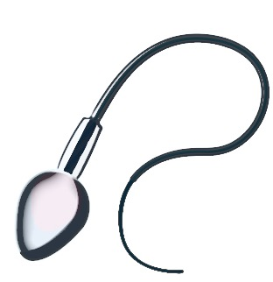
cytoplasm | site of chemical reactions in the cell | gel like substance containing enzymes to catalyse the reactions
nucleus | contains genetic material | controls the activities of the cell and codes for proteins
cell membrane | semi permeable | controls the movement of substances in and out of the cell
ribosome | site of protein synthesis | mRNA is translated to an amino acid chain
mitochondrion | site of respiration | where energy is released for the cell to function
2) Prokaryotes simpler organisms
cell membrane | site of chemical reactions in the cell | gel like substance containing enzymes to catalyse the reactions
bacterial DNA | not in nucleus floats in the cytoplasm | controls the function of the cell
cell wall | NOT made of cellulose | supports and strengthens the cell
plasmid | small rings of DNA | contain additional genes
cytoplasm | semi permeable | controls the movement of substances in and out of the cell
animal cell
1) Eukaryotes complex organisms
Cell Structure
Autumn 1
plant cell
contains all the parts of animal cells plus extras
3) Specialised cells
permanent vacuole | contains cell sap | keeps cell turgid, contains sugars and salts in solution
cell wall | made of cellulose | supports and strengthens the cell
chloroplast | site of photosynthesis | contains chlorophyll, absorbs light energy
nerve |  | carry electrical signals | long branched connections and insulating sheath
sperm |  | fertilise an egg | streamlined with a long tail acrosome containing enzymes large number of mitochondria
muscle |  | contract to allow movement | contains a large number of mitochondria long
specialised animal cells
4) Cell differentiation
how a cell changes and becomes specialised
Undifferentiated call are called STEM cells
root hair |  | absorb water and minerals from soil | hair like projections to increase the surface area
xylem |  | carry water and minerals | TRANSPIRATION - dead cells cell walls toughened by lignin flows in one direction
phloem |  | carry glucose | TRANSLOCATION - living cells cells have end plates with holes flows in both directions
animal cell differentiation
plant cell differentiation
early stages of development
only for repair and replacement
all stages of life cycle the stem cells are grouped together in meristems
specialised plant cells
5) Microscopy
Feature | Light (optical) microscope | Electron microscope
Radiation used | Light rays | Electron beams
Max magnification | ~ 1500 times | ~ 2 000 000 times
Resolution | 200nm | 0.2nm
Size of microscope | Small and portable | Very large and not portable
Cost | ~£100 for a school one | Several £100,000 to £1 million plus
PREFIXES
Prefix | Multiple | Standard form
centi (cm) | 1 cm = 0.01 m | x 10 ⁻²
milli (mm) | 1 mm = 0.001 m | x 10 ⁻³
micro (𝛍m) | 1 𝛍m = 0.000 001 m | x 10 ⁻⁶
nano (nm) | 1nm = 0.000 000 001 m | x 10 ⁻⁹

Slide 2
Section 1: Keywords
Pre 1900 |  | Tiny solid spheres that could not be divided | Before the discovery of the electron, John Dalton said the solid sphere made up the different elements.
1897 ‘plum pudding’ |  | A ball of positive charge with negative electrons embedded in it | JJ Thompson ‘s experiments showed that showed that an atom must contain small negative charges (discovery of electrons).
1909 nuclear model |  | Positively charge nucleus at the centre surrounded negative electrons | Ernest Rutherford's alpha particle scattering experiment showed that the mass was concentrated at the centre of the atom.
1913 Bohr model |  | Electrons orbit the nucleus at specific distances | Niels Bohr proposed that electrons orbited in fixed shells; this was supported by experimental observations.
Atom | The smallest part of an element that can exist | Have a radius of around 0.1 nanometres and have no charge (0).
Element | Contains only one type of atom | Around 100 different elements each one is represented by a symbol e.g. O, Na, Br.
Compound | Two or more elements chemically combined | Compounds can only be separated into elements by chemical reactions.
Section 3 The development of the model of the atom
Section 2: Electron configuration
Electronic shell | Max number of electrons
1 | 2
2 | 8
3 | 8
4 | 2
Central nucleus | Contains protons and neutrons
Electron shells | Contains electrons
James Chadwick | Provided the evidence to show the existence of neutrons within the nucleus
Section 4: relative charges
Name of Particle | Relative Charge | Relative Mass
Proton | +1 | 1
Neutron | 0 | 1
Electron | -1 | Very small
Rutherford's scattering experiment | A beam of alpha particles are directed at a very thin gold foil | Most of the alpha particles passed right through. A few (+) alpha particles were deflected by the positive nucleus. A tiny number of particles reflected back from the nucleus.
Atomic structure Autumn 1
7
Li
3
Mass number | The sum of the protons and neutrons in the nucleus
Atomic number | The number of protons in the atom | Number of electrons = number of protons
Section 4: Separating mixtures
Section 5 : Understanding how to present equations
Chemical equations | Show chemical reactions - need reactant(s) and product(s) energy always involves and energy change | Law of conservation of mass states the total mass of products = the total mass of reactants.
Method | Description | Example
Filtration | Separating an insoluble solid from a liquid | To get sand from a mixture of sand, salt and water.
Crystallisation | To separate a solid from a solution | To obtain pure crystals of sodium chloride from salt water.
Simple distillation | To separate a solvent from a solution | To get pure water from salt water.
Fractional distillation | Separating a mixture of liquids each with different boiling points | To separate the different compounds in crude oil.
Chromatography | Separating substances that move at different rates through a medium | To separate out the dyes in food colouring.
Word equations | Uses words to show reaction reactants → products magnesium + oxygen → magnesium oxide | Does not show what is happening to the atoms or the number of atoms.
Symbol equations | Uses symbols to show reaction reactants → products 2Mg + O₂ → 2MgO | Shows the number of atoms and molecules in the reaction, these need to be balanced.

Slide 3
Energy Autumn 1
Kinetic energy | Energy stored by a moving object | ½ X mass X (speed)² ½ mv²
Elastic Potential energy | Energy stored in a stretched spring, elastic band | ½ X spring constant X (extension)² ½ ke² (Assuming the limit of proportionality has not been exceeded)
Gravitational Potential energy | Energy gained by an object raised above the ground | Mass X gravitational field strength X height mgh
1
Mechanical | Force acts upon an object
Electrical | Electric current flow
Heat | Temperature difference between objects
Radiation | Electromagnetic waves or sound
System | An object or group of objects that interact together
Energy stores | Kinetic, chemical, internal (thermal), gravitational potential, elastic potential, magnetic potential, electrostatic potential, nuclear
Types of transfer | Waves, heating, electrical current, mechanical (caused by a force).
Prefix | Multiple | Standard form
Kilo | 1000 | 10³
Mega | 1000 000 | 10⁶
Giga | 100 000 000 | 10⁹
2
Useful energy | Energy transferred and used
Wasted energy | Dissipated energy, stored less usefully
Work | Doing work transfers energy from one store to another | By applying a force to move an object the energy store is changed. | Work done = Force X distance moved W = Fs
Power | The rate of energy transfer | 1 Joule of energy per second = 1 watt of power | Power = energy transfer ÷ time P = E ÷ t Power = work done ÷ time, P = W ÷ t
Efficiency | How much energy is usefully transferred
3
Efficiency = Useful power output
Total power input
Efficiency = Useful output energy transfer
Total input energy transfer
4
Change in thermal energy = mass X specific heat capacity X temperature change
Dissipate | To scatter in all directions or to use wastefully | When energy is ‘wasted’, it dissipates into the surroundings as thermal energy.
∆E= m X c X ∆θ
Specific Heat Capacity | Energy needed to raise 1kg of substance by 1°C | Depends on: mass of substance, what the substance is and energy put into the system.

Slide 4
Energy : Autumn 1
 | Units
Specific Heat Capacity | Joules per Kilogram degree Celsius (J/Kg°C)
Temperature change | Degrees Celsius ( °C)
Work done | Joules (J)
Force | Newton (N)
Distance moved | Metre (m)
Power | Watts (W)
Time | Seconds (s)
Principle of conservation of energy | The amount of energy always stays the same. | Energy cannot be created or destroyed, only changed from one store to another.
Ways to reduce ‘wasted’ energy | Energy transferred usefully | Insulation, streamline design, lubrication of moving parts.
5
 | Units
Energy | Joules (J)
Velocity | Metres per second (m/s)
Spring constant | Newton per metre (N/m)
Extension | Metres (m)
Mass | Kilogram (kg)
Gravitational field strength | Newton per kilogram (N/kg)
Height | Metres (m)
What does it mean to describe a material as having a high thermal conductivity? | A high rate of thermal transfer via conduction.
Describe the relationship between the thickness of walls and the rate at which cooling occurs. | The thicker the walls the slower the rate of cooling.
Closed system | No change in total energy in system
Open system | Energy can dissipate
6
Define internal energy. | Internal energy is the sum of all the kinetic and potential energy of the particles in a system.
7
Work done = Force X distance moved
Reducing air resistance:
travelling slowly
streamlining.
Reducing friction:
Using wheels
Applying lubrication
Explain what is meant by conservation of energy. | Energy can’t be created or destroyed. It can be transferred The total amount stays the same.
Explain what is happening with the absorption and emission of energy when an object stays at a constant temperature. | The rate of absorption of energy is equal to the rate of emission of energy when an object remains at a constant temperature.
8
Make m the subject $$E_{k}=\frac{1}{2}mv^{2}$$ | $$m=\frac{{2E}_{k}}{v^{2}}$$
Make v the subject $$E_{k}=\frac{1}{2}mv^{2}$$ | $$v=\sqrt{\frac{{2E}_{k}}{m}}$$
Non-renewable energy resource | These will run out. It is a finite reserve. It cannot be replenished. | e.g. Fossil fuels (coal, oil and gas) and nuclear fuels.
Renewable energy resource | These will never run out. It is an infinite reserve. It can be replenished. | e.g. Solar, Tides, Waves, Wind, Geothermal, Biomass, Hydroelectric

Slide 5
1) CELL STRUCTURES
2) ADAPTATIONS FOR DIFFUSSION
The greater the difference in concentrations the faster the rate of diffusion.
cell | The smallest structural and functional unit of an organism.
nucleus | A structure that contains genetic material and controls the activities of the cell.
chromosome | A thread like structure of coiled DNA found in the nucleus of eukaryotic cells.
DNA | A polymer made up of two strands forming a double helix.
gene | A section of DNA that codes for a specific protein or characteristic.
Small intestines | Villi – increase surface area, Good blood supply – to maintain concentration gradient, Thin membranes – short diffusion distance.
Lungs | Alveoli– increase surface area, Good blood supply – to maintain concentration gradient, Thin membranes – short diffusion distance.
Gills in fish | Gill filaments and lamella – increase surface area, Good blood supply – to maintain concentration gradient, Thin membranes – short diffusion distance.
Roots | Root hair cells - increase surface area.
Leaves | Large surface area, thin leaves for short diffusion path, stomata on the lower surface to let O₂ and CO₂ in and out.
smallest largest
3) TRANSPORT IN CELLS
5) MITOSIS AND THE CELL CYCLE
Cells divide in a series of stages. The genetic material is doubled and then divided into two identical cells.
Diffusion No energy required | Movement of particles in a solution or gas from a higher to a lower concentration | E.g. O₂ and CO₂ in gas exchange, urea in kidneys. Factors that affect the rate are concentration, temperature and surface area.
Osmosis No energy required | Movement of water from a dilute solution to a more concentrated solution | E.g. Plants absorb water from the soil by osmosis through their root hair cells. Plants use water for several vital processes including photosynthesis and transporting minerals.
Active transport ENERGY required | Movement of particles from a dilute solution to a more concentrated solution | E.g. movement of mineral ions into roots of plants and the movement of glucose into the small intestines.
Cell
Division
Autumn 2
Stage 1 | Growth | Increase the number of sub-cellular structures e.g. ribosomes and mitochondria.
Stage 2 | DNA Synthesis | DNA replicates to form two copies of each chromosome.
Stage 3 | Mitosis | One set of chromosomes is pulled to each end of the cell and the nucleus divides. Then the cytoplasm and cell membranes divide to form two cells that are identical to the parent cell.
4) STEM CELLS
Undifferentiated cell of an organism.
Human Embryonic stem cells | Can be cloned and made to differentiate into most cell types | Therapeutic cloning uses same genes so the body does not reject the tissue. Can be a risk of infection
Adult bone marrow stem cells | Can form many types of human cells e.g. blood cells | Tissue is matched to avoid rejection, risk of infection. Only a few types of cells can be formed.
Meristems (plants) | Can differentiate into any plant cell type throughout the life of the pant. | Used to produce clones quickly and economically, e.g. rare species, crop plants with pest /disease resisitance
Mitosis occurs during growth, repair, replacement of cells. Asexual reproduction occurs by mitosis in both plants
& simple animals.

Slide 6
Section : Development of the Periodic table
Alkali metals
Halogens
Noble gases
Metals | To the left of the Periodic table | Form positive ions. Conductors, high melting and boiling points, ductile, malleable.
Non metals | To the right of the Periodic table | Form negative ions. Insulators, low melting and boiling points.
1
2
3
4
5
6
7
0
14) Metals and non metals
H
Transition metals
He
Li
Be
B
C
N
O
F
Ne
Na
Mg
Al
Si
P
S
Cl
Ar
K
Ca
Sc
Ti
V
Cr
Mn
Fe
Co
Ni
Cu
Zn
Ga
Ge
As
Se
Br
Kr
Rb
Sr
Y
Zr
Nb
Mo
Tc
Ru
Rh
Pd
Ag
Cd
In
Sn
Sb
Te
I
Xe
Before discovery of protons, neutrons and electrons | Elements arranged in order of atomic weight | Early periodic tables were incomplete, some elements were placed in inappropriate groups if the strict order atomic weights was followed.
Mendeleev | Left gaps for elements that hadn’t been discovered yet | Elements with properties predicted by Mendeleev were discovered and filled in the gaps. Knowledge of isotopes explained why order based on atomic weights was not always correct.
Cs
Ba
La
Hf
Ta
W
Re
Os
Ir
Pt
Au
Hg
Tl
Pb
Bi
Po
At
Rn
Fr
Ra
Ac
Rf
Db
Sg
Bh
Hs
Mt
?
?
?
Metals to the left of this line, non metals to the right
Section 1: The periodic table
Elements arranged in order of atomic number | Elements with similar properties are in columns called groups | Elements in the same group have the same number of outer shell electrons and elements in the same period (row) have the same number of electron shells.
Section: Properties of group 7
Section : Group 1 metals
Halogens | Consist of molecules made of a pair of atoms | Have seven electrons in their outer shell. Form -1 ions.
 | Melting and boiling points increase down the group (gas → liquid → solid) | Increasing atomic mass number.
 | Reactivity decreases down the group | Increasing proton number means an electron is more easily gained
Atomic structure Autumn 2
Alkali metals | Very reactive with oxygen, water and chlorine | Only have one electron in their outer shell. Form +1 ions.
 | Reactivity increases down the group | Negative outer electron is further away from the positive nucleus so is more easily lost.
Section : properties of group 0
Noble gases | Unreactive, do not form molecules | This is due to having full outer shells of electrons.
 | Boiling points increase down the group | Increasing atomic number.
With oxygen | Forms a metal oxide | Metal + oxygen → metal oxide | e.g. 4Na + O₂ → 2Na₂O
With water | Forms a metal hydroxide and hydrogen | Metal + water → metal hydroxide + hydrogen | e.g. 2Na + 2H₂O → 2NaOH + H₂
With chlorine | Forms a metal chloride | Metal + chlorine → metal chloride | e.g. 2Na + Cl₂ → 2NaCl
With metals | Forms a metal halide | Metal + halogen → metal halide e.g. Sodium + chlorine → sodium chloride | e.g. NaCl metal atom loses outer shell electrons and halogen gains an outer shell electron
With hydrogen | Forms a hydrogen halide | Hydrogen + halogen → hydrogen halide e.g. Hydrogen + bromine → hydrogen bromide | e.g. Cl₂ + H₂ → 2HCl
With aqueous solution of a halide salt | A more reactive halogen will displace the less reactive halogen from the salt | Chlorine + potassium bromide → potassium chloride + bromine | e.g. Cl₂ +2KBr →2KCl + Br₂

Slide 7
Energy : Autumn 2
1
Power station | Generates electricity | Fuel burnt releasing thermal energy | Water boils into steam | Steam turns turbine | Turbine turns generator | Generator induces voltage
National Grid | Transports electricity across UK | Power station | Step-up transformer | Pylons and cables | Step-down transformer | House, factory
Transport | Petrol, diesel, kerosene produced from oil | Used in cars, trains and planes.
Heating | Gas and electricity | Used in buildings.
Electricity | Most generated by fossil fuels | Used to power most devices.
Energy resource | How it works | Uses | Positive | Negative
Fossil Fuels (coal, oil and gas) | Burnt to release thermal energy used to turn water into steam to turn turbines | Generating electricity, heating and transport | Cheap to extract. Easy to transport. No radioactive waste | Non-renewable. Burning fossil fuels releases carbon dioxide which contributes to global warming.
Nuclear | Nuclear fission process | Generating electricity | No greenhouse gases produced. Lots of energy produced from small amounts of fuel. | Non-renewable. Start up costs and decommission costs very expensive. Produces radioactive waste.
Biofuel | Plant matter burnt to release thermal energy | Transport and generating electricity | Renewable. Carbon neutral | Large areas of land needed to grow fuel crops. Habitats destroyed and food not grown.
Tides | Every day tides rise and fall, so generation of electricity can be predicted | Generating electricity | Renewable. Predictable due to consistency of tides. No greenhouse gases produced. | Expensive to set up.
Waves | Up and down motion turns turbines | Generating electricity | Renewable. No waste products. | Can be unreliable
Hydroelectric | Falling water spins a turbine | Generating electricity | Renewable. No waste products. | Habitats destroyed when dam is built.
Wind | Movement causes turbine to spin which turns a generator | Generating electricity | Renewable. No waste products. | Unreliable – wind varies. Visual and noise pollution. Dangerous to migrating birds.
Solar | Directly heats objects in solar panels or sunlight captured in photovoltaic cells | Generating electricity and some heating | Renewable. No waste products. | Making and installing solar panels is expensive. Unreliable due to light intensity.
Geothermal | Hot rocks under the ground heats water to produce steam to turn turbine | Generating electricity and heating | Renewable. Clean. No greenhouse gases produced. | Limited to a small number of countries. Geothermal power stations can cause earthquake tremors.
2
3
4

Slide 8
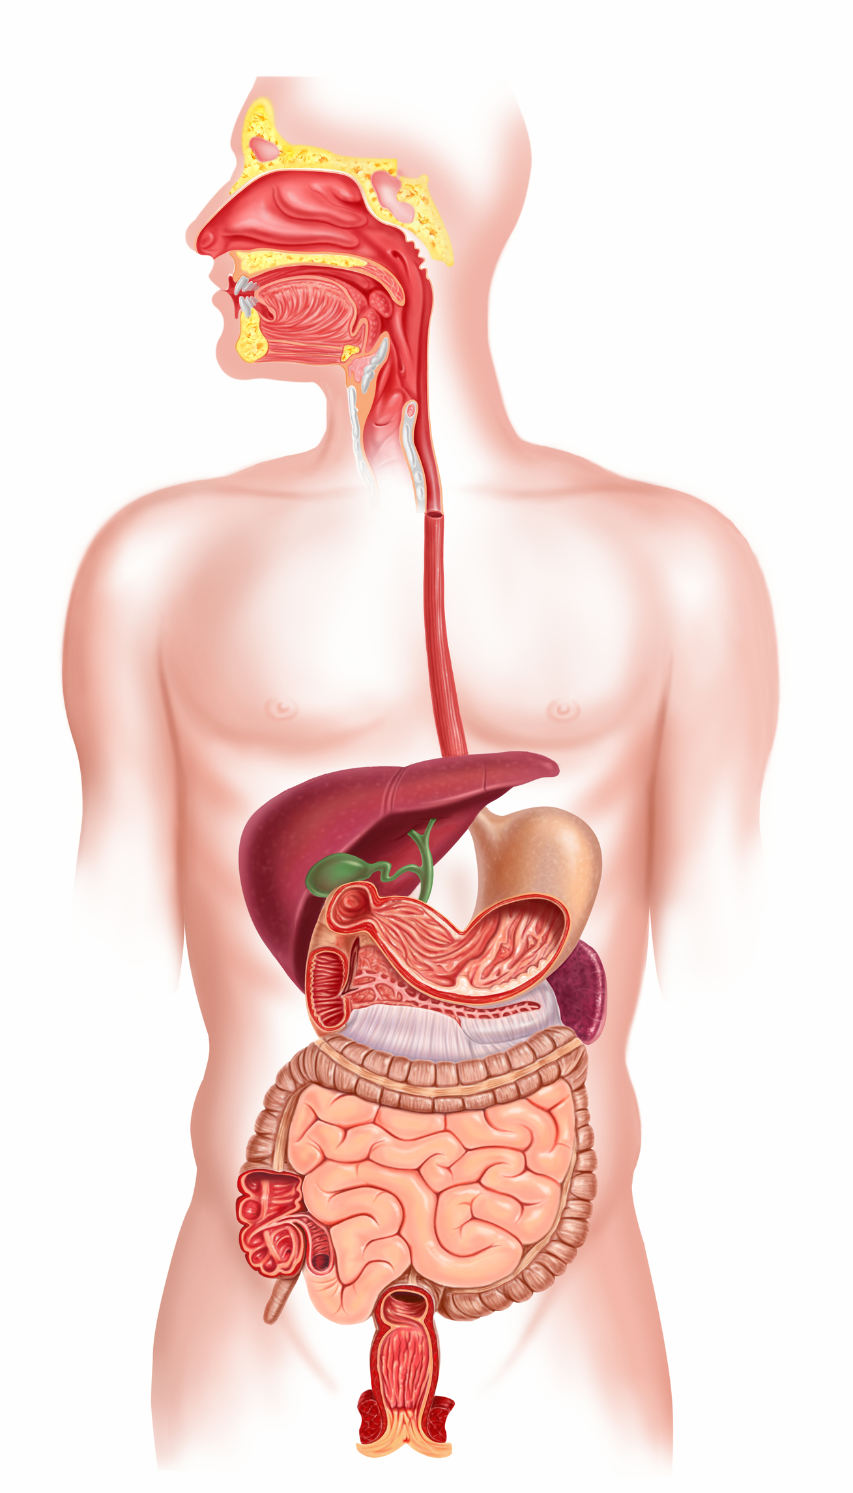

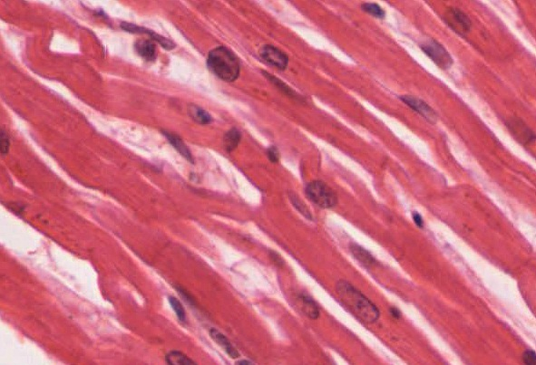
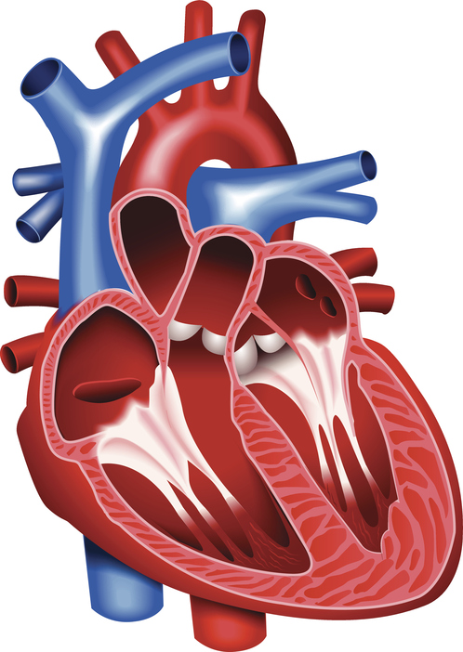
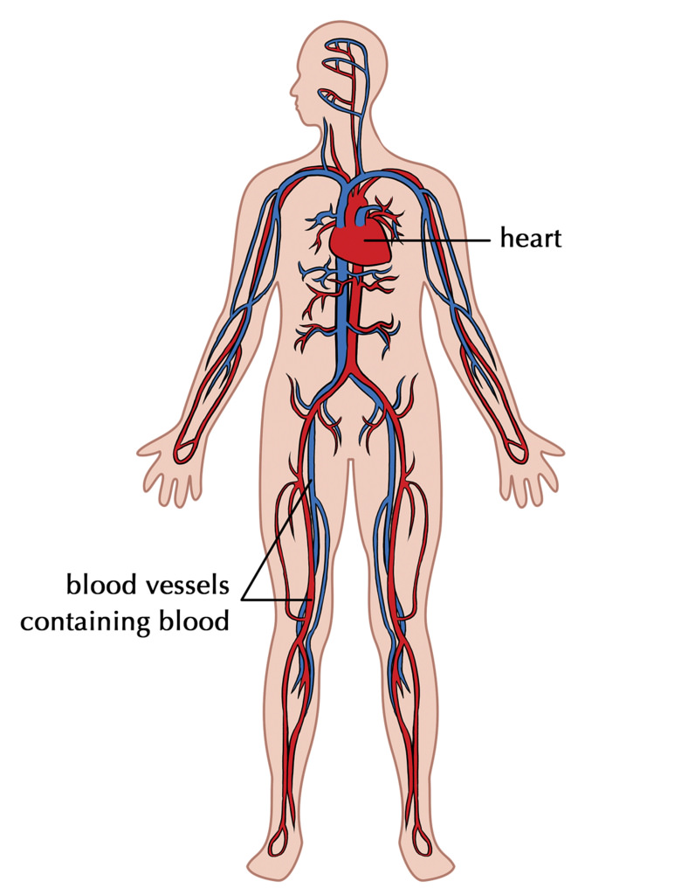
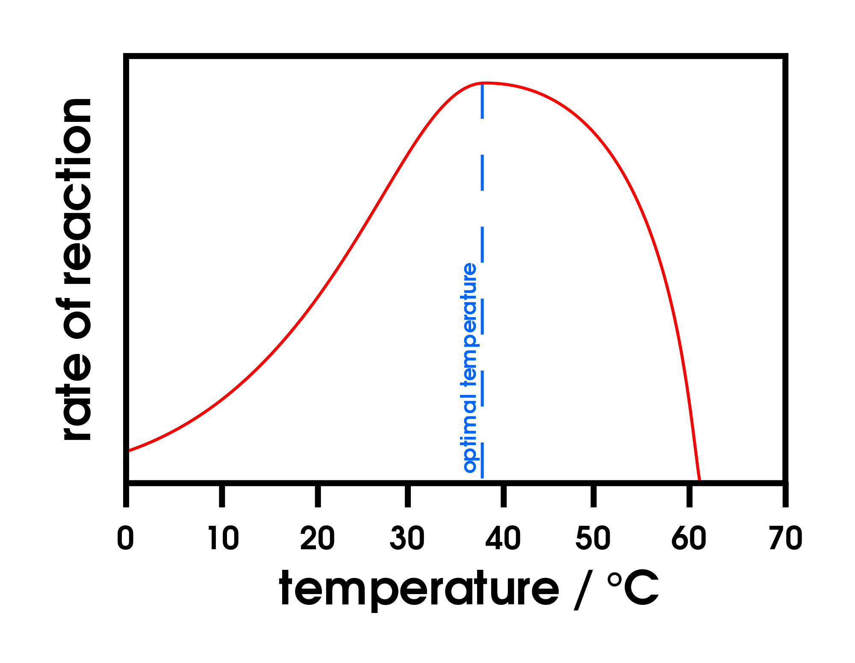
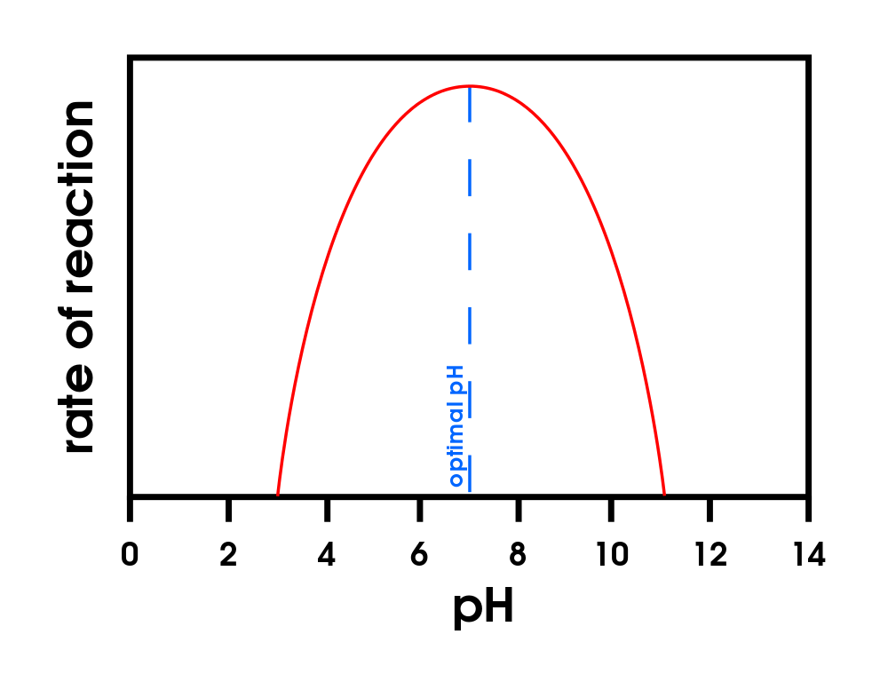
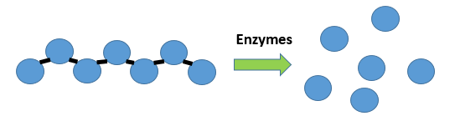
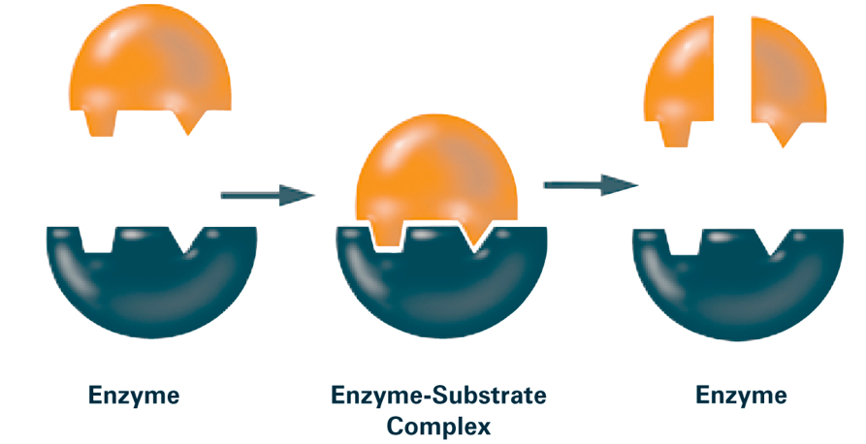
1) Cells, tissues, organs and systems
2) The human digestive system
Cells |  | e.g. muscle cells | The basic building blocks of all living organisms.
Tissues |  | e.g. muscle tissue | A group of cells with a similar structure and function.
Organs |  | e.g. the heart | Aggregations (working together) of tissues performing a specific function.
Organ systems |  | e.g. the circulatory system | Organs working together to form organ systems, which work together to form an organism.
mouth
More energy consumed in food and drink than used
obesity
Linked to increased rates of cardiovascular disease and development of diabetes type 2.
oesophagus
Non-communicable diseases
liver
stomach
gall bladder
pancreas
small intestines
large intestines
Food tests
anus
Sugars (glucose) | Benedicts’ test | Orange to brick red precipitate.
Starch | Iodine test | Turns black.
Biuret | Biuret reagent | Mauve or purple solution.
ORGANISATION Spring 1
3) Enzymes
Enzymes catalyse (increase the rate of) specific reactions in living organisms
The activity of enzymes is affected by changes in temperature and pH
Enzymes activity has an optimum temperature | Enzyme activity has an optimum pH
4) Enzymes in digestion
Digestive enzymes speed up the conversion of large insoluble molecules (food) into small soluble molecules that can be absorbed into the bloodstream
Carbohydrases (e.g. amylase) |  | Made in salivary glands, pancreas, small intestine | Break down carbohydrates to simple sugar (e.g. amylase breaks down starch to glucose).
Proteases |  | Made in stomach, pancreas | Break down protein to amino acids.
Lipases |  | Made in pancreas (works in small intestine) | Break down lipids (fats) to glycerol and fatty acids).
Bile (not an enzyme) |  | Made in liver, stored in gall bladder. | Emulsifies lipids to increase surface area to increase the rate of lipid break down by lipase. Changes pH to neutral for lipase to work.
The ‘lock and key theory’ is a simplified model to explain enzyme action
Enzymes catalyse specific reactions in living organisms due to the shape of their active site
Large changes in temperature or pH can stop the enzyme from working (denature)
Temperature too high | pH too high or too low
Enzyme changes shape (denatures) the substrate no longer fits the active site.

Slide 9
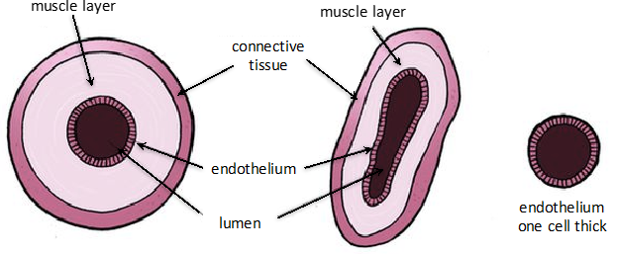
1) Blood vessels
2) Heart
The heart is an organ that pumps blood around the body in a double circulatory system
Different structure in the heart have different functions | Right ventricle | Pumps blood to the lungs where gas exchange takes place.
 | Left ventricle | Pumps blood around the rest of the body.
 | Pacemaker (in the right atrium) | Controls the natural resting heart rate. Artificial electrical pacemakers can be fitted to correct irregularities.
 | Coronary arteries | Carry oxygenated blood to the cardiac muscle.
 | Heart valves | Prevent blood in the heart from flowing in the wrong direction.
Artery | Vein | Capillary
Carry blood away from the heart | Carry blood to the heart | Connects arteries and veins
Thick muscular walls, small lumen, carry blood under high pressure, carry oxygenated blood (except for the pulmonary artery). | Thin walls, large lumen, carry blood under low pressure, have valves to stop flow in the wrong direction, carry deoxygenated blood (except for the pulmonary vein). | One cell thick to allow diffusion, Carry blood under very low pressure.
ORGANISATION Spring 1
3) Blood
Blood is a tissue consisting of plasma, in which blood cells, white blood cells and platelets are suspended
4) Lungs and gas exchange
The heart pumps low oxygen/high carbon dioxide blood to the lungs
Trachea | Carries air to/from the lungs | Rings of cartilage protect the airway.
Bronchioles | Carries air to/from the air sacs (alveoli) | Splits into multiple pathways to reach all the air sacs.
Alveoli | Site of gas exchange in the lungs | Maximises surface area for efficient gas exchange.
Capillaries | Allows gas exchange between into/out of blood | Oxygen diffuses into the blood and carbon dioxide diffuses out.
Plasma (55%) | Pale yellow fluid | Transports CO₂, hormones and waste.
Red blood cells (45%) | Carries oxygen | Large surface area, no nucleus, full of haemoglobin.
White blood cells (<1%) | Part of the immune system | Some produce antibodies, others surround and engulf pathogens.
Platelets (<1%) | Fragments of cells | Clump together to form blood clots.

Slide 10
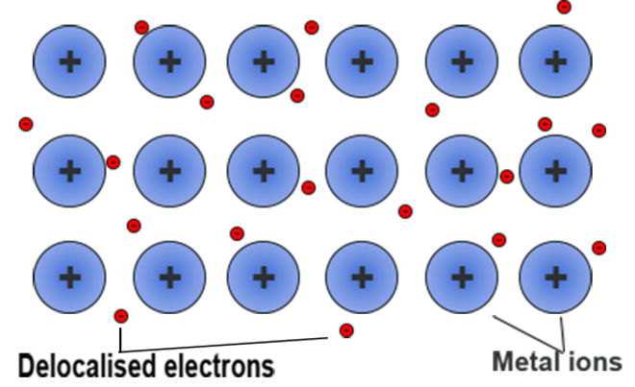
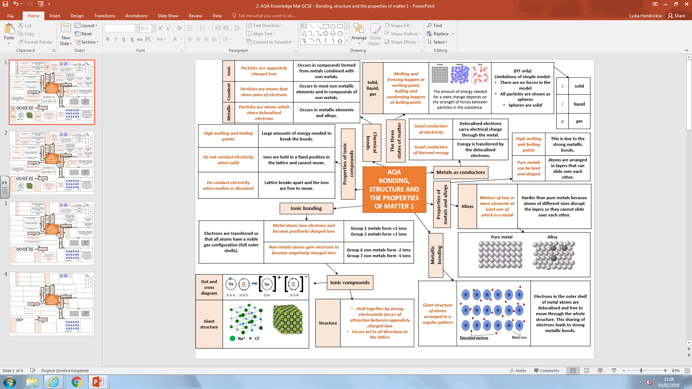
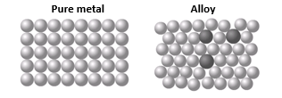
Section 1: Types of bonding
1.Ionic | Particles are oppositely charged ions | Occurs in compounds formed from metals combined with non metals.
2. Covalent | Particles are atoms that share pairs of electrons | Occurs in most non metallic elements and in compounds of non metals.
3. Metallic | Particles are atoms which share delocalised electrons | Occurs in metallic elements and alloys.
Section 2: Ionic Bonding – Structure and properties
4. High melting and boiling points | Large amounts of energy needed to break the bonds.
5. Do conduct electricity when molten or dissolved | Lattice breaks apart and the ions are free to move.
6. Do not conduct electricity when solid | Ions are held in a fixed position in the lattice and cannot move.
7. Structure | Held together by strong electrostatic forces of attraction between oppositely charged ions Forces act in all directions in the lattice
6. Giant structure
7. Dot and cross diagram
Section 4: Metallic Bonding – Structure and properties
9. Giant structure of atoms arranged in a regular pattern
10. Good conductors of electricity | Delocalised electrons carry electrical charge through the metal.
11. Good conductors of thermal energy | Energy is transferred by the delocalised electrons.
12. High melting and boiling points | This is due to the strong metallic bonds.
13. Pure metals can be bent and shaped | Atoms are arranged in layers that can slide over each other.
14. Alloys are mixture of two or more elements at least one of which is a metal | Harder than pure metals because atoms of different sizes disrupt the layers so they cannot slide over each other.
Electrons in the outer shell of metal atoms are delocalised and free to move through the whole structure. This sharing of electrons leads to strong metallic bonds.
Section 3: What happens during bonding?
8. Electrons are transferred so that all atoms have a noble gas configuration (full outer shells). | Metal atoms lose electrons and become positively charged ions | Group 1 metals form +1 ions Group 2 metals form +2 ions
 | Non metals atoms gain electrons to become negatively charged ions | Group 6 non metals form -2 ions Group 7 non metals form -1 ions
Types of Bonding
Spring 1

Slide 11
Electricity: Spring 1
Cell | Battery | Switch | Lamp | Ammeter | Volt meter
Store of chemical energy | Two or more cells in series | Breaks circuit, turning current off | Lights when current flows | Measures current | Measures potential difference
Diode | LED | LDR | Fuse | Resistor | Variable resistor | Thermistor
Current flows one way | Emits light when current flows | Resistance low in bright light | Melts when current is too high | Affects the size of current flowing | Allows current to be varied | Resistance low at high temp
1
Current | Flow of electrical charge | Ampere (A)
Potential difference (p.d.) | How much electrical work is done by a cell | Volts (V)
Charge | Amount of electricity travelling in a circuit | Coulombs (C)
Charge = Current X time
Q = I X t
Resistance (Ω) | A measurement of how much current flow is reduced
The higher the resistance, the more difficult it is for current to flow.
Increasing resistance, reduces current.
Increasing voltage, increases current.
2
Changing current | Change the p.d. of the cells
 | Add more components
Ammeter | Set up in series with components
Voltmeter | Set up parallel to components
R = V ÷ I
Thermistor | LDR
Resistance varies with temperature | Resistance varies with light intensity
Resistance decreases as temperature increases. | Resistance decreases as light increases.
Ohmic conductor | At a constant temperature, current is directly proportional to the p.d. across the resistor.
Filament lamp | As current increases, the resistance increases. The temperature increases as current flows.
Diode | Current flows when p.d. flows forward. Very high resistance in reverse.
3
Resistance = Potential difference ÷ Current
‘Earthing’ a safety device; Earth wire joins the metal case.
3 pin plug | Live - Brown | Carries p.d from mains supply. | p.d between live and earth = 230V
 | Neutral - Blue | Completes the circuit. | p.d. = OV
 | Earth – Green and Yellow stripes | Only carries current if there is a fault. | p.d. = 0V
Alternating current | Direct current
p.d. switches direction many times a second, current switches direction | p.d. remains in one direction, current flows the same direction
Generator. | Cell or battery.
4
Mains supply
50Hz, 230V

Slide 12
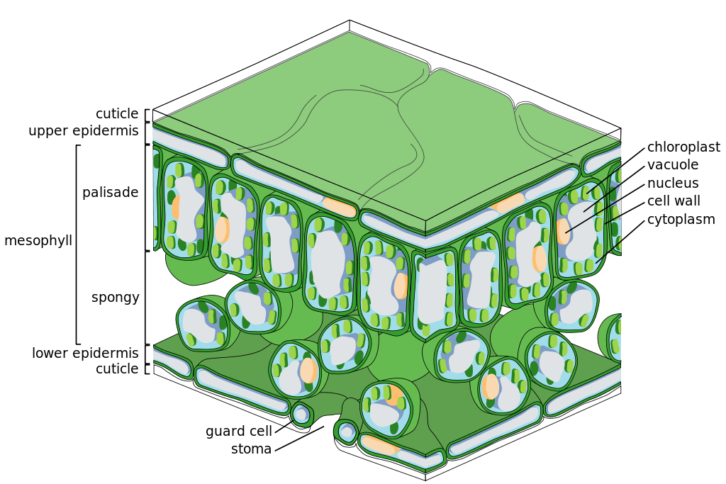
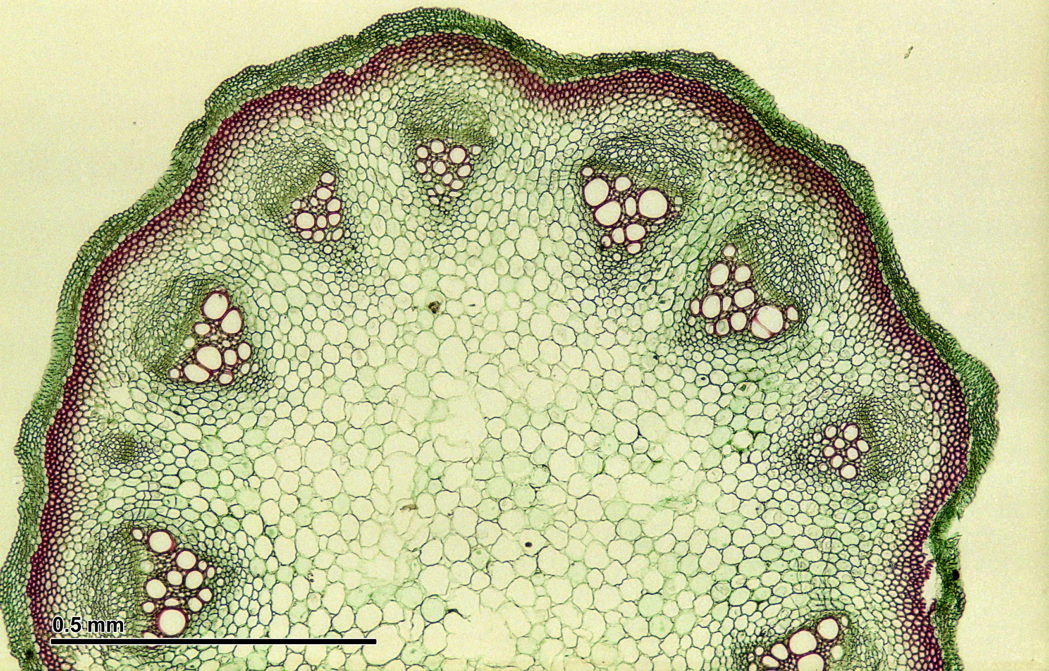
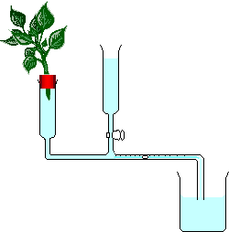
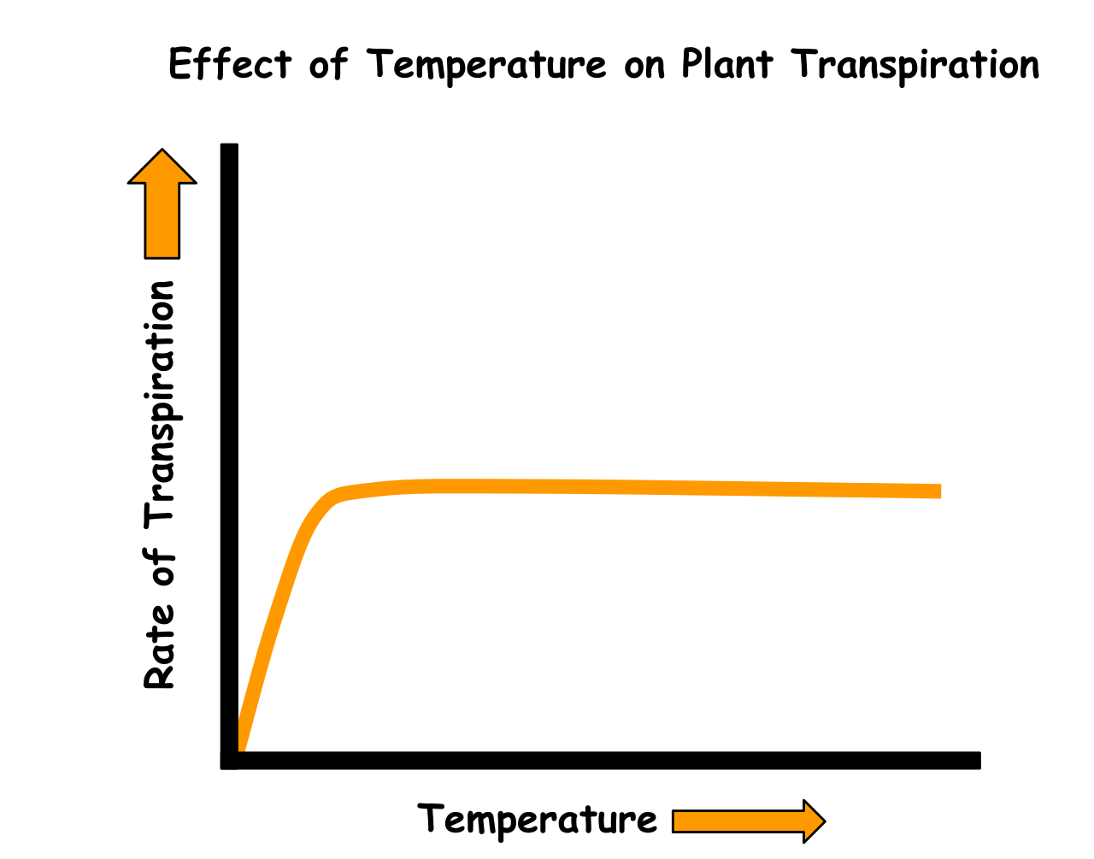
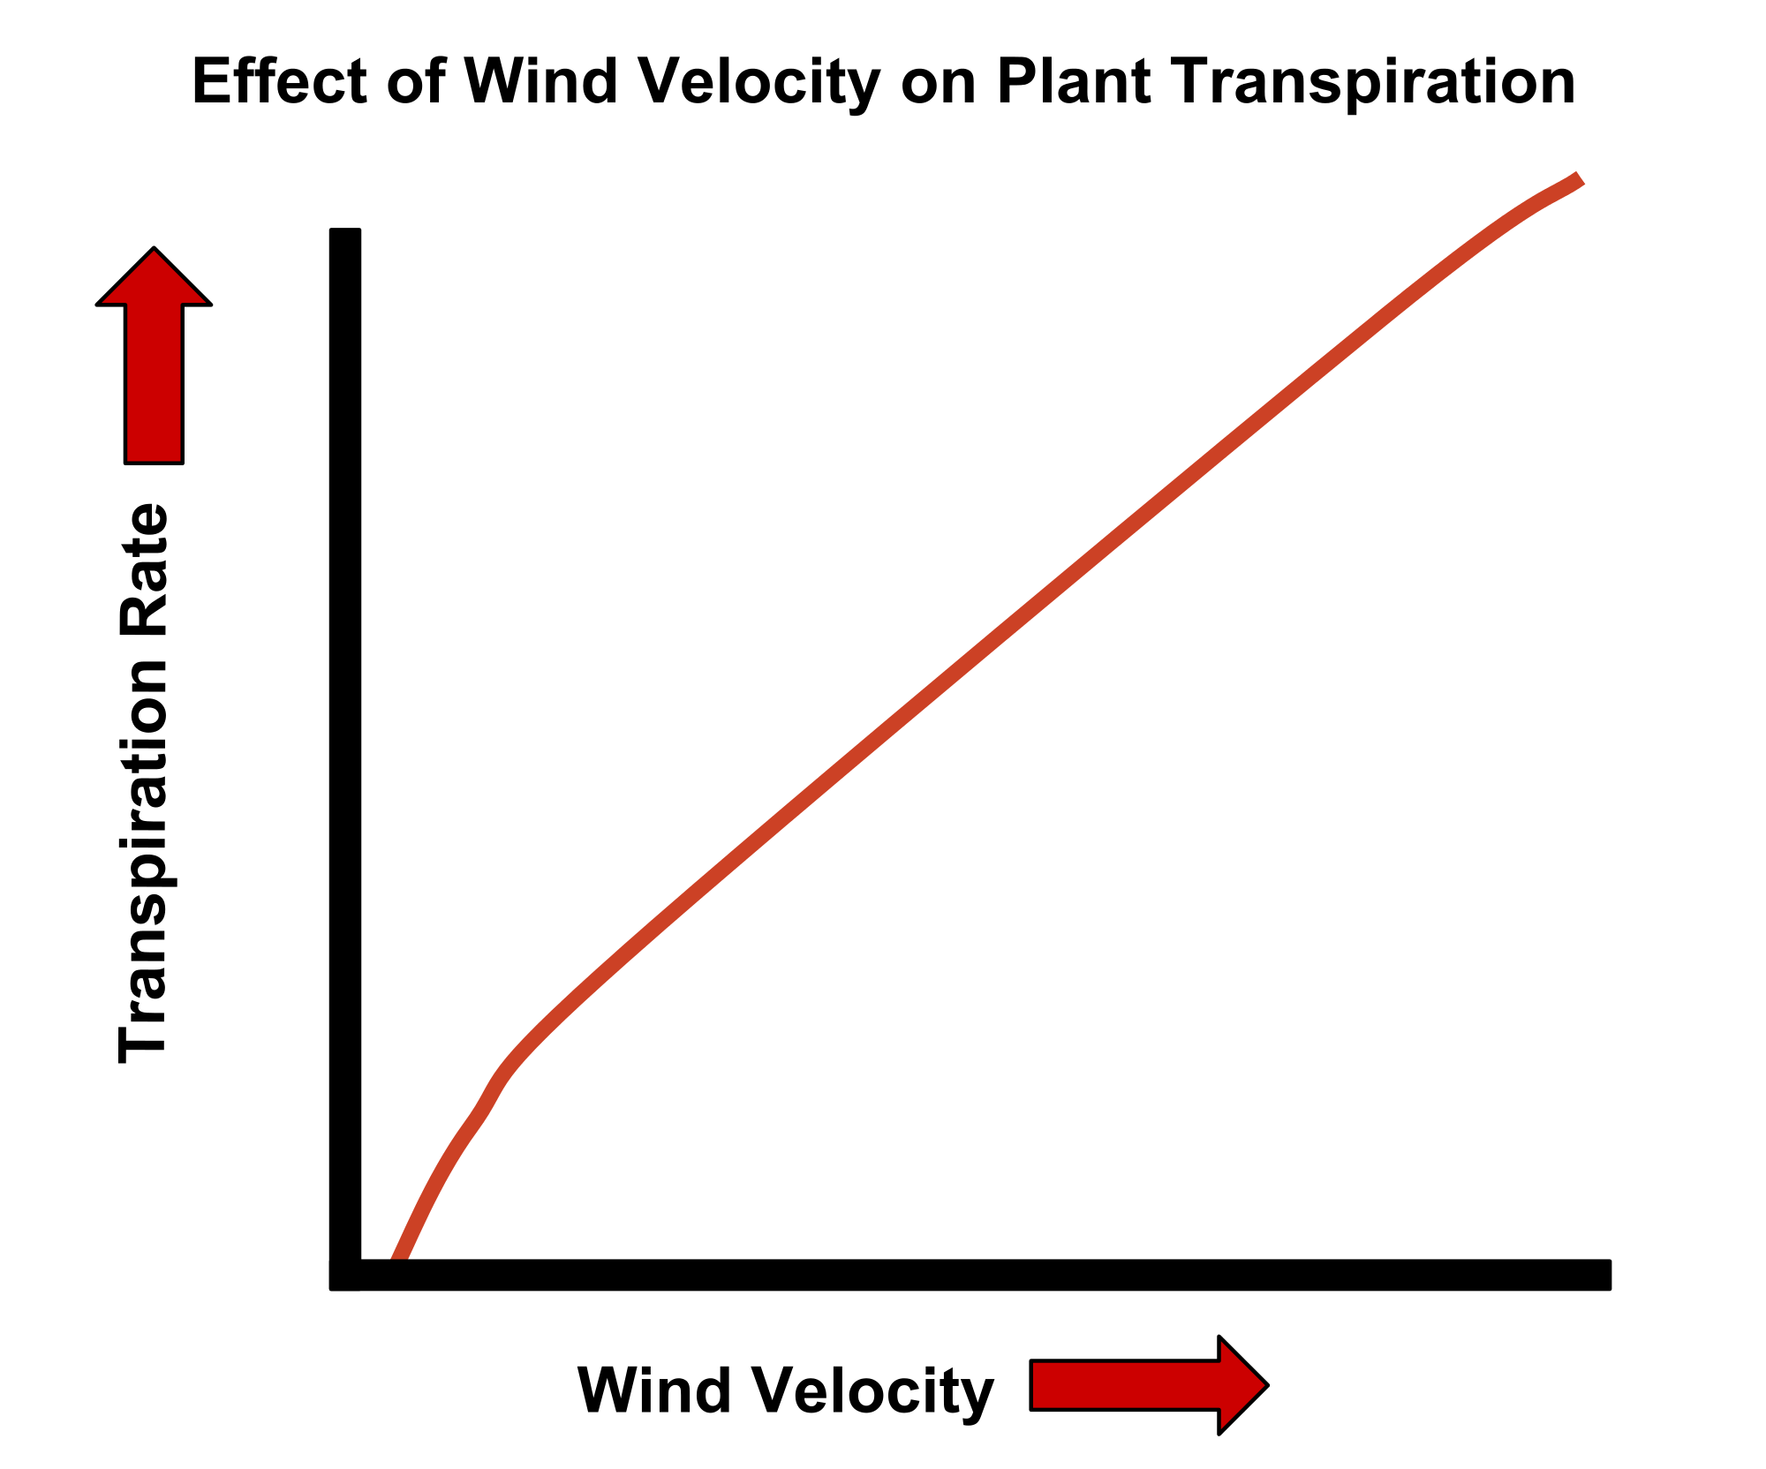
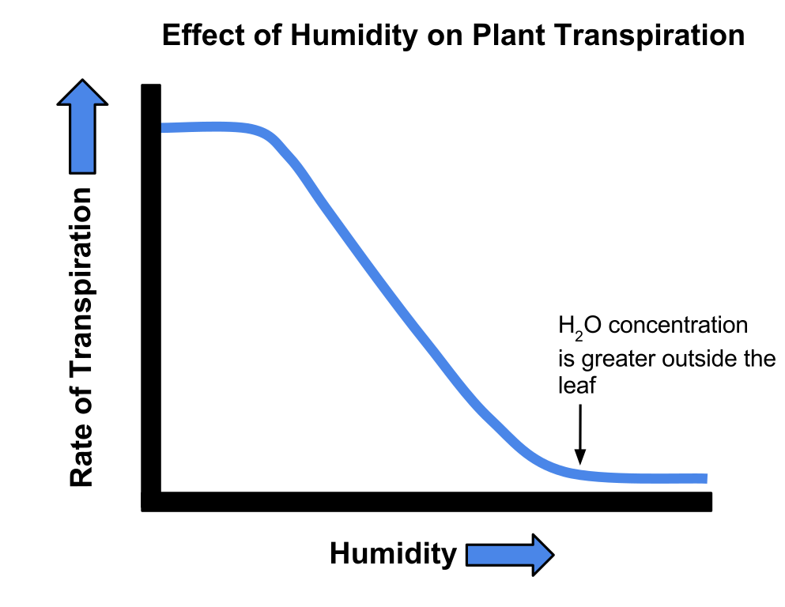
Heart problems
Heart failure can be treated with a transplant or artificial heart.
2. Plant tissues
Epidermal tissues | Waxy cuticle (top layer of the leaf) | Reduces water loss from the leaf
 | Guard cells and stomata | Guard cells open and close the stomata to control water loss and allow for gas exchange (oxygen and carbon dioxide).
Palisade mesophyll | Palisade cells | Cells near the top surface of the leaf that are packed with chloroplasts that contain chlorophyll. Both adaptations maximize photosynthesis.
Spongy mesophyll | Air spaces in the leaf between cells | Increased surface area for gas exchange so that carbon dioxide can diffuse into photosynthesising cells.
xylem | Hollow tubes strengthened by lignin adapted for the transportation of water in the transpiration stream | Allows transport of water and mineral ions from the roots to the stem and the leaves.
phloem | Cell sap moves from one phloem cell to the next through pores in the end walls | Transports dissolved sugars from the leaves to the rest of the plant for immediate use or storage (translocation).
Meristem tissue | New cells (roots and shoot tips) are made here including root hair cells | Root hair cells have an increased surface area for the uptake of water by osmosis, and mineral ions by active transport.
Disease | Cause | Effect | Treatment
Coronary heart disease (CHD) | A build up for fatty substances in the coronary arteries (atherosclerosis) | Oxygenated blood cannot get to the cardiac muscle. | Stents: inserted into the blocked artery to open it up. Statins: lower harmful cholesterol.
Faulty heart valves | Valves don’t open or close properly | Blood can leak or flow in the wrong direction | Biological valve transplant or a mechanical valve can be inserted
3. Non-communicable diseases
Cancer
The result of changes in DNA that lead to uncontrolled growth and division
ORGANISATION
Spring 2
Benign tumour | Contained in one area of the body (usually by a membrane) – not cancer.
Malignant tumour | Invade tissues and spread to different parts of the body to form secondary tumours.
4. Transpiration
A potometer is used to measure the amount of water lost over time (rate of transpiration)
Some cancers have genetic risk factors.
Carcinogens and ionising radiation increase the risk of cancer by changing/ damaging DNA.
Transpiration | The rate at which water is lost from the leaves of a plant. The transpiration stream is the column of water moving through the roots, stem and leaves | Temperature, humidity, air movement and light intensity affect the rate of transpiration.
Risk factors for heart/lung disease and certain types of cancer include drinking alcohol, diet, obesity and smoking
These risks factors can also affect the brain, liver and the health of unborn babies.

Slide 13
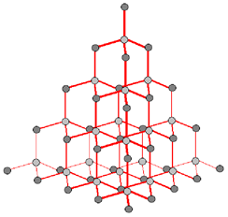
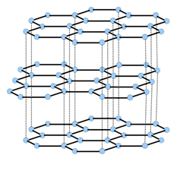
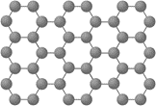
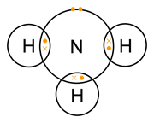

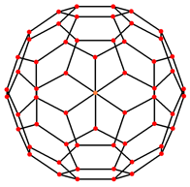
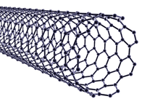
1. Comparing diamond and graphite
2. Properties of small molecules
Covalent bonds in the molecule are strong but forces between molecules (intermolecular) are weak | Usually gases or liquids with ow melting and boiling points. | Due to having weak intermolecular forces that easily broken.
 | Do not conduct electricity. | Due to them molecules not having an overall electrical charge.
 | Larger molecules have higher melting and boiling points. | Intermolecular forces increase with the size of the molecules.
Diamond Each carbon atom is bonded to four others |  | Very hard. | Rigid structure.
 |  | Very high melting point. | Strong covalent bonds.
 |  | Does not conduct electricity. | No delocalised electrons.
Graphite Each carbon atom is bonded to three others forming layers of hexagonal rings with no covalent bonds between the layers |  | Slippery. | Layers can slide over each other.
 |  | Very high melting point. | Strong covalent bonds.
 |  | Does conduct electricity. | Delocalised electrons between layers.
Bonding
Spring 2
3. Other carbon based molecules
Graphene |  | Excellent conductor. | Contains delocalised electrons.
 |  | Very strong. | Contains strong covalent bonds.
4. Covalent bonding
Particles are atoms that share pairs of electrons. These bonds between atoms are strong. | Occurs in most non metallic elements and in compounds of non metals.
Single layer of graphite one atom thick
How to present covalent bonds
Fullerenes |  | Hexagonal rings of carbon atoms with hollow shapes. Can also have rings of five (pentagonal) or seven (heptagonal) carbon atoms.
2D with bonds:
Show which atoms are bonded together
Dot and cross :
Show which atom the
electrons in the bonds come
Carbon nanotubes |  | Very thin and long cylindrical fullerenes | Very conductive. | Used in electronics industry.
 |  |  | High tensile strength. | Reinforcing composite materials.
 |  |  | Large surface area to volume ratio. | Catalysts and lubricants.

Slide 14
Electricity: Spring 2
Series circuit | Current is the same in all components. | Total p.d. from battery is shared between all the components. | Total resistance is the sum of each component’s resistance.
Parallel circuit | Total current is the sum of each component’s current. | p.d. across all components is the same. | Total resistance is less than the resistance value of the smallest individual resistor.
5
Series | Parallel
A circuit with one loop | A circuit with two or more loops
Total p.d | If cells are joined in series, add up individual cell values
Power (W) = potential difference X current
R = V X I
Charge = Current X time
Q = I X t
6
Work is done when a charge is flowing.
Power = (current)² X resistance
P = I² X R
R = V ÷ I
Energy transferred = Power X time
E = P X t
Resistance = Potential difference ÷ Current
7
Step-up transformers | Step-down transformers
Increase voltage, decrease current | Decrease voltage, increase current
Increases efficiency, reduces heat loss. | Makes safer for houses.
Electric field diagrams
National Grid | Distributes electricity generated in power stations around UK
Like charges | Repel
Unlike charges | Attract
8
Static electricity | Electrical charge is stationary | When two insulating material are rubbed together, electrons move from one material to the other.
Shocks | Walking on carpet causes friction. Electrons move to the person and charge builds up. When the person touches a metal object, the electrons conduct away, making a spark.
Electric fields | Charged objects create electric fields around them. Strongest closest to the object. The field direction is the direction of force on a positive charge. Add more charge increases field strength.

Slide 15
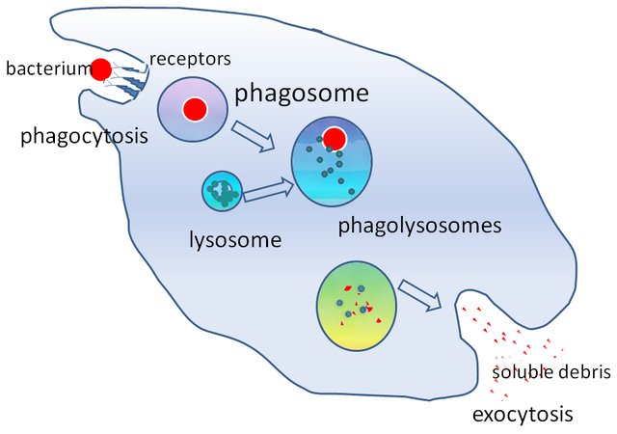
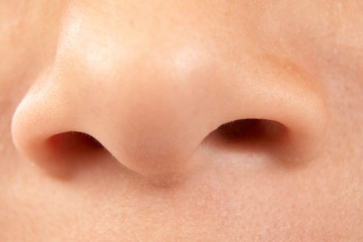
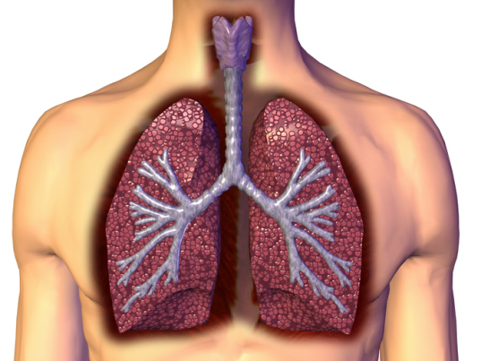
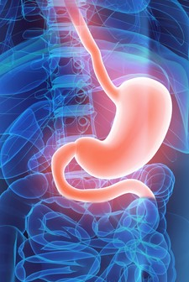
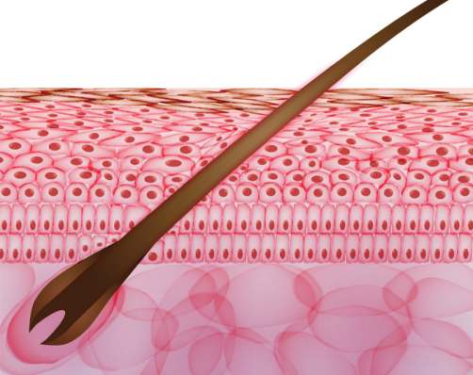
1. Immune system
Phagocytes | Phagocytosis | Phagocytes engulf the pathogens and digest them.
Lymphocytes | Antibody production | Specific antibodies destroy the pathogen. This takes time so an infection can occur. If a person is infected again by the same pathogen, the lymphocytes make antibodies much faster.
 | Antitoxin production | Antitoxin is a type of antibody produced to counteract the toxins produced by bacteria.
4. Plant defence system
Plants have several ways of defending themselves from pathogens and animals
Detection and identification of plant diseases (bio only) | Detection | Identification
 | Stunted growth | Reference using gardening manual or website, laboratory test for pathogens, testing kit using monoclonal antibodies.
 | Spots on leaves
 | Area of decay
 | growths
 | Malformed stem/leaves
 | Discolouration
 | Presence of pests
Physical | Mechanical
Thick waxy layers, cell walls stop pathogen entry. | Thorns, curling up leaves to prevent being eaten.
Chemical
Antibacterial and toxins made by plant.
2. Non-specific defence systems
Pathogens are identified by white blood cells by the different proteins on their surfaces ANTIGENS.
The human body has several non specific ways of defending itself from pathogens getting in |  | Nose | Nasal hairs, sticky mucus and cilia prevent pathogens entering through the nostrils.
 |  | Trachea and bronchus (respiratory system) | Lined with mucus to trap dust and pathogens. Cilia move the mucus upwards to be swallowed.
 |  | Stomach acid | Stomach acid (pH1) kills most ingested pathogens.
 |  | Skin | Hard to penetrate waterproof barrier. Glands secrete oil which kill microbes.
INFECTION AND RESPONSE Summer 1
5. Communicable diseases
Pathogens may infect plants or animals and can be spread by direct contact, water or air
Pathogen | Disease | Symptoms | Method of transmission | Control of spread
Virus | Measles | Fever, red skin rash. | Droplet infection from sneezes and coughs. | Vaccination as a child.
Virus | HIV | Initially flu like systems, serious damage to immune system. | Sexual contact and exchange of body fluids. | Anti-retroviral drugs and use of condoms.
Virus | Tobacco mosaic virus | Mosaic pattern on leaves. | Enters via wounds in epidermis caused by pests. | Remove infected leaves and control pests that damage the leaves.
Bacteria | Salmonella | Fever, cramp, vomiting, diarrhoea. | Food prepared in unhygienic conditions or not cooked properly. | Improve food hygiene, wash hands, vaccinate poultry, cook food thoroughly.
Bacteria | Gonorrhoea | Green discharge from penis or vagina. | Direct sexual contact or exchange of body fluids. | Use condoms. Treatment using antibiotics.
Protists | Malaria | Recurrent fever. | By an animal vector (mosquitoes). | Prevent breeding of mosquitoes. Use of nets to prevent bites.
Fungus | Rose black spot | Purple black spots on leaves. | Spores carried via wind or water. | Remove infected leaves. Spray with fungicide.
3. Pathogens
Pathogens are microorganisms that cause infectious disease.
Viruses | Bacteria (prokaryotes) | Protists (eukaryotes) | Fungi (eukaryotes)
e.g. cold, influenza, measles, HIV, tobacco mosaic virus | e.g. tuberculosis (TB), Salmonella, Gonorrhoea | e.g. dysentery, sleeping sickness, malaria | e.g. athlete’s foot, thrush, rose black spot
DNA or RNA surrounded by a protein coat. | No membrane bound organelles (no chloroplasts, mitochondria or nucleus). Cell wall. Single celled organisms. | Membrane bound organelles. Usually single celled. | Membrane bound organelles, cell wall made of chitin. Single celled or multi-cellular.

Slide 16
1 )Mass changes when a reactant or product is a gas
Whenever a measurement is taken, there is always some uncertainty about the result obtained | Can determine whether the mean value falls within the range of uncertainty of the result | Calculate the mean Calculate the range of the results Estimate of uncertainty in mean would be half the range
Mass appears to increase during a reaction | One of the reactants is a gas | Magnesium + oxygen → magnesium oxide
Mass appears to decrease during a reaction | One of the products is a gas and has escaped | Calcium carbonate → carbon dioxide + calcium oxide
2) Chemical measurements
3 )Relative formula mass (M_{r}) with worked example
Conservation of mass | No atoms are lost or made during a chemical reaction | Mass of the products equals the mass of the reactants.
M_{r} | The sum of the relative atomic masses of the atoms in the numbers shown in the formula | The sum of the M_{r} of the reactants in the quantities shown equals the sum of the M_{r} of the products in the quantities shown. | 2Mg + O₂ → 2MgO 48g + 32g = 80g 80g = 80g
4) Conservation of mass
Balanced symbol equations | Represent chemical reactions and have the same number of atoms of each element on both sides of the equation | H₂ + Cl₂ → 2HCl Subscript numbers show the number of atoms of the element to its left. Normal script numbers show the number of molecules.
5) Concentration of solutions
Measured in mass per given volume of solution (g/dm³) | Conc. = mass (g) . volume (dm³) | HT only Greater mass = higher concentration. Greater volume = lower concentration.
QUANTITATIVE CHEMISTRY
Summer 1
7 Amounts of substances in equations (HT only)
6) Moles worked example (HT only)
Chemical equations show the number of moles reacting and the number of moles made | Mg + 2HCl → MgCl₂ + H₂ One mole of magnesium reacts with two moles of hydrochloric acid to make one mole of magnesium chloride and one mole of hydrogen | WORKED EXAMPLE If you have a 60g of Mg, what mass of HCl do you need to convert it to MgCl₂? A_{r} : Mg =24 so mass of 1 mole of Mg = 24g M_{r} : HCl (1 + 35.5) so mass of 1 mole of HCl = 36.5g So 60g of Mg is 60/24 = 2.5 moles Balanced symbol equation tells us that for every one mole of Mg, you need two moles of HCl to react with it. So you need 2.5x2 = 5 moles of HCl You will need 5 x 36.5g of HCl= 182.5g
Chemical amounts are measured in moles (mol) | Mass of one mole of a substance in grams = relative formula mass | One mole of H₂O = 18g (1 + 1 + 16) One mole of Mg = 24g
Avogadro constant | One mole of any substance will contain the same number of particles, atoms, molecules or ions. | 6.02 x 10²³ per mole One mole of H₂O will contain 6.02 x 10²³ molecules One mole of NaCl will contain 6.02 x 10²³ Na⁺ ions
Number of moles = mass (g) or mass (g) A_{r} M_{r} | WORKED EXAMPLE How many moles of sulfuric acid molecules are there in 4.7g of sulfuric acid (H₂SO₄)? 4.7 = 0.05 mol 98 M_{r} of H₂SO₄

Slide 17
Particles: Summer 1
State | Particle arrangement | Motion | Forces | Properties
Solid | Packed in a regular structure. | Particles can only vibrate. | Strong | Difficult to change shape.
Liquid | Close together. | Particles free to move around | Forces keep particles in contact | Can change shape but difficult to compress.
Gas | Separated by large distances. | Particles move with a range of speeds in random directions. | Weak | Can expand to fill a space, easy to compress.
1
Describe the relationship between temperature and pressure. | Describe the relationship between temperature and the average kinetic energy of a gas. | Explain the relationship between temperature and pressure. | Describe the relationship between volume and pressure. | Explain the relationship between volume and pressure.
The hotter the temperature the greater the pressure. | The hotter a gas the greater the average kinetic energy of the particles. | Hotter particles have more kinetic energy and move faster. They collide with the container more frequency, hence there is more pressure. | The smaller the volume the greater the pressure. | The smaller the volume the shorter the distance the particles move before colliding with the container, hence collisions are more frequent.
2
3
4
5
State an equation for density | Density = mass / volume
Measurement | Units
Density | Kilograms per metre cubed (kg/m³)
Mass | Kilograms (kg)
Volume | Metres cubed (m³)
Energy needed | Joules (J)
Specific latent heat | Joule per kilogram (J/kg)
Change in thermal energy | Joules (J)
Specific heat capacity | Joule per kilogram degrees Celsius (J/kg°C)
Temperature change | Degrees Celsius ( °C)
Pressure | Pascals (Pa)
Key word | Definition
Specific Heat Capacity | Energy needed to raise 1kg of substance by 1°C
Specific Latent Heat | Energy needed to change 1kg of a substance’s state
Specific Latent Heat of Fusion | Energy needed to change 1kg of solid into 1 kg of liquid at the same temperature
Specific Latent Heat of Vaporisation | Energy needed to change 1kg of liquid into 1 kg of gas at the same temperature
Freezing | Liquid turns to a solid. Internal energy decreases.
Melting | Solid turns to a liquid. Internal energy increases.
Boiling / Evaporating | Liquid turns to a gas. Internal energy increases.
Condensation | Gas turns to a liquid. Internal energy decreases.
Sublimation | Solid turns directly into a gas. Internal energy increases.
Conservation of mass | When substances change state, mass is conserved.
Physical change | No new substance is made, process can be reversed.

Slide 18
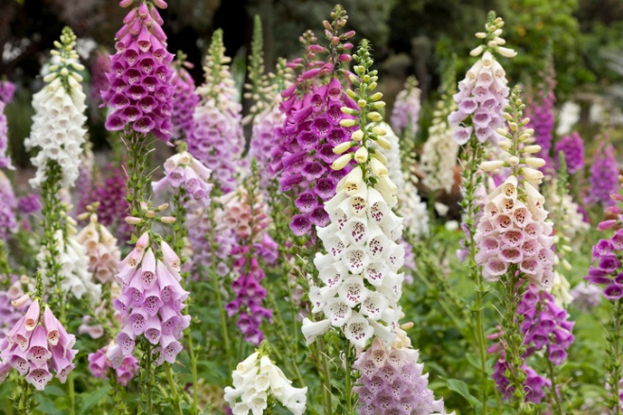
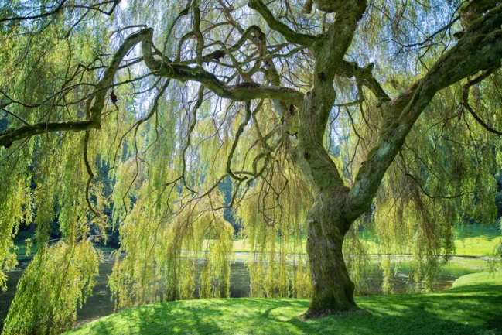
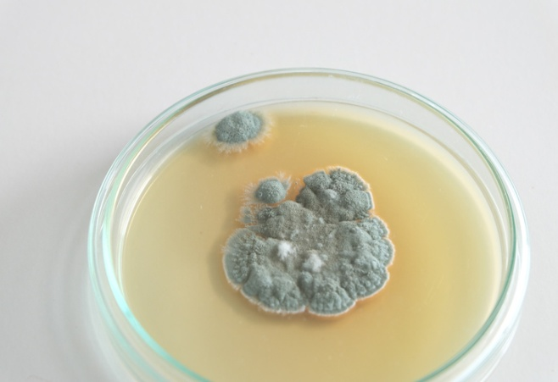
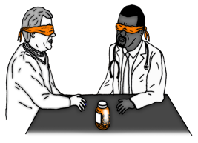
1) Discovery and drug development
Most new drugs are synthesised by chemists in the pharmaceutical industry.
2) Antibiotics and painkillers
Antibiotics have greatly reduced deaths from infectious bacterial disease
Traditionally drugs were extracted from plants and microorganisms
Digitalis | Aspirin | Penicillin
Extracted from foxglove plants and used as a heart drug | A painkiller and anti-inflammatory that was first found in willow bark | Discovered by Alexander Fleming from the Penicillium mould and used as an antibiotic
Antibiotics | e.g. penicillin | Kill infective bacteria inside the body. Specific bacterial infections require specific antibiotics.
Painkillers and other medicines | e.g. aspirin, paracetamol, ibuprofen | Drugs that are used to treat the symptoms of a disease. They do not kill pathogens.
Antibiotics cannot be use to treat viral pathogens
It is difficult to develop drugs to kill viruses without harming body tissues because viruses live and reproduce inside cells
Used to immunise a large proportion of the population to prevent the spread of a pathogen
3) Vaccination
5) Testing drugs
INFECTION AND RESPONSE
Summer 2
Vaccination | Small amount of dead or inactive form of the pathogen | 1st infection by pathogen | White blood cells detect pathogens in the vaccine. Antibodies are released into the blood.
 |  | Re-infection by the same pathogen | White blood cells detect pathogens. Antibodies are made much faster and in larger amounts.
New drugs are extensively tested for: | Efficacy | Make sure the drug works
 | Toxicity | Check that the drug is not poisonous
 | Dose | The most suitable amount to take
Double blind trial: patients and scientists do not know who receives the new drug or placebo until the end of the trial. This avoids bias.
4) Monoclonal antibodies
Specific to one binding site on the antigen. Can target specific chemicals or cells in the body.
Preclinical trials - using cells, tissues and live animals - must be carried out before the drug can be tested on humans.
Stage 1 | Stage 2 | Stage 3 | Stage 4
Healthy volunteers try small dose of the drug to check it is safe record any side effects. | A small number of patients try the drug at a low dose to see if it works. | A larger number of patients; different doses are trialled to find the optimum dose. | A double blind trial will occur. The patients are divided into groups. Some will be given the drug and some a placebo.
(Biology only HT)
Monoclonal antibodies can be used in a variety of ways
Diagnosis | Detecting pathogens | Detecting molecules | Treatment
e.g. pregnancy test – measure the level of hormones | Can detect very small quantities of chemicals in the blood | Fluorescent dye can be attached so it can be seen inside cells or tissues | Bound to radioactive substance, toxic drug or chemical Cancer cells are targeted to normal body cells are unharmed
Monoclonal antibodies | Identical copies of one types of antibody produced in laboratory | 1. A mouse is injected with pathogen
 |  | 2. Lymphocytes produce antibodies
 |  | 3. Lymphocytes are removed from the mouse and fused with rapidly dividing mouse tumour cells
 |  | 4. The new cells are called hybridomas
 |  | 5. The hybridomas divide rapidly and release lots of antibodies which are then collected
A placebo can look identical to the new drug but contain no active ingredients.

Slide 19
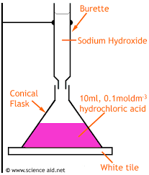
1) Atom economy
Titration equipment
A measure of the amount of starting materials that end up as useful products | Atom economy = Relative formula mass of desired product from equation x 100 Sum of relative formula mass of all reactants from equation | High atom economy is important or sustainable development and economic reasons
WORKED EXAMPLE Calculate the atom economy for making hydrogen by reacting zinc with hydrochloric acid: Zn + 2HCl → ZnCl₂ + H₂ M_{r} of H₂ = 1 + 1 = 2 M_{r} of Zn + 2HCl = 65 + 1 + 1 + 35.5 + 35.5 = 138 Atom economy = ²∕₁₃₈ × 100 = ²∕₁₃₈ × 100 = 1.45% This method is unlikely to be chosen as it has a low atom economy.
3) Completing a titration
QUANTITATIVE CHEMISTRY
Summer 2
Learn the step by step method | Titrations are a very accurate experimental technique to find the concentration of a solution. 1. A known volume of an acid or alkali is measured out using a pipette and placed into a conical flask. 2. A few drops of a suitable indicator are added, (methyl orange or phenolphthalein). 3. The other solution is added to the burette and the volume read. 4. The solution is added from the burette into the conical flask until the indicator changes colour. The solution is added dropwise towards the end to ensure the exact volume is used. 5. The end volume of the burette is recorded and the difference found. 6. The experiment is repeated until similar results are achieved.
2) Percentage yield
Yield is the amount of product obtained | It is not always possible to obtain the calculated amount of a product | The reaction may not go to completion because it is reversible.
 |  | Some of the product may be lost when it is separated from the reaction mixture.
 |  | Some of the reactants may react in ways different to the expected reaction.
Percentage yield is comparing the amount of product obtained as a percentage of the maximum theoretical amount | % Yield = Mass of product made x 100 Max. theoretical mass | A piece of sodium metal is heated in chlorine gas. A maximum theoretical mass of 10g for sodium chloride was calculated, but the actual yield was only 8g. Calculate the percentage yield. Percentage yield = 8/10 x 100 =80%
4) Use of amount of substance in relation to volumes of gases (HT only)
Equal amounts of moles or gases occupy the same volume under the same conditions of temperature and pressure | The volume of one mole of any gas at room temperature and pressure (20°C and 1 atmospheric pressure) is 24 dm³ | No. of moles of gas = vol of gas (dm³) 24dm³

Slide 20
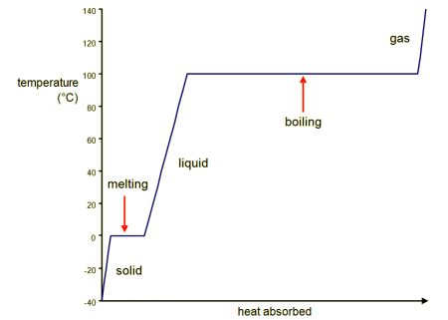
Particles: Summer 2
1
Define internal energy | Why does heating a gas influence the internal energy of a system? | (HIGHER) Why does pumping air into a bike tyre increase the internal energy of a system?
Total kinetic and potential energies of all the particles in a system. | The separation between the particles increases, causing their potential energy to increase. | Increase in kinetic energy causes an increase in internal energy.
2
Sketch a temperature – thermal energy store graph that shows all three states of matter.
Label any sections that involve a change of state.
Label any sections that represent a temperature increase.
Label the section that could be used in calculating the specific latent heat of vaporisation.
Label the section that could be used in calculating the specific latent heat of fusion.
Change in temperature
Change in state
Change in temperature
Specific latent heat of vaporisation
Change in state
Change in temperature
Specific latent heat of fusion
Thermal energy store

