Slide 1


Welcome to the Nishkam Biology Department!
AQA AS Biology (7401)
A-level Biology (7402).
More than Academic Excellence | More than a School | More than ‘Self’

Slide 2

Head of Department welcome
Welcome to A Level Biology at Nishkam High School - Learning about the living world around. Biology is a truly fascinating subject area, relevant to all of us!
Biology equips students with an array of skills including critical thinking and analysis, practical skills, communication and numeracy. A Level Biology at Nishkam is taught by skilled and experienced teachers who are passionate about their subject and profession and provide all students with ongoing support. All we ask is that you share our passion and determination to succeed!
More than Academic Excellence | More than a School | More than ‘Self’

Slide 3
Meet the department
Miss Roberts (Subject leader of Biology)
Mrs Dhanda (Teacher of Biology)
Mrs Kular (Teacher of Biology)
Miss Hawkey (Senior laboratory technician)
More than Academic Excellence | More than a School | More than ‘Self’

Slide 4
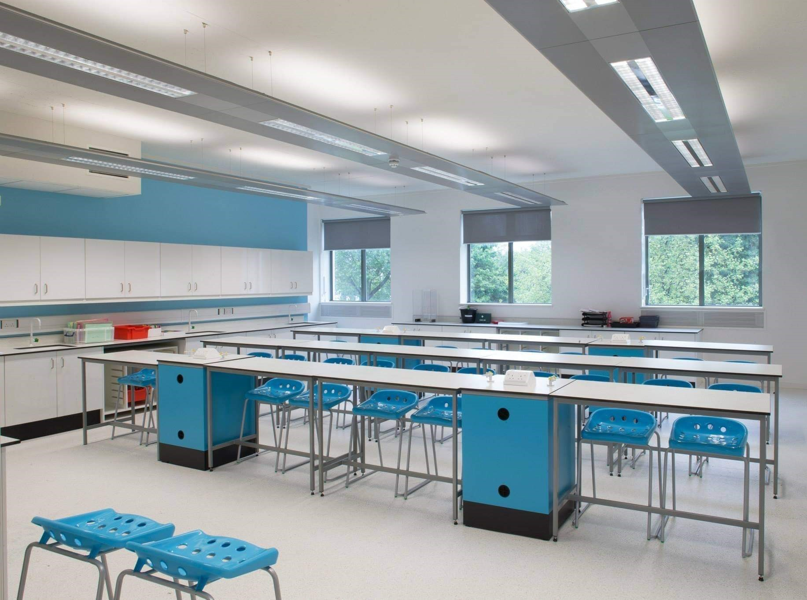
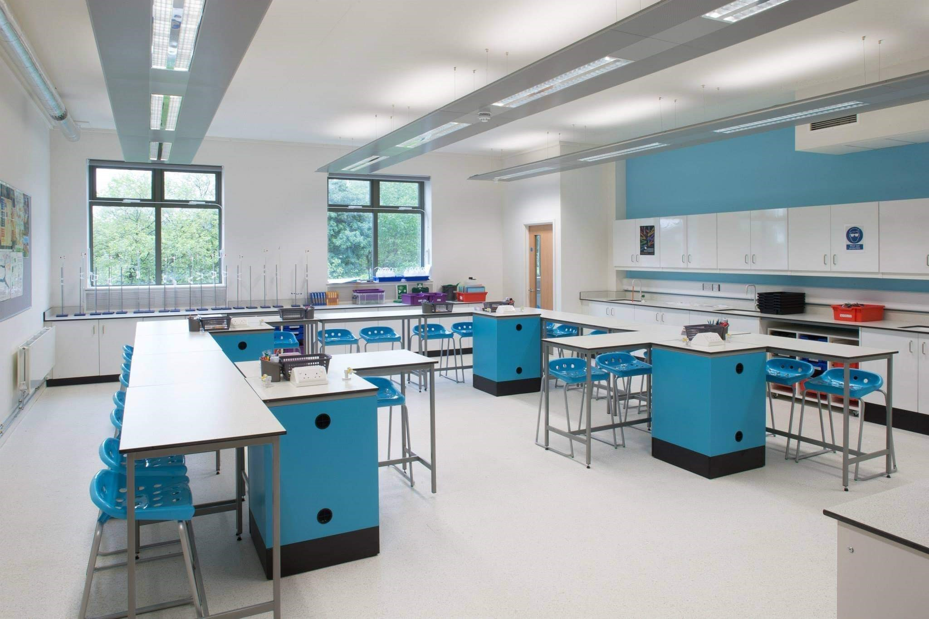
Photo tour of the department
More than Academic Excellence | More than a School | More than ‘Self’

Slide 5
What you can expect in your Biology lessons
We work closely as a department to share experience and good practice to ensure that we use the very best teaching strategies to support all our students
Students complete weekly knowledge tests to improve retention and recall
Exam question practice is built into lessons from the start of the course with teachers modelling the biological concepts and thinking processes required to answer these questions
Independence is established from the beginning with students following a structured program of pre-reading tasks ahead of lessons as well as receiving regular homework and independent learning tasks after lessons
Practical skills are modelled by teachers and developed in students through frequent opportunities to use a variety of apparatus and practical techniques
More than Academic Excellence | More than a School | More than ‘Self’

Slide 6
What you will study in Biology
* Plus a total of 12 required practical investigations
AS units | A Level units
Biological molecules | Energy transfer
Cells | Response of organisms to change
Exchange | Genetics, evolution & ecosystems
Genetic information, variation and relationships between organisms | Control of gene expression
More than Academic Excellence | More than a School | More than ‘Self’

Slide 7
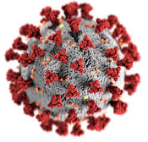
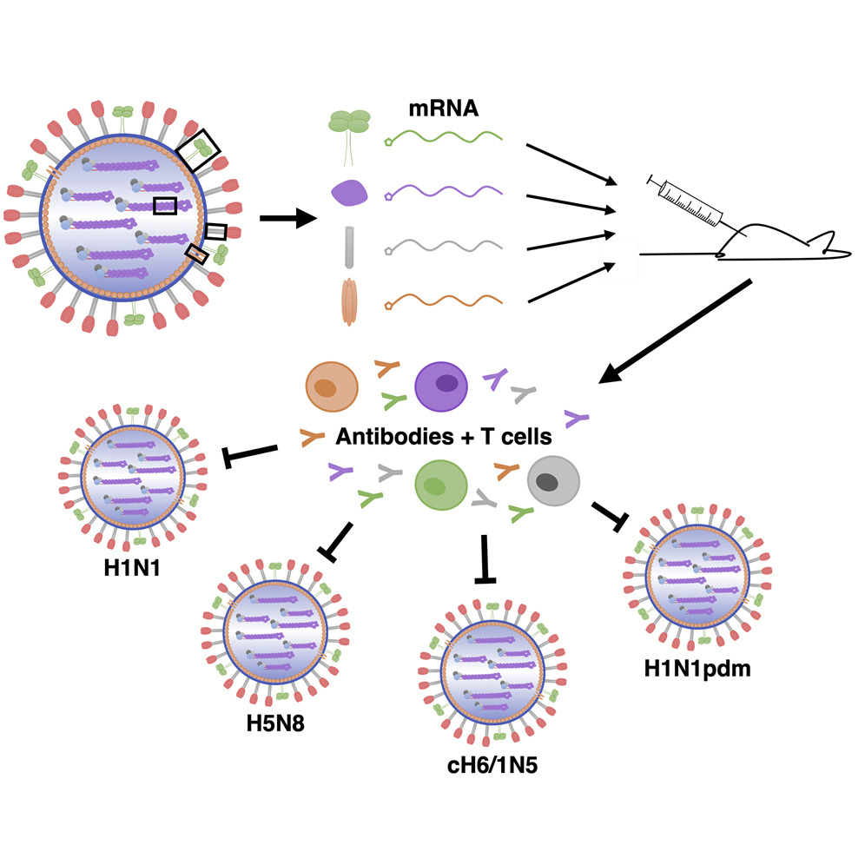
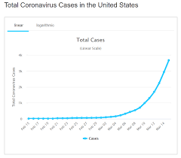

An example topic from Biology
Immunity
More than Academic Excellence | More than a School | More than ‘Self’

Slide 8
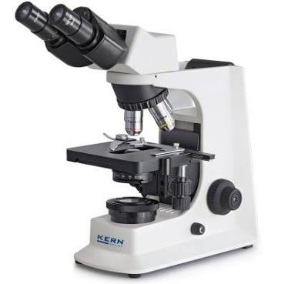
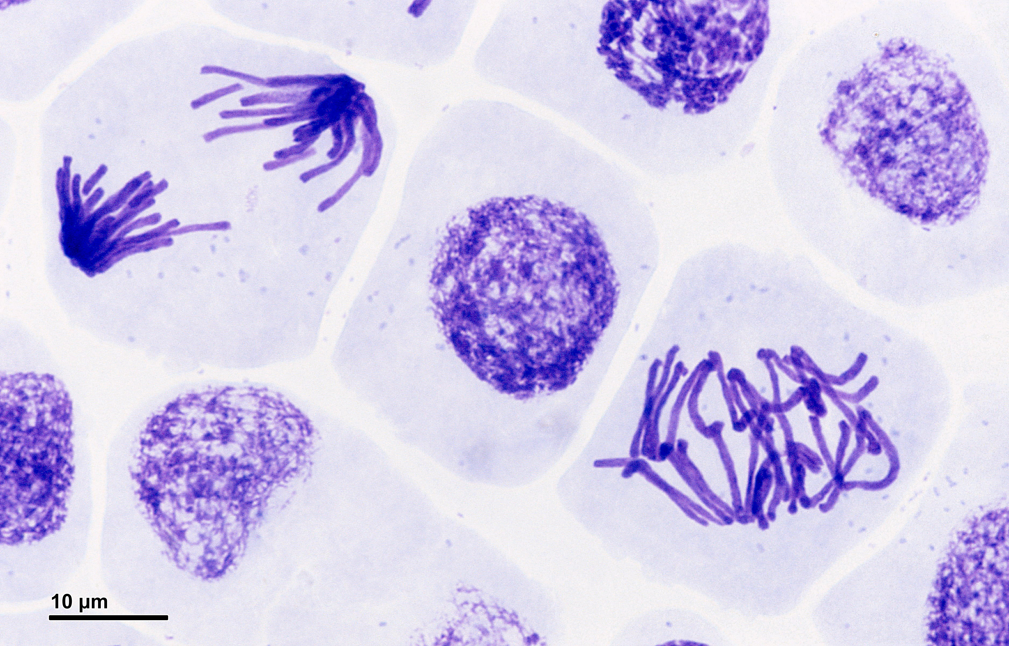
An example topic from Biology
Practical technique (Microscopy)
More than Academic Excellence | More than a School | More than ‘Self’

Slide 9
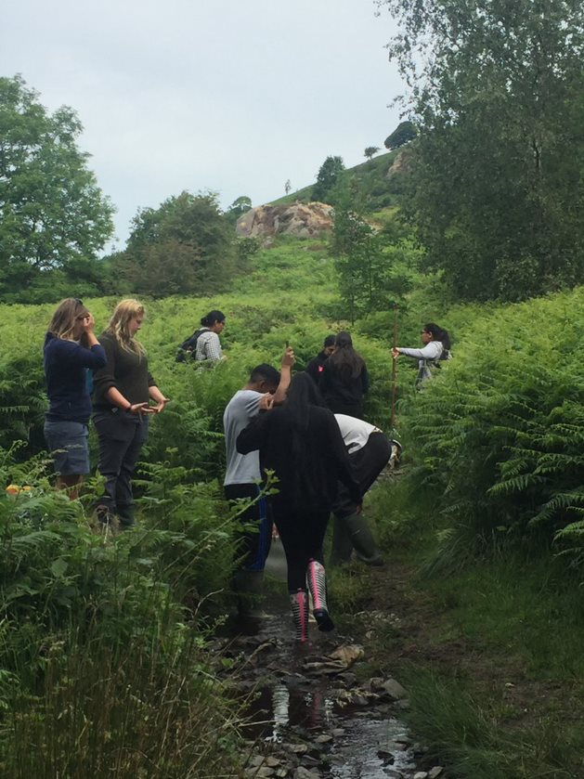
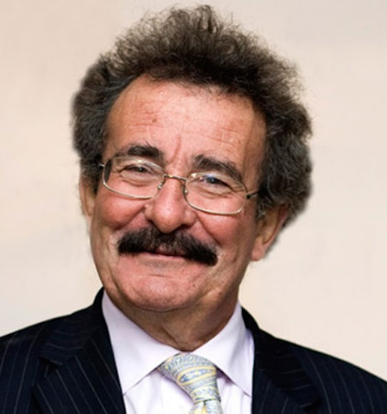
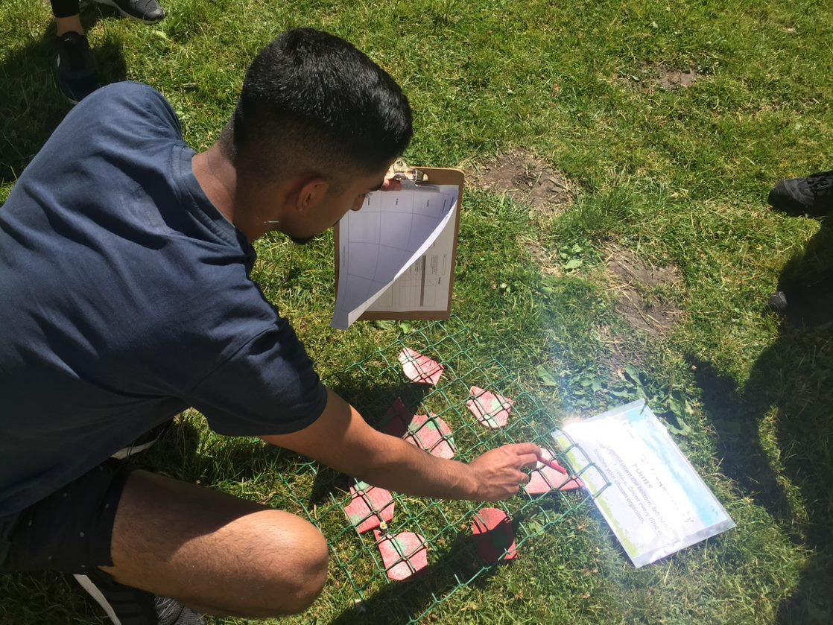
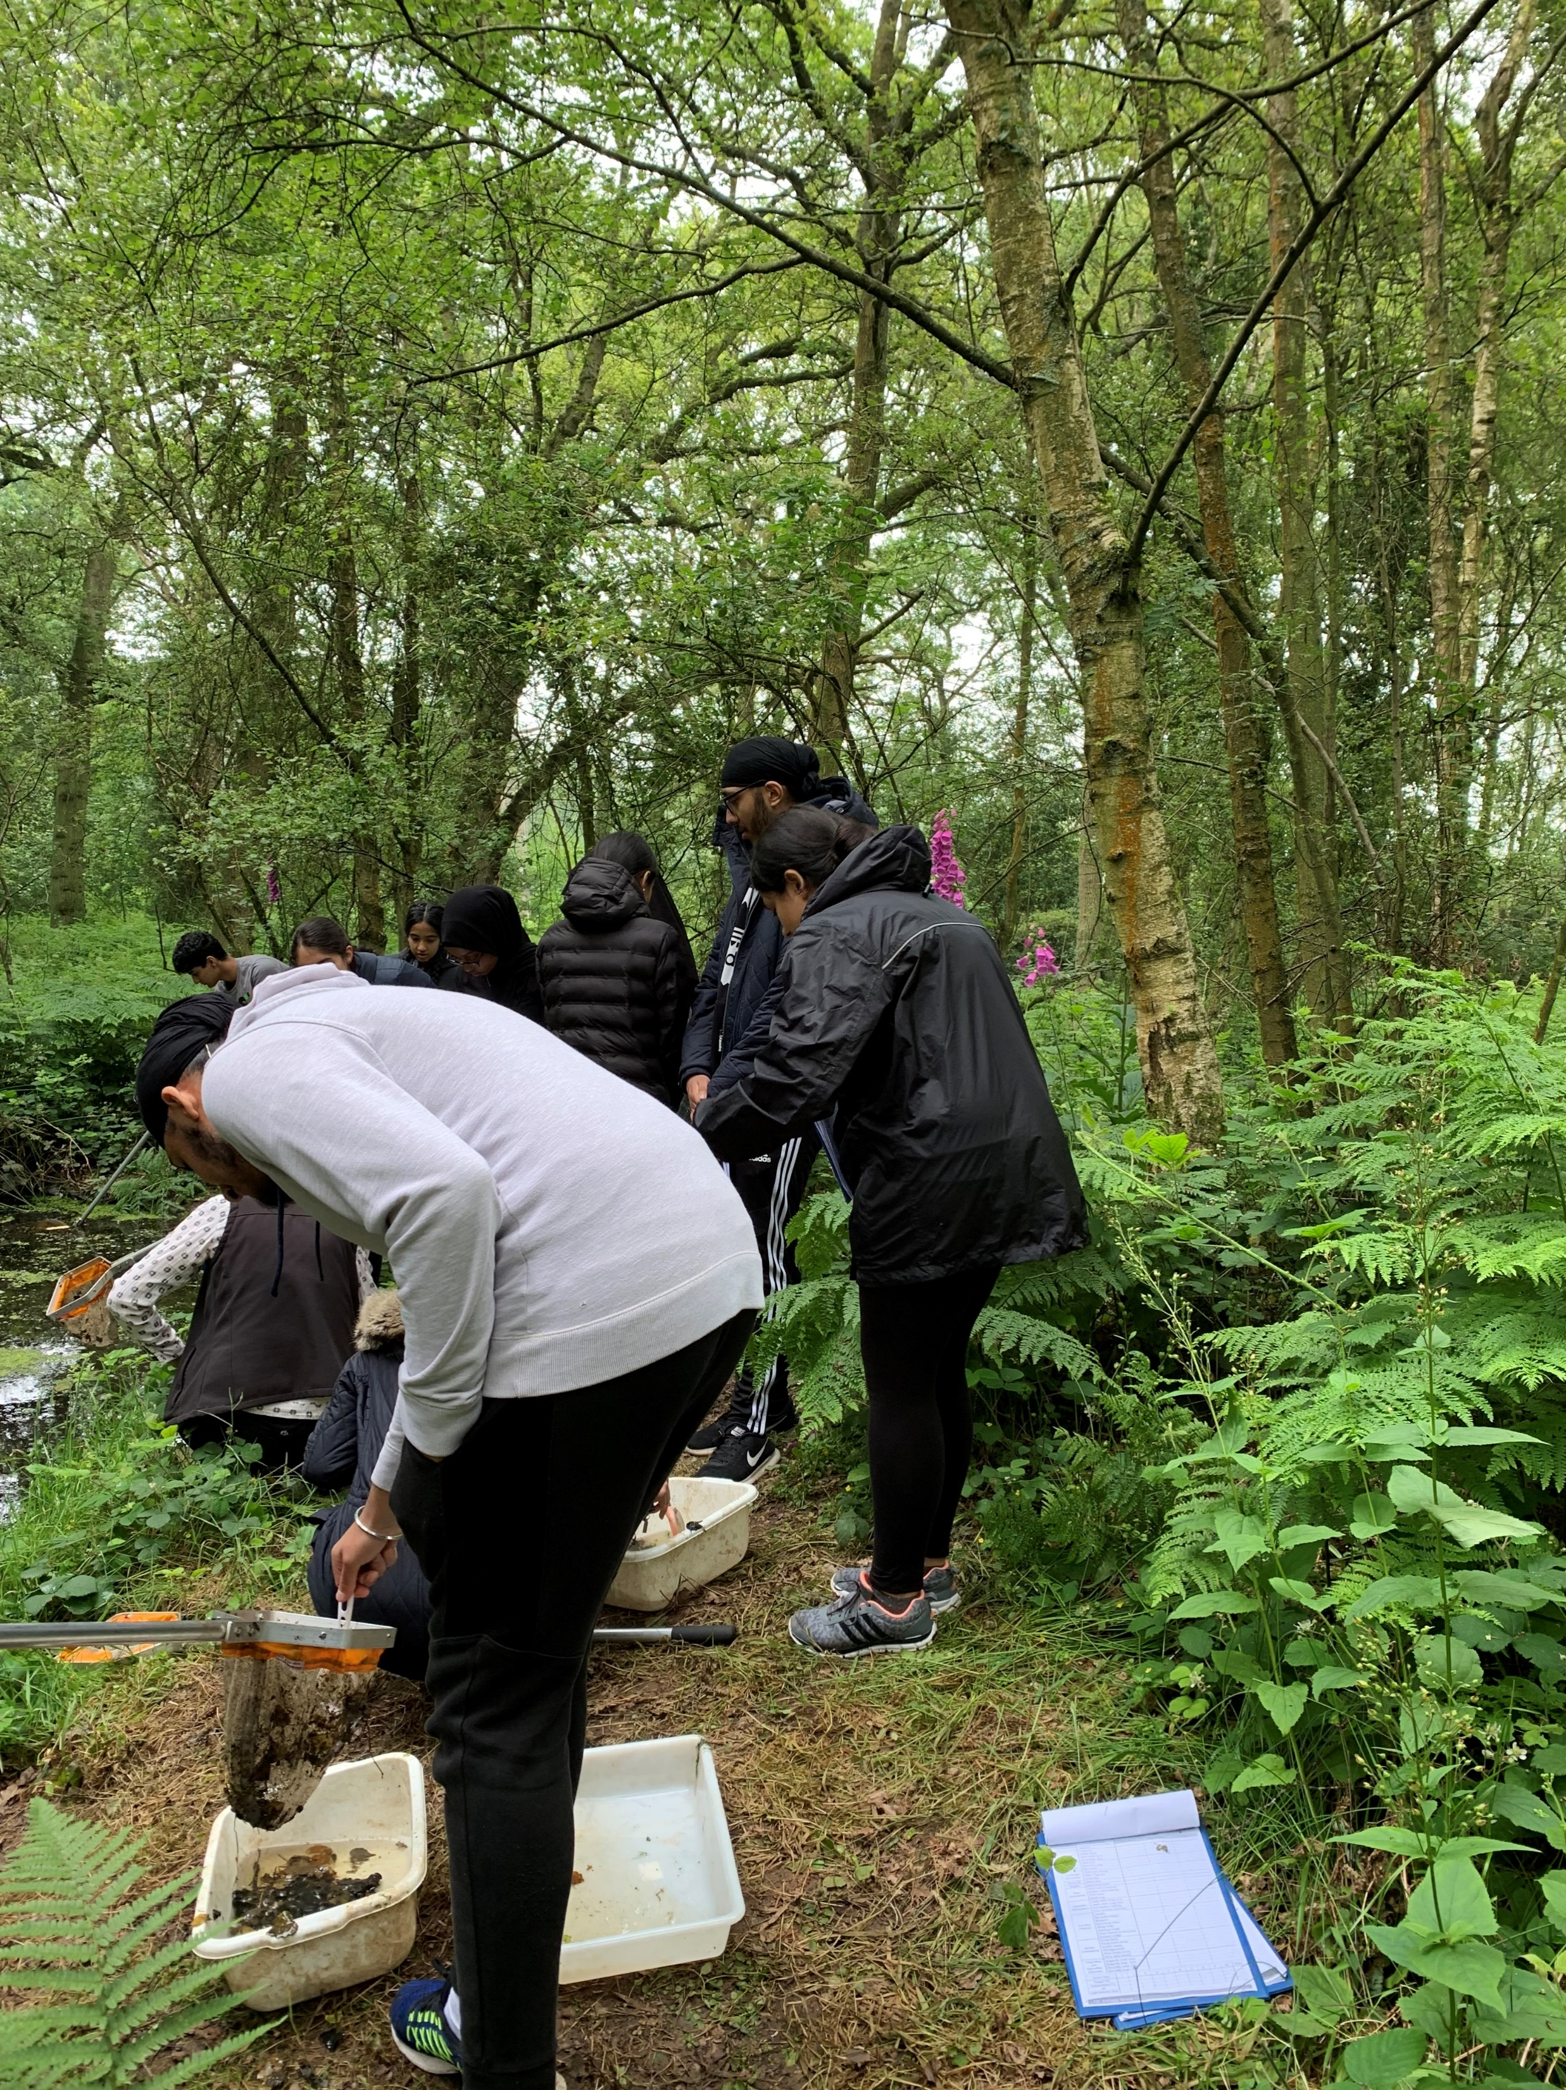
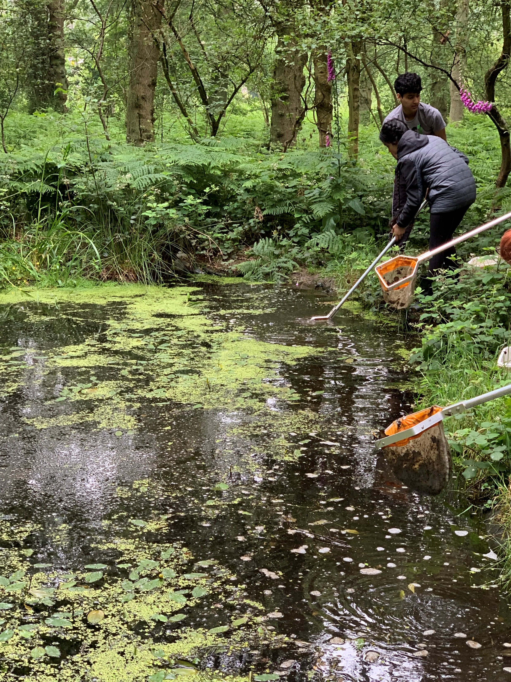
Extra-curricular opportunities in Biology
In the past, Biology students have had an opportunity to attend:
Local field study days and a residential field trip providing an opportunity to develop essential practical field study skills
An A Level Biology conference at the Cambridge Union lead by the world renowned scientists Lord Robert Winston
More than Academic Excellence | More than a School | More than ‘Self’

Slide 10
Where can Biology take you?
Biology is a pre-requisite for many science based and medical professions
A great choice of subject for people who want to pursue a career in health and clinical professions, such as:
Medicine, dentistry, veterinary science, physiotherapy, pharmacy, optometry, nursing, marine biology, forensic science and many more
More than Academic Excellence | More than a School | More than ‘Self’

Slide 11
What we expect from you
Hard work and commitment from the outset
A genuine interest in Biology and practical work
Strong English skills to cope with the extended writing essays and comprehension questions
An interest in reading scientific literature
Strong Mathematical skills (forms 10% of every exam paper in Biology)
Entry requirements: Five grades at grade 6 or higher, including a 6 in Biology, English language and Mathematics
More than Academic Excellence | More than a School | More than ‘Self’

Slide 12
Student perceptions
Enjoy the practical element of the course and the opportunities for field work
Challenging but intriguing
Appreciate the excellent links Nishkam High School has with local universities and value the opportunities provided to boost UCAS personal statements
My personal perception as a teacher and a parent of a child studying at Nishkam: Nishkam is an excellent school providing high quality education delivered by dedicated and skilled staff, whilst focussing on the core purpose of life through its virtues led approach
Value the virtues-led approach adopted by the school and support received from teachers
Surrounded by students who share a similar work ethic. Students have high aspirations
More than Academic Excellence | More than a School | More than ‘Self’

Slide 13
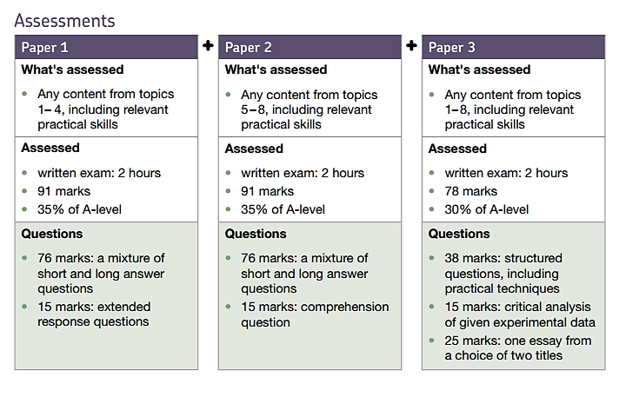

Qualification Details:
Year 12 (AS) | % towards overall grade
Paper 1 (1hr30) | 50%
Paper 2 (1hr30) | 50%
More than Academic Excellence | More than a School | More than ‘Self’
Notes:
Images courtesy of Microsoft Stock Images.

