Slide 1

Welcome to the Nishkam Sociology department
More than Academic Excellence | More than a School | More than ‘Self’

Slide 2

Head of Department welcome
More than Academic Excellence | More than a School | More than ‘Self’

Slide 3
What you can expect in your Sociology lessons
The study of sociology focuses on contemporary society; it provides students with an awareness of how social structure such as the family, media, religion and the education system can influence our behaviour. Sociologists learn to develop their ability to sensitively interpret theories alongside data in order engagement in political, legal and social debates about the world. You can expect to:
acquire knowledge and a critical understanding of social processes and social changes
appreciate the significance of theoretical and conceptual issues in sociological debate
understand and evaluate sociological methodology and a range of research methods through active involvement in the research process
develop skills that enable individuals to focus on their personal identity, roles and responsibilities within society
develop a lifelong interest in social, political, legal and cultural issues
More than Academic Excellence | More than a School | More than ‘Self’

Slide 4
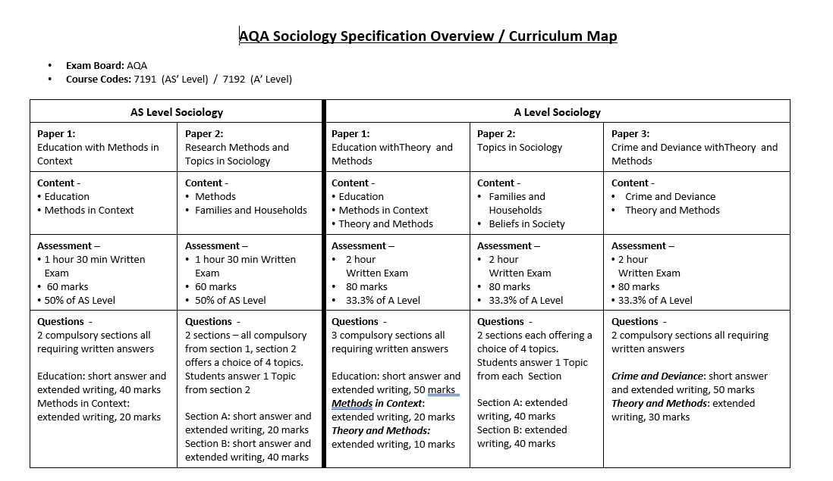
What you will study in Sociology
More than Academic Excellence | More than a School | More than ‘Self’

Slide 5
An example topic from Sociology
Crime and deviance
• crime, deviance, social order and social control
• the social distribution of crime and deviance by ethnicity, gender and social class, including recent patterns and trends in crime
• globalisation and crime in contemporary society
• crime control, surveillance, prevention and punishment, victims, and the role of the criminal justice system and other agencies
More than Academic Excellence | More than a School | More than ‘Self’

Slide 6
Where can Sociology take you?
Students who take Sociology often also study, Psychology, Economics, Business Studies, Geography, English, Law and Politics.
Career Options
International aid development worker
Lawyer
Civil service – research and development
Data analyst
Journalism
Political correspondence
Counsellor
Social worker
University lecturer
Teacher
More than Academic Excellence | More than a School | More than ‘Self’

Slide 7
What we expect from you
Learn to demonstrate knowledge and understanding of sociological theories and research methods. Develop the ability to apply knowledge and understanding of evidence to a range of issues and evaluate knowledge to present sound arguments.
Above all, you are expected to form synoptic links, showing connections between ideas from one topic to another, and seeing connections between aspects of key topic such as:
the relationship of the family to the social structure and social change, with particular reference to the economy and to state policies
the significance of religion and religiosity in the contemporary world, including the nature and extent of secularisation in a global context, and globalisation and the spread of religions.
the nature of science and the extent to which sociology can be regarded as scientific
differences in the educational achievement of social groups by social class, gender and ethnicity in contemporary society
crime control, surveillance, prevention and punishment, victims, and the role of the criminal justice system and other agencies
More than Academic Excellence | More than a School | More than ‘Self’

Slide 8
Student perceptions
“Sociology has been an interesting subject to study because it helps you to view the world through the perspectives of different theorists; building a critical trains of thought. Building a critical train of thought is essential if you’re looking to continue studying into higher education. I study Sociology in combination with Psychology which tends to overlap with one another. Learning the combination of these subjects may help you to understand both subjects better. I plan on using the skills I have learnt from studying these subjects to help pursue my aspirations of studying Psychology after completing my A levels.” – Covleen
“I enjoy studying Sociology with miss Silvera. Not only does she make the lesson 10x more fun by embedding her own stories and giving life advice, but she also teaches you some valuable educational skills such as, useful ways to improve your writing.” – Jasmin
“Sociology is my favourite A-level subject. We have amazing class debates and what I love most is the fact that we can apply what we learn in the classroom to the outside world”! - Gian
Sociology a social science, is a very intellectual and interesting subject. Educating and expanding your knowledge on social behavior, society, patterns of social relationships, social interaction, and cultures enables further understanding on issues that surround everyday life. It directs attention to how the parts of society fit together and change, as well as makes us aware of the consequences of that social change. This is such an enjoyable subject to learn that helps contribute to a further understanding of societal issues. It is one of my favourites. – Riya
Studying Sociology has broadened my knowledge of the different functions structures play in society.” – Inderpreet
More than Academic Excellence | More than a School | More than ‘Self’

