Slide 1


Welcome to the Nishkam Science: Chemistry department
More than Academic Excellence | More than a School | More than ‘Self’

Slide 2
Head of Department welcome
Welcome to Chemistry!
Chemistry as a subject equips you to question and explain the world around you by learning a range of practical and problem-solving skills.
At Nishkam, all Chemistry is delivered by teachers with a strong background in Chemistry.
More than Academic Excellence | More than a School | More than ‘Self’

Slide 3
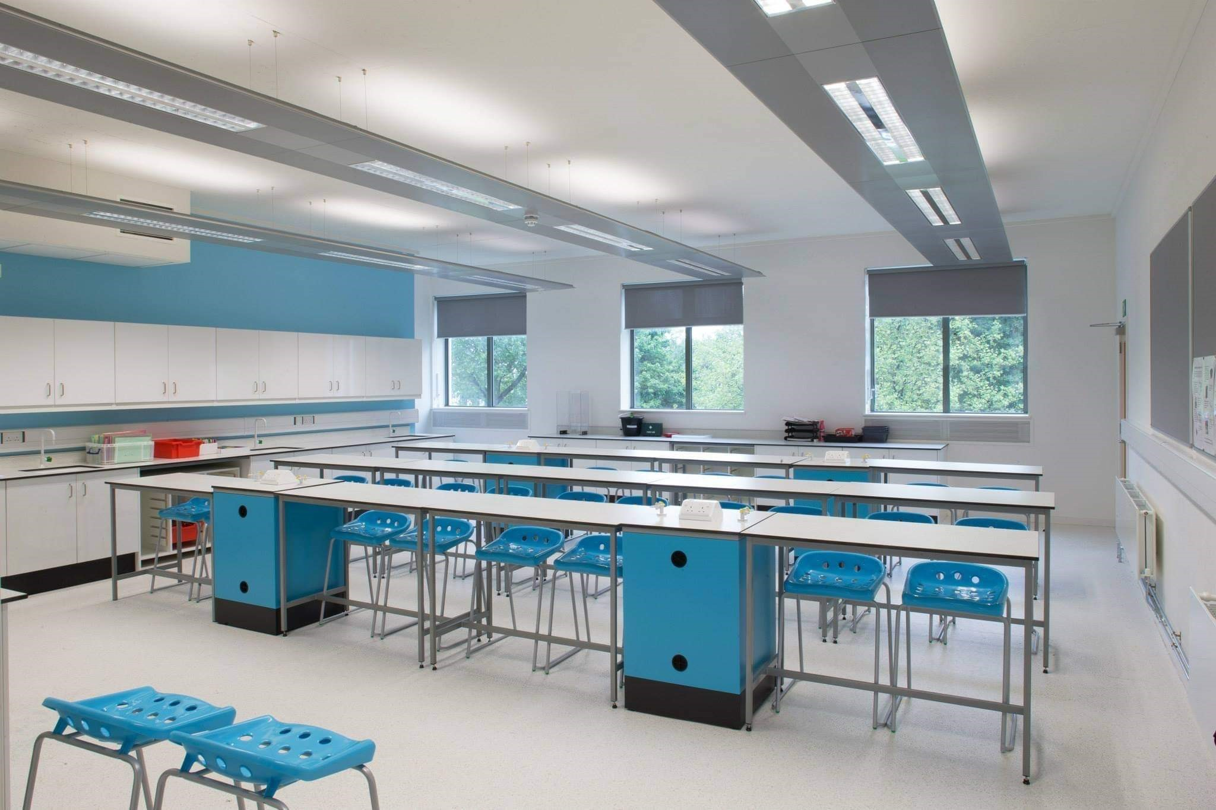

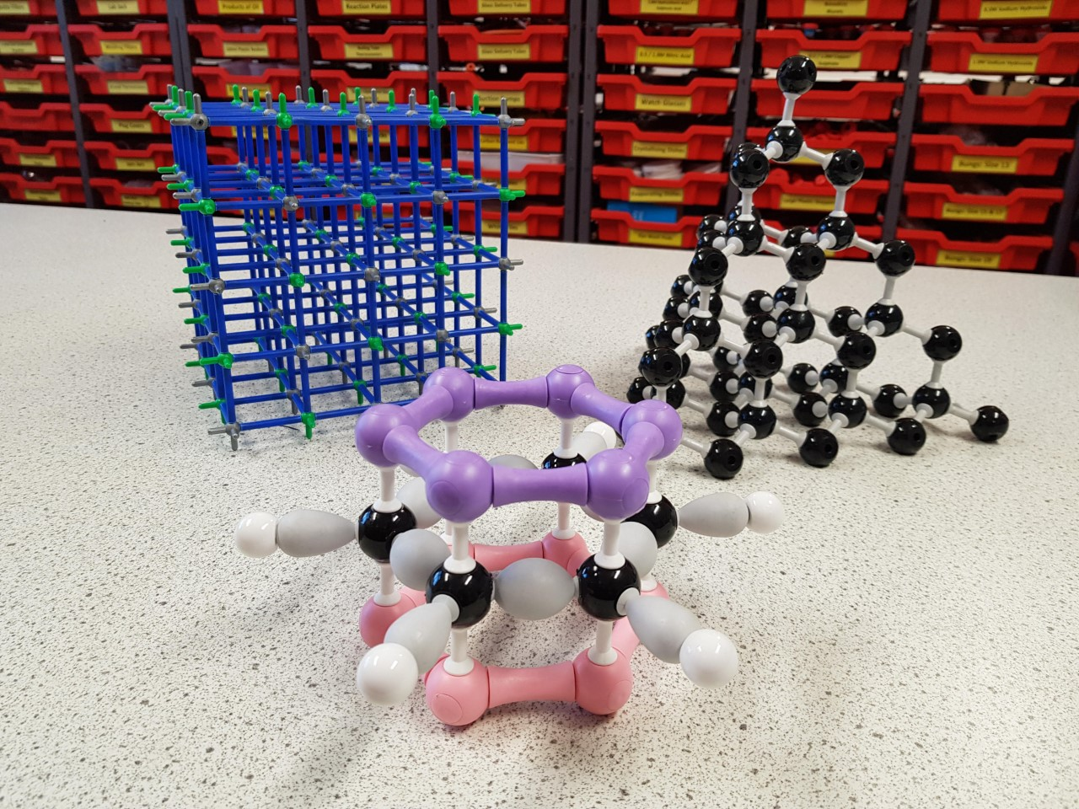
Meet the department
Mrs Ridley: Interim Head of Chemistry
Miss Samuels: Teacher of Chemistry
Mrs Riaz: Teacher of Chemistry
(Maternity Leave)
More than Academic Excellence | More than a School | More than ‘Self’

Slide 4




What you can expect in your chemistry lessons
5 Lessons per week
Pre-read activity before lesson
Consolidation of topic e.g. practicals, practice questions
Exam questions as homework and further reading
Lessons will be…
Challenging
Thought provoking
Critically think like a chemist
More than Academic Excellence | More than a School | More than ‘Self’

Slide 5
What you will study in Chemistry
Understand the fundamentals of life….
Concepts which get you thinking about…
Why are the resources on Earth becoming depleted?
How to synthesise Aspirin?
How to design, construct and analyse a practical?
Our AIM: Make sense of the awe around us
More than Academic Excellence | More than a School | More than ‘Self’

Slide 6
What you will study in Chemistry
Students study 3 topics:
Physical Chemistry
This is the study of macroscopic, atomic, subatomic, and particulate phenomena in chemical systems in terms of laws and concepts of physics.
Inorganic Chemistry
This deals with the synthesis and behaviour of inorganic and organometallic compounds. This field covers all chemical compounds except organic compounds.
Organic Chemistry
This involves the scientific study of the structure, properties, and reactions of organic compounds and organic materials, i.e., matter in its various forms that contain carbon atoms.
More than Academic Excellence | More than a School | More than ‘Self’

Slide 7
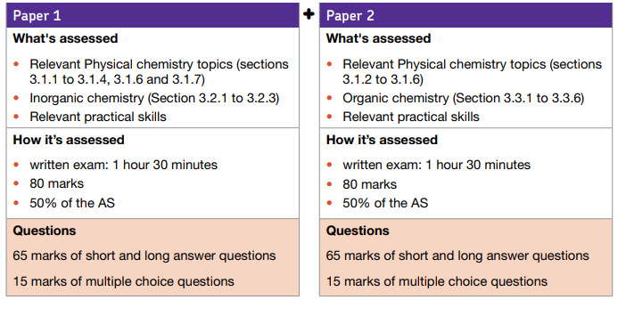
What you will study in Chemistry
*
More than Academic Excellence | More than a School | More than ‘Self’

Slide 8
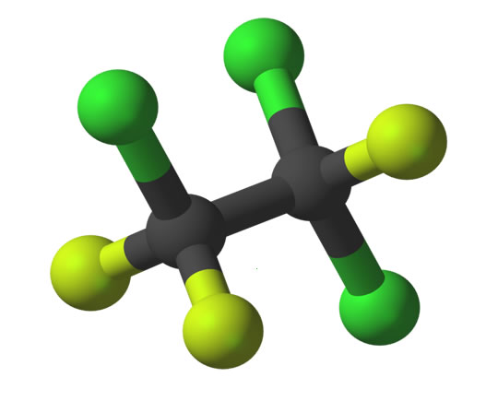


An example topic from Chemistry
Topic: Halogenoalkanes
You will learn:
How to name and distinguish them
How to synthesis a halogenoalkane from an alkene
Use of halogenoalkanes e.g. CFCS
Impacts on the environment
More than Academic Excellence | More than a School | More than ‘Self’

Slide 9
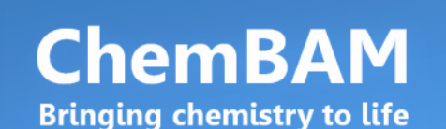


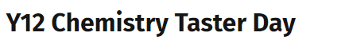
Extra-curricular opportunities in chemistry
Links with UOB masterclasses
Taster days: Imperial College London
Virtual lectures
Guest lecturers
Chemistry competitions
Big Bang Conference
More than Academic Excellence | More than a School | More than ‘Self’

Slide 10











Where can chemistry take you?
*
More than Academic Excellence | More than a School | More than ‘Self’

Slide 11
What we expect from you
Hardworking ethos
A can-do attitude
Diligence
Love of chemistry
Perseverance
More than Academic Excellence | More than a School | More than ‘Self’

Slide 12
Student perceptions
‘Chemistry is hard and can be overwhelming at first but the teachers really support you and want you to the achieve the best grade possible. It has some interesting topics and can be useful for a lot of degrees’
‘Chemistry has taught me to be patient and take things one step at a time’
‘I like how chemistry challenges me, its like a puzzle.’
‘Chemistry is great to do at A-level because it leads to lots of different avenues from geology to medicine. I have been able to see things around me differently and appreciate them more knowing the complex chemistry involved.’
More than Academic Excellence | More than a School | More than ‘Self’

Slide 13
Qualification details
5 GCSEs A*-C including Maths and English at grade 6
Grade 6 or above in Chemistry
Desirable: Grade 7 in chemistry and maths
More than Academic Excellence | More than a School | More than ‘Self’

