Slide 1



Welcome to the Nishkam Business & Economics department
More than Academic Excellence | More than a School | More than ‘Self’

Slide 2
Head of Department welcome
Business
A Level Business is a dynamic and engaging subject with a holistic approach to business. You will study models, theories and techniques to help you develop a deeper understanding of business issues relevant in the modern world.
More than Academic Excellence | More than a School | More than ‘Self’

Slide 3
Economics
Economics focuses more on aspects such as demand, supply, foreign exchange rate, inflation, central bank policies, foreign trade national budget, etc.
Economics can be broadly classified into two:
Micro Economics – individual units of the economy
Macro Economics - activities carried out in an economy as a whole

Slide 4
Head of Department welcome
Subject specialists with experience
Popular subject at sixth form.
Progression to Higher education / apprenticeships and the world of work
All employees need sound business skills behind them.
Excellent results
Pass rates in Business
2022:
94% A - C
Pass rates in Economics
2022:
95% - A - C
More than Academic Excellence | More than a School | More than ‘Self’

Slide 5
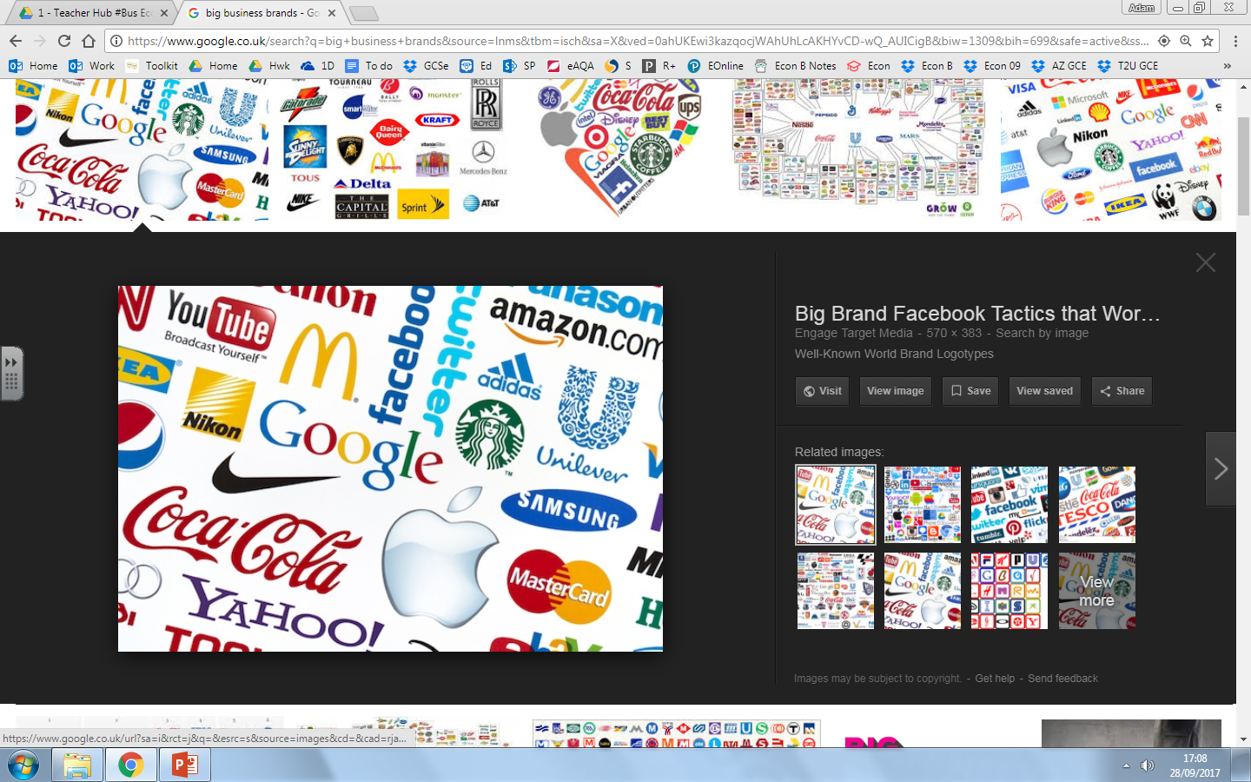

What you can expect in your Business lessons
Marketing & people
Market
Marketing Mix and strategy
Managing people
Entrepreneurs and leaders
Raising finance
Financial liability
Managing Finance
Resource management
External influences
More than Academic Excellence | More than a School | More than ‘Self’

Slide 6
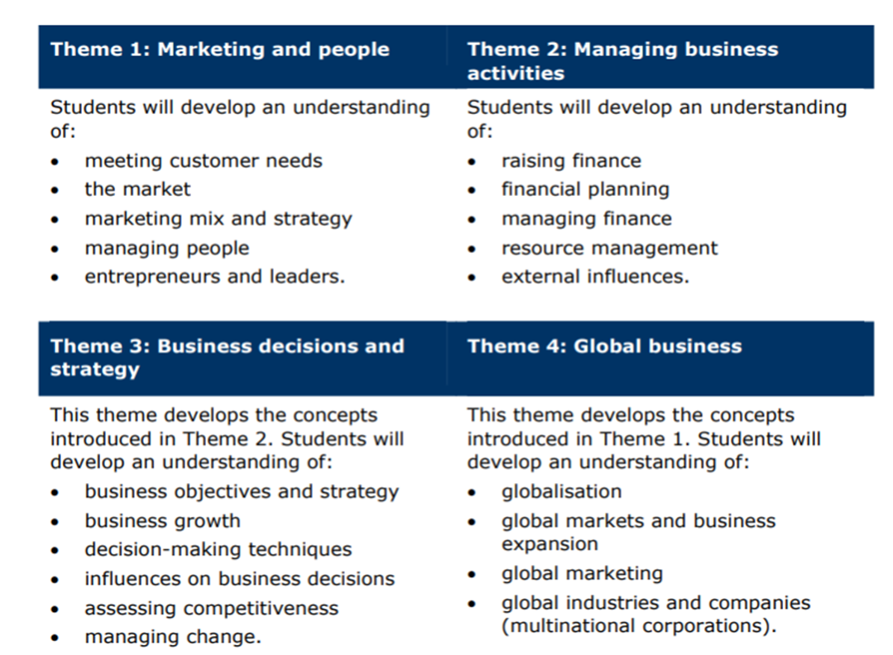
What you will study in Business
More than Academic Excellence | More than a School | More than ‘Self’

Slide 7
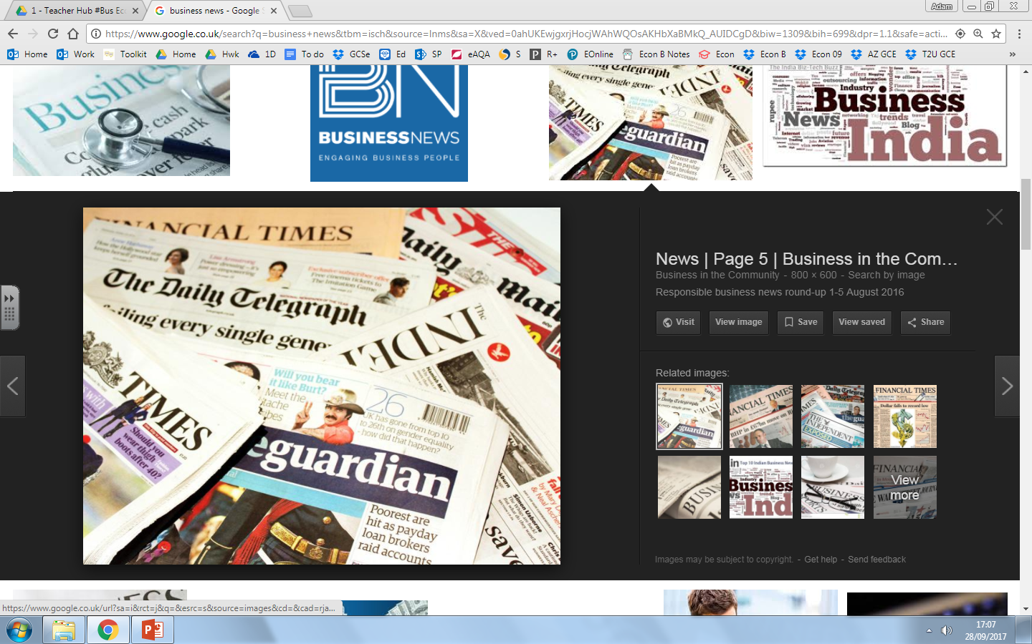

What you can expect in your Economics lessons
Scarcity, choice and potential conflict
Markets, Consumers and Firms
Enterprise
Global economy
The wider economic environment
The role of credit in the economy
The economic cycle
More than Academic Excellence | More than a School | More than ‘Self’

Slide 8
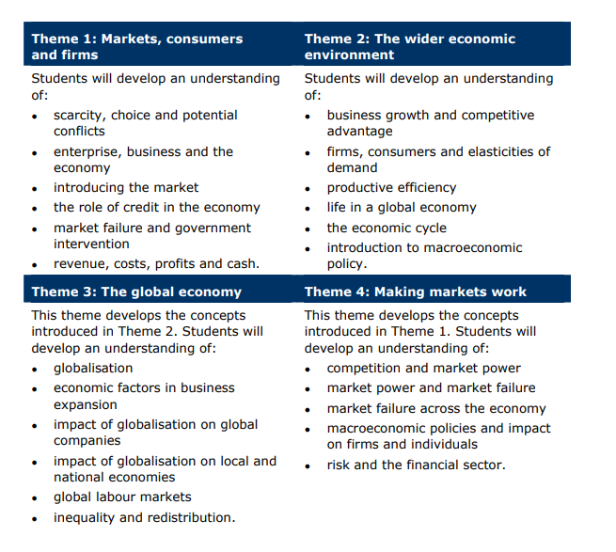
What you will study in Economics
More than Academic Excellence | More than a School | More than ‘Self’

Slide 9
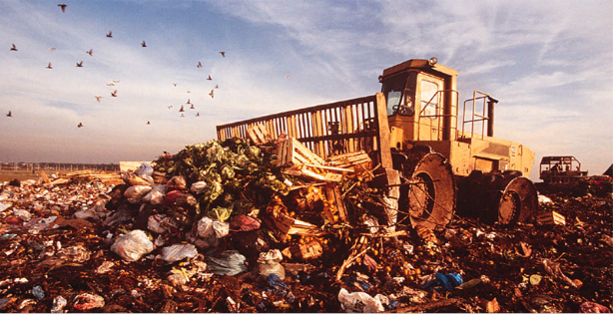
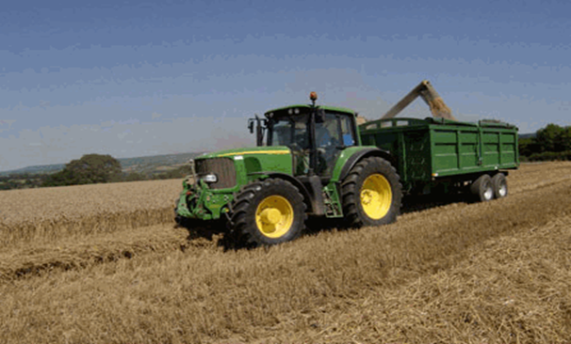
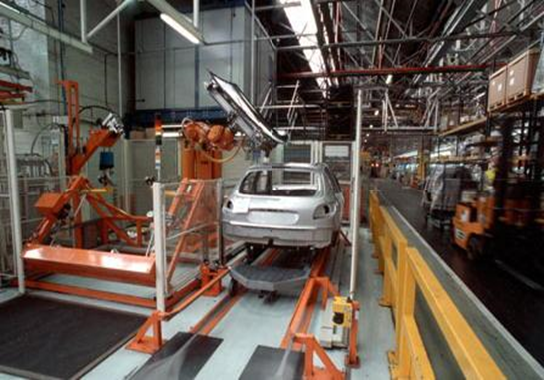

An example topic from Economics
*
Has the impact of improved standards of living being positive?
Should we offer subsidies for all of this?
Productivity – what is it? Why is it so important?
Global business & ethical products
More than Academic Excellence | More than a School | More than ‘Self’

Slide 10




Extra-curricular opportunities in Business/Economics
Young Enterprise
Jaguar Land Rover
Cadbury World
Star City Grade Booster workshops
More than Academic Excellence | More than a School | More than ‘Self’

Slide 11
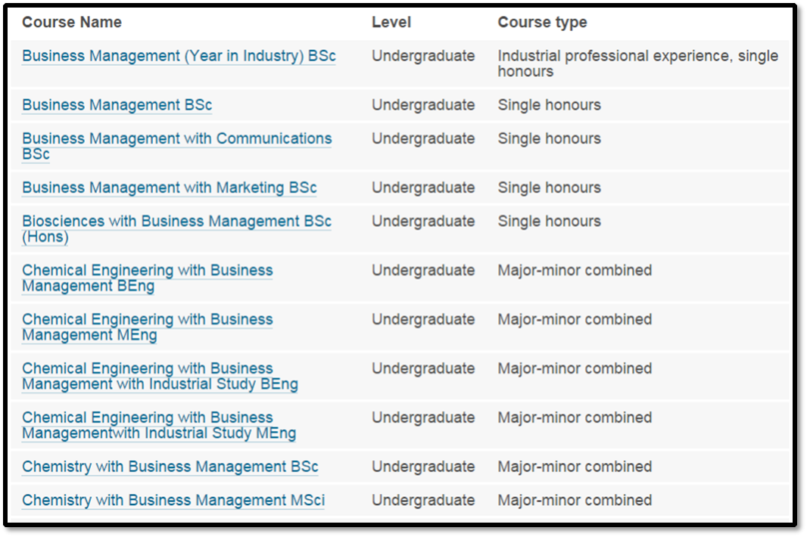
Where can Business/Economics take you?
Level 3 apprenticeship
World of work
University
University of Birmingham has sixty business related courses
More than Academic Excellence | More than a School | More than ‘Self’

Slide 12

What we expect from you
Conscientious
Commitment
Hard work
Dedication
Passionate
Extra reading
Meeting deadlines
More than Academic Excellence | More than a School | More than ‘Self’

Slide 13
Student perceptions
“I studied GCSE Business at Nishkam and now A level. This is the subject I want to study at University and teachers have given me sound advice and knowledge to be able to do so.”
“The teaching staff were key to helping me deicide on a course at University.”
“Its an interesting subject and the teachers bring the subject to life with real life examples.”
“The subject complements my other A levels.”
More than Academic Excellence | More than a School | More than ‘Self’

Slide 14

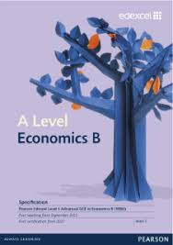
Qualification details
Edexcel AS and A level Business 2015
Edexcel AS and A level Economics B 2015
More than Academic Excellence | More than a School | More than ‘Self’

