Slide 1

Welcome to Nishkam:
Applied Science
More than Academic Excellence | More than a School | More than ‘Self’

Slide 2
Head of Department welcome
Welcome to Applied Science !
Applied Science covers a wide range of topics across Biology, Chemistry and Physics. It allows you to acquire a high level of practical laboratory skills from which the theory is then drawn.
An Applied Science Diploma will provide you with a broad range of skills to prepare you for employment or higher education. You will build on your previous studies of science by widening your knowledge of scientific investigation and practical techniques.
You will develop the following :
Numeracy skills required in a scientific setting.
Gain knowledge about working in the science industry.
Examine perceptions of science in the wider community.
Gain skills needed for completing research projects.
More than Academic Excellence | More than a School | More than ‘Self’

Slide 3
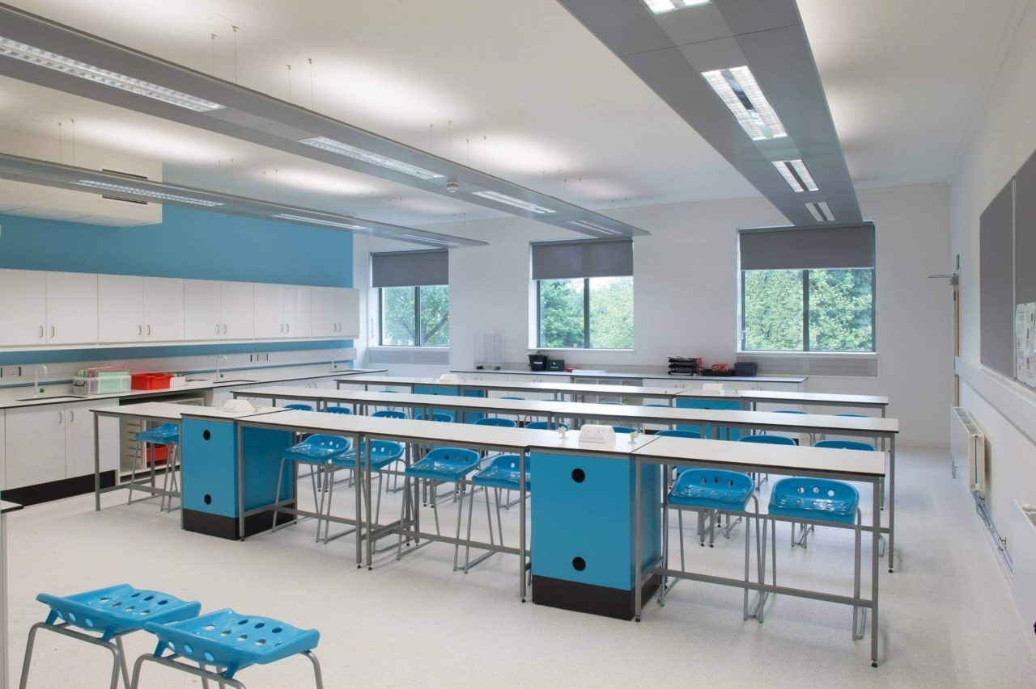
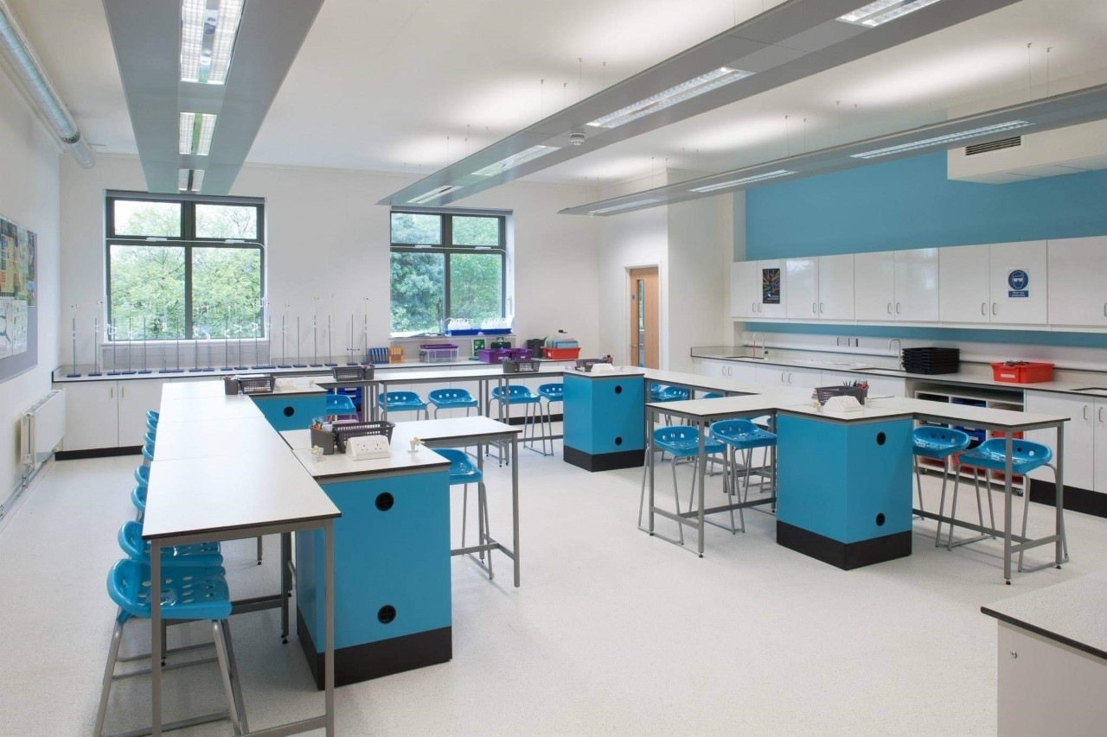
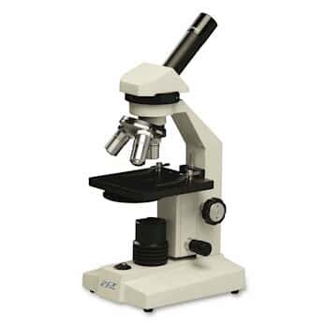
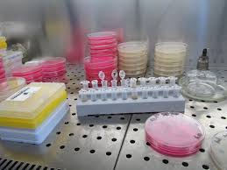
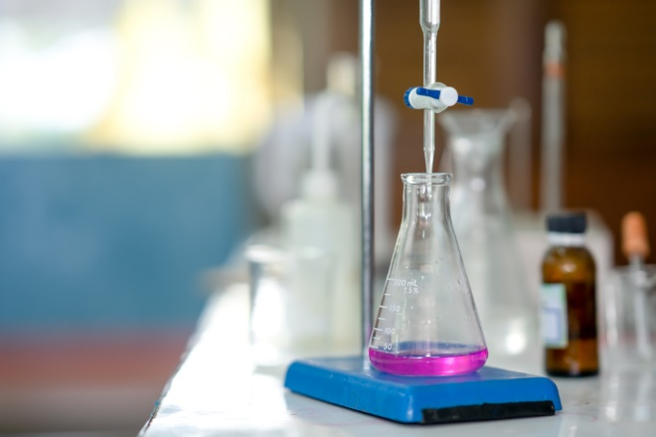
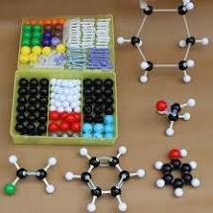
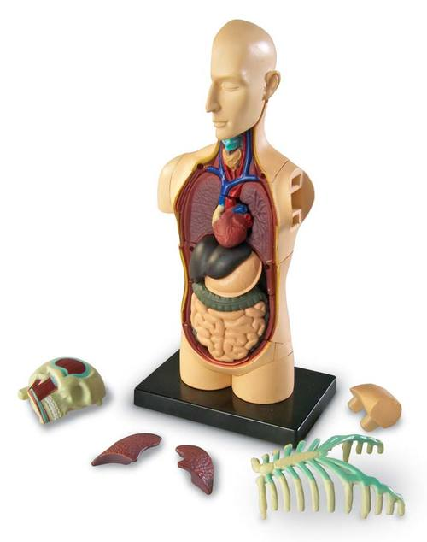
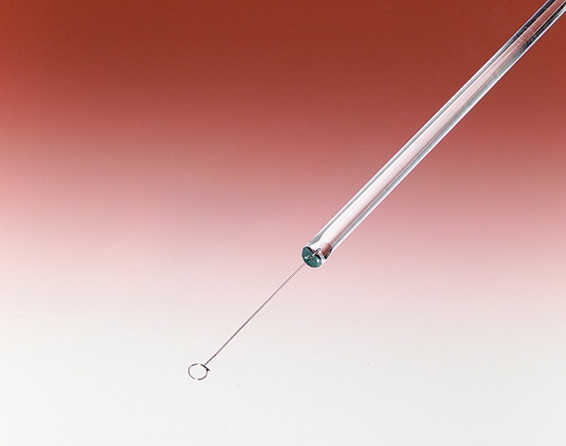
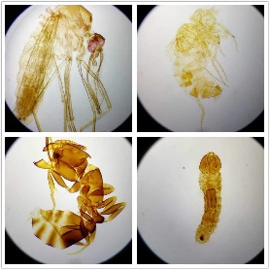
Photo tour of the department
More than Academic Excellence | More than a School | More than ‘Self’

Slide 4
What you can expect in your Applied Science lessons
Taught by subject specialists, with laboratory experience, you will learn by completing laboratory-based practical assignments, supported self-study assignments, presentations and discussions that are based on real workplace situations, activities and demands. Staff will implement a range of teaching and learning styles to help you succeed within your lessons.
This will be done through :
Modelling
Exam questions / paper ( individual feedback)
Range of practical's
Online platform
Pre-reading / Homework
You will have a very clear understanding of your progress throughout the course, to help you plan and achieve your next steps.
More than Academic Excellence | More than a School | More than ‘Self’

Slide 5
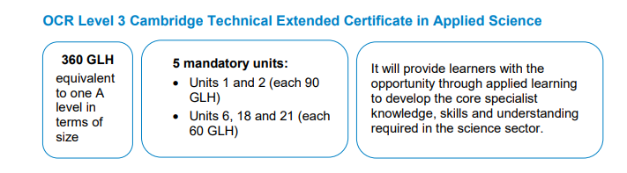
What you will study in Applied Science
5 Modules :
Unit 1 - Science Fundamentals ( 90 GLH Exam based)
Unit 2 -Laboratory techniques (90 GLH Exam based)
Unit 6 - Control of hazards in the laboratory ( 60 GLH internally assessed )
Unit 18 - Microbiology ( 60 GLH internally assessed )
Unit 21-Product testing technique ( 60 GLH internally assessed )
More than Academic Excellence | More than a School | More than ‘Self’

Slide 6
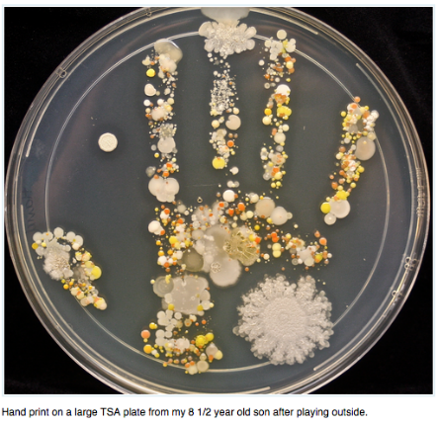
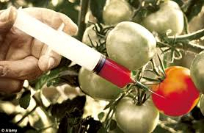

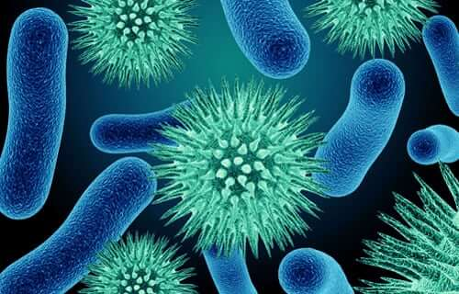
An example unit from Applied Science
Unit 18 – Microbiology
The study of Microorganisms ( those too small to be seen with the naked eye).
Studied through specialised techniques : Microscopes, culturing , genetics and serology.
Microbes are found everywhere including inside and outside the body, on your laptop keyboard, on your phone screen and in your food.
You will cover the structures and functions of key microorganisms , processes used for identification and classification of microbes ,as well as the beneficial uses of microbes in agriculture, food and medicine.
More than Academic Excellence | More than a School | More than ‘Self’

Slide 7
Extra-curricular opportunities in Applied Science
Guest speakers.
Q & A with relevant employers.
Trips and visits ( i.e – Laboratory ).
More than Academic Excellence | More than a School | More than ‘Self’

Slide 8
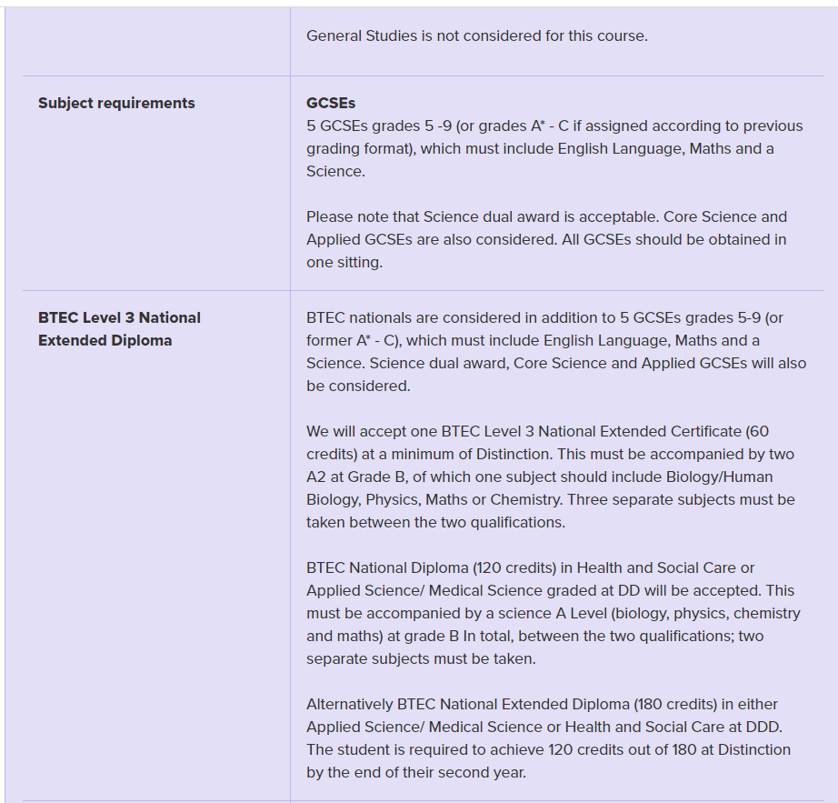
Where can Applied Science take you?
The Level 3 Extended Certificate in Applied Science is the same size as one GCE A level.
Some of the pathways you can take:
University - nursing, radiography, chemical engineering, biochemistry, veterinary science or forensics.
Apprentiship / Work (Paid) - Laboratory technician
More than Academic Excellence | More than a School | More than ‘Self’

Slide 9
What we expect from you
Accountability - Organised
Trust - Independent
Determination – Pre – reading / Homework / Extra work
Enthusiasm – Love for the course
Diligence - Meeting coursework deadlines
More than Academic Excellence | More than a School | More than ‘Self’

Slide 10


Student perceptions
Enthusiasm - Enjoy the content within the course – Very relatable.
“I enjoy the challenge in lessons and a sense of accomplishment I get from the lesson content”
Committed – Exceptional effort apparent in folders.
“ I always know what ill be studying and the teacher guides us through step by step”
Optimism – Exams were not their strong point , allowed them find a sense of belonging.
“I enjoy how the course allow me to demonstrate my understanding through course work and projects.”
More than Academic Excellence | More than a School | More than ‘Self’

Slide 11
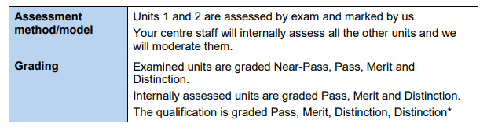
Qualification details
OCR Cambridge technical ( 2 year course).
5 Mandatory units.
2 Exam based / 3 course work based.
Exam based units – Unit 1 & 2 , Near-Pass ,Pass, Merit & Distinction (January & June).
Internal units – Unit 6,18,21,Pass , Merit & Distinction ( Split over the two years).
Each grade equates to points which helps in calculating the final grade.
More than Academic Excellence | More than a School | More than ‘Self’

