Slide 1

Welcome to the Nishkam Geography department
More than Academic Excellence | More than a School | More than ‘Self’
Notes:
Hi – I’m Subject Lead for Geography

Slide 2
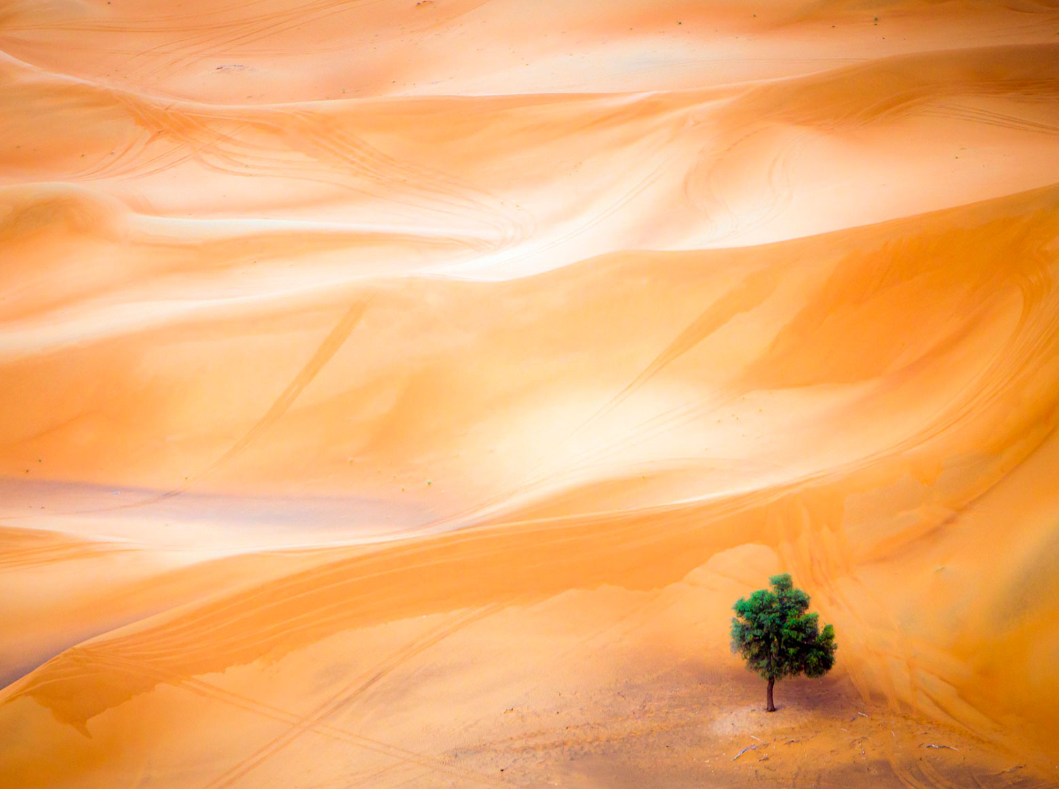
Humanities
Humanities education at Nishkam will provide students with the skills and experiences necessary to become global citizens.
More than Academic Excellence | More than a School | More than ‘Self’

Slide 3
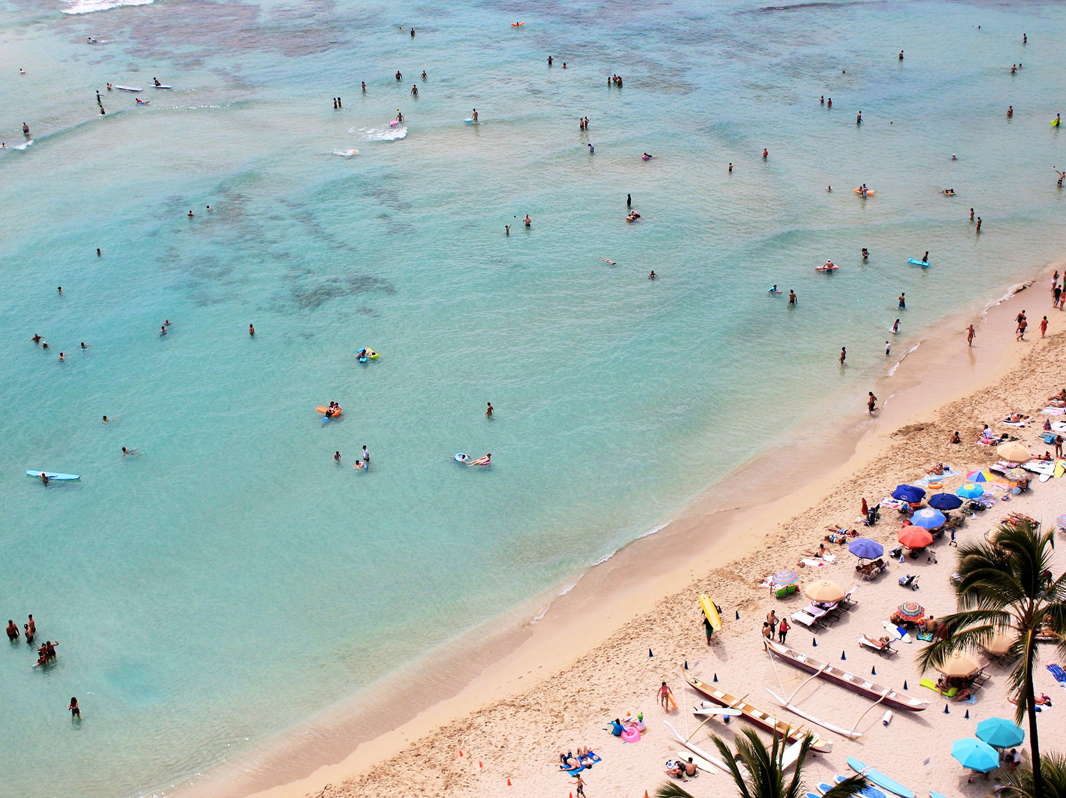
Geography
'Geography prepares young people with the knowledge, skills and understanding to make sense of their world and to face the challenges that will shape our societies and environments at the local, national and global scales’.
Dr Rita Gardner, Director, RGS
More than Academic Excellence | More than a School | More than ‘Self’

Slide 4

Head of Department welcome
What skills will I gain?
Intellectual skills: critically evaluating theories and judging evidence to make informed decisions
Research skills: a range of technical methods for collection and analysis of data
Transferable skills: teamwork, problem solving, IT skills and communication skills
Personal attributes: time-management, self-reflection, motivation and creativity
More than Academic Excellence | More than a School | More than ‘Self’

Slide 5
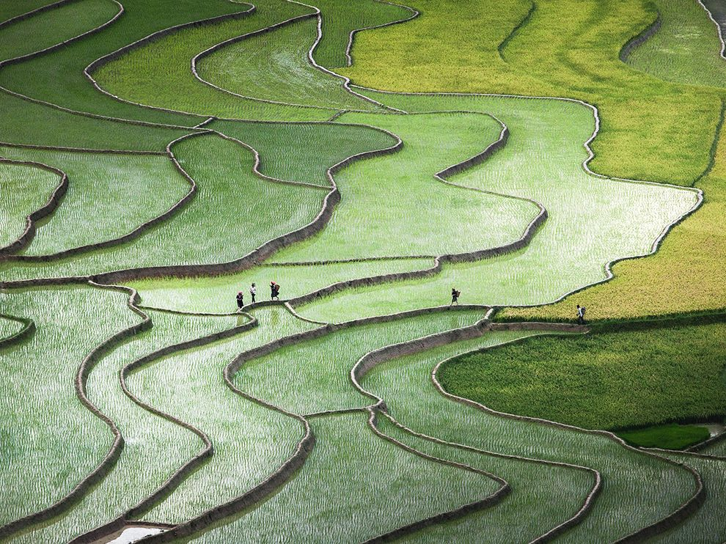
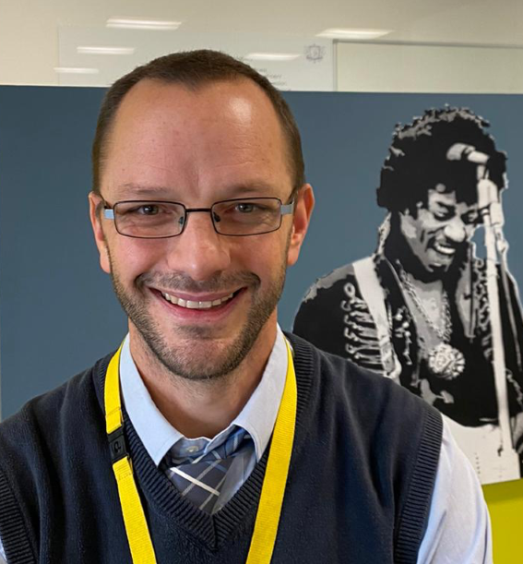

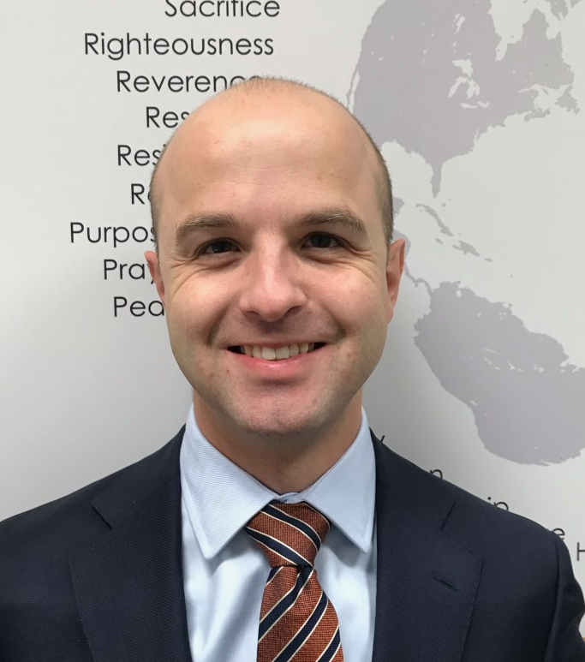
Meet the department
*
Mr Vaughan
(Subject Leader of Geography)
Mr Darby
(Teacher of Geography)
Mr Blackburn
(Faculty Leader of Humanities)
More than Academic Excellence | More than a School | More than ‘Self’

Slide 6
Photo tour of the department
*
More than Academic Excellence | More than a School | More than ‘Self’

Slide 7
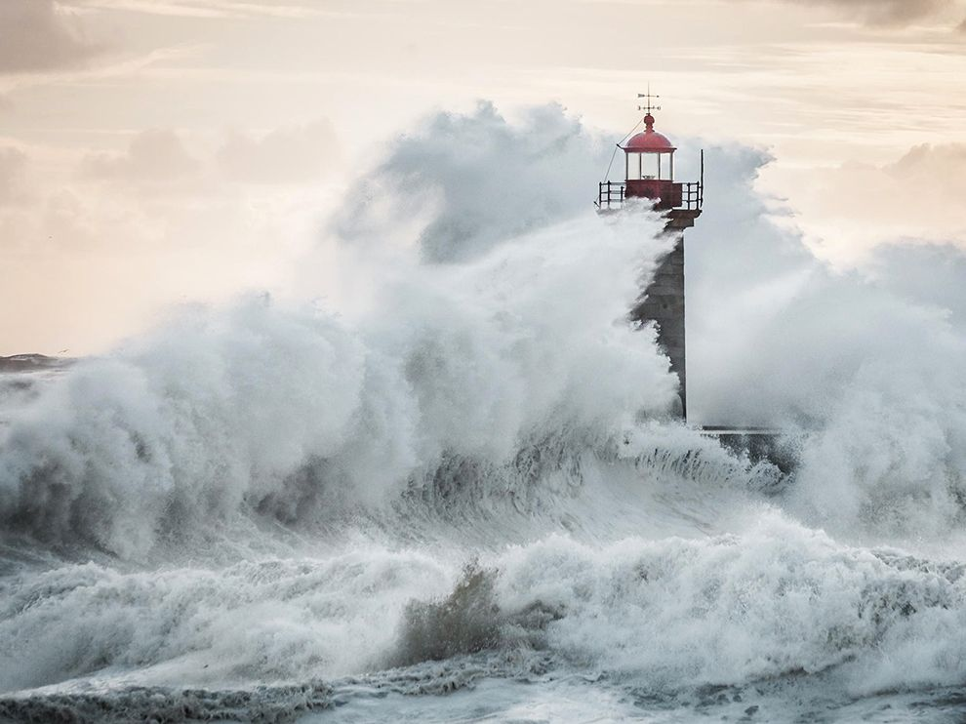
What you can expect from Geography
Six lessons per week, each lasting 55 minutes
Independent study to be approximately the same duration each week as the time spent in lessons
Lessons that are engaging
A range of resources and source information
Specific focus in areas that will increase your ability to achieve the top grades
  ‘wider reading’
  developing written style in extended answers
More than Academic Excellence | More than a School | More than ‘Self’

Slide 8
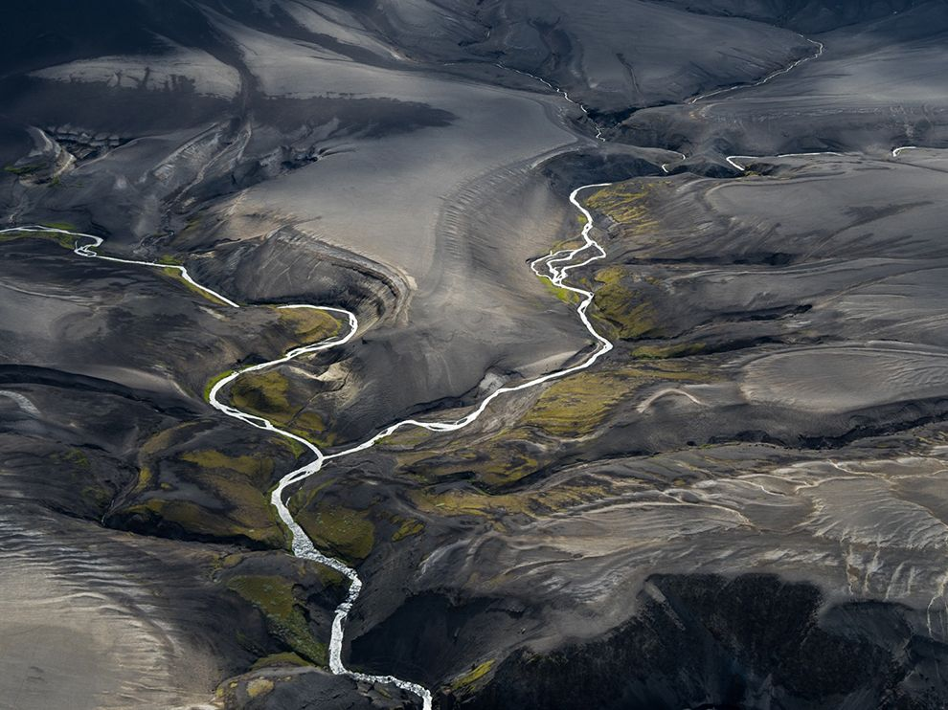
What you will study in Geography
Component 1:
Physical geography
Section A:
Water and carbon cycles
Section B: either
Hot desert environments or Coastal systems and landscapes
Section C: either
Hazards or Ecosystems under stress or Cold environments
Component 2:
Human geography
Section A:
Global systems and governance
Section B:
Changing places
Section C: either
Urban environments or Population and the environment or Resource security
More than Academic Excellence | More than a School | More than ‘Self’

Slide 9
What you will study in Geography
Component 1:
Physical geography
Section A:
Water and carbon cycles
Section B: either
Hot desert environments or Coastal systems and landscapes
Section C: either
Hazards or Ecosystems under stress or Cold environments
Component 2:
Human geography
Section A:
Global systems and governance
Section B:
Changing places
Section C: either
Urban environments or Population and the environment or Resource security
More than Academic Excellence | More than a School | More than ‘Self’

Slide 10
What you will study in Geography
Component 1:
Physical geography
Section A:
Water and carbon cycles
Section B: either
Hot desert environments or Coastal systems and landscapes
Section C: either
Hazards or Ecosystems under stress or Cold environments
Component 2:
Human geography
Section A:
Global systems and governance
Section B:
Changing places
Section C: either
Urban environments or Population and the environment or Resource security
More than Academic Excellence | More than a School | More than ‘Self’

Slide 11
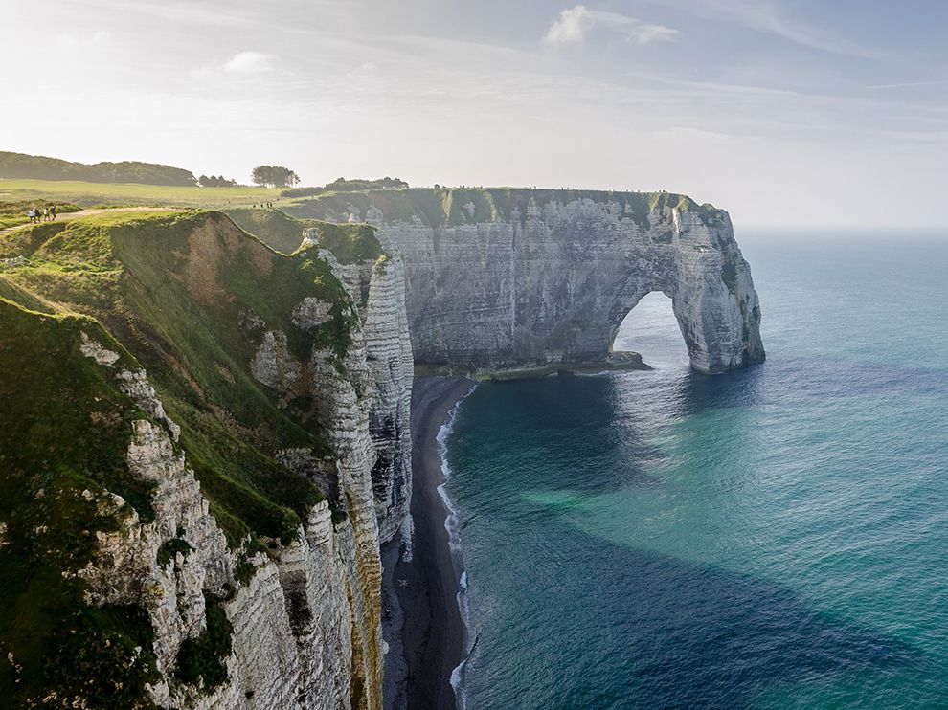
Qualification details
Component 1:
Physical geography
Written exam: 2 hours 30 mins
120 marks
40% of A-level
Component 2:
Human geography
Written exam: 2 hours 30 mins
120 marks
40% of A-level
Component 3:
Geographical investigation
Written report: 3000-4000 words
60 marks
20% of A-level
Question types:
short answer, levels of response, extended prose
Fieldwork requirement
More than Academic Excellence | More than a School | More than ‘Self’

Slide 12
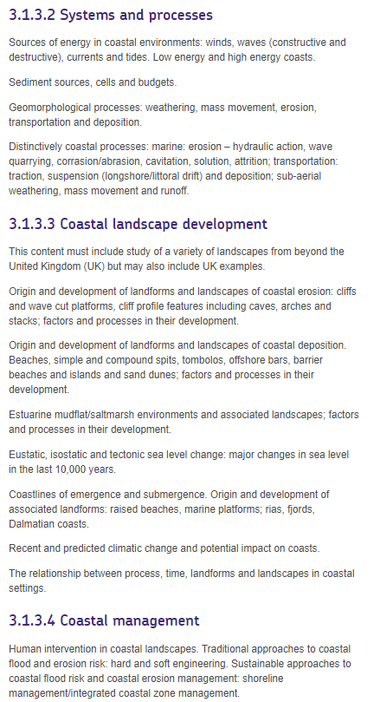
An example topic from Geography
Example exam question:
‘No amount of coastal intervention by people can halt the natural processes which continue to present potentially serious risks to coastal communities now and even more so in the future.’
[20 marks]
https://www.aqa.org.uk/subjects/geography/as-and-a-level/geography-7037
More than Academic Excellence | More than a School | More than ‘Self’

Slide 13
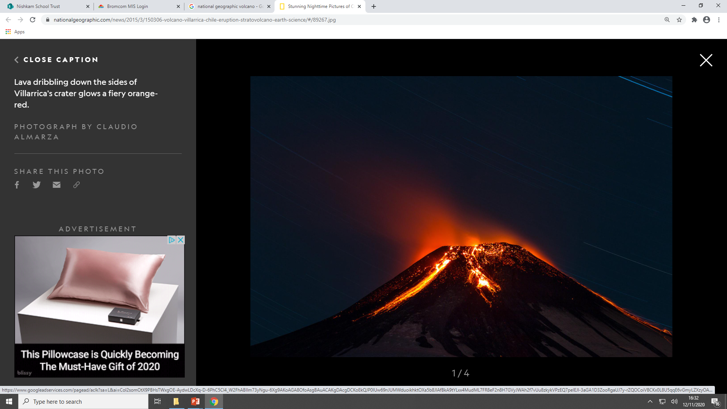
Extra-curricular opportunities in Geography
There is a requirement for you to experience four days fieldwork over the two years.
A self-determined Geographical Investigation of your own that forms the basis of the NEA component.
Opportunities to attend conferences organised by the Geographical Association.
More than Academic Excellence | More than a School | More than ‘Self’

Slide 14
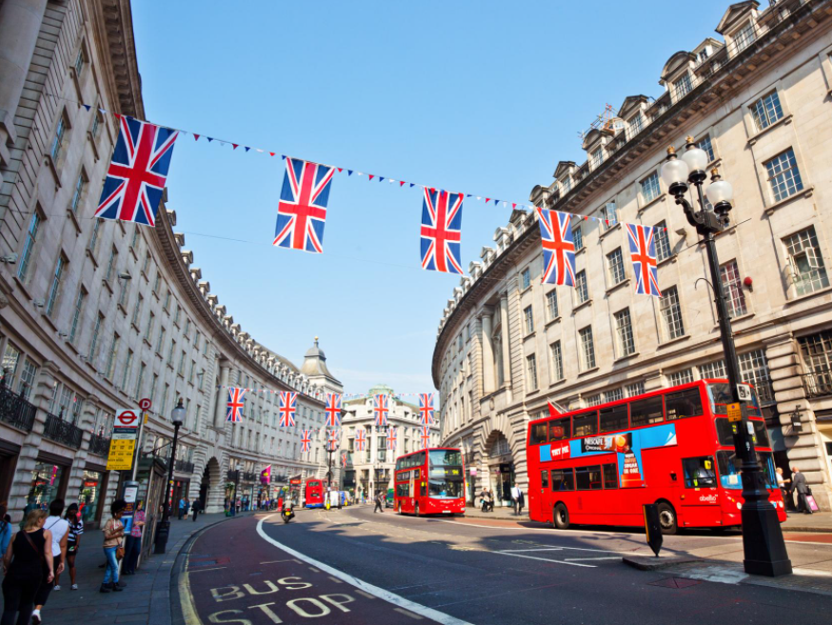
Where can Geography take you?
An almost endless range of possibilities:
  Civil service
  Transport Infrastructure
  Teaching
  Environmental surveying or management
  Logistics
  International development / NGOs
  Utilities
  Tourism
  Journalism
  Town Planning
‘Geographers are more likely to be employed.’ (GA, 2019)
A recent report by the IFS highlights that Geography graduates have an above average likelihood of gaining employment, relative to graduates of other subjects. Graduates earn more than the average graduate, especially females. New analysis for the IFS has placed Geography among the top subjects for graduate earnings.
More than Academic Excellence | More than a School | More than ‘Self’

Slide 15
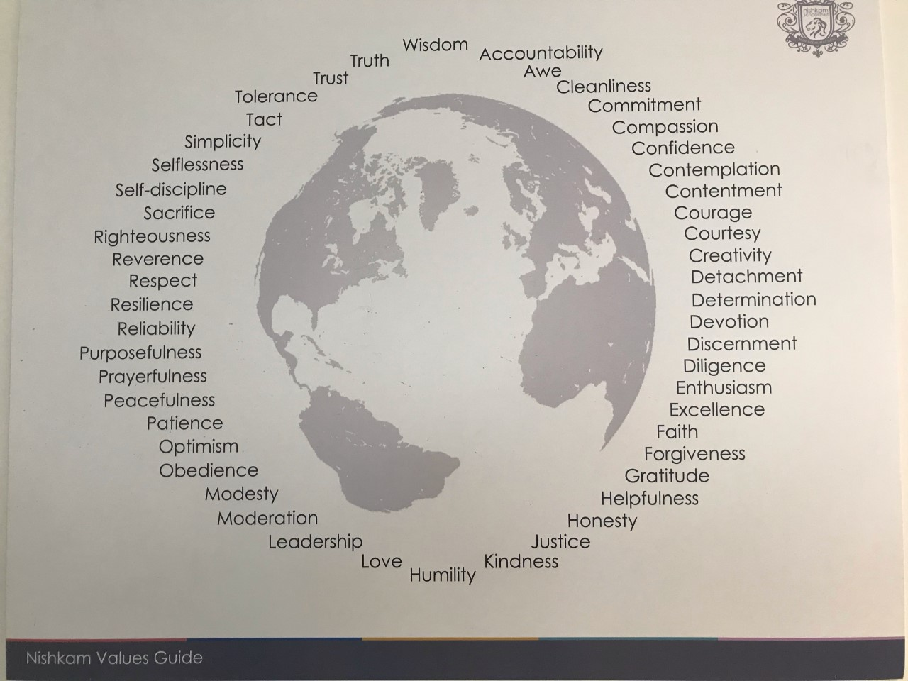
What we expect from you
Engagement, intentionality, initiative!
A hunger for excellence
High levels of organisation
Wider reading around the subject
More than Academic Excellence | More than a School | More than ‘Self’

Slide 16
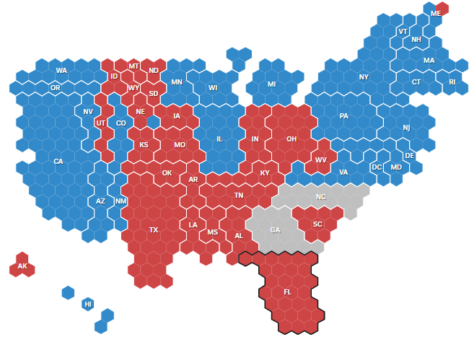
Student perceptions
“Geography is a great subject and it’s relevant to current affairs in the world (and it is helping me overcome my weakness at locating countries on a world map!)” (Parmeet, Y12)
“Geography is very relevant to the world around us and enabled me to understand major global issues. The wide range of interesting topics mean you are never bored.” (Kajol, Y12)
“The teachers bring an enthusiasm and positivity to the lessons and the subject matter, making it a fun subject to study.” (Himat, Y12)
“The teaching staff go above and beyond for the students to make sure they achieve their full potential.” (Nimmi, Y12)
“A-level Geography helped me understand the world around us so much more, from the influence of factors on perceptions of place to how seemingly little activities that humans may carry out can influence significant issues in the environment. You will no longer be the same person after studying A-level Geography; the way you see the world and behave in it changes as you understand your role within it more.” (Coveleen, Y13)
*
More than Academic Excellence | More than a School | More than ‘Self’

Slide 17
Student perceptions
“Of all my A-Levels, Geography is the one that really relates to the real world, looking at a range of topics including climate change, migration and demography, environmental issues and natural hazards. It has links to politics, economics, biology, English, culture and media studies, and I have been able to develop both my literacy skills and statistical skills while studying the subject.” (Amrit, Y13)
“Geography has allowed me to make better sense of the world we live in. I can form better opinions and see how everyday processes effect people and the environment. Learning about sustainability and climate change is of great importance for our future. Studying geography has helped me build a range of skills such as using maps and analysing data and also my literary skills. A-level geography complements my other A-level courses and is valued by universities.” (Avneet, Y13)
*
More than Academic Excellence | More than a School | More than ‘Self’

