Slide 1
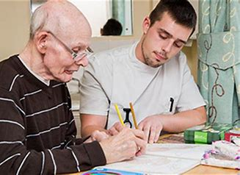


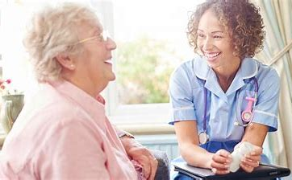
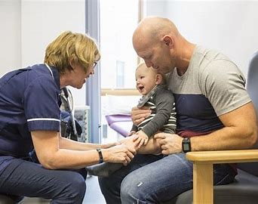
OCR CAMBRIDGE TECHNICALS
HEALTH AND SOCIAL CARE

Slide 2
Welcome
There are many roles available in the Health & Social Care sector, and demand is increasingly rapidly.
You will work alongside a small team of dedicated and supportive staff to assist you in achieving your very best, and we look forward to meeting you.

Slide 3
What can you expect in your Health and Social Care lessons?
A unit-based structure with some examination assessment and some assignment work.
A chance to look at and practice a broad range of skills that will be applicable to any workplace and extremely valuable to your progression through into higher education and employment – regardless of the final career route that you take.
The opportunity to practice extended pieces of writing in your assignments and learn about referencing and organisation skills (such as meeting deadlines), all of which will be key to your work in further education and ultimately your future employment.

Slide 4
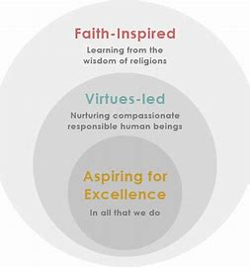
What attributes do I need for this course?
It is very important that you are as organised as you can be from the first day on the course.
Demonstrate confidence to practice until you master something.
Have a diligent approach that strives for excellence
Be fully committed – give 100% in all that you do.

Slide 5

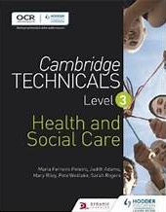
How will I be assessed?
In total, there are 6 units covering the following topic areas.
Building positive relationships in health and social care (M)
Equality, diversity and rights in health and social care (M)
Health, safety and security in health and social care (M)
Anatomy and physiology for health and social care (M)
Supporting people with learning disabilities (O)
Nutrition for health (O)

Slide 6

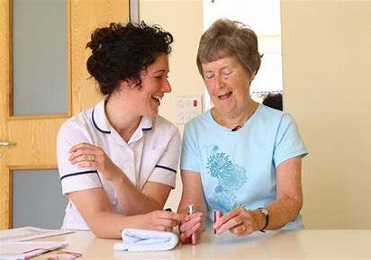
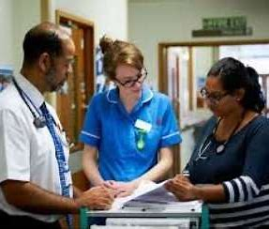
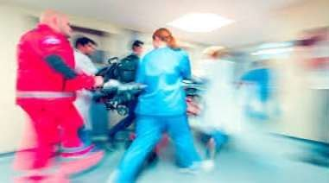
Internally assessed
Different relationships that you will encounter within the health and social care sector.
By doing this unit you will apply communication and relationship building skills in a practical way, considering how different factors, including context, can impact on the building of positive relationships.
You will also be introduced to the concept of the person-centred approach which will help with your relationship building skills.

Slide 7
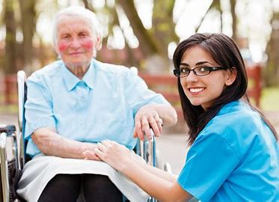


Equality, diversity and rights in health and social care – 60 credits
Externally assessed
This unit will help you to understand the implications of diversity on practice and also the effects of discriminatory practice on individuals who require care or support.
You will also gain an appreciation of how legislation and national initiatives can support and promote anti-discriminatory practice.

Slide 8
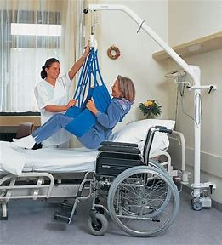

Health, safety and security in health and social care – 60 credits
Externally assessed
This unit introduces you to the necessary knowledge and skills to equip you in maintaining a safe working environment for yourself, your colleagues and individuals who require care and support.
You will learn how legislation, policies and procedures work to reduce risks in health and social care and the consequences of not following them.
You will also learn how to respond to different incidents and emergencies with health and social care settings.

Slide 9
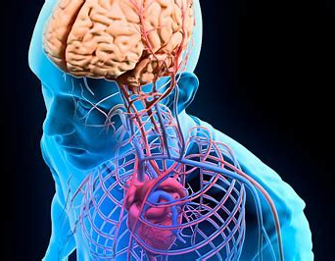
Anatomy and physiology in health and social care – 90 credits
Externally assessed
Introduces you to the basic structure and functions of the body systems involved in everyday activities and maintenance of health, including cardiovascular, respiratory and digestive systems.
You will also understand the part played by organs such as the pancreas, liver and kidney.
You will investigate the systems and organs involved in detecting and responding to change such as the nervous system as well as the eyes and ears.
As individuals age, they are likely to be affected by malfunctions as a result of degeneration. Some of these will simply be inconvenient; others will be life-changers. You will understand the effects on individuals and what has to be done on a daily basis to enable them to lead as full and independent a life as possible.

Slide 10

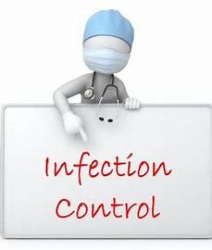
Supporting people with learning disabilities - 60 credits
Internally assessed
In this unit you will learn about the importance of how to support people with learning disabilities and consider issues involved in providing support for people with learning disabilities and their families.
This unit explores the areas of inclusion, human rights, advocacy, empowerment and active participation.

Slide 11
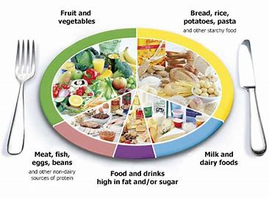
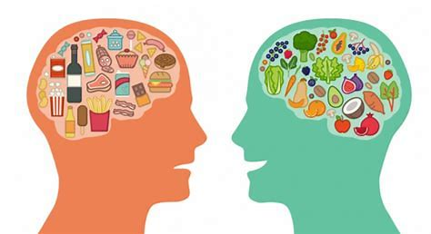
Nutrition for health – 30 credits
Internally assessed
This unit introduces nutritional health and the components of good nutrition.
You will have the opportunity to scrutinise different foods, consider their health benefits and investigate how to support other people to impact their health and well-being.

Slide 12

Links to assessment materials
Unit 2
Microsoft Word - CTech_HSC_QP_Unit 2_June17_V6 (ocr.org.uk)
Unit 3
OCR Level 3 Cambridge Technical in Health and Social Care Unit 3
Unit 4
Microsoft Word - CTech_HSC_QP_Unit 4_June17_V8.docx (ocr.org.uk)

Slide 13

Where can Health and Social Care take you?
Nursing
Midwifery
Teaching
Childcare
Police Officer
Care Worker
Counselling
Social Work
Mental Health
Occupational therapy
Health Visitor
Paediatrics

Slide 14
How will Health and Social Care complement my other subject choices?
An A-level in Biology, which could lead to a BSc (Hons) in Nursing or Midwifery
An A-level in Sociology, which could lead to BA (Hons) in Social Work
An A-level in Psychology, which could lead to a BSc (Hons) in Psychology.

Slide 15

Closing Message
Approximately 3 million people work in Health and Social Care and Childcare related roles, and the demand is increasing!
The skills developed on this course are invaluable across all other subjects and career roles, such as, effective communication and valuing people.
We look forward to welcoming you to our classrooms in September 2021

