Slide 1






Welcome to Philosophy, Religion and Ethics A-level
More than Academic Excellence | More than a School | More than ‘Self’

Slide 2
Head of Department welcome
Welcome! On behalf of the department, thank you for showing an interest in the Philosophy, Religion and Ethics A level. If you have any further questions at all, please contact me on: A.Mehta@Nishkamhighschools.org and I will be happy to help!
The following presentation will cover:
The purposes and aims of Philosophy, Religion and Ethics
What you can expect to learn in Philosophy, Religion and Ethics
Extra-curricular opportunities in Philosophy, Religion and Ethics
Future Opportunities / where Philosophy, Religion and Ethics can take you
Qualification details
How to prepare for this A level
More than Academic Excellence | More than a School | More than ‘Self’

Slide 3
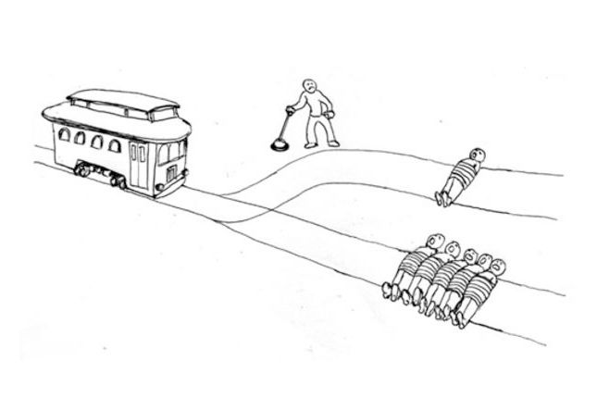
What would you do?
The Trolley Problem is a famous thought experiment which asks us if we would intervene in the situation to stop the trolley hitting five people.
The dilemma is if we do this the trolley will still hit one person and we could be held responsible for it.
More than Academic Excellence | More than a School | More than ‘Self’

Slide 4

What would you do?
Most of us will end up feeling like this! Unsure of what to do.
More than Academic Excellence | More than a School | More than ‘Self’

Slide 5



What would you do?
Our decision may change if the one person that will be killed is a doctor, a child or a criminal. We may think this does not matter as it is only a thought experiment. However, these are the type of decisions many of us may have to make in our lifetime…..
More than Academic Excellence | More than a School | More than ‘Self’

Slide 6

What would you do?
Discussions are currently being had about how self driving cars should act when issues arise. Should the car save the most people? The youngest people? The human over the animal?
More than Academic Excellence | More than a School | More than ‘Self’

Slide 7

What would you do?
During the pandemic doctors and nurses had to make very real decisions about who to give oxygen to. The old? The young? This issue continued in the early stages of the vaccine roll out.
More than Academic Excellence | More than a School | More than ‘Self’

Slide 8

Philsophy, Religion and Ethics
This A level helps you to think critically about the world we all share… ​
It allows you to explore the nature of human life and morality as a whole... ​
It allows you to develop your own values, beliefs and identity…​
Philosophy, Religion and Ethics helps to develop transferrable skills that are useful in a wide range of other subjects/jobs roles. ​
It helps you to develop advanced literacy skills through the reading of complex extracts and scripture and regular essay writing. ​
It is REALLY engaging! A subject that invites discussion and debate every lesson!
More than Academic Excellence | More than a School | More than ‘Self’

Slide 9
What you can expect in your Philosophy, Religion and Ethics lessons?
Engaging lessons which focus on discussion and debate on a wide range of ethical, philosophical and theological topics…
Challenging lessons which draw on a wide range of complex academic sources.
Independent learning, as well as working as part of a team with your fellow classmates to research different topic areas.
Lessons which explore philosophical and ethical concepts and encourage you to voice your own beliefs, as well as listen to the views of others.
Development of literacy skills with frequent essay writing practice – a focus on what makes an ‘excellent’ essay in RS.
More than Academic Excellence | More than a School | More than ‘Self’

Slide 10
What you will study in Religious Studies?
In this A level you will Study Three Papers as part of the Edexcel course:
https://qualifications.pearson.com/en/qualifications/edexcel-a-levels/religious-studies-2016.coursematerials.html#filterQuery=category:Pearson-UK:Category%2FSpecification-and-sample-assessments
The Philosophy Paper (Paper 1)
The Religion and Ethics Paper (Paper 2)
The Sikh Paper (Paper 4f)
You be taught 50% of the A level content in year 12 and the remaining 50% of the paper in Y13.
More than Academic Excellence | More than a School | More than ‘Self’

Slide 11
The Philosophy Paper
Can God exist in a world full of suffering?
What happens after you die?
Did man create the idea of God? Or did God create man?
How do we know God exists?
More than Academic Excellence | More than a School | More than ‘Self’

Slide 12
The Ethics Paper
What does a good decision look like?
Can we have a ‘just war’ in the modern day?
Can faith help us live a good life?
Does an embryo have a right to life before it is born?
More than Academic Excellence | More than a School | More than ‘Self’

Slide 13
The Sikh Paper
Should Gurdwaras in the UK use the English language in religious devotion more often?
Should Sikhs living in the UK be allowed to marry whoever they want, regardless of faith, race or social background?
What impact has living in the UK had on Sikh beliefs, values and practices?
How have the roles of women changed over time?
More than Academic Excellence | More than a School | More than ‘Self’

Slide 14


Extra-curricular opportunities in Philosophy, Religion and Ethics
We are always keen to involve students in extra-curricular activities and trips related to Religious Studies and Faith in the school.
In 2019 a small group of sixth form students took part in a trip to Rome. This is something we plan to run in the next academic year.
The Department organises visits to lectures to watch key speakers such as Peter Singer (Philosopher).
More than Academic Excellence | More than a School | More than ‘Self’

Slide 15


Where can Philosophy, Religion and Ethics take you?
More than Academic Excellence | More than a School | More than ‘Self’

Slide 16


Where can Philosophy, Religion and Ethics take you?
More than Academic Excellence | More than a School | More than ‘Self’

Slide 17


Where can Philosophy, Religion and Ethics take you?
More than Academic Excellence | More than a School | More than ‘Self’

Slide 18
Where can Philosophy, Religion and Ethics take you?
This is a valuable qualification because it demonstrates to universities and employers that you can understand diverse viewpoints and analyse complex subjects critically.
Philosophy, Religion and Ethics helps to develop transferrable skills that are useful in a wide range of other subjects/jobs roles, such as: Law, Journalism, Education, Publishing/Editing, Charity/Community work,, Business and many more!
It helps you to develop advanced literacy skills through the reading of complex extracts and scripture and regular essay writing which is useful in many sectors.
Philosophy, Religion and Ethics demonstrates to employers that you can work with all different types of people, that you are confident in voicing your ideas and that you have strong communication skills.
Many PRE students go on to further study at university including courses in Law, Education, History, Philosophy, Theology, Politics, Philosophy, Religion and Ethics and many more!
More than Academic Excellence | More than a School | More than ‘Self’

Slide 19
What we expect from you:
Resilience – Some topics are very academically challenging and you must remain positive in your approach to your studies as well as ask for support if you need it. Never be afraid to ask for help!
Diligence – Be proactive in researching and reading around your topics prior to the lessons and after the lessons to consolidate your learning.
Enthusiasm – Come to lessons with a passion for the subject and be prepared to contribute verbally in class discussion – this is an essential part of the subject.
Determination – You must be hardworking and disciplined... You will be regularly set independent tasks, including essays at least once a week. It is important you are organised and take responsibility for your learning so you are able to meet deadlines.
More than Academic Excellence | More than a School | More than ‘Self’

Slide 20
Qualification details
This A level is examined through three 2-hour exams for each paper at the end of Year 13.
Each paper (exam) counts for 33.33% of your overall qualification (a third).
You will have one 2-hour written exam for each paper in the summer, worth 80 marks each.
There are three parts in each exam: Section A, B and C - All sections require you to write an essay or an essay style response to questions.
There is no coursework in this A level and no external exams in year 12, you are assessed through two mock examinations in AS and regular practice essays.
More than Academic Excellence | More than a School | More than ‘Self’

Slide 21
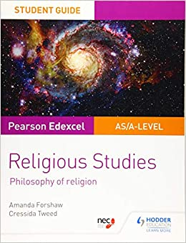
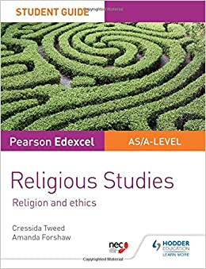
Preparing for Philosophy, Religion and Ethics:
It is important to prepare for your studies…
A great way to do this is by purchasing books related to each paper in the A level and reading around your topics prior to the course.
The Edexcel textbooks for Philosophy and Ethics are very useful guides for students and cover all topics in the papers.
There are also key books for the Sikhism paper on the next slide…
More than Academic Excellence | More than a School | More than ‘Self’

Slide 22

Preparing for Philosophy, Religion and Ethics:
Useful books to help you prepare for the Sikh paper include:
Nicky-Guninder Kaur-Singh, Sikhism: An Introduction (I.B. Tauris, 2011)
Cole W O and Sambhi P S, The Sikhs: Their Religious Beliefs and Practices (Sussex Academic, 1998)
Louis E. Fenech, Martyrdom in the Sikh Tradition: Playing the 'Game of Love' (OUP India, 2001)
More than Academic Excellence | More than a School | More than ‘Self’

