Slide 1

Welcome to the Nishkam
Psychology department
More than Academic Excellence | More than a School | More than ‘Self’

Slide 2

Head of Department welcome
More than Academic Excellence | More than a School | More than ‘Self’

Slide 3
What you can expect in your Psychology lessons
Psychology plays a significant part in modern day life, from the school classroom to the courtroom, in medicine, technology, business organisations and in universities. Psychology students should expect to develop:
A deep knowledge and understanding of different areas of the subject and how they relate to each other
An appreciation of the skills, knowledge and understanding of scientific methods
Confidence in a variety of mathematical and problem-solving skills,
An understanding how society makes decisions about scientific issues and how the sciences contribute to the success of the economy and society.
explore real socio-psychology issues
understand the role that psychological research plays in shaping government agendas and social attitudes
More than Academic Excellence | More than a School | More than ‘Self’

Slide 4
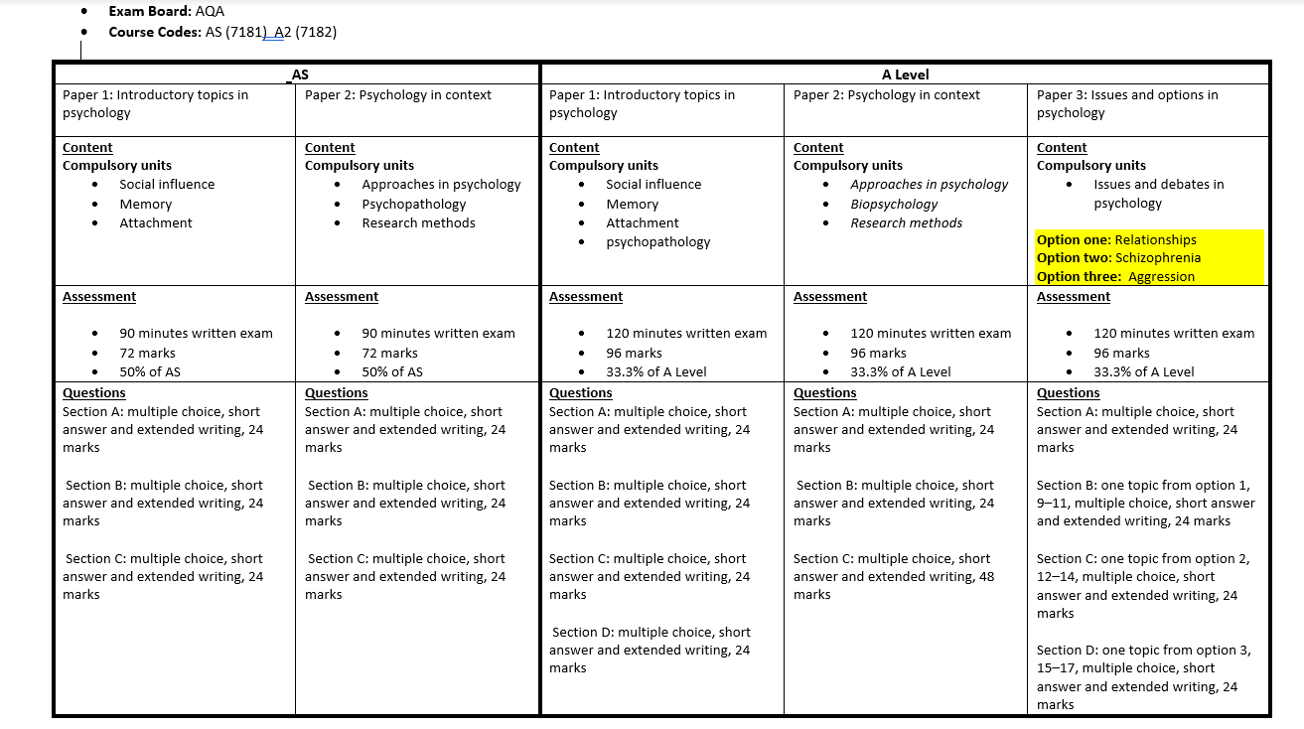
What you will study in Psychology
More than Academic Excellence | More than a School | More than ‘Self’

Slide 5
Examples of topic from Psychology
Approaches in psychology – Are we products of our biology or our environment, is the mind separate from the brain, how much of our behaviour is governed by the unconscious mind?
Biopsychology – The role of biological process and structures in recovery after
Trauma and the development/treatment of psychological illnesses
Relationships – Why we are attracted to certain individuals and the extent to
which the formation of relationships is based on our own choice
More than Academic Excellence | More than a School | More than ‘Self’

Slide 6
Where can Psychology take you?
Students who take Psychology often also study, Sociology, Biology, Chemistry Business Studies, Geography and English
Career Options
Clinical psychologist
Marketing
Educational psychologist
Forensic psychologist
Teacher/lecturer
Health psychologist
Therapist
Occupational health
Psychological wellbeing practitioner
Sport and exercise psychologist
More than Academic Excellence | More than a School | More than ‘Self’

Slide 7
What we expect from you
Demonstrate knowledge and understanding of psychological concepts, theories, research studies, research methods and ethical issues in relation to the specified content
Apply psychological knowledge and understanding of the specified content in a range of contexts
Analyse, interpret and evaluate psychological concepts, theories, research studies and research methods in relation to the specified content
Evaluate therapies and treatments including in terms of their appropriateness and effectiveness.
Develop knowledge and understanding of research methods, practical research skills and mathematical skills
Develop an understanding for ethical practical research activities involving designing research, conducting research, analysing and interpreting data.
More than Academic Excellence | More than a School | More than ‘Self’

Slide 8
Student perceptions
Psychology is a subject with a depth of detail that never gets boring. It is a subject that relates to almost every aspect of your everyday life. Exceptional teaching which means that you always have direction to make progress.” - Saffron
" I enjoy Psychology because it is interesting to study human behaviour from conflicting viewpoints “ – Kirpa-Joyt
“I take both sociology and psychology. The positive in doing both is they interrelate in many ways so me I feel this gives me a head start in comparison to my peers. Sociology and psychology have taught me to have an open mind when studying a subject as there is more than one answer or approach to a question. Both subjects have taught me a vast amount of knowledge to do with society and the reason why a person acts in a certain way.” - Musiab
“ Psychology has allowed me to gain a deeper understanding into human behaviour as well as the ability to critically discover why humans behave the way they do. This has further led to an improvement in my problem solving and analytical skills; capabilities, I see as being transferable from the classroom to the workplace in the future”. - Manisha
“Psychology is a really interesting subject which has shown me how complex the human experience actually is”. - Thea
I have studied Psychology for 2 years, and I have found the study of the brain is my favourite topic. Learning how different parts of the brain are responsible for various functions has allowed me to understand why people behave in a particular way - Dillon
More than Academic Excellence | More than a School | More than ‘Self’

