Slide 1

Welcome to the Nishkam Computing department
More than Academic Excellence | More than a School | More than ‘Self’

Slide 2
Head of Department welcome
Welcome to Computing at Nishkam!
Build skills for life
Development of ICT skills
Impact of ICT on everyday life
Preparing you for the future
More than Academic Excellence | More than a School | More than ‘Self’

Slide 3
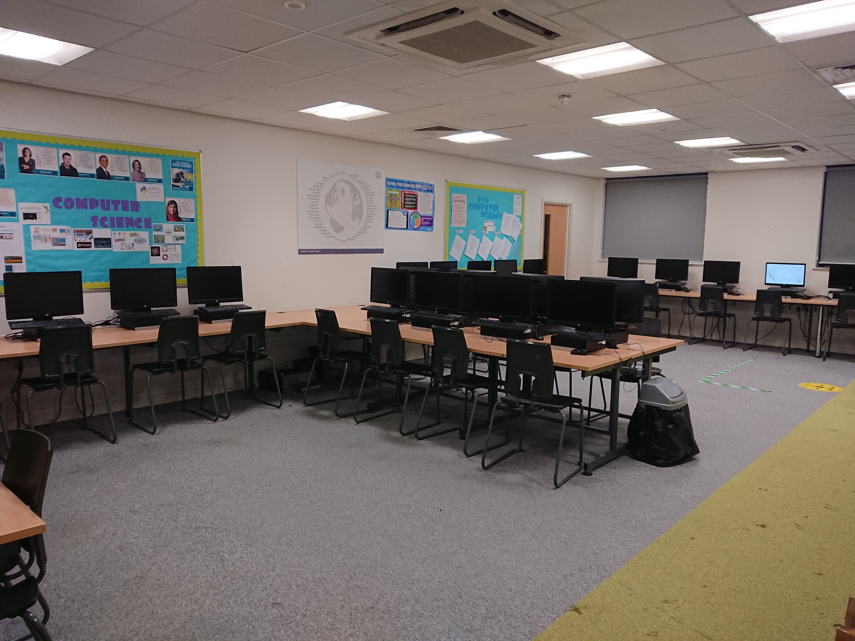
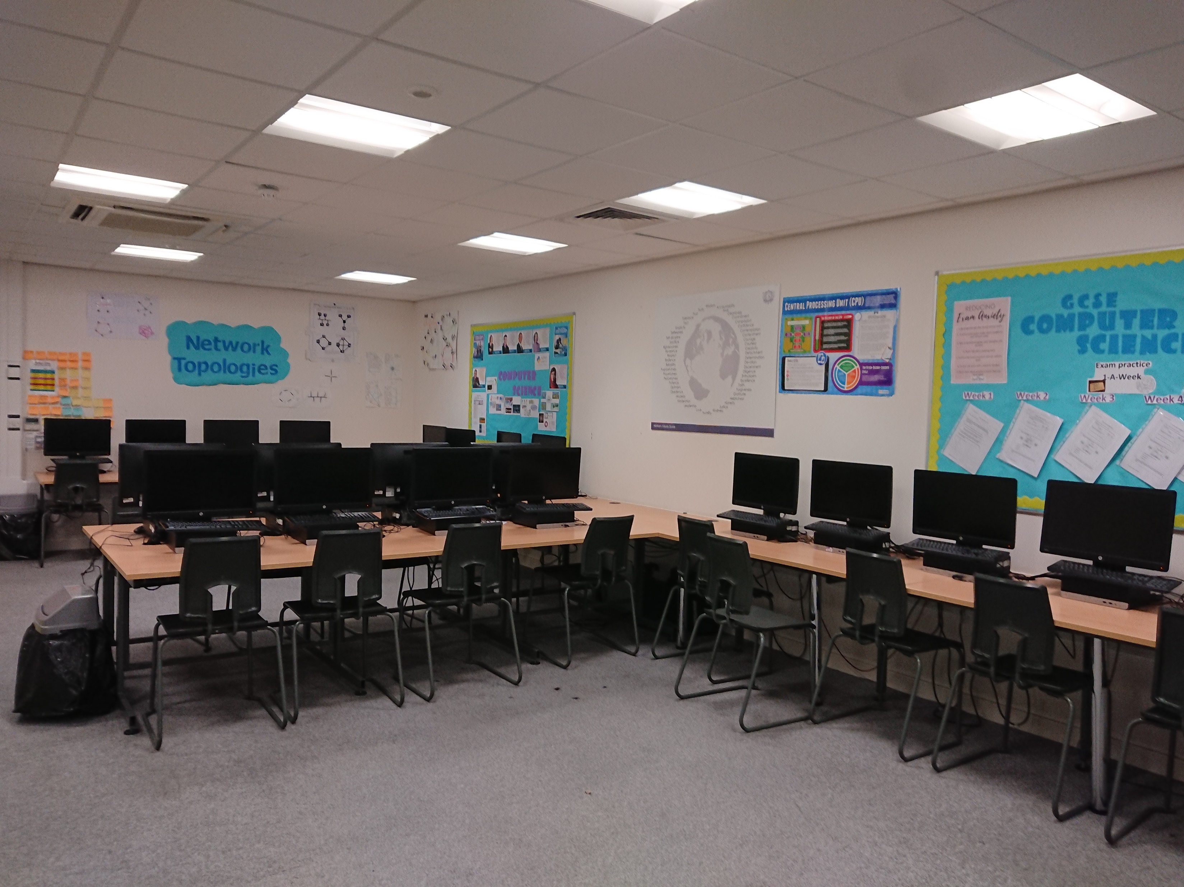
Photo tour of the department
*
More than Academic Excellence | More than a School | More than ‘Self’

Slide 4
What you can expect in your Applied IT lessons
Theory
Practical
Specialist software such as Microsoft Access and Microsoft Excel
Impacts of technology on wider society
Software skills
More than Academic Excellence | More than a School | More than ‘Self’

Slide 5
What you will study in Applied IT
3 Mandatory units
Unit 2 – Creating systems to manage information (Practical Exam using Microsoft Access, assessed in Y12)
Unit 3 – Using social Media in Business (coursework assessed in Y12)
Unit 1 – Information Technology Systems (Written exam in Y13)
1 Optional unit
Unit 5 –Data Modelling(coursework assessed in Y13)
More than Academic Excellence | More than a School | More than ‘Self’

Slide 6
An example topic from Applied IT
Unit 2: Creating systems to manage information
Use of Microsoft Access- this is essential software
Learning Aim A: The purpose and the structure of relational database management systems
Learning Aim B: Standard methods and techniques to design relational database solutions
Learning Aim C: Creating a relation database structure
Learning Aim D: Evaluating a database development project
More than Academic Excellence | More than a School | More than ‘Self’

Slide 7
Extra-curricular opportunities in Applied IT
Use of IT suit during lunch times
Support in STEM club
More than Academic Excellence | More than a School | More than ‘Self’

Slide 8
Where can Applied IT take you?
When taken alongside other Level 3 qualifications, including BTEC Higher Nationals or A Levels in
complementary or contrasting subjects, such as mathematics, physics, science, arts or technology,
the qualification gives learners the opportunity to progress to a degree in an information technology
discipline or a degree where information technology related skills and knowledge may be
advantageous.
This qualification carries UCAS points and is recognised by higher education providers as meeting
admission requirements to many relevant courses. As the content is equivalent in size to one
A Level, higher education representatives have confirmed that it is appropriate to allow learners to
choose their optional units from a wide range so that they can explore their own choice of areas for
further study. The qualification supports entry to, for example:
• HND in Business
• BA (Hons) in Computer Arts
• BSc (Hons) in Fashion Buying Management
• BSc (Hons) in Software Development for Animation
• BA (Hons) in Accounting and Finance.
More than Academic Excellence | More than a School | More than ‘Self’

Slide 9
What we expect from you
Strong work ethic
Enthusiasm for IT
Determination to meet deadlines
Independent studying
More than Academic Excellence | More than a School | More than ‘Self’

Slide 10
Student perceptions
I really enjoy applied IT because I like the project feel to the work we do and how we start something and keep adapting it for both units.
Applied IT is a nice subject to pick if students didn't want to do exams all the time. One thing that stands out to me about this subject is that it is very broad in terms of knowledge and that certain aspects link with the subject business. So far Applied IT has been a good subject to study.
Applied IT is good if you want to do something in the IT industry. There are lots of careers you can go into with this qualification. Having done computer science, I was fond of the subject and wanted to continue it, so this gave me an option. It can be difficult and challenging at times but it feels rewarding in the end once you have completed it.
More than Academic Excellence | More than a School | More than ‘Self’

